Slide 1

PHP Arrays
Dr. Charles Severance
www.wa4e.com
http://www.wa4e.com/code/arrays
http://www.wa4e.com/code/arrays.zip
Notes:
Note from Chuck. If you are using these materials, you can remove my name and URL from this replace it with your own, but please retain the CC-BY logo on the first page as well as retain the entire last page when you remix and republish these slides.

Slide 2
PHP Arrays Rock!
Better than Python Dictionaries
Better than Java Hash Maps
PHP Arrays have all the benefits of Python Dictionaries but they can also maintain the order of the items in the array
http://en.wikipedia.org/wiki/Associative_array

Slide 3
Associative Arrays
Can be key => value or simply indexed by numbers
Ignore two-dimensional arrays for now...
http://en.wikipedia.org/wiki/Associative_array

Slide 4
Integer Indices
<?php
$stuff = array("Hi", "There");
echo $stuff[1], "\n";
?>
There

Slide 5
Key / Value
<?php
$stuff = array("name" => "Chuck",
"course" => "WA4E");
echo $stuff["course"], "\n";
?>
WA4E

Slide 6
Dumping an Array
The function print_r() shows PHP data - it is good for debugging
<?php
$stuff = array("name" => "Chuck",
"course" => "WA4E");
echo("<pre>\n");
print_r($something);
echo("\n</pre>\n");
?>
Array(
[name] => Chuck
[course] => WA4E
)

Slide 7
Dumping an Array
The function print_r() dumps out PHP data - it is used mostly for debugging
<?php
$stuff = array("name" => "Chuck",
"course" => "SI664");
print_r($stuff);
?>
Array
(
[name] => Chuck
[course] => SI664
)

Slide 8
Dumping an Array
The function print_r() dumps out PHP data - it is used mostly for debugging
<?php
$stuff = array();
$stuff[2] = "Hello";
$stuff[9] = "World";
print_r($stuff);
?>
Array
(
[2] => Chuck
[9] => SI664
)

Slide 9
var_dump .vs. print_r
<?php
$stuff = array("name" => "Chuck",
"course" => "SI664");
var_dump($stuff);
?>
array(2) {
["name"]=>
string(5) "Chuck"
["course"]=>
string(5) "SI664"
}

Slide 10
var_dump() is more verbose
<?php
$thing = FALSE;
    echo("One\n");
    print_r($thing);
    echo("Two\n");
    var_dump($thing);
?>
One
Two
bool(false)
http://stackoverflow.com/questions/3406171/php-var-dump-vs-print-r

Slide 11
Building up an Array
You can allocate a new item in the array and append a value at the same time using empty square braces [ ] on the right hand side of an assignment statement
$va = array();
$va[] = "Hello";
$va[] = "World";
print_r($va);
Array(
[0] => Hello
[1] => World
)

Slide 12
Building up an Array
You can also add new items in an array using a key as well
$za = array();
$za["name"] = "Chuck";
$za["course"] = "WA4E";
print_r($za);
Array(
[name] => Chuck
[course] => WA4E
)

Slide 13
Looping Through an Array
<?php
$stuff = array("name" => "Chuck",
"course" => "SI664");
foreach($stuff as $k => $v ) {
echo "Key=",$k," Val=",$v,"\n";
}
?>
Key=name Val=Chuck
Key=course Val=SI664

Slide 14
Looping Through an Array
<?php
$stuff = array("Chuck","SI664");
foreach($stuff as $k => $v ) {
echo "Key=",$k," Val=",$v,"\n";
}
?>
Key=0 Val=Chuck
Key=1 Val=SI664

Slide 15
Counted Loop Through an Array
<?php
$stuff = array("Chuck","SI664");
for($i=0; $i < count($stuff); $i++) {
echo "I=",$i," Val=",$stuff[$i],"\n";
}
?>
I=0 Val=Chuck
I=1 Val=SI664

Slide 16
Arrays of Arrays
$products = array(
'paper' => array(
'copier' => "Copier & Multipurpose",
'inkjet' => "Inkjet Printer",
'laser' => "Laser Printer",
'photo' => "Photographic Paper"),
'pens' => array(
'ball' => "Ball Point",
'hilite' => "Highlighters",
'marker' => "Markers"),
'misc' => array(
'tape' => "Sticky Tape",
'glue' => "Adhesives",
'clips' => "Paperclips")
);
The elements of an array can be many things other than a string or integer. You can even have objects or other arrays.
echo $products["pens"]["marker"];
Markers

Slide 17
Array Functions

Slide 18
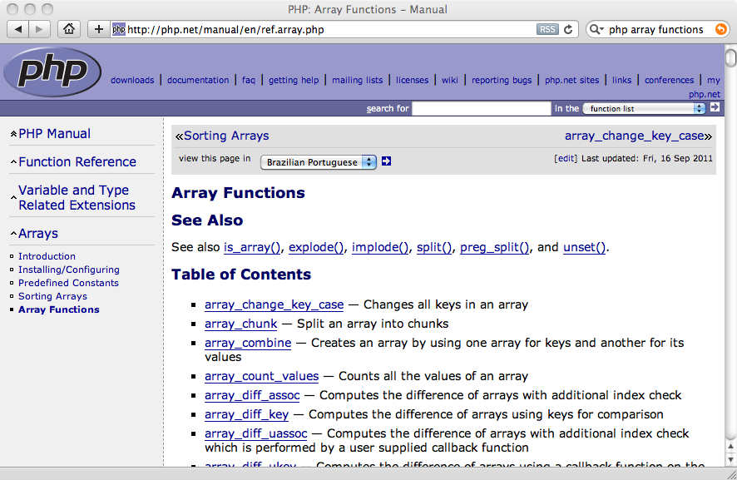

Slide 19
Array Functions
array_key_exists($key, $ar) - Returns TRUE if key is set in the array
isset($ar['key']) - Returns TRUE if key is set in the array
count($ar) - How many elements in an array
is_array($ar) - Returns TRUE if a variable is an array
sort($ar) - Sorts the array values (loses key)
ksort($ar) - Sorts the array by key
asort($ar) - Sorts array by value, keeping key association
shuffle($ar) - Shuffles the array into random order

Slide 20
Course exists
name is set
addr is not set
$za = array();
$za["name"] = "Chuck";
$za["course"] = "WA4E";
if (array_key_exists('course',$za) ) {
echo("Course exists\n");
} else {
echo("Course does not exist\n");
}
echo isset($za['name']) ? "name is set\n" : "name is not set\n";
echo isset($za['addr']) ? "addr is set\n" : "addr is not set\n";

Slide 21
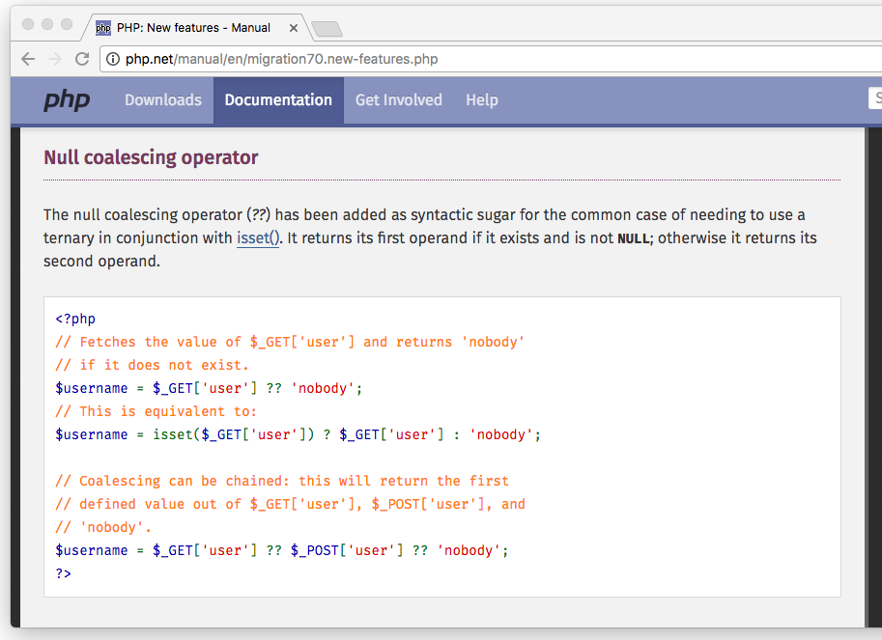

Slide 22
Null Coalesce
<?php
$za = array();
$za["name"] = "Chuck";
$za["course"] = "WA4E";
// PHP >= 7.0.0 only
$name = $za['name'] ?? 'not found';
$addr = $za['addr'] ?? 'not found';
echo("Name=$name\n");
echo("Addr=$addr\n");
// PHP < 7.0.0 equivalent
$name = isset($za['name']) ? $za['name'] : 'not found';
Name=Chuck
Addr=not found

Slide 23
Count: 2
$za Is an array
$za = array();
$za["name"] = "Chuck";
$za["course"] = "WA4E";
print "Count: " . count($za) . "\n";
if ( is_array($za) ) {
echo '$za Is an array' . "\n";
} else {
echo '$za Is not an array' . "\n";
}

Slide 24
Array(
[name] => Chuck
[course] => WA4E
[topic] => PHP
)
Array(
[0] => Chuck
[1] => PHP
[2] => WA4E
)
$za = array();
$za["name"] = "Chuck";
$za["course"] = "WA4E";
$za["topic"] = "PHP";
print_r($za);
sort($za);
print_r($za);

Slide 25
Array(
[name] => Chuck
[course] => WA4E
[topic] => PHP
)
Array(
[course] => WA4E
[name] => Chuck
[topic] => PHP
)
Array(
[name] => Chuck
[topic] => PHP
[course] => WA4E
)
$za = array();
$za["name"] = "Chuck";
$za["course"] = "WA4E";
$za["topic"] = "PHP";
print_r($za);
ksort($za);
print_r($za);
asort($za);
print_r($za);

Slide 26
Exploding Arrays
$inp = "This is a sentence with seven words";
$temp = explode(' ', $inp);
print_r($temp);
Array(
[0] => This
[1] => is
[2] => a
[3] => sentence
[4] => with
[5] => seven
[6] => words
)

Slide 27
Arrays and URL Parameters

Slide 28
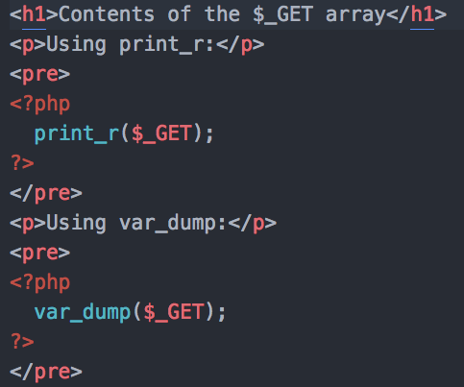
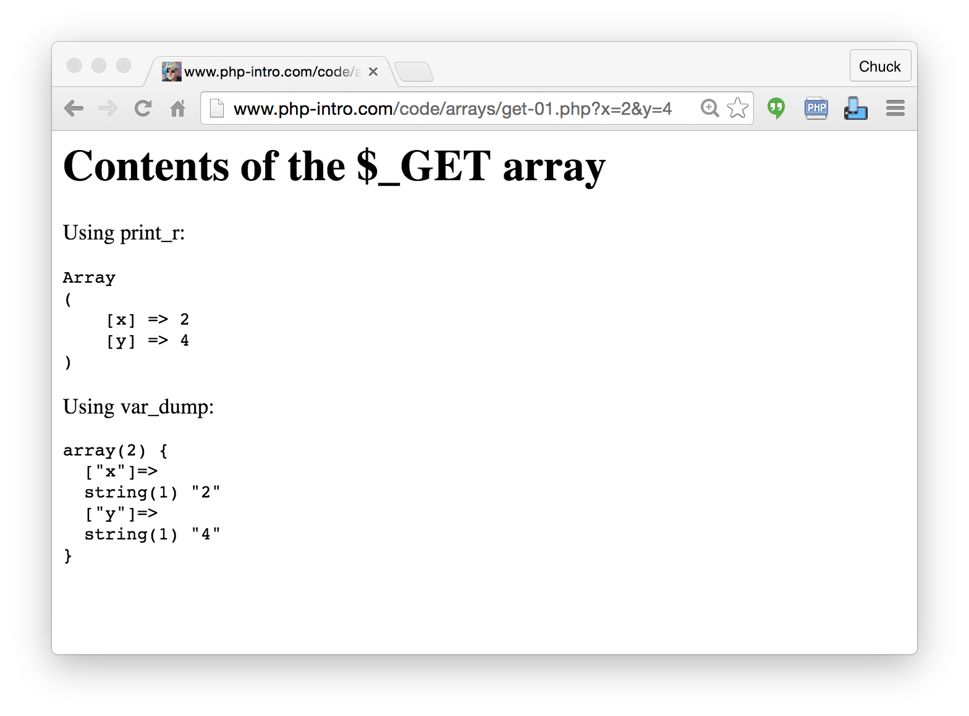
http://www.wa4e.com/code/arrays/get-01.php

Slide 29
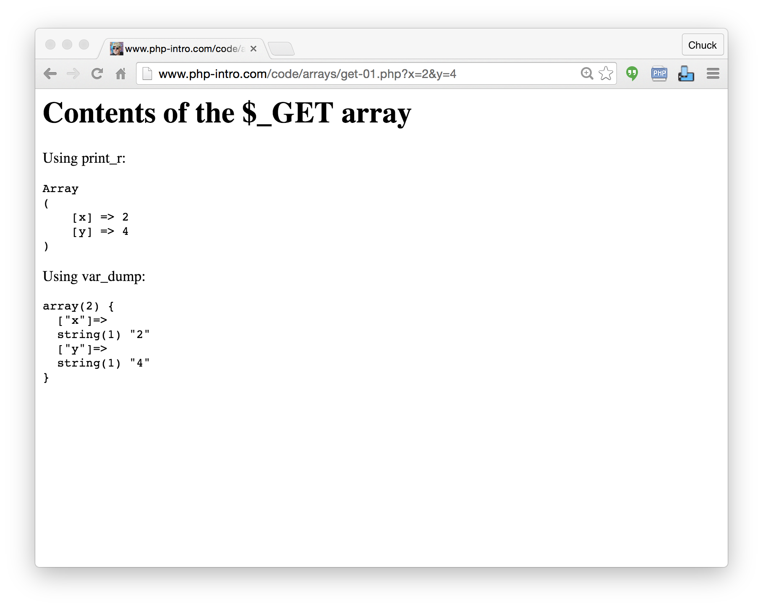

Slide 30
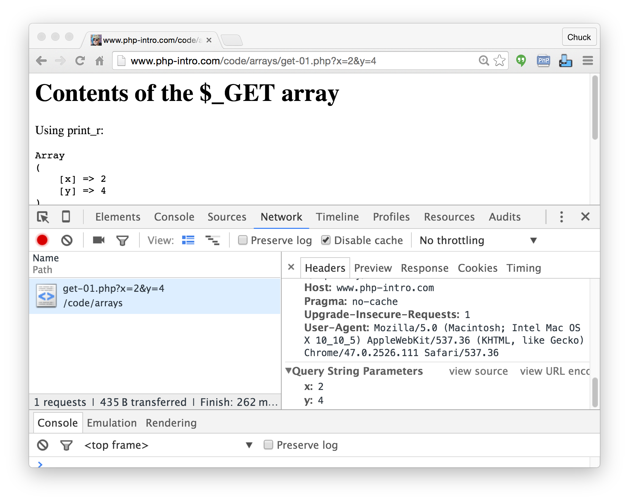

Slide 31
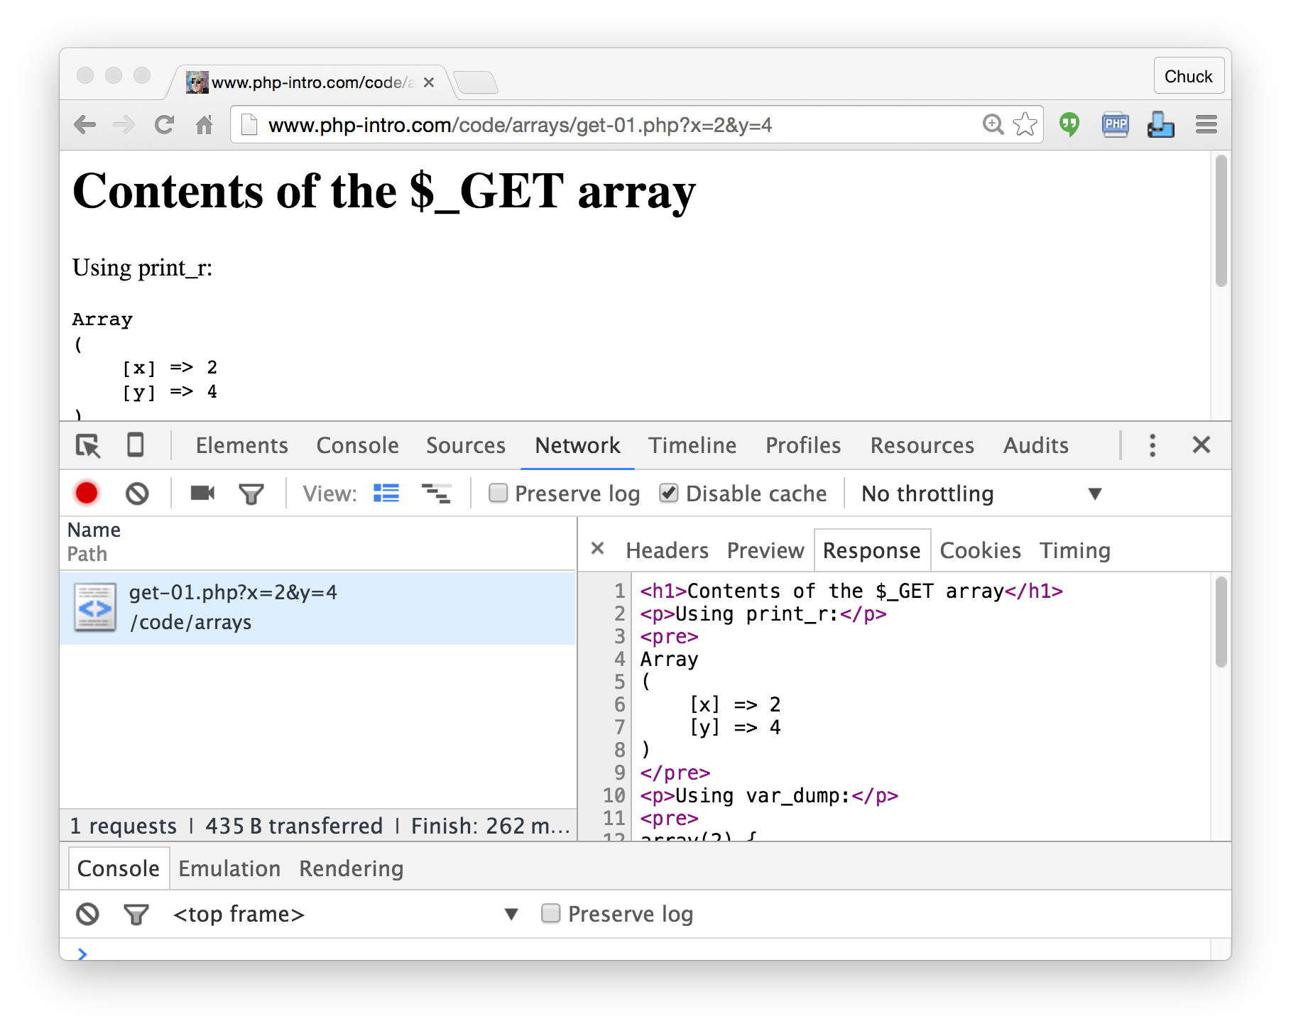

Slide 32


Time
Browser
Web Server
Database Server
D
OM
Apache
static
files
MySql
Parse
Request
Parse
Response
$_GET
PHP
php
code
ind.php
JavaScript
RRC/HTTP
SQL

Slide 33
Summary
This is a sprint through some of the unique language features of PHP Arrays

Slide 34
Acknowledgements / Contributions
These slides are Copyright 2010- Charles R. Severance (www.dr-chuck.com) as part of www.wa4e.com and made available under a Creative Commons Attribution 4.0 License. Please maintain this last slide in all copies of the document to comply with the attribution requirements of the license. If you make a change, feel free to add your name and organization to the list of contributors on this page as you republish the materials.
Initial Development: Charles Severance, University of Michigan School of Information
Insert new Contributors and Translators here including names and dates
Continue new Contributors and Translators here
Notes:
Note from Chuck. Please retain and maintain this page as you remix and republish these materials. Please add any of your own improvements or contributions.

