Slide 1

C# Expert Sessions

Slide 2
Travel Plan – Day 1
Visual Studio Ninja Tricks
An Object-Oriented Brush up
Interfaces and OO
Dependency Injection

Slide 3
Travel Plan – Day 2
Generics and Constraints
Event-Based Architecture
Higher-Order programming
Reflection

Slide 4
Travel Plan – Day 3
LINQ
Asynchronous Programming
Parallel programming

Slide 5
Our Journey With C#
C# 1 - MS Java (J#)
Objects
C# 2 - Becoming a new language
Generic types
Delegates
C# 4 – Internals upgrade
Anonymous methods
Properties
Partial Types
C# 3 - Awesome new features
Lambdas
Expression Trees
Partial Methods
Extension methods
Much more
Dynamics
Named/Optional Arguments
IOP On steroids

Slide 6
Our Journey With C#
C# 5 – Don’t tell me what order to do things
Compiler services expanded
Async / Await
E.g. Caller info
C# 6 – Compiling sooner or later
ROSLYN – Compile new code in code
nameof Expression
Auto-Properties
C# 7 – Wait is this Javascript ?
Tuples
Discards _
Local Functions
C# 8 – soon to come

Slide 7
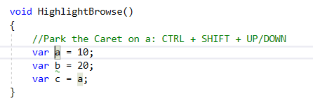
Visual Studio Ninja Tricks
Highlight and Browse variables
This becomes extra usable with mixed scopes

Slide 8
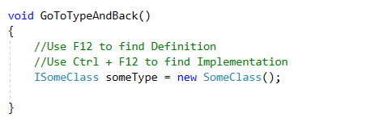
Visual Studio Ninja Tricks
Go to Definition
Go to Implementation

Slide 9
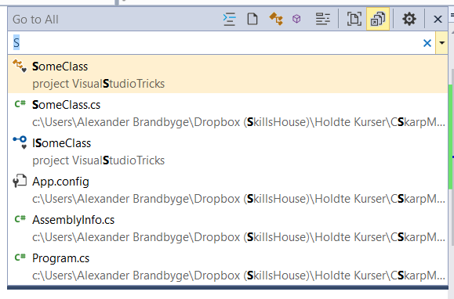
Visual Studio Ninja Tricks
Go to All: [Ctrl] T

Slide 10
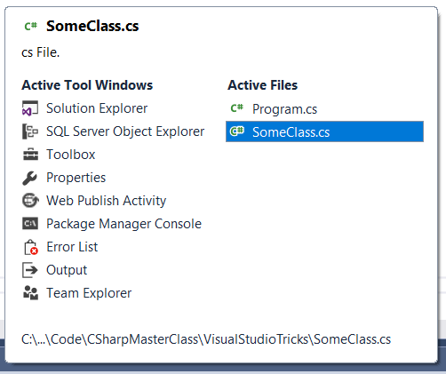
Visual Studio Ninja Tricks
[Ctrl] [Shift] [Tab]
Optionally use arrow keys or mouse

Slide 11
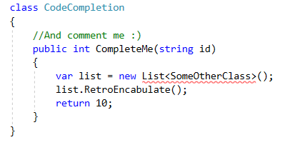
Visual Studio Ninja Tricks
[Ctrl] [.] On any error will suggest a fix
Good for Behavior driven design
Triple slash for auto-Comment

Slide 12
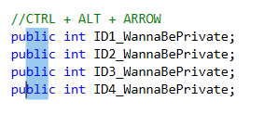
Visual Studio Ninja Tricks
[Alt] [Shift] + arrow keys or [Alt] [Left-click] mouse to select acros lines
[Alt] arrow up or down keys to Swap lines
[Ctrl][L] - cut line
[Ctrl][Shift][L] - deletes line
http://visualstudioshortcuts.com/2017

Slide 13
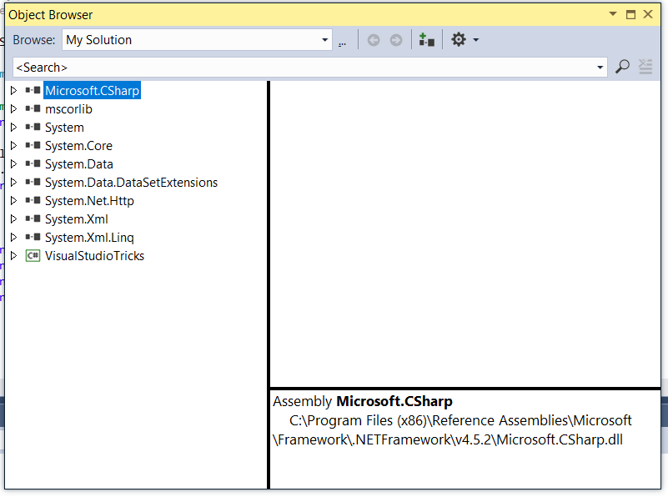
Visual Studio Ninja Tricks
Use the object explorer to traverse object structures

Slide 14
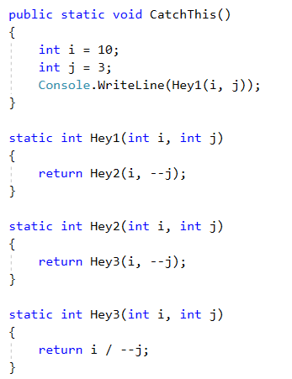
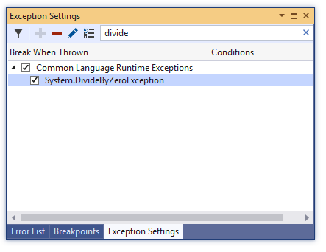
Visual Studio Ninja Debugging
We can break on otherwise caught exceptions

Slide 15
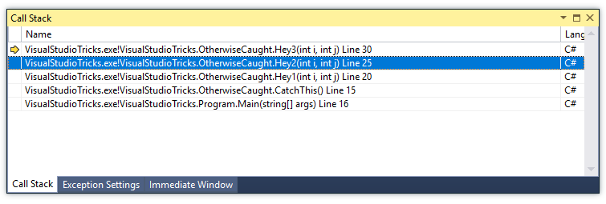
Visual Studio Ninja Debugging
And travel up and down the callstack
This includes the complete scope data for each frame

Slide 16
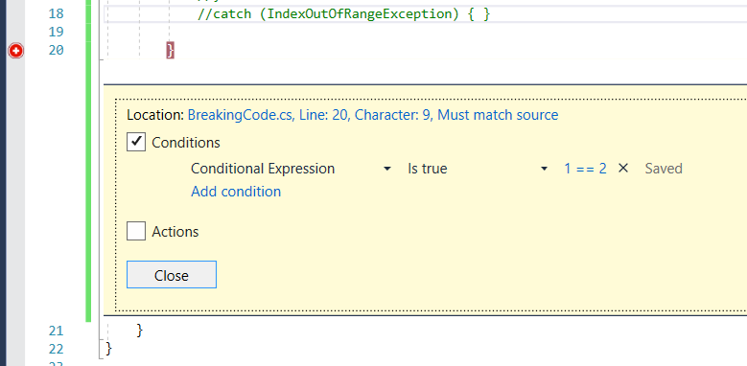
Visual Studio Ninja Debugging
Conditional Breakpoints can be hit if:
Some condition is true
At certain interval
At specific thread / Machine

Slide 17
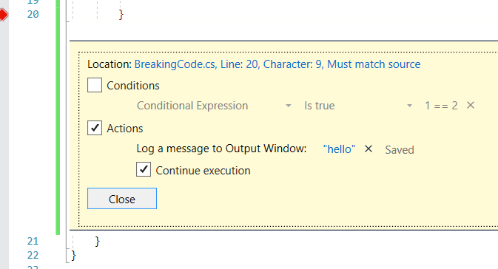
Visual Studio Ninja Debugging
At a breakpoint we can perform actions
This is much better than scattering ”Console.Log” around

Slide 18
Object-Oriented Brush up
We think of objects as containers of:
State
Behaviours
Some Class
Var 1
Var 2
Var 3
Var 4
Method 1
Method 2
Method 3

Slide 19
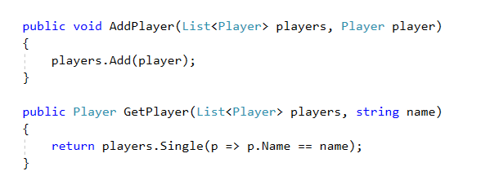
Object-Oriented Brush up
Procedural code

Slide 20
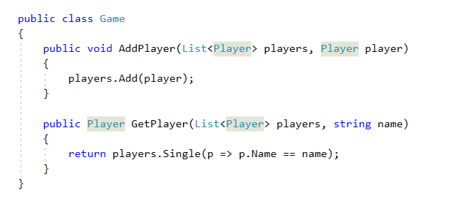
Object-Oriented Brush up
Encapsulation
Put stuff in a capsule, e.g. Behaviours

Slide 21
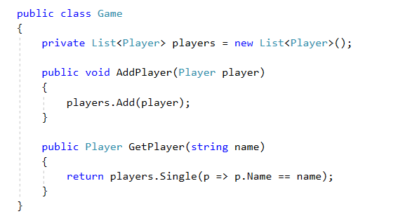
Object-Oriented Brush up
State encapsulation and Data hiding
Each object has its own state to track

Slide 22
Object-Oriented Brush up
Implementation Hiding
We require consumers to know nothing of the internals

Slide 23
Object-Oriented Brush up
Why do we care:
It enables refactoring
And logic reuse
User cannot access internals and thereby break the code
As a result we are allowed to change our implementation
Encapsulation boundaries is genuinely hard

Slide 24
Object-Oriented Brush up
Object and Dynamic
Object is the minimal working unit in .Net
Everything inherits object
It is type checked at compile time
Dynamic can change shape and form at will
Even runtime
It will only generate errors at runtime should they exist

Slide 25
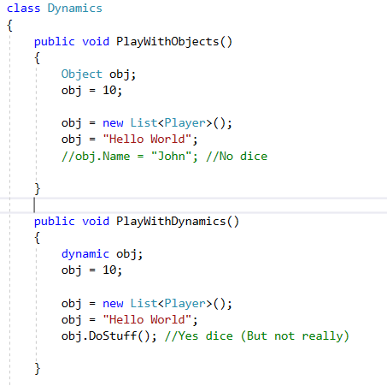
Object-Oriented Brush up

Slide 26
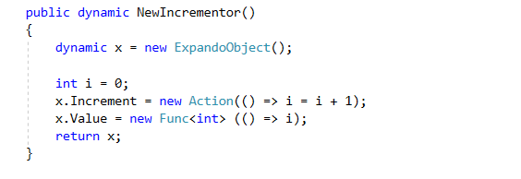
Object-Oriented Brush up
It turns out we can completely ignore the concept of classes and still have objects
Much like in javascript

Slide 27
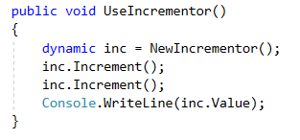
Object-Oriented Brush up
Expando objects came in C# 4 and are able to be mutated at will, at any time.
All other dynamic types originates from the ExpandoObject
We can now specialize instances

Slide 28
DRY
”Dont repeate youself”
Make efford not to have code that is a repetition or multiplication of a patter

Slide 29
CPR nummer kontrol
git clone Github.com/CSExpertSessions/DRY

Slide 30
Object-Oriented Brush up
Exercise time:
Make a TIC-TAC-TOE game
Printing to console is fine
Track two players, but each player object is dynamic, with a custom ”strategy” method.

Slide 31
Interfaces and OO
Traditional object orientation focuses on objects
But we seem to have forgotten about the message passing
One solution is Late binding

Slide 32
Interfaces and OO
By segmenting our code out in the Client/Server pattern we come closer
By using dynamic we can disable typechecking at compile time and we gain the option to enable message passing

Slide 33
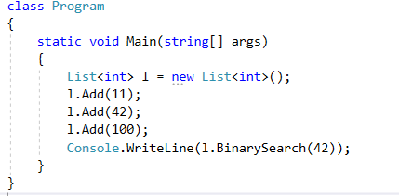
Interfaces and OO
Dynamic Decorator
What if I want all actions logged ?

Slide 34
Interfaces and OO
Late Binding in C# comes at three levels
Inheritance: ”We know it is a subclass”
Interfaces: ”We know what it implements”
Dynamic: ”We know nothing”

Slide 35
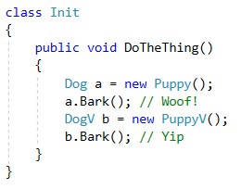
Interfaces and OO
Opting in to virtual methods
Is this a good design?
Interfaces allows us to circumvent this issue

Slide 36
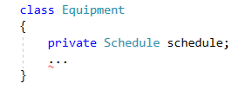
Interfaces and OO
Example time:
We can now only work with this schedule type

Slide 37
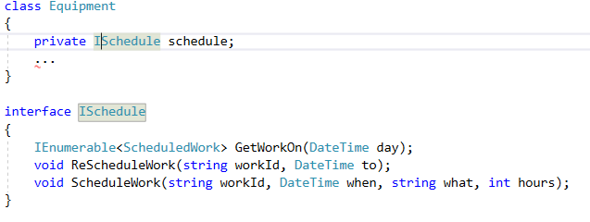
Interfaces and OO
Lets open ourselves to extension by using abstraction
But our interface definition is too broad

Slide 38
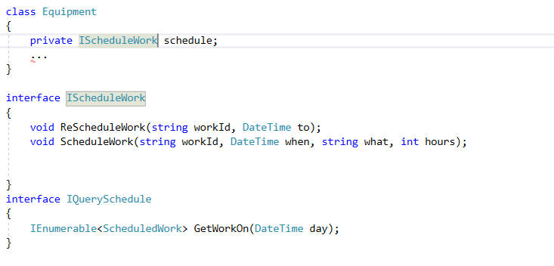
Interfaces and OO
With interface segregation we get

Slide 39
Interfaces and OO
Design pattern:
The Decorator pattern
Wrap an object in another object with the same interface

Slide 40
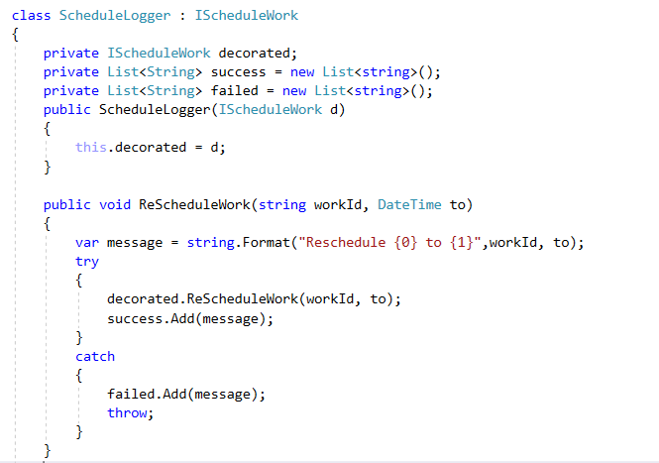
Interfaces and OO
We implement an interface and forward calls
We should add value for each layer

Slide 41
Interfaces and OO
We can reuse the pattern indefinetly
Preferably with each implementation having a unique facet
Object1 : Iwork
Object2 : Iwork
Object3 : Iwork

Slide 42
Interfaces and OO
Design pattern:
The strategy pattern
Enable algorithms to be selected at runtime

Slide 43
Interfaces and OO
The idea is to enable classes to be customized depending on the situation.
Eg. List.Sort(quicksort/mergesort/binarysort etc.)
Can be done in many ways, but the most common is through lambdas or through interfaces

Slide 44
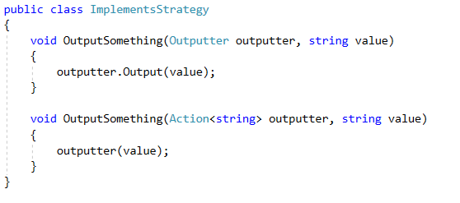
Interfaces and OO
Like this:

Slide 45
IComparable
github.com/CSExpertSessions/IComparable

Slide 46
Interfaces and OO
Excercise time:
Rewrite the Tic-Tac-Toe game, this time properly decoupled and object oriented
Players still have their own strategies but this time as either function objects or as lambdas

Slide 47
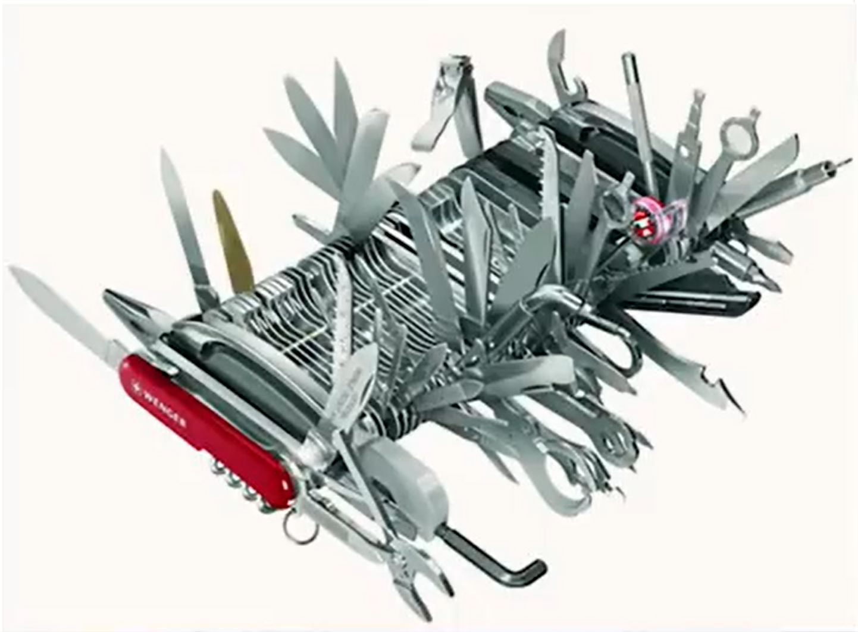
When creating software - be aware…

Slide 48
The SOLID Principles
Single Responsibility Principle
Open/Closed Principle
Liskovs Substitution Principle
Interface Segregation Principle
Dependency Inversion Principle

Slide 49
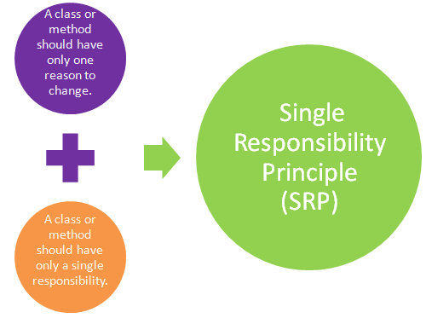
Single Responsibility Principle
”a class should have only one reson to change…”
Every module or class should have responsibillity over a single part of the functionallity provided by the software, and that responsibillity should be entirely encapsulated by the class.

Slide 50
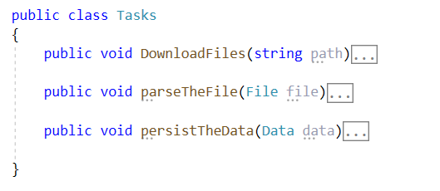
Single Responsibility Principle

Slide 51
Open/Closed Principle
”Software entities such as classes, modules, functions etc. Should be open for extension, but closed for modification”
Any new functionality should be implemented by adding new classes, attributes and methods, instead of changing the current ones or existing ones.

Slide 52
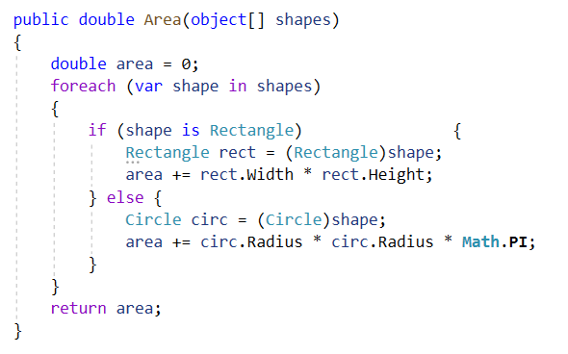
Open/Closed Principle
What if you should handle a triangle class?

Slide 53
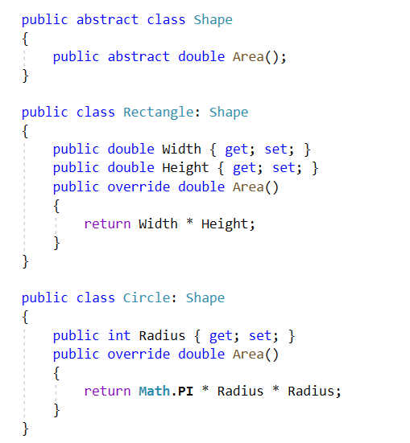
Open/Closed Principle
Use abstract classes

Slide 54
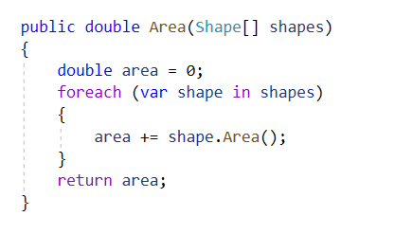
Open/Closed Principle
Use abstract classes

Slide 55
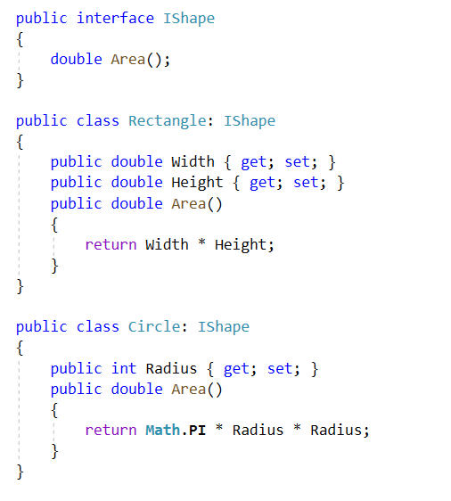
Open/Closed Principle
Use interfaces

Slide 56
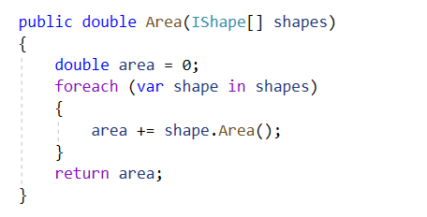
Open/Closed Principle
Use interfaces

Slide 57
Liskovs Substitution Principle
”If S is a subtype of T, the objects of type T may be replaced by objects of type S”
Derived types must be completely substitutable for their base type.
No new exceptions can be thrown by the subtype

Slide 58
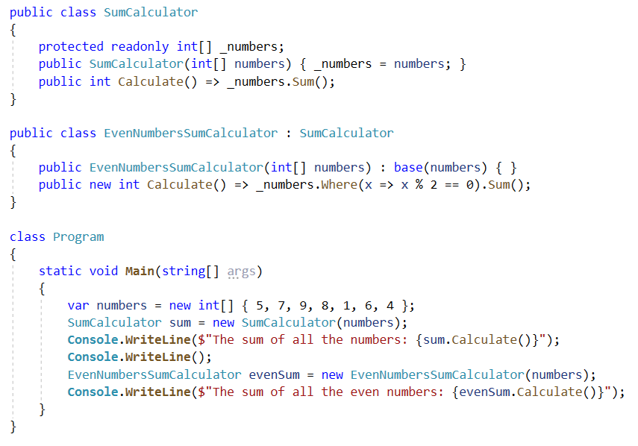
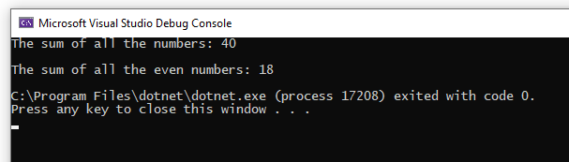
Liskovs Substitution Principle

Slide 59
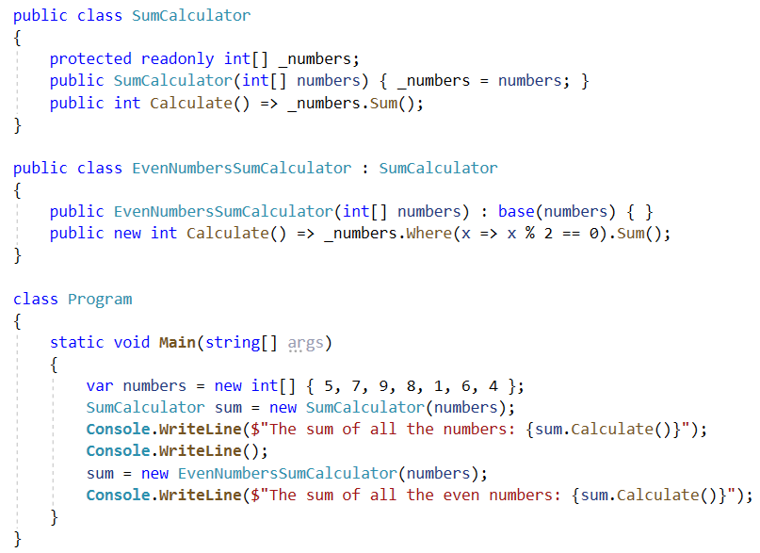
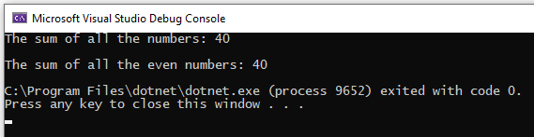
Liskovs Substitution Principle

Slide 60
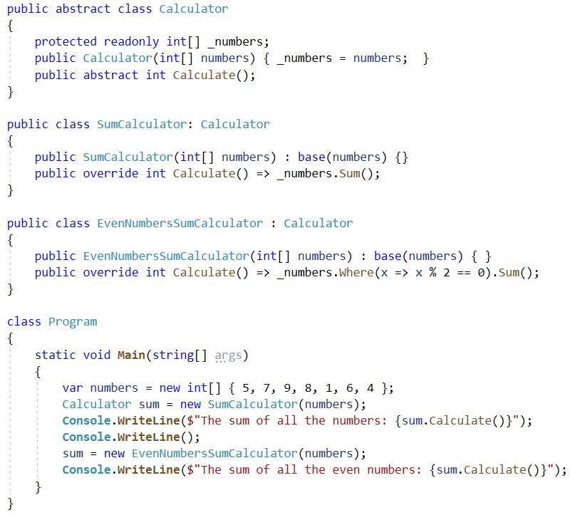
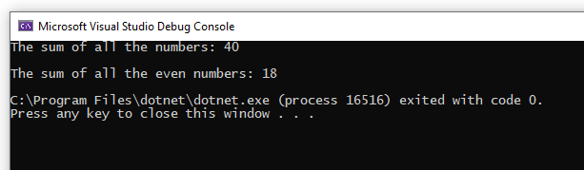
Liskovs Substitution Principle

Slide 61
Interface Segregation Principle
”No client should be forced to depend on methods they don’t use”
One fat interface need to be spilt into many smaller and relavant interfaces so that clients can know about the interfaces that are relavant to them

Slide 62
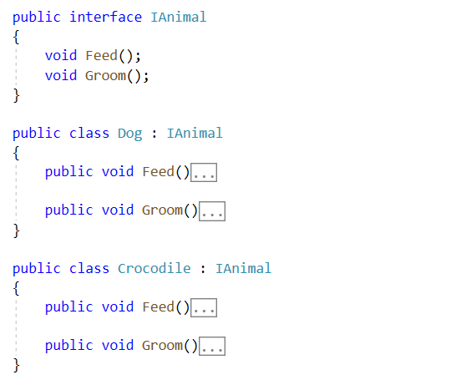
Interface Segregation Principle
Man skal være modig…!

Slide 63
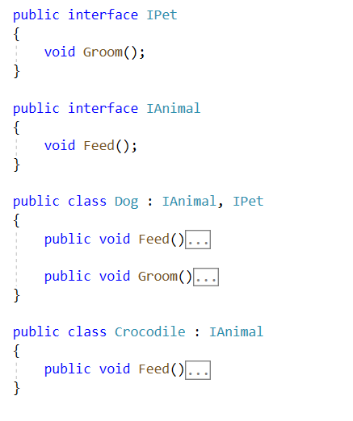
Interface Segregation Principle

Slide 64
Dependency Inversion Principle
”High-level modules should not depend on low-level modules. Both should depend on abstrations”
Robert C. Martin
We should never depend on concrete instances only abstractions
As an application grows, so does the total available amount of dependencies needed and offered

Slide 65
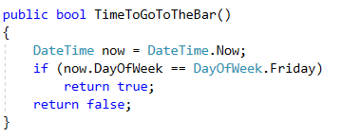
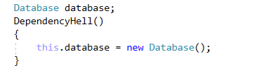
Dependency Inversion Principle
Dependencies have many forms:
Static members
New’ing up classes

Slide 66
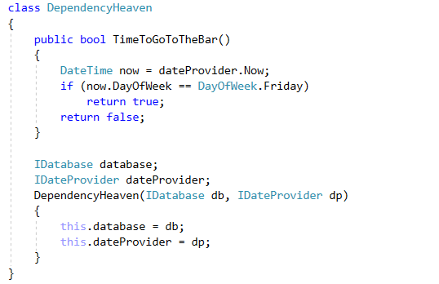
Dependency Inversion Principle
By allowing a class to fetch dependencies itself we are violating the O/C and the SR Principles
So how do we fix it?

Slide 67
Dependency Injection
Dependency injection
When talking about dependency inversion we typically also include injection
Two types:
Property injection
Constructor injection

Slide 68
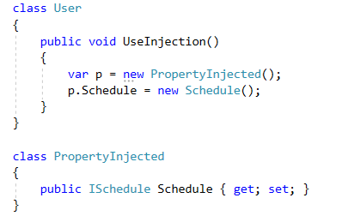
Dependency Injection
Property injection
Puts the work on the caller
Api Implementation is simpler

Slide 69
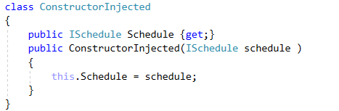
Dependency Injection
Constructor Injection
Moves logic into the constructor
Allows for instantiation control and no need for setters

Slide 70
Dependency Injection
One issue:
Keeping track of dependencies can become a burden and as needed dependencies grow, our instantiation logic becomes complex
Solution:
Use IOC - often called IOC Container

Slide 71
Dependency Injection
We are gonna use the Unity Dependency Injector (But we could make our own)
This allows a complete decoupling between our object creation code and the use of the objects

Slide 72
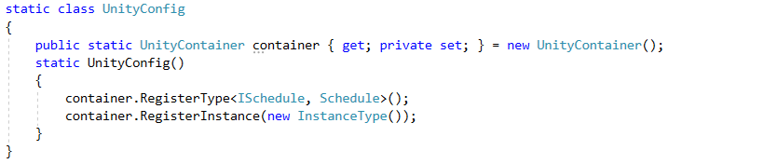
Dependency Injection
Configuration:
We teach Unity how to resolve each specific type

Slide 73
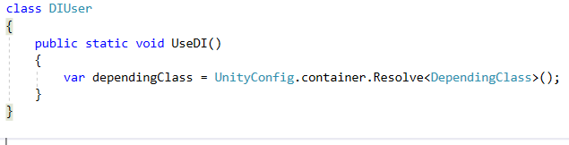
Dependency Injection
Resolution
Unity handles the dependencies of dependencies
As well as construction

Slide 74
Dependency Injection
Dependency Injection therefore allows us to decouple our dependencies
It can and should be mixed with the strategy pattern as well.
Good tip:
Use Interfaces on all dependencies, as this allows a DI enabled app to be 100% Unit tested

Slide 75
Dependency injection øvelse
github.com/CSExpertSessions/DI

Slide 76
Generic Programming
Code with ”Holes”
When we write methods we allow for parameters, such that we dont have a method for each input permutation (that would be crazy)
Eg. No ”HelloWorld()”, ”HelloOtherWorld” etc.
Instead ”Hello(”World”)”, ”Hello(”OtherWorld”)”

Slide 77
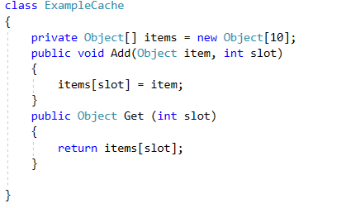
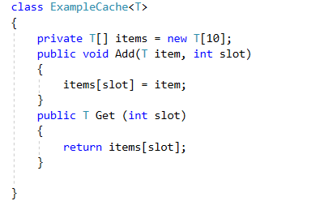
Generic Programming
We can allow types to become ”holes” as well through the use of generics

Slide 78
Generic Programming
Type Constraints:
We can constrain what kind of type we allow in our generic declarations

Slide 79

Generic Programming
By interface or baseclass:
This includes inherited types

Slide 80

Generic Programming
By class or struct

Slide 81

Generic Programming
Or enforce the existence of a default CTOR
And they can be combined!

Slide 82

Generic Programming
Methods can be independently generic as well
And we can have more than one parameter

Slide 83
Generic Programming
Excercise Time:
github.com/CSExpertSessions/Generic

Slide 84
Event-based architecture
The concept of reacting to events when ever they occur
Registration phase -> Action phase (Event loop)
Traditionally used in GUI environments
Events allow us to work with a publish-subscribe model.

Slide 85
Event-based architecture
Plus:
Low performance hit, no busy waiting
Provides pseudo-multithreading
Minus:
Leads to spaghetti if used improperly
EVENT HANDLERS ARE OBJECT REFERENCES, THEY PREVENT GC!!!
Use the dispose/finalize pattern

Slide 86
Event-based architecture
Exercise time:
github.com/CSExpertSessions/Events

Slide 87
Higher-Order Programming
Higher order Programming in a nutshell:
”Functions that accepts other functions as arguments and/or return values”
Types accepted as parameters is called:
1st. class citisens
Primitives
Classes
Types
Code
Method

Slide 88
Higher-Order Programming
The most obvious example is Lambda Expressions
If everything else fails, they can always be used as function passing

Slide 89
Higher-Order Programming
Lambda Syntax:
(...) => { }
Parameter list Executable code
Return Type is determined by what is returned

Slide 90


Higher-Order Programming
Arguments (input)
Does not need types but can have them

Slide 91

Higher-Order Programming
Multiple lines of codes can be executed in a lambda, and they can return values
Should there be more than one return statement the return type can be different

Slide 92
Higher-Order Programming
Delegate types
Most common are Func and Action
Type | Definition
Action | No arguments, no result
Action<int> | Int argument, no result
Action<int,float> | Int & float argument, no result
Func<double> | No argument, double result
Func<int,double> | Int argument, double result
Func<string,int,double> | String & int argument, double result

Slide 93


Higher-Order Programming
The Lambda Wrapper pattern

Slide 94
Higher-Order Programming
We want to factor out the ”generic” error handling and invariant enforcement
We solve this by making a generic request handler instead

Slide 95

Higher-Order Programming
Example:

Slide 96

Higher-Order Programming
Slight issue though, we cannot handle return values
We turn to using the Func object instead of the Action object.

Slide 97

Higher-Order Programming
Function generators and Closures
We can use lambdas to generate functions for us
A single purpose, pseudo object, even thread safe

Slide 98
Higher-Order Programming
Function generators can be combined with linq for amazing results
Beware LINQ is not instant evaluation!

Slide 99

Higher-Order Programming
Pipelining via HOP Filters
This is open for extension at both run and compile time

Slide 100
Higher-Order Programming
Excercise time:
Try to implement the lambda wrapper pattern and create a data store for the tic-tac-toe game.
Create/Delete/Get from datastore
Test it first with a console app
Then integrate it in the game

Slide 101
Reflective programming
Reflection
Being able to observe the inner workings of our type/method engine
This includes
Fields, methods, properties, types, generics
Of both classes and objects

Slide 102
Reflective programming
Our app lives in the app domain:
MyApp
mscorlib
System
System.Core
Type1
Hello World
MyApp
Type2

Slide 103
Reflective programming
All of this information is available at runtime:
Concept | Type
Application domain | AppDomain
Assembly | Assembly
Class, struct, interface and enum | Type
Constructor | ConstructorInfo
Method | MethodInfo
Fields | FieldInfo
Properties | PropertyInfo

Slide 104

Reflective programming
Basic member access
We can alway inspect the current types we have access to

Slide 105

Reflective programming
Including going through the app domain
Warning: This query will take a long time!

Slide 106


Reflective programming
Get current assembly
Get types from assembly
Implementerer en type et interface

Slide 107

Reflective programming
You can use LINQ
klasser som implementerer IDrive interface

Slide 108

Reflective programming
Should we want to, we can create instances of type definitions using the Activator class
The job of finding an appropriate constructor is entirely up to you!

Slide 109
Reflective programming
So when to use reflection?
In Diagnostics situations
Where high performance does not matter
As a last resort

Slide 110

Reflective programming
Custom attributes
We can decorate types with attributes, using the [AttributeName] syntax
There are some built in
They operate on the definition level, not run time

Slide 111

Reflective programming
Accessing our new attribute usage is done through reflection

Slide 112
Reflective programming
Excercise time:
github.com/CSExpertSessions/Reflection

Slide 113
LINQ
Stands for Language Integrated Query
By default works on all built-in memory collections
With adaptors it can work on most other data.
E.g. SQL , XML

Slide 114

LINQ
Demo structure:

Slide 115

LINQ
We can then query through our datastructures
Linq has two forms
The first compiles to the second

Slide 116

LINQ
Use Let to introduce variables mid-query
These let variables are rebuilt on each execution

Slide 117
LINQ
Evaluation order
LINQ Queries are evaluated when the individual results are needed, as lazily as can be done
If parts of the statement has side effects, beware!
This is also true for LINQ-To-Database scenarios
LINQ queries embedded in other queries are evaluated when needed as well

Slide 118
LINQ
Extra LINQ Goodness:
Count(), LINQ can count up any enumerable if need be.
Join(), Access another element in another dataset when values match
Group, Group elements by a certain property
ToDictionary,
Single(OrDefault), will ensure only one element!

Slide 119

LINQ
Yield tricks
We can use the yield keyword to on the fly construct enumerables from any method

Slide 120
LINQ
Linq also allows for set operations such as:
Union: listA.Union(listB)
Intersect: listA.InterSect(ListB)
Except: listA.Except(ListB)

Slide 121
LINQ
Excercise time:
Server: SuperDuper.database.windows.net
Database: kursus
Tabel: Customer
User Id sqladmin
Password SuperDuper1234
Lav en liste over kunder fra Tyskland i en Console app. For hver kunder skal vises hvor mange ordre de har afgivet.

Slide 122
Asynchronous programming
Traditionally when coding, we expect each statement to execute in the order it completes
In asynchronous programming we explicitly set up orders of operation but, the point of execution is a mystery (Runtime decides)
Good Example, when waiting for files/IO or system.Sleep, async really shines.

Slide 123
Asynchronous programming
Concurency
Parallelism
T1
T2
T1
T2
Goal:
non-blocking
Goal:
Performance!
Context switching
Single core
Multiple core

Slide 124

Asynchronous programming
Cuncurrency

Slide 125

Asynchronous programming
Cuncurrency

Slide 126
Asynchronous programming
await are signals which mark code positions from where control should resume after a task completes…
await can only be used in methods that has been marked with async keyword

Slide 127

Asynchronous programming
WinForm

Slide 128

Asynchronous programming
In newer days we have then introduced the async/await keywords to help with boilerplate

Slide 129

Parallel Programming
Doing more with more threads
A bunch of dangers
Amazing power

Slide 130

Parallel Programming
.Net has built in CIL support for multithreading
Eg. Lock, ReadersWritersLock/ReadersWritersLockSlim
.Net also has specialized concurrent containers for us to use
//System.Collections.Concurrent

Slide 131


Parallel Programming
We have two primary kinds of paralellism
Data paralellism and Task paralellism
Task based are Threads, Invokations etc.

Slide 132
Asynchronous programming
Excercise:
Github.com/CSExpertSessions/Async

Slide 133
Tak for nu!
Kursus evaluering:
http://eval.superusers.dk/
på deltagerliste står et nummer ud for dit navn
Kontakt mig:
Peter@wallenius.dk
linkedin.com/in/pwallenius

