Slide 1

CMR COLLEGE OF ENGINEERING & TECHNOLOGY
Kandlakoya, Medchal, Hyderabad - 501401
Department of Computer Science and Engineering
Pnuemonia Detection using Deep Learning
Batch No.: 37
Name of the student:
20H51A05A3 – P. Tanujha Reddy
20H51A05D1 – N. Aditya
20H51A05M1- T.Ruchitha
Under esteemed guidance of
Ms.M.Srikala
Assistant Professor

Slide 2
Outline
Abstract
Introduction
Research Objective
Problem Definition
Scope of the Project
Literature Review
Implementation of Existing System
Conclusion
Future Work
References
Notes:
2

Slide 3
Abstract
Notes:
3

Slide 4
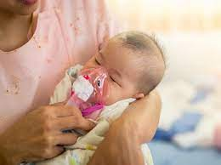
ABSTRACT
Pneumonia causes the death of around 700,000 children every year and affects 7% of the global population. Chest X-rays are primarily used for the diagnosis of this disease.
However, even for a trained radiologist, it is a challenging task to examine chest X-rays.
We develop an algorithm which detects pneumonia from frontal-view chest X-ray images at a level exceeding practicing radiologist

Slide 5
INTRODUCTION
Notes:
5

Slide 6
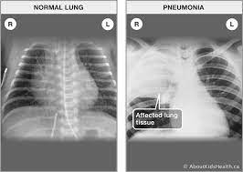
Introduction
Pneumonia poses a significant global health risk, over 4 million premature deaths annually due to air pollution.
Accurate diagnosis traditionally relies on expert review of chest radiographs (CXR) and clinical data.
CXR interpretation is complex due to various lung conditions mimicking pneumonia.
We develop an algorithm which detects pneumonia from frontal-view chest X-ray images at a level exceeding practicing radiologist
Notes:
6

Slide 7
Research Objective
Notes:
7

Slide 8

Research objective
The primary objective of this study is to develop a deep neural network-based model for pneumonia detection, aimed at overcoming the challenges associated with traditional diagnostic methods.
This model aims to automate and optimize the classification of pneumonia in chest radiographs, improving accuracy and accessibility for early diagnosis, particularly in resource-constrained settings.

Slide 9
Problem Definition
Notes:
9

Slide 10
Problem Definition
Pneumonia is among the most prevalent diseases, and due to lack of experts it is difficult to detect. So, we need to build a binary classifier to detect pneumonia using chest x-rays.

Slide 11
Literature Review
Notes:
11

Slide 12
Literature Review:
In various types of learning techniques, CNN proved to be
one of the best algorithms for image classification, analysis,
segmentation and other tasks .

Slide 13
Comparison table for the existing system
S.No | Authors and Year of publication | Problem Statement | Name of the Proposed solution/Method | Drawback
1 | Sarang Mahajan, 2019 5th International conference for I2CT IEEE | Motive is to develop a model capable of detecting pneumonia as a supplementary means to access radiology diagnostics Dataset: Chest X-ray dataset from Kaggle | 121-layer DenseNet when trained on top of a finely tuned CheXNet model | The proposed model can only detect pneumonia and not its subtypes.
2 | Xhong Gu, Liyan Pan, Huiying Liang, Ran Yang ICMIP '18: Proceedings of the 3rd International Conference on Multimedia and Image Processing | Author used open Japanese society of radiological technology database (JSRT, 241 images) and Montgomery County, Md (MC, 138 images) dataset for detection of lung diseases based on chest X-ray images. | Feature Extraction of InceptionV3 CNN Architecture+ Machine Learning Classifier (SVM) | Most papers are only able to focus on the feature extraction rather than the performance of each classifier. In addition, machine learning algorithms still cannot beat Neural networks in terms of sensitivity.
3 | Ashitosh Tilve; Shrameet Nayak; Saurabh Vernekar2020 International Conference on (ic-ETITE) | Author used dataset from Indiana, Kit, paper focuses on surveying and comparing the detection of lung disease using different computer-aided techniques and suggests a revised model for detecting pneumonia | Artificial Neural Network (ANN) for pneumonia detection. | There is a problem of false disease detection with this model.

Slide 14
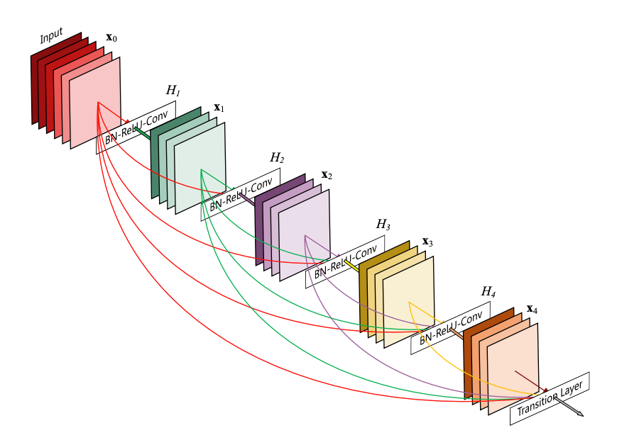
Implementation of Existing System
DenseNet121 Densenet is a convolutional network where each layer is connected to all other layers that are deeper in the network:
* The first layer is connected to the 2nd, 3rd, 4th etc.
* The second layer is conected to the 3rd, 4th, 5th etc.

Slide 15
Inception v3
Inception models are a type of deep neural network (DNN) architecture developed by a researcher named Szegedy et al. for the first time in 2014, and the model was named as inception model . The structures of inception models and the conventional CNN model are different from each other in such a way that inception models are inception blocks which means lapping the same input tensor with multiple filters and concatenating their results.

Slide 16
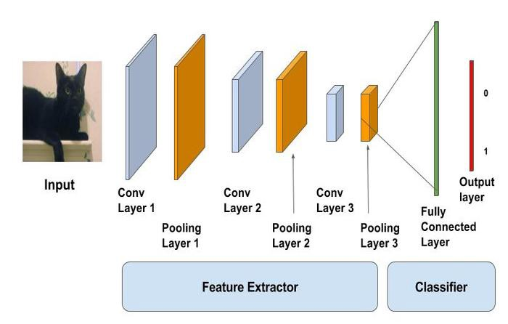
Proposed System:
Computer Vision can be realized using Convolutional neural networks (CNN) They are neural networks making features extraction over an image before classifying it. The feature extraction performed consists of three basic operations: * Filter an image for a particular feature (convolution)
* Detect that feature within the filtered image (using the ReLU activation)
* Condense the image to enhance the features (maximum pooling)

Slide 17
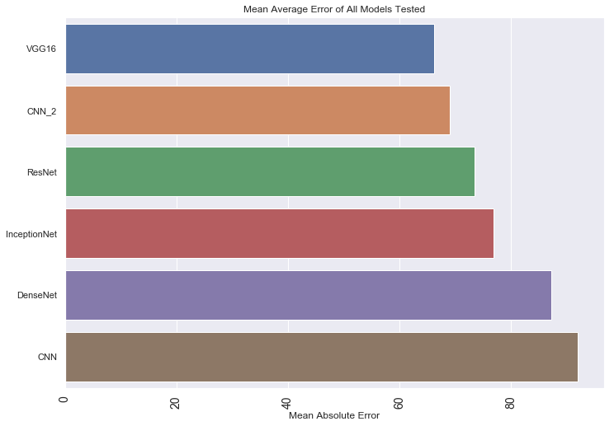
Comparison of Proposed system with an existed system
The existing systems have limitations in handling pneumonia detection,VGG16 processes fixed-sized images and outputs vectors for classification, while Inception-V3 is advanced but complex.
In contrast, our proposed system introduces a novel approach tailored for pneumonia detection. We resize images, use deep learning for segmentation, and employ connected components to identify pneumonia regions accurately.

Slide 18
Scope of the Project
Notes:
18

Slide 19
Scope of the Project
Development of a deep learning-based pneumonia detection system using convolutional neural networks (CNNs).
Evaluation of the system's performance and accuracy with a diverse dataset of nearly 6000 chest X-ray images.
Integration of the model into a user-friendly web application for real-time diagnosis, ensuring accessibility to a wider audience.
Emphasis on the project's potential to improve early diagnosis, especially in regions with limited access to specialized healthcare resources.

Slide 20
Conclusion
We develop an algorithm which detects pneumonia from frontal-view chest X-ray images at a level exceeding practicing radiologist with an accuracy of 91.98.
A web application is also deployed for easy usage of the model.

Slide 21
Future work
Future Enhancement is being planned to further analyze and enhance the protocol is to a bit faster,but it reduces the credibility of the whole system by being partially centralized because it only runs where the authority wants it

Slide 22
References
- Kaushik, V. S., Nayyar, A. (April 2020). Pneumonia Detection Using Convolutional Neural Networks (CNNs). In Proceedings of the First International Conference on Computing, Communications, and Cyber-Security (IC4S 2019), Duy Tan University. DOI: 10.1007/978-981-15-3369-3_36.
- . Rahman T., Chowdhury M.E., Khandakar A., Islam K.R., Islam K.F., Mahbub Z.B., Kadir M.A., Kashem S. Transfer Learning with Deep Convolutional Neural Network (CNN) for Pneumonia Detection using Chest X-ray.
- Nicholas E Ross, Charles J Pritchard, David M Rubin and Adriano G Duse, "Automated image processing method for the diagnosis and classification of malaria on thin blood smears", Medical and Biological Engineering and Computing, vol. 44, no. 5, 2006.
- Karen Simonyan and Andrew Zisserman, "Very deep convolutional networks for large-scale image recognition", 2014.

Slide 23
Thank You!

