Slide 1
Battleship with Phaser
Cameron Titus
Corey Gray
Duane Shaffer

Slide 2
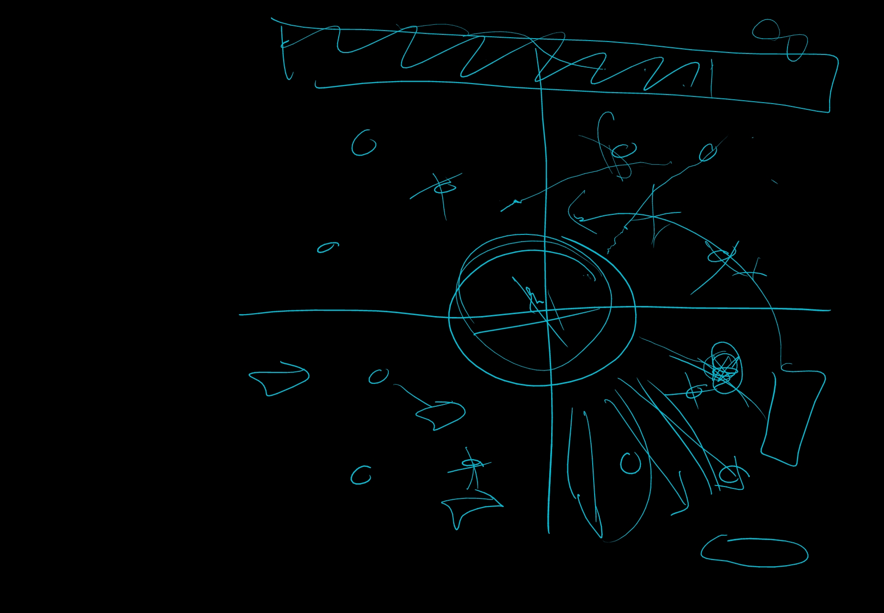
Original Concept
GUI
Mouse or keyboard control
Local or online co-op boss fight
Time-based final attack and random extra attacks forces decision making
Multi-platform
Different ships and difficulties
Teams and lobbies

Slide 3
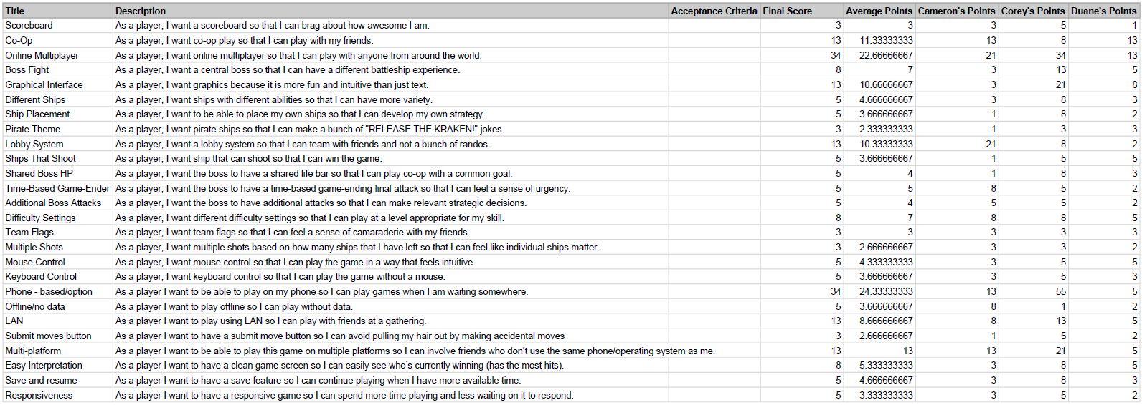
Planning Poker

Slide 4
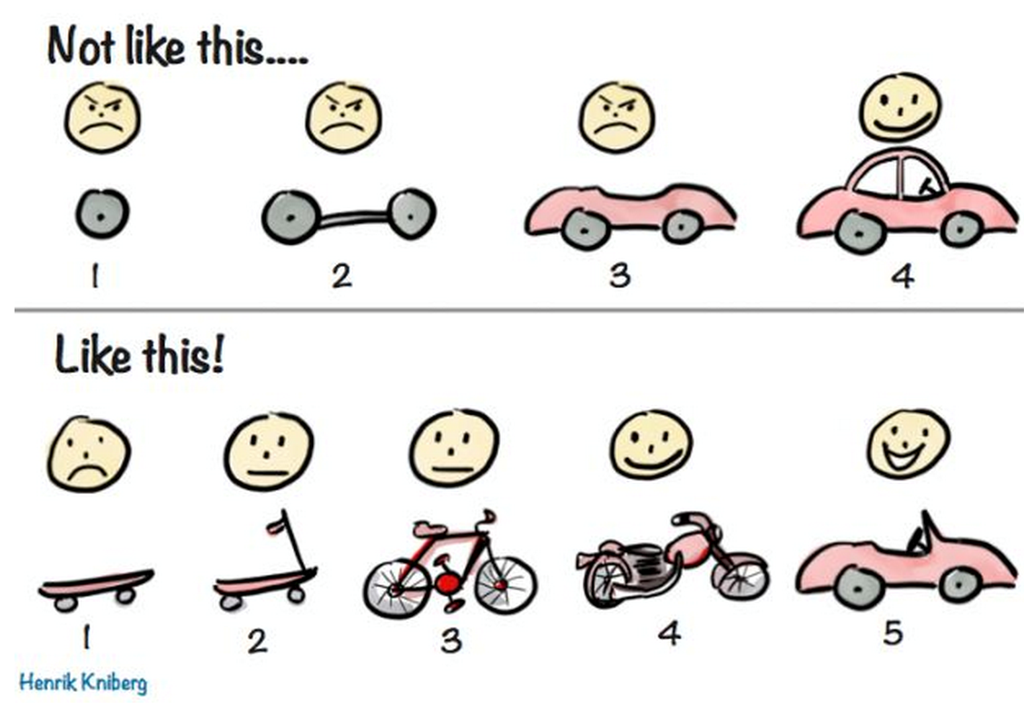
Iterative Development

Slide 5

Triplet Programming
The Good:
Reduced errors
Additional inspiration
Parallel research and development
The Bad:
Three developers sitting around for three hours trying to solve one problem and not solving it.

Slide 6
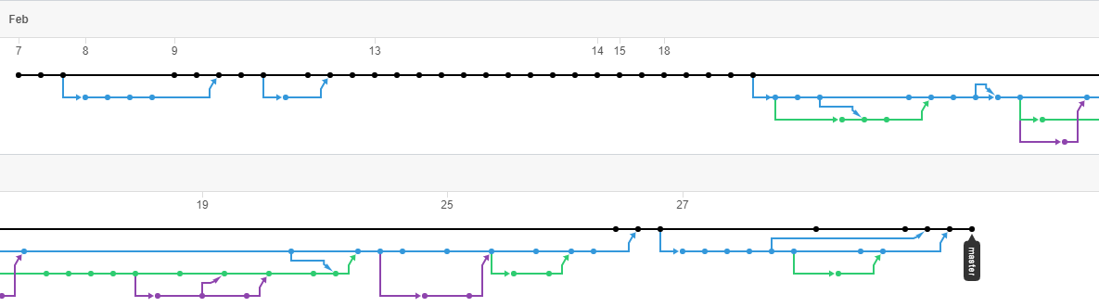
Beautiful Branching

Slide 7
Cameron’s Final Thoughts
“Pair programming (triplet programming) is a really powerful and useful tool. As is agile development. Often at work I will sit down and think about what classes I need to make, make a prototype and it feels like when I'm finally going it’s a few days later and even then I will find I don't need half the crap I put in there. If we follow the agile mantra we will test often and develop quickly with faster results. I will incorporate some of the mantras in my day to day coding life most definitely.”

Slide 8
Corey’s Final Thoughts
“I think we saw the good and bad sides of pair programing with this project, and I’d like to try it at work. Not as a extreme as XP but as another tool in the toolbox. There are benefits to sometimes working by yourself.
“I had to learn a new programming language for this project, which was a good experience, but I’m increasing wary of libraries and cargo cult programming, especially in web development where there seems to always be some hot new fad. Phaser allowed us to make some quick initial gains, but we hit a wall when we wanted to do something that the documentation didn’t cover. I kept imagining how upset my manager would be if his entire team worked for an afternoon without producing anything.”

Slide 9
Duane’s Final Thoughts

Slide 10
