Slide 1
Battleship with Phaser
Cameron Titus
Corey Gray
Duane Shaffer

Slide 2
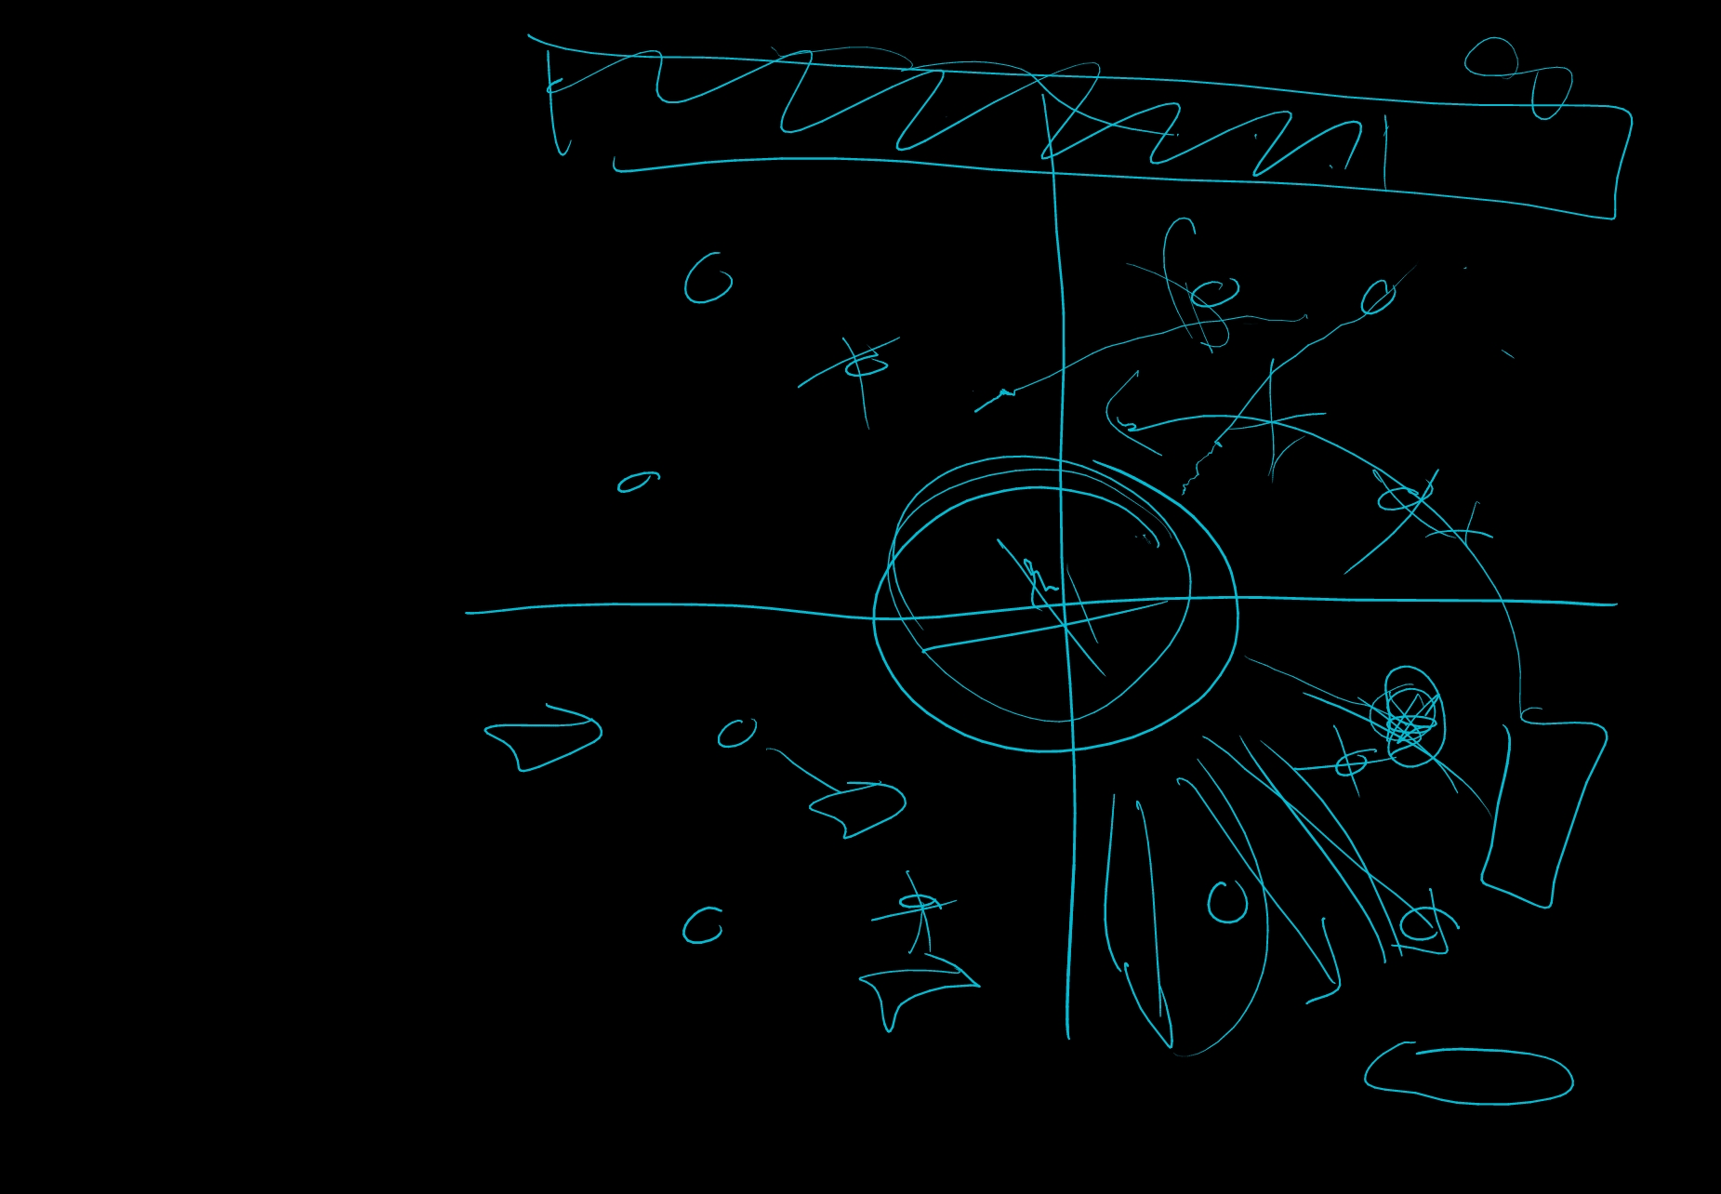
Original Concept
GUI
Mouse or keyboard control
Local or online co-op boss fight
Time-based final attack and random extra attacks forces decision making
Multi-platform
Different ships and difficulties
Teams and lobbies
Notes:
Like everyone else, we first started thinking about how we could make a bigger, better battleship. Maybe even a game that was only tangentially related to battleship. We brainstormed as many features as we could and wrote them down no matter how far-fetched they seem. Editing comes after creation.

Slide 3
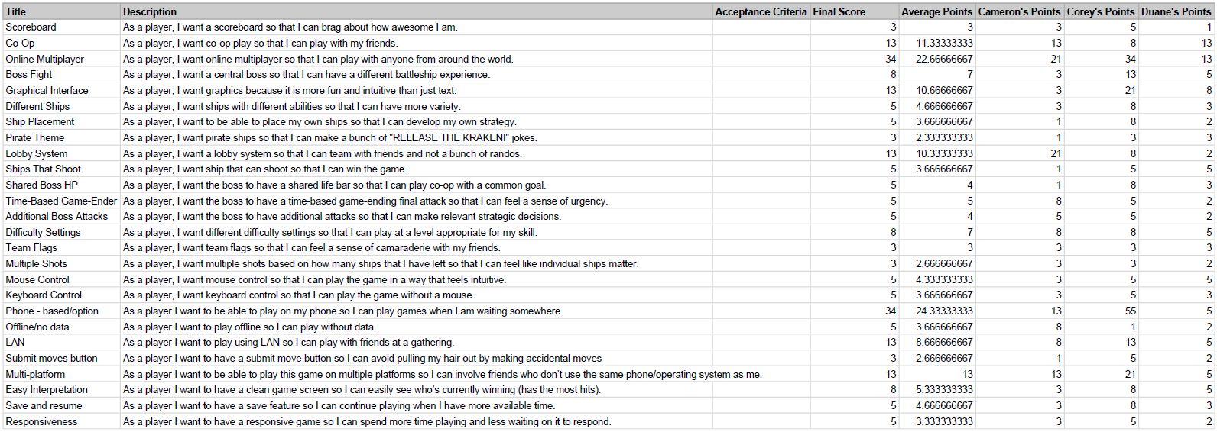
Planning Poker
Notes:
We ranked these features using arbitrary points on a Fibonacci scale, but we ranked them separately on individual Google Sheets. This way one person’s scores wouldn’t subconsciously influence another person’s scores thereby resulting in the most accurate scores possible. The final score was the average value rounded up to the next Fibonacci value. We ranked the features by importance later.

Slide 4
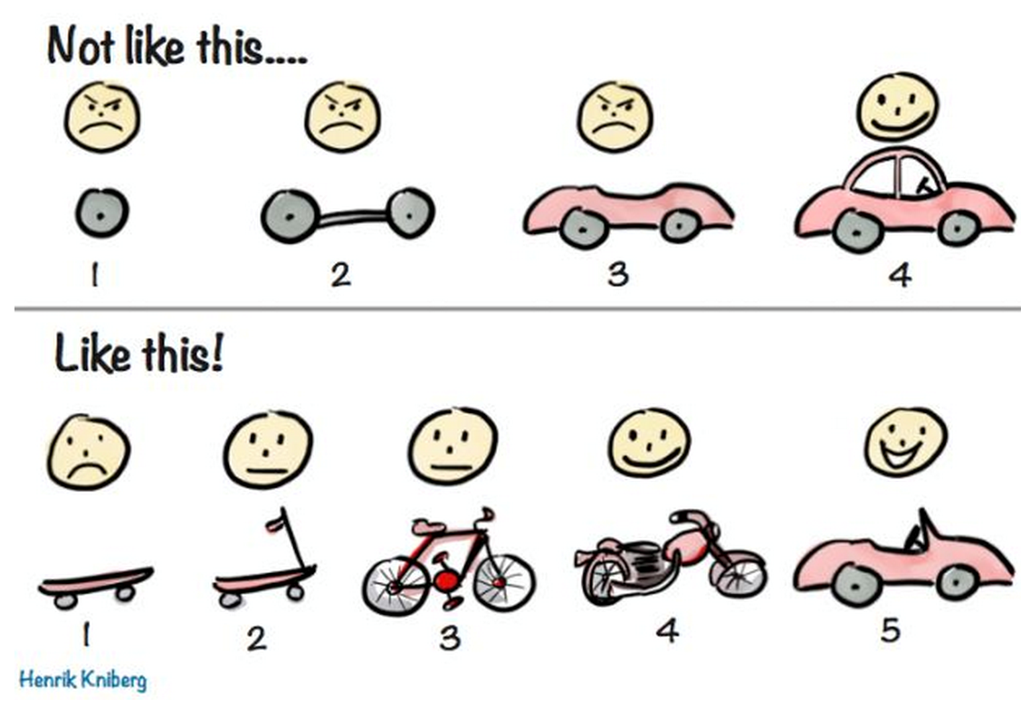
Iterative Development
Notes:
An ambitious project that doesn’t work is worse than a more mundane project with features, so we decided to work on core battleship functionality instead. We were able to implement the GUI, mouse control, and ship placement using the Phaser framework. Since our entire project was graphical and web-based, we didn’t write traditional tests but fired up a development web server and tested our code as we wrote it by using it in the game.

Slide 5

Triplet Programming
The Good:
Reduced errors
Additional inspiration
Parallel research and development
The Bad:
Three developers sitting around for three hours trying to solve one problem and not solving it.
Notes:
This was a lot easier when we could share one person’s screen on a big screen. The Book (upstairs in Bunnell) was great for triplet programming, which let us bounce ideas off of each other and catch errors as we wrote them, and our first session was extremely productive so that we felt like we were going to crush our deliverables. Except then our second session was hardly productive at all as all three of us tried to figure out ship rotation.

Slide 6
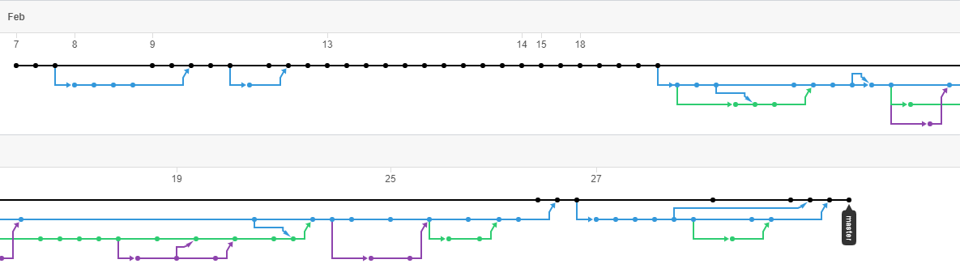
Beautiful Branching
Notes:
Version control discipline was good and at times we had three development branches going, which is where we broke things so that the game running on Git Pages was always the most stable version. Once we hammered out some of the initial administrative and configuration tasks and actually had a game running, pushing to master stopped except for journal entries. No one merged their own code, and triplet programming made code reviews easy.

Slide 7
Cameron’s Final Thoughts
“Pair programming (triplet programming) is a really powerful and useful tool. As is agile development. Often at work I will sit down and think about what classes I need to make, make a prototype and it feels like when I'm finally going it’s a few days later and even then I will find I don't need half the crap I put in there. If we follow the agile mantra we will test often and develop quickly with faster results. I will incorporate some of the mantras in my day to day coding life most definitely.”

Slide 8
Corey’s Final Thoughts
“I think we saw the good and bad sides of pair programing with this project, and I’d like to try it at work. Not as a extreme as XP but as another tool in the toolbox. There are benefits to sometimes working by yourself.
“I had to learn a new programming language for this project, which was a good experience, but I’m increasing wary of frameworks/libraries and cargo cult programming, especially in web development where there seems to always be some hot new fad. Phaser allowed us to make some quick initial gains, but we hit a wall when we wanted to do something that the documentation didn’t cover. I kept imagining how upset my manager would be if his entire team worked for an afternoon without producing anything.”

Slide 9
Duane’s Final Thoughts
Fail Fast!
Improved Git skills
YAGNI
Refactor later

Slide 10
