Slide 1
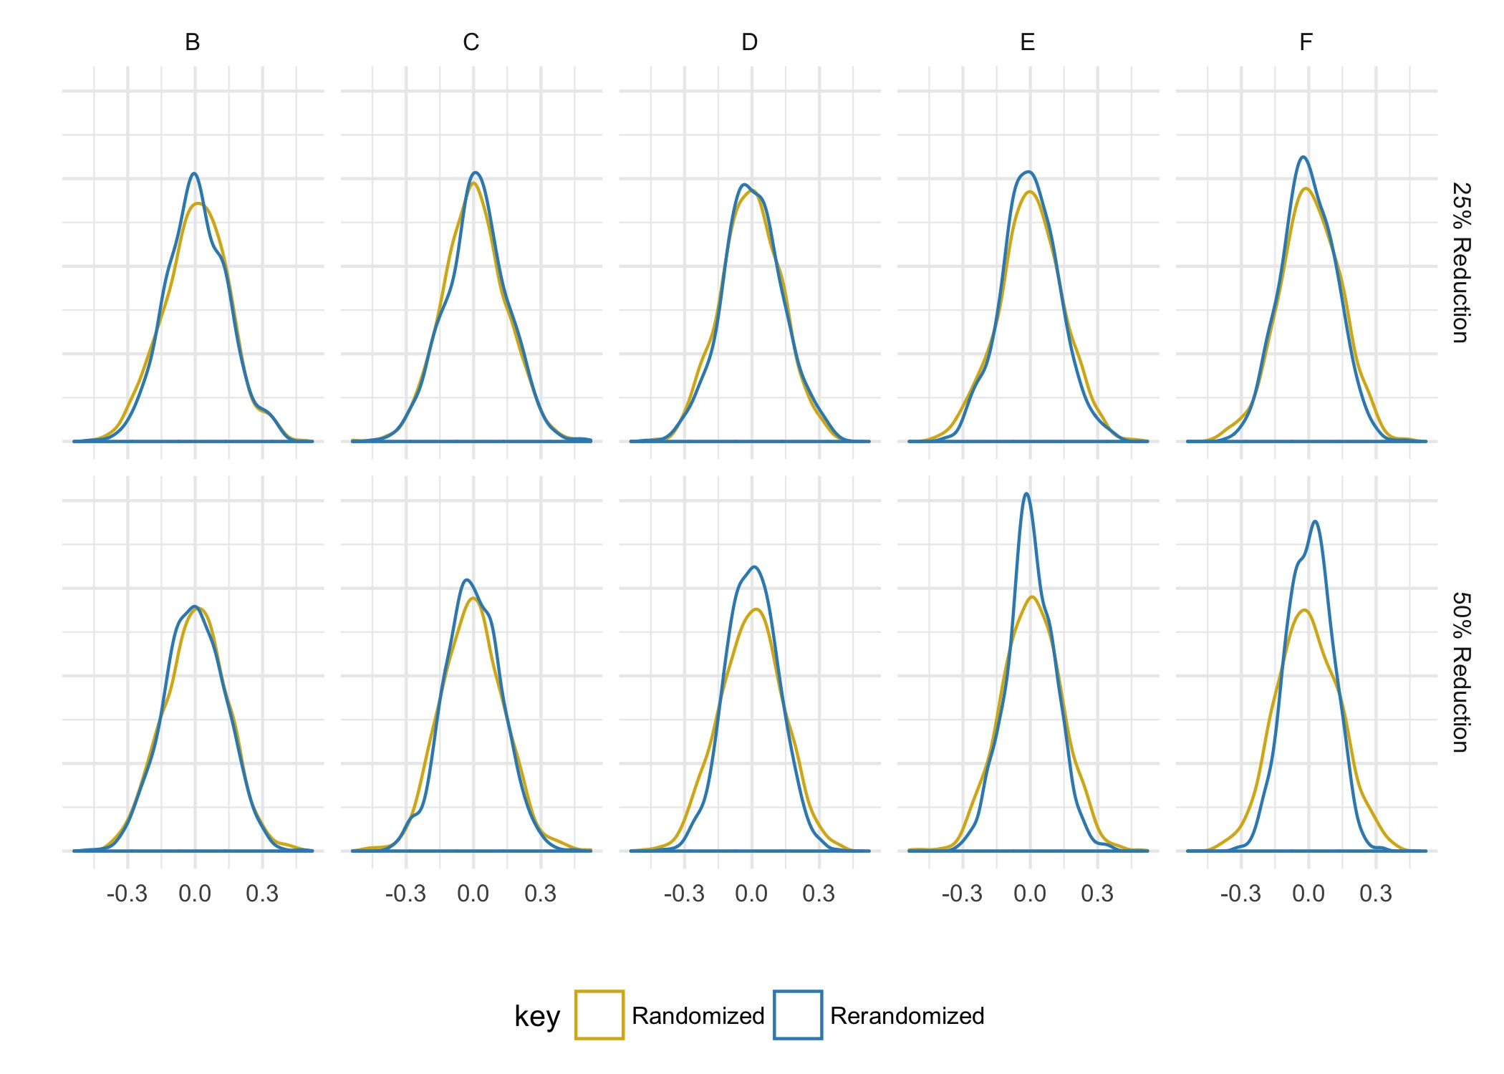
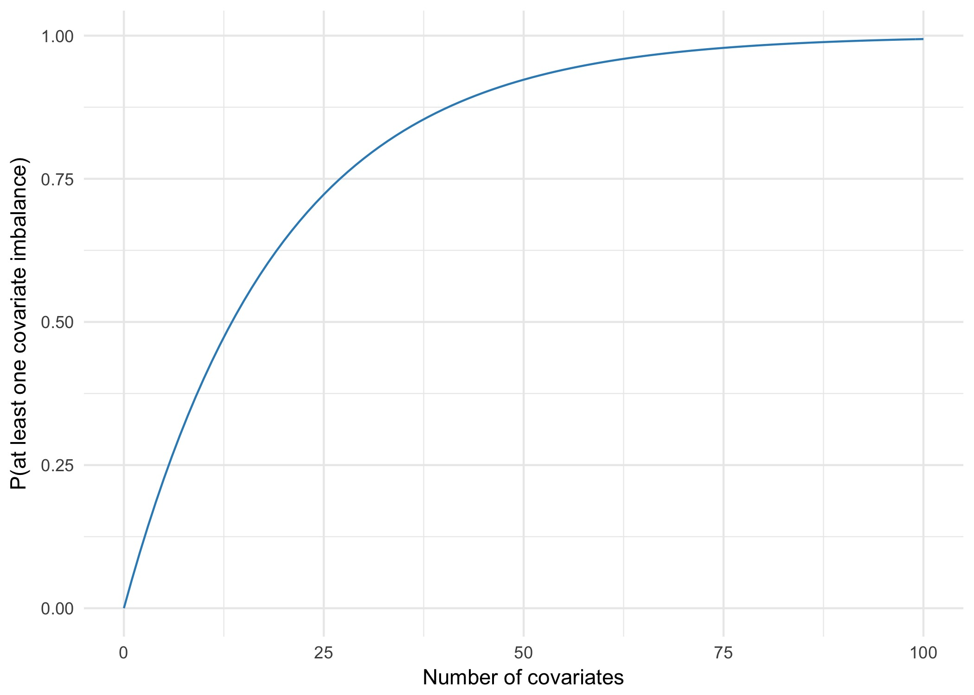
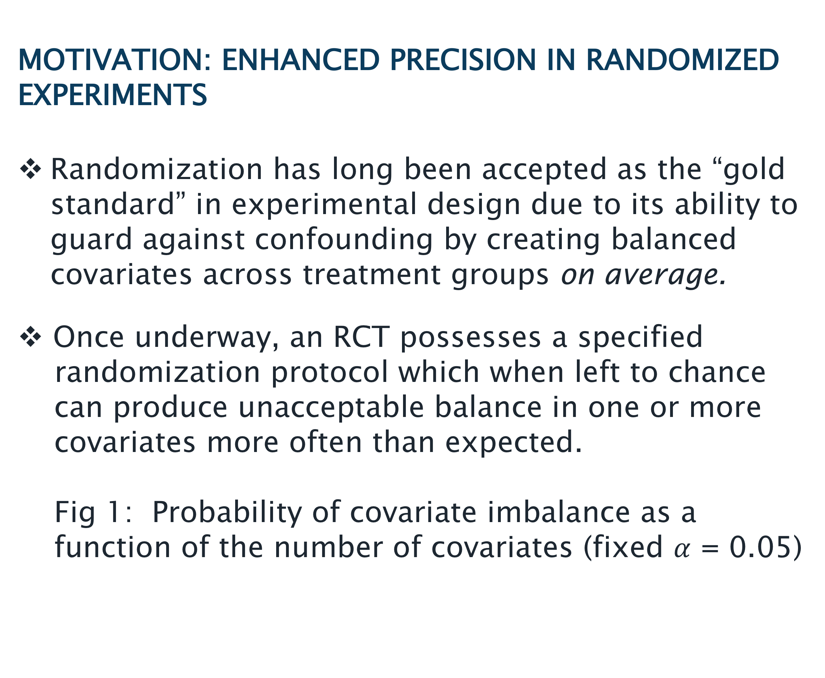
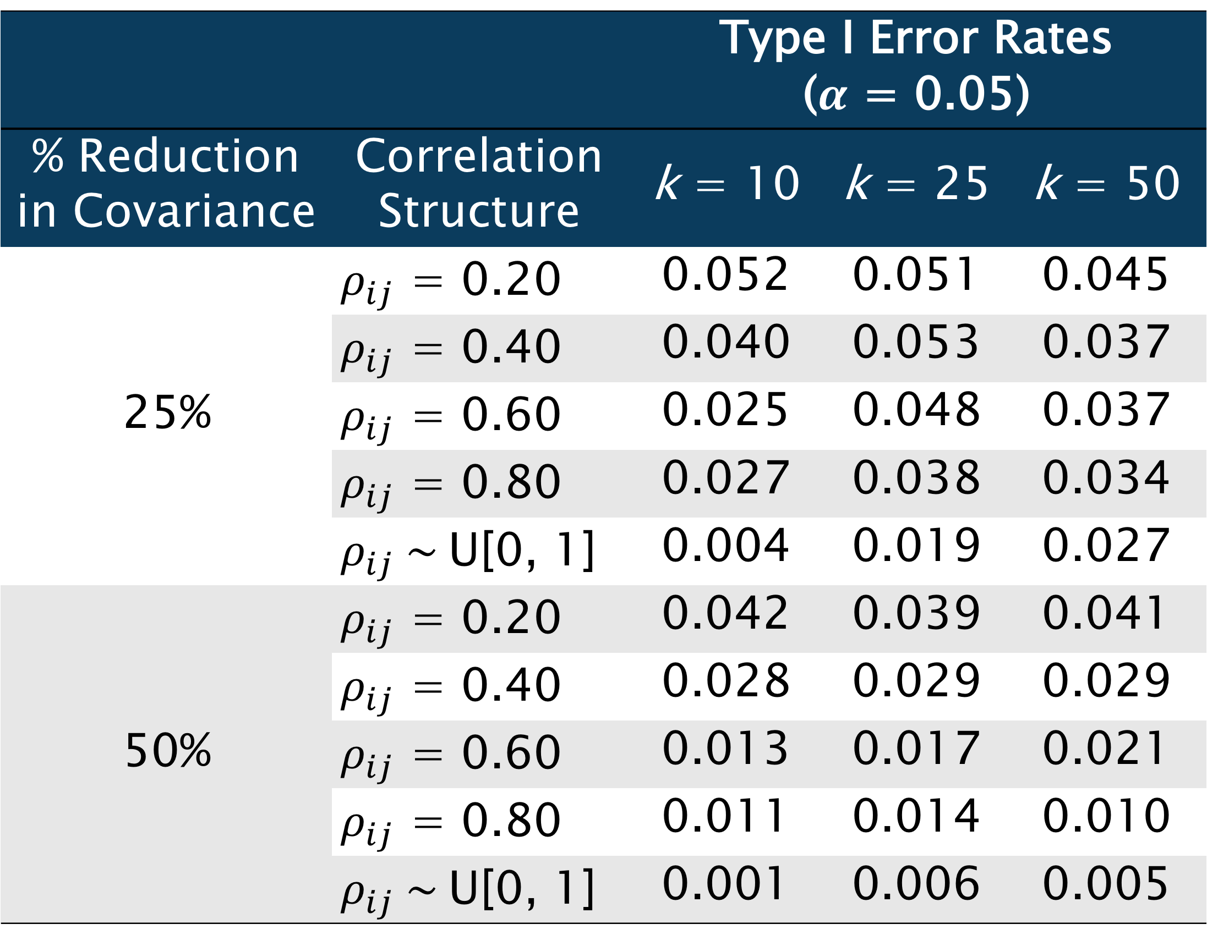
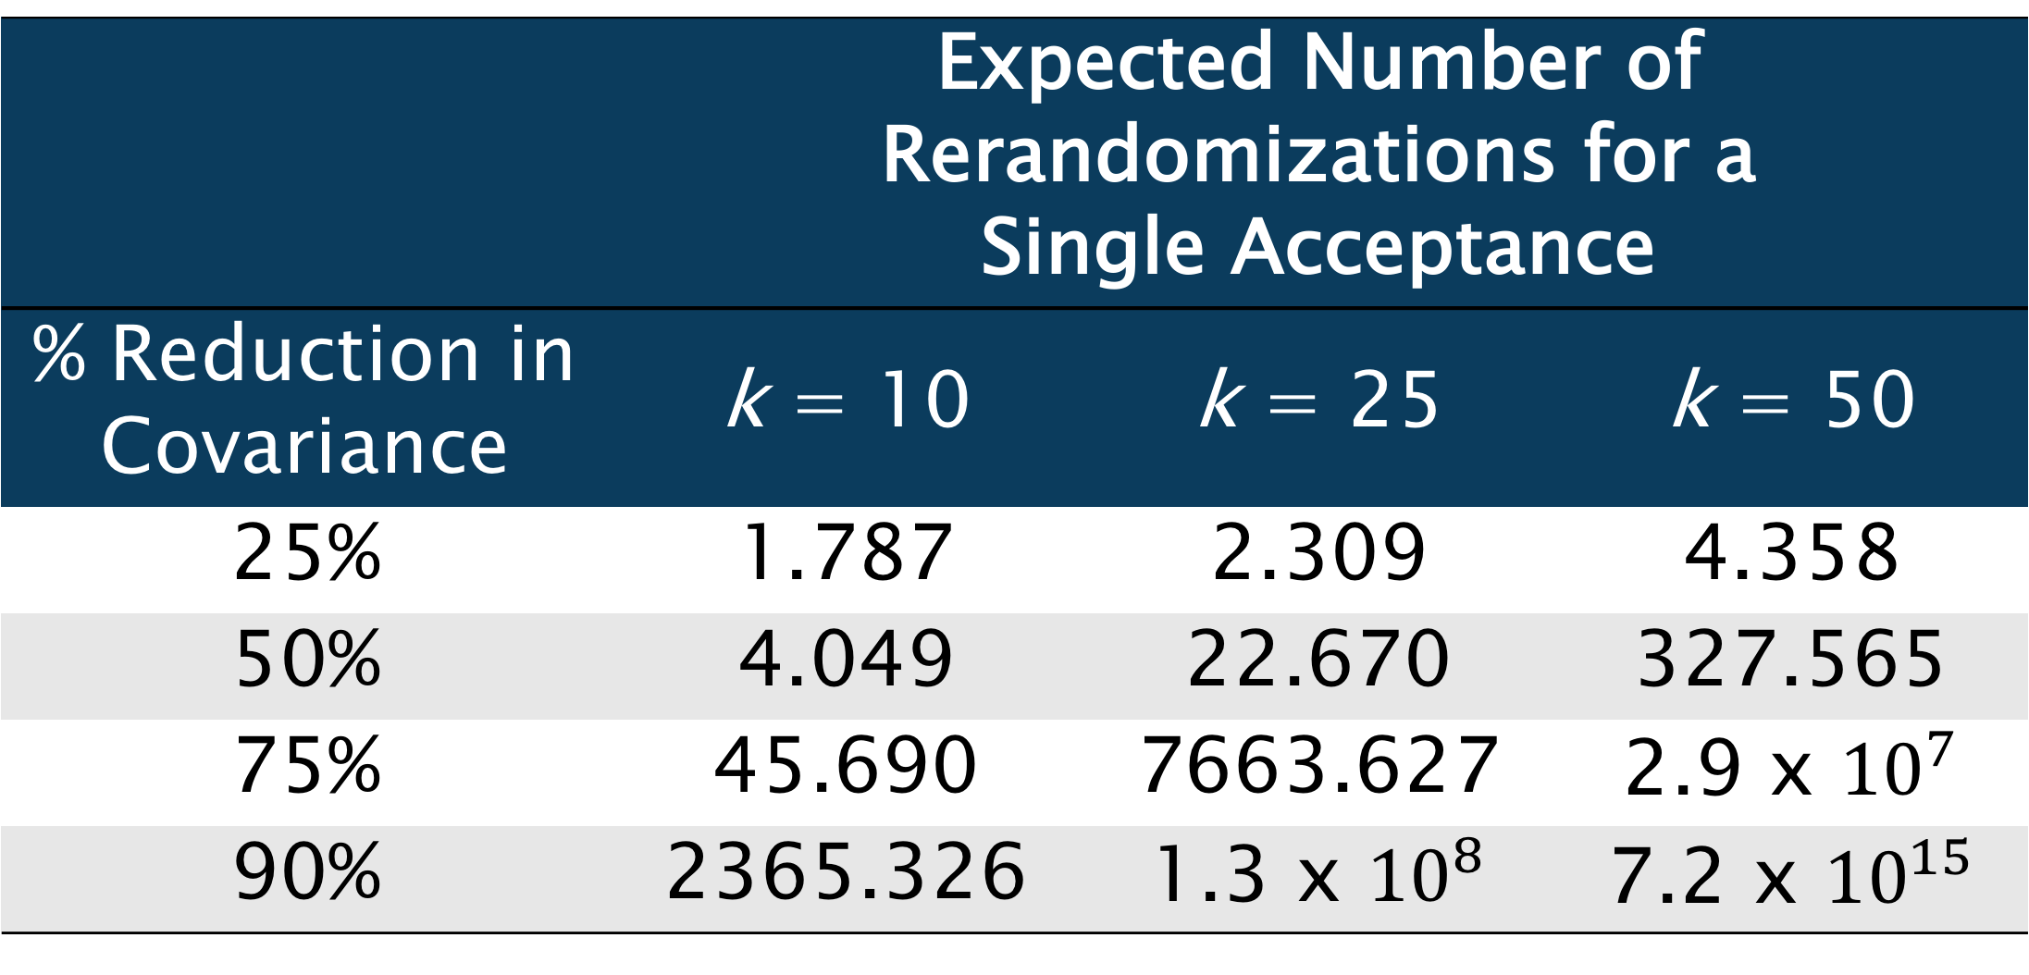
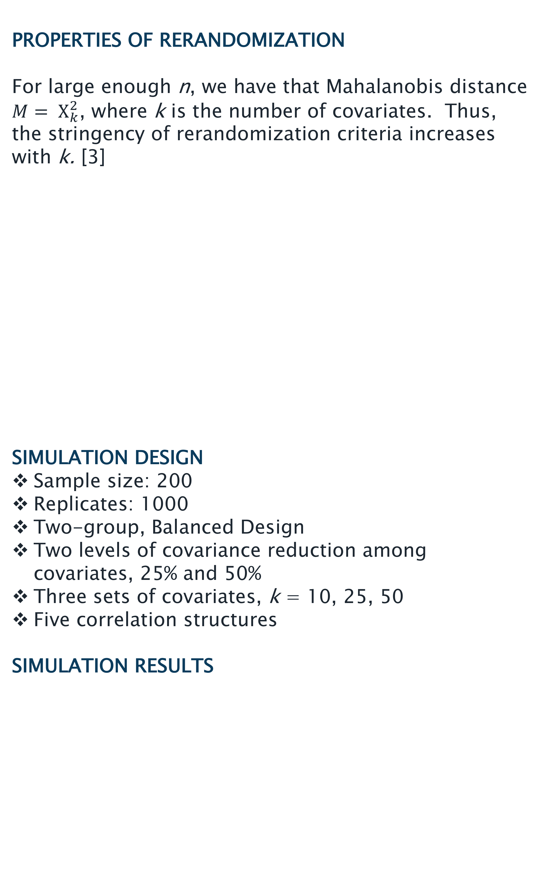
Understanding Rerandomization through Simulation
Crystal Shaw, M.S. & Thomas R. Belin, Ph.D.
UCLA Department of Biostatistics
Los Angeles, California, USA
MOTIVATION: ENHANCED PRECISION IN RANDOMIZED EXPERIMENTS
Randomization has long been accepted as the “gold standard” in experimental design due to its ability to guard against confounding by creating balanced covariates across treatment groups on average.
Once underway, an RCT possesses a specified
randomization protocol which when left to chance can produce unacceptable balance in one or more covariates more often than expected.
Fig 1: Probability of covariate imbalance as a function of the number of covariates (fixed $α$ = 0.05)
PROPERTIES OF RERANDOMIZATION
For large enough n, we have that Mahalanobis distance $M= Χ_{k}^{2}$, where k is the number of covariates. Thus, the stringency of rerandomization criteria increases with k. [3]
SIMULATION DESIGN
Sample size: 200
Replicates: 1000
Two-group, Balanced Design
Two levels of covariance reduction among covariates, 25% and 50%
Three sets of covariates, k = 10, 25, 50
Five correlation structures
SIMULATION RESULTS
RANDOMIZATION DISTRIBUTIONS OF TWO-SAMPLE T-TESTS FOR k = 25 COVARIATES
CONCLUSIONS
Sensitivity of t-tests increases with the degree of correlation among covariates and outcomes as well as the desired degree of balance among covariates. Simultaneously, t-tests become more robust to this effect as the number of covariates increases.
For a modest amount of correlation and conservative reduction in covariance, greater balance can be achieved with little impact on Type I error rates.
In these cases, we can reap the benefits of rerandomization, namely increased precision in estimated treatment effects, at a greatly reduced computational cost.
REFERENCES
[1] J.W. Tukey, “Tightening the clinical trial,” Controlled Clinical Trials, vol. 14, no. 4, pp. 266-285, Aug. 1993.
[2] T. Treasure and K.D. Macrae, “Minimisation: The Platinum Standard for Trials? Randomisation Doesn’t Guarantee Similarity of Groups; Minimisation Does,” Source BMJ: British Medical Journal, vol. 317, no. 7155, pp. 362-363, 1998.
[3] K.L. Morgan and D.B. Rubin, “Rerandomization to improve covariate balance in experiments,” Annals of Statistics, vol. 40, no. 2, pp. 1263-1282, 2012.
$ρ_{ij}$ = 0.20 | $ρ_{ij}$ = 0.40 | $ρ_{ij}$ = 0.60 | $ρ_{ij}$ = 0.80 | $ρ_{ij} \sim$ U[0, 1]
 | Expected Number of Rerandomizations for a Single Acceptance
% Reduction in Covariance | k = 10 | k = 25 | k = 50
25% | 1.787 | 2.309 | 4.358
50% | 4.049 | 22.670 | 327.565
75% | 45.690 | 7663.627 | 2.9 x ${10}^{7}$
90% | 2365.326 | 1.3 x ${10}^{8}$ | 7.2 x ${10}^{15}$
Rerandomization, dubbed the ”platinum standard” in experimental design [1][2] can ensure covariate balance and preserve the integrity of inferences.
In practice, the balance between design optimality and feasibility is crucial. The computationally intensive nature of rerandomization and subsequent analyses necessitates a deeper understanding of the relationship between the reduction in variance of both covariate mean differences and treatment effects, and the impact of this increased precision on the coverage probabilities of standard testing procedures.
The following simulation studies use Mahalanobis distance as the rerandomization criteria as this measure has the desirable property of preserving the correlational structure of covariates.
 |  | Type I Error Rates ($α$ = 0.05)
% Reduction in Covariance | Correlation Structure | k = 10 | k = 25 | k = 50
25% | $ρ_{ij}$ = 0.20 | 0.052 | 0.051 | 0.045
 | $ρ_{ij}$ = 0.40 | 0.040 | 0.053 | 0.037
 | $ρ_{ij}$ = 0.60 | 0.025 | 0.048 | 0.037
 | $ρ_{ij}$ = 0.80 | 0.027 | 0.038 | 0.034
 | $ρ_{ij} \sim$U[0, 1] | 0.004 | 0.019 | 0.027
50% | $ρ_{ij}$ = 0.20 | 0.042 | 0.039 | 0.041
 | $ρ_{ij}$ = 0.40 | 0.028 | 0.029 | 0.029
 | $ρ_{ij}$ = 0.60 | 0.013 | 0.017 | 0.021
 | $ρ_{ij}$ = 0.80 | 0.011 | 0.014 | 0.010
 | $ρ_{ij} \sim$U[0, 1] | 0.001 | 0.006 | 0.005
Notes:
Add line saying possible mechanism hypothesis

