Slide 1
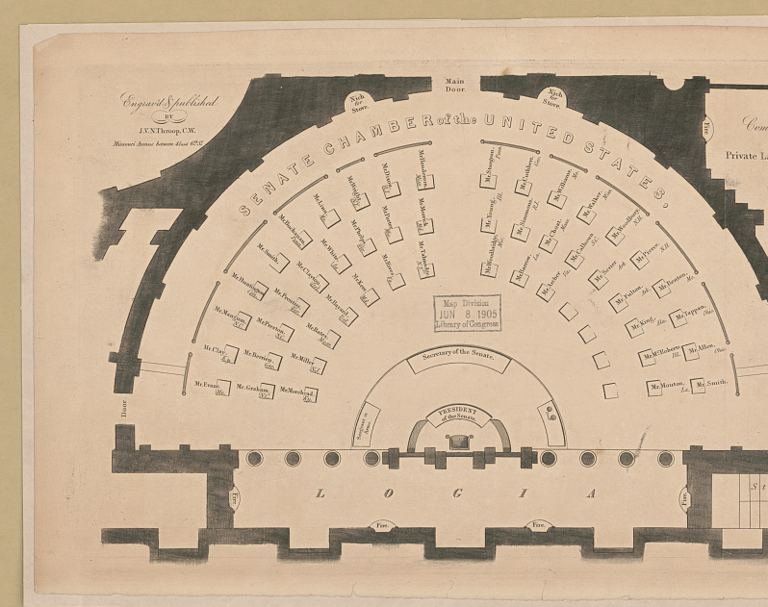

Crossing the Aisle:
An EDA on Congressional Bipartisanship
Github.com/CShawnKeech
LinkedIn.com/in/ChristopherShawnKeech
Notes:
My name is Shawn Keech. Today we’ll be looking at an important concern in American political life: bipartisanship.

Slide 2
Perceptions of Bipartisanship
Voters respond positively to appeals to bipartisanship
There is no standard definition of bipartisanship
Voters face difficulty when evaluating the merits of bipartisanship claims
Notes:
Research indicates that American voters respond positively to suggestions that certain policy positions enjoy bipartisan support. Research suggests that many less party-aligned voters will adjust their opinion of and willingness to support legislation if they are convinced that it has bipartisan support.
There is no standard definition of bipartisanship, and the legislative process is not well understood by many voters.
It’s difficult to fact check and weigh the merits of a politician’s assertions. It’s also difficult for a politician to counter spurious suggestions of bipartisanship with any currently accepted metric.

Slide 3
Bipartisanship Ratio (BPR)
Arriving at a functional metric
Roll-Call Vote (yea / nay)
51 / 49
40 / 60
60 / 40
Successful Vote
51 yea
60 nay
60 yea
Party Ratio
1 / 50
0 / 60
30 / 30
Bipartisanship Ratio (BPR)
0.02
0
1
Notes:
What we are striving towards is a measurement of balance.
- Measures passed with little support from one party will be lower, with purely partisan actions rating a zero.
Completely balanced measures, although rare, receive a 1. The more bipartisan the nature of vote, the closer the metric approaches one.
For the purposes of this ratio, I removed any third party from the vote.

Slide 4
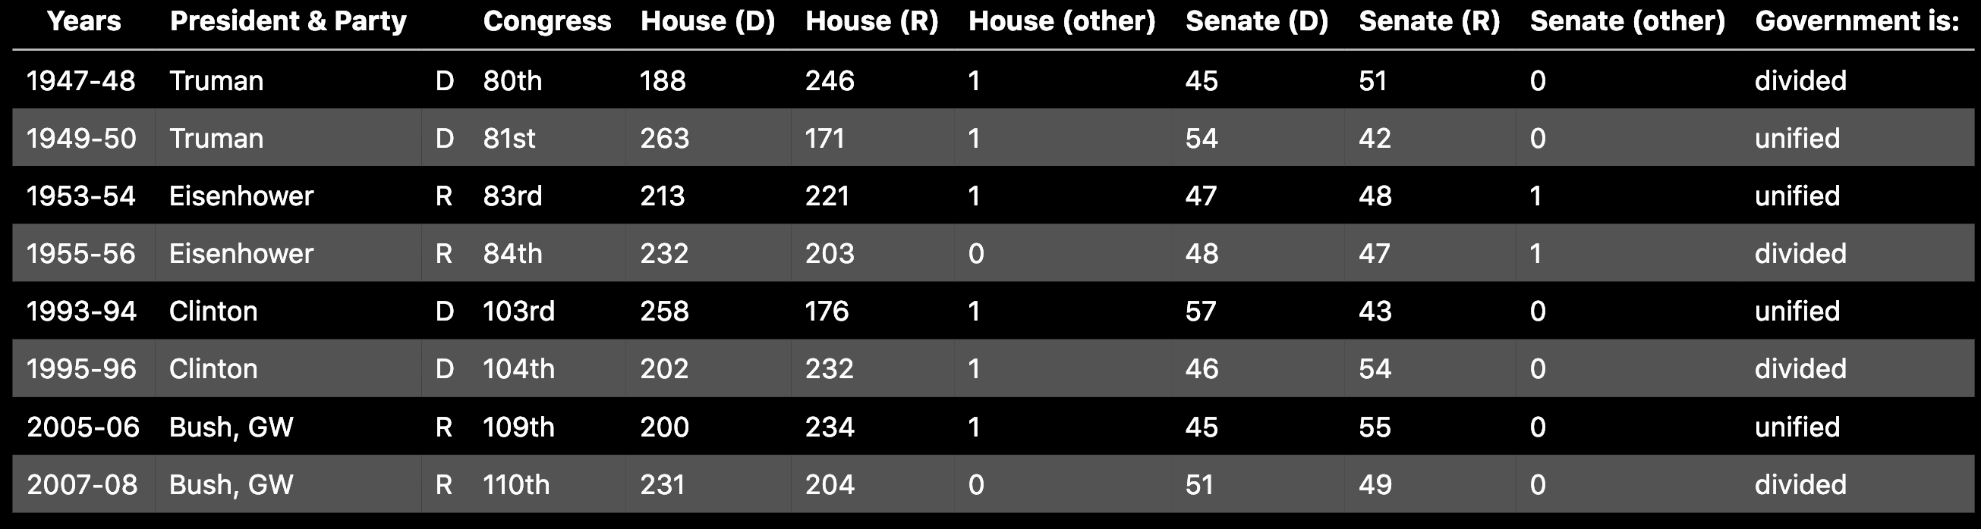
Hypothesis Testing: Four Administrations
Two Republican and Two Democratic Administrations
Two Mutually-Exclusive Scenarios:
Unified
Divided
Notes:
# Four Administrations: A Hypothesis Test
The composition of congress often changes during the course of a president's administration. This change provides an interesting opportunity: the ability to compare bipartisanship within an administration.
<advance>
Four presidencies in particular,
<advance>
a balance of two Republican and two Democratic,
two mid-century and two more modern
<advance>
presented two mutually-exclusive scenarios within their administrations:
<advance> A Unified scenario where the party holds both the executive and both legislative chambers
<advance> A Divided situation where one party holds the executive and the opposition holds the legislative branch

Slide 5

Hypothesis Testing: Central Question
Is there a significant difference in legislative bipartisanship during unified and divided governments?
$H_{0}: μ_{1}= μ_{2}\text{: } \text{There} \text{is} \text{no} \text{statistical} \text{difference} \text{in} \text{the} \text{means}$
$H_{a}: μ_{1}≠μ_{2 }\text{: }\text{There} \text{is} \text{a} \text{statistical} \text{difference} \text{in} \text{the} \text{means}$
$$α= 0.05$$
Hypothesis Testing: Methodology
Divide data into mutually exclusive categories:
  Four Divided Years and Four Unified Years
Calculate the BPR for each individual roll-call vote
Utilize Welch’s T test to check for significance
Notes:
# Four Administrations: A Hypothesis Test
Our Central Question:
Is there a significant difference in legislative bipartisanship during unified and divided governments?
Sample data will be divided into mutually exclusive categories: four Unified years and four Divided years.
Calculate the Bipartisanship Ratio for each individual roll-call vote from both chambers during those years
- Welch's T test will be employed on the data to determine statistical difference
- Welch's accommodates for possible differences in variance
- Sample sizes are large enough to accommodate possible non-normal distribution

Slide 6
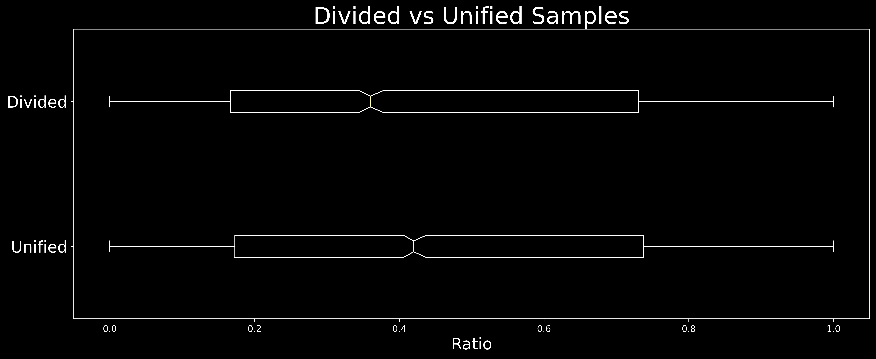

Hypothesis Testing:
Welch’s T Test Results: Welch's T test returned a p value of $7.04 × {10}^{−6}$, well within our 𝛼=0.05.
Bootstrapping would help confirm the results
Notes:
Initial box plots of the two groups indicate differences in mean.
Welch’s T Test returned a p value of 7.04 times ten to the negative sixth, a value well within our pre-chosen alpha of 0.05.
Bootstrapping samples from each distribution would help confirm and illustrate the results.

Slide 7
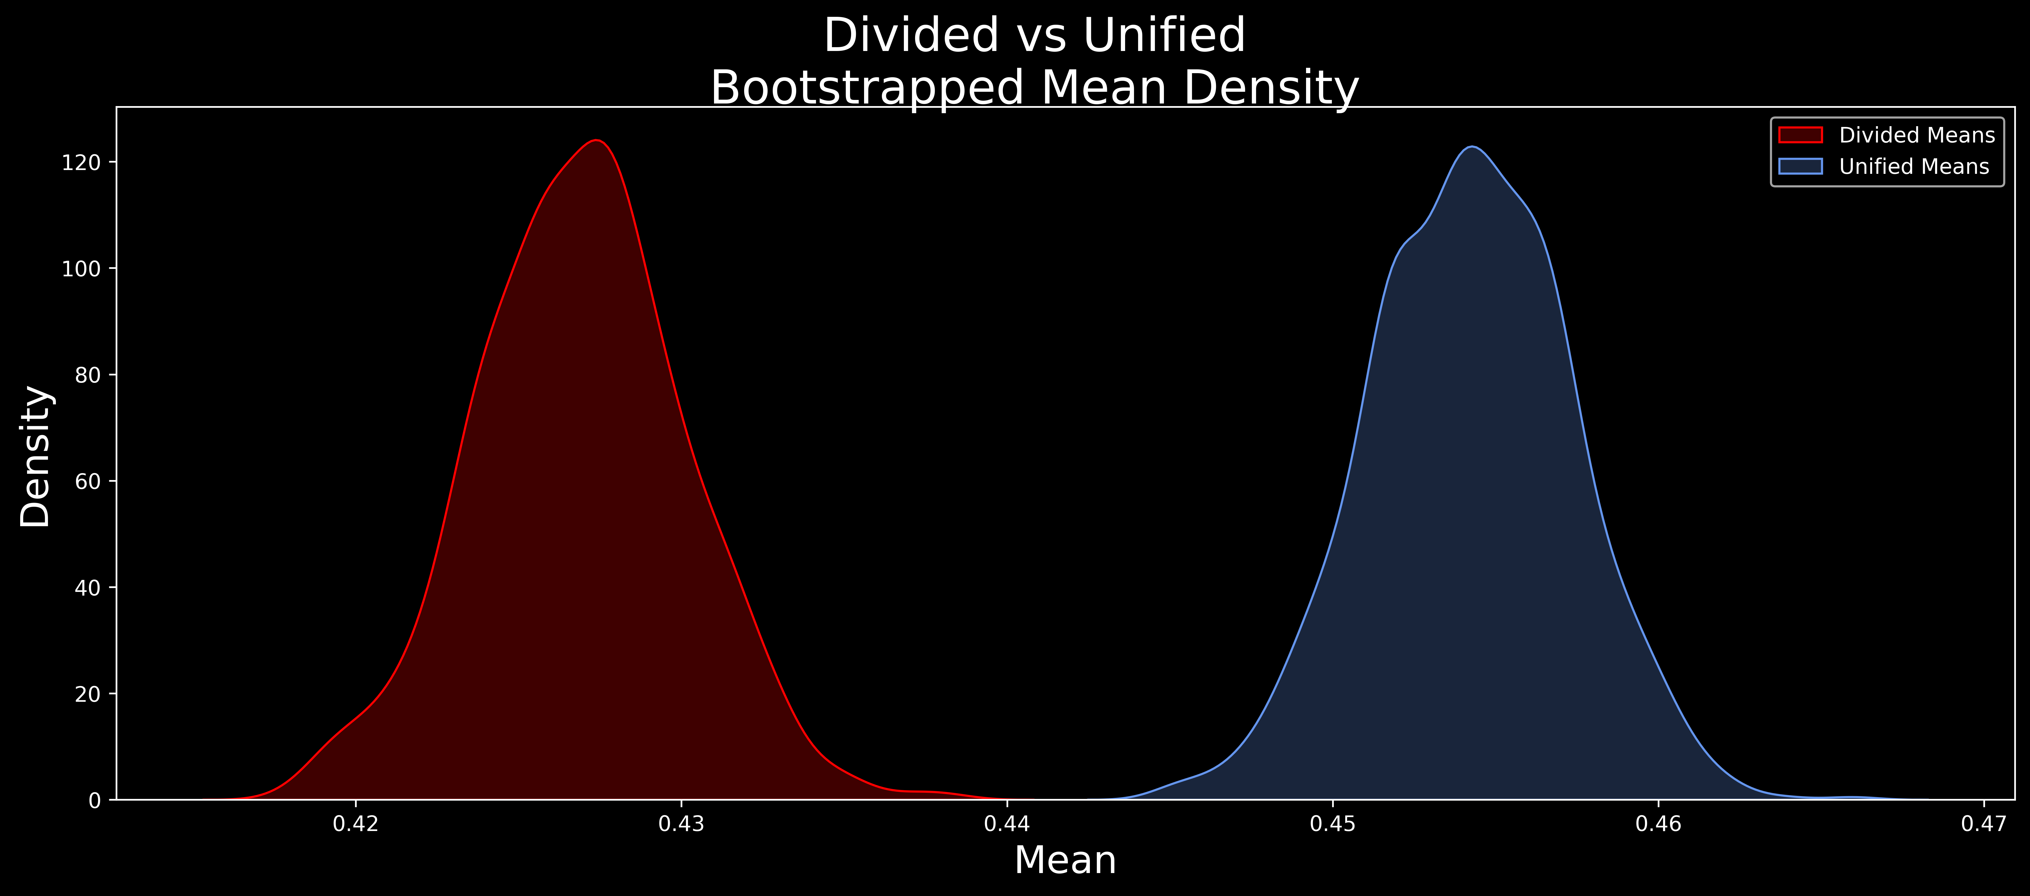
Hypothesis Testing: Confirmation & Conclusion
Reject the null hypothesis, as the results are statistically significant
Divided margin of error: 0.0064 Unified margin of error: 0.0062
Notes:
The bootstrapping results really illustrate the significance of the mean differences between the two distributions. There’s hardly any notable overlap at all.
Given these results, we are able to reject the null hypothesis.
# We are 95% confident that the population mean lies within this margin of error.
# More specifically if we were to take many samples, then 95% percent of the time the
# the population mean would lie in this margin of error.
Divided Margin of Error: 0.006423912039799648
Unified Margin of Error: 0.0061711078795822355

Slide 8
Sources & References
Primary Data Source:
  Lewis, Jeffrey B., Keith Poole, Howard Rosenthal, Adam Boche, Aaron Rudkin, and Luke Sonnet (2020). Voteview: Congressional Roll-Call Votes Database. https://voteview.com/
Senate Chamber Diagram:
  https://www.loc.gov/resource/pga.12973/
Party Control of Presidency and Congress
  https://en.wikipedia.org/wiki/Divided_government_in_the_United_States
linkedin.com/in/christophershawnkeech
github.com/cshawnkeech

