Slide 1
Rolling Intrinsic ID paper summary
C.Shen 2025-8

Slide 2
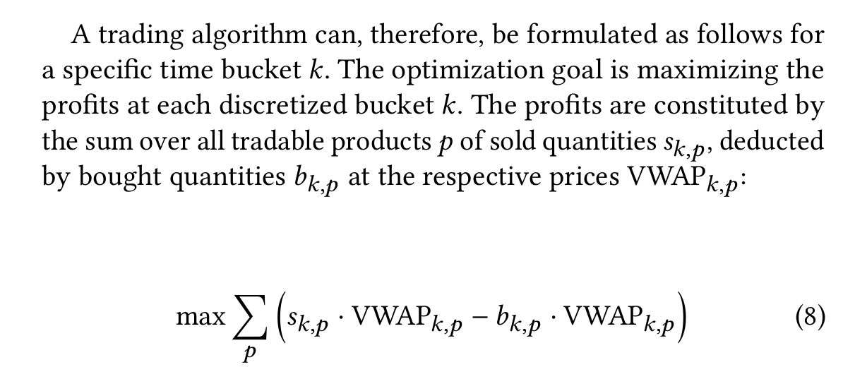
An Algorithm for Modelling Rolling Intrinsic Battery Trading on the Continuous Intraday Market
https://energy.acm.org/eir/an-algorithm-for-modelling-rolling-intrinsic-battery-trading-on-the-continuous-intraday-market/
Step-wise optimization for ID market
In each step, trying to maximize PnL from buying and selling from different contracts that are available during the time bucket

Slide 3
Pros
Include max cycle count per day
Possible to add discount (battery time value) to the far-away trades
Includes RTE for SOC and split per charge/discharge
Use optimizers to arrange the tradings
Implemented with database

Slide 4
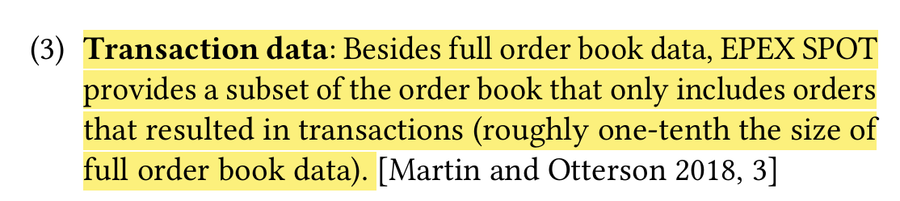
Cons
Not using full limit order book. But use transaction book which is a subset
Pro: smaller data set
Con:
Not always tradable as the transaction may be taken by existing orders that are in the market
Not guarantee enough volume to trade (may be ok if the battery is small)
May miss some tradable market orders when they were not executed in historical data

Slide 5
Cons
Trade in buckets with foresight data and use weighted average price
The algo design use bucket (default value is 15min) to group enough orders and trade them at beginning of each bucket.
Because of the grouping, the algo is forced to use weighted average price in the bucket period
When the bucket is small enough, it may behave like Algo2 in real-world trading

Slide 6
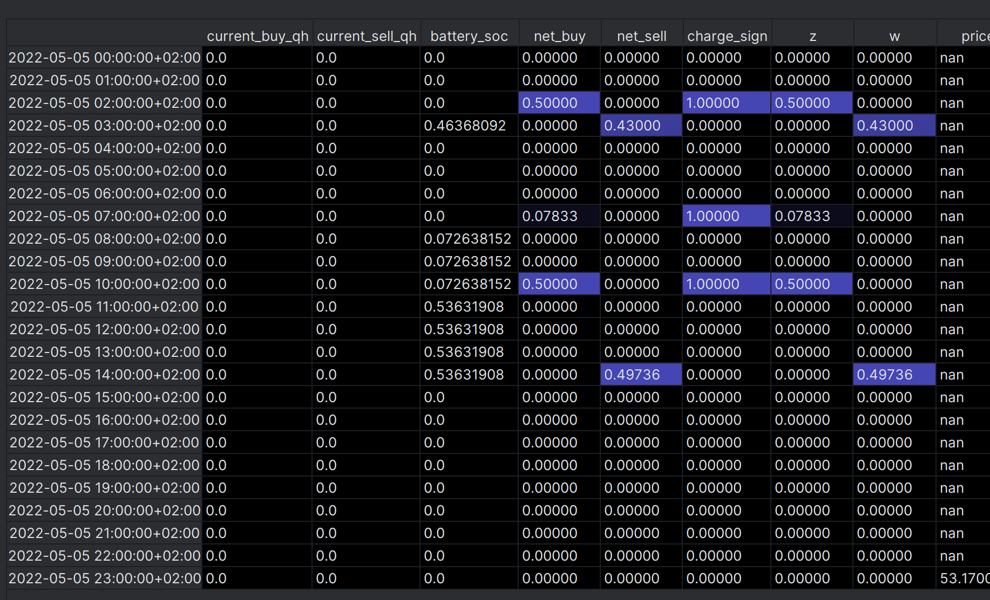
Cons
RTE not included in PnL but only included in SOC
It fine if the SOC of each hour (or QH or HR) eventually come to 0 at the end of day.
But in reality, there are imbalances left. These may face the RTE loss

Slide 7
Cons
No over-sell may potentially loss some trading opportunities
No over-sell policy is implied in implementation of SOC in solver parameters
Means for same contract (hour), always charge first, then discharge
Means good selling opportunities may be lost for the beginning a few hours of a trading day

Slide 8
Implementation
run_optimization_quarterhours_repositioning() is the core algo function
Init condition:
Initial SOC is 0
RTE is square rooted for charge and discharge sparetely
Obj func:
Sum(Sell_price[i] – buy_price[i] – e, for each i in the contracts)
With slightly adjusted obj function for the cases when prev_net_charge/discharge is 0 (introduce extra threshold+e to the buy/sell spread)
Boundaries:
SOC within [0,1]
Net_buy or net_sell in an hour cannot be more than cap*c_rate, which is the power limit of the battery (in MW)
Cannot exceed total cycle count for each day (use net_buy as obj func will tend to sell the positions at the end of same day)

Slide 9
Hidden boundaries:
Current_buy_qh for PnL is always linked to Net_buy in the same period
Current_buy_qh and current_sell_qh will not be non-zero at same time due to the ‘e’ in obj function
net_buy and net_sell has constraint via ‘w’ and ‘z’, cannot be non-zero at same time
Via the constraint of ‘w-z’ , current_buy_qh and current_sell_qh are linked with net_buy and net_sell. Eventually current_buy_qh is equal to Net_buy or equal to Net_buy+prev_sell and current_sell_qh is equal to net_sell or equal to net_sell +prev_buy
Always charge first, then discharge in the same day
SOC has a lower bound of 0 means no over-discharge
This means selecting the start time of the trading day is crucial
In the same day, later SOCs will tends to be 0
The obj function encourage selling existing positions
The SOC limit forbids over-sell
There’s a ‘battery balance’ constraint passes SOC from earlier period (in the day) to later period, but not reversed order
So the SOC will tend to remain 0 at the end of day unless there’s a good buying opportunity but in later period it will be sold.
For the same contract, SOC do NOT tend to recover to 0
So may have RTE issues.

