Slide 1

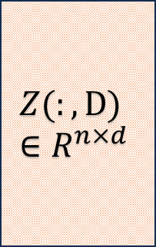
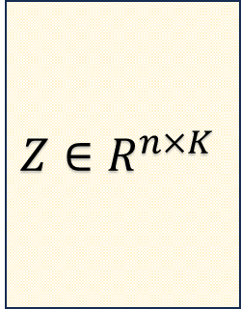

$$A∈R^{n×n}$$
$$Z∈R^{n×K}$$
$$Z(:,D)∈R^{n×d}$$
sufficient embedding
sufficient embedding
GEE
Principal GEE
$$Y$$
Unbiased & Normalized
Importance Score

