Slide 1
Neighborhoods clustering in Sutton
Group the different neighborhoods in Sutton, using both their geographical information, and also venue categories within the areas.
Dataset Used
Ordnance Survey Data – geographical information
Foursquare API – Venue Categories

Slide 2
Methodology
Exploratory Analysis
Factor Analysis – combining similar categories into one
One Hot Encoding – transforming categorical variables to numeric
Standardization – making sure all variables are of comparable scale
Machine Learning
K Means – clustering neighborhood by minimizing distances within clusters and maximize distance between clusters

Slide 3
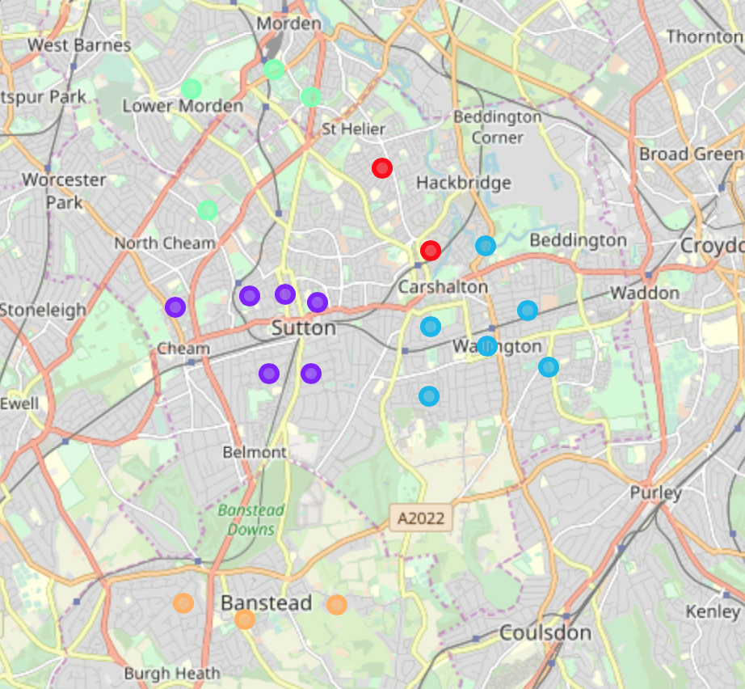
Results
The clusters indeed do make sense geographically, and nicely align with the towns in real-life!

