Slide 1
Neighborhoods clustering in Sutton
Group the different neighborhoods in Sutton, using both their geographical information, and also venue categories within the areas.
This will be useful to local governments and business to understand catchment areas, as well as planning new store locations.
Dataset Used
Ordnance Survey Data – geographical information
Foursquare API – Venue Categories

Slide 2
Methodology
Exploratory Analysis
Factor Analysis – combining similar categories into one
One Hot Encoding – transforming categorical variables to numeric
Standardization – making sure all variables are of comparable scale
Machine Learning
K Means – clustering neighborhood by minimizing distances within clusters and maximize distance between clusters

Slide 3
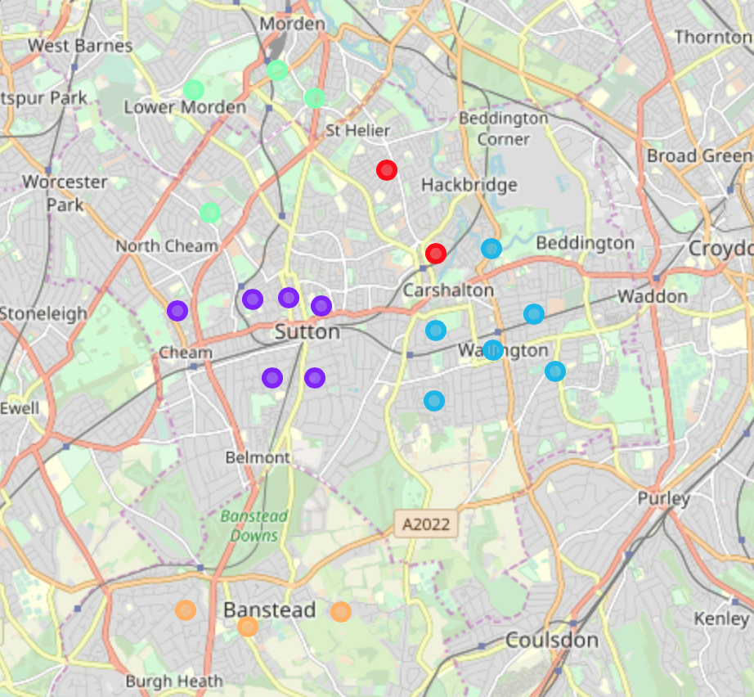
Results
The clusters indeed do make sense geographically, and nicely align with the towns in real-life!

