Slide 1
Big Data For Health Final Presentation
Team A1
Jorge Mateo Jara Fabian and Cole Sheridan
GitHub: https://github.com/csheridan30/CSE6250_TeamA1_Spring2025_Project
Video: https://youtu.be/UembQgz2m1Y
Notes:
Please find Video presentation at

Slide 2
Our Paper
Dynamic Survival Transformers for Causal Inference
with Electronic Health Records
Prayag Chatha, Yixin Wang, Zhenke Wu, Jeffrey Regier
Link to Paper: https://openreview.net/forum?id=6quJeu5gJ7
Codebase: https://github.com/prob-ml/DynST?utm_source=chatgpt.com

Slide 3
The Goals
Simulate outcome of treatment on patient’s survival time.
Train dynamic survival transformer to determine hazard function (probability of failure) for patients at each hour.
Calculate Restricted Mean Survival Time for patients.
Calculate Average Treatment Effect (ATE) on entire dataset.

Slide 4
Dataset
The data for this project comes from MIMIC-III and was gathered using MIMIC Extract under the default parameters.
MIMIC Extract: https://github.com/MLforHealth/MIMIC_Extract
This data is also provided via a google bucket: https://console.cloud.google.com/storage/browser/mimic_extract
Data is restricted to patients who have stays between 15 and 127 hours.
All continuous variables are centered to mean 0, std 1.

Slide 5
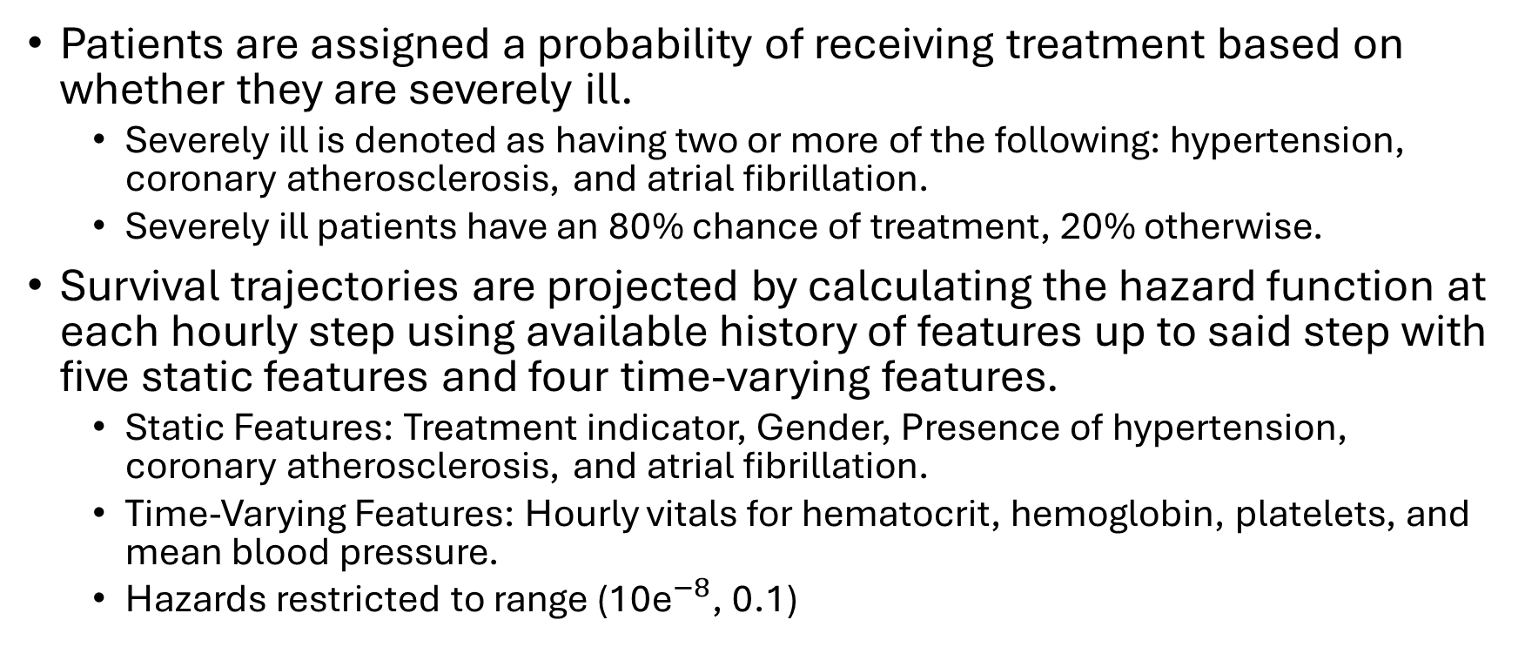
Methods
Patients are assigned a probability of receiving treatment based on whether they are severely ill.
Severely ill is denoted as having two or more of the following: hypertension, coronary atherosclerosis, and atrial fibrillation.
Severely ill patients have an 80% chance of treatment, 20% otherwise.
Survival trajectories are projected by calculating the hazard function at each hourly step using available history of features up to said step with five static features and four time-varying features.
Static Features: Treatment indicator, Gender, Presence of hypertension, coronary atherosclerosis, and atrial fibrillation.
Time-Varying Features: Hourly vitals for hematocrit, hemoglobin, platelets, and mean blood pressure.
Hazards restricted to range (${\text{10}\text{e}}^{−8}$, 0.1)

Slide 6
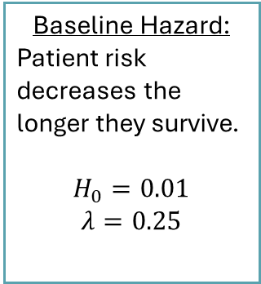
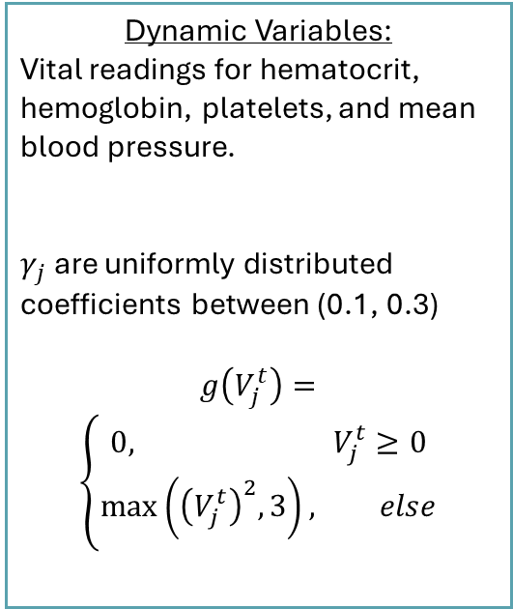
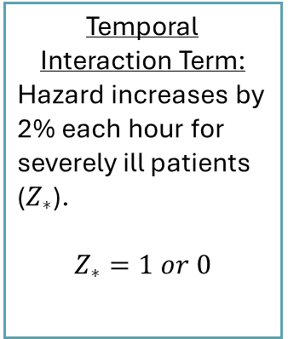
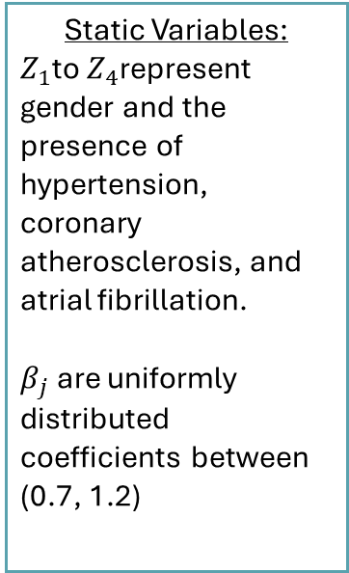
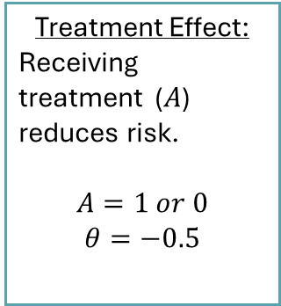
The Hazard Function
$$\text{h}\text{(}\text{t}\text{) = }{\text{H}}_{0} {\text{e}}^{\left(\text{−}\text{λ}\text{t}\right)}\text{· }{\text{e}}^{\left(\text{θ}\text{A}\right)}\text{· }{\text{e}}^{\text{(}\sum_{j=1}^{4}{{\text{β}}_{j}{\text{Z}}_{j}}\text{ )}}\text{·}e^{\left(\text{log}\text{(1.02)}\text{t}{\text{Z}}_{∗}\right)} \text{· }e^{\left(\sum_{j=1}^{4}{γ_{j}g\left(V_{j}^{t}\right)}\right)}$$
Baseline Hazard:
Patient risk decreases the longer they survive.
$$H_{0}=0.01$$
$$λ=0.25$$
Treatment Effect:
Receiving treatment ($A$) reduces risk.
$$A=1 or 0$$
$$θ=−0.5$$
Static Variables:
$Z_{1}$to $Z_{4}$represent gender and the presence of hypertension, coronary atherosclerosis, and atrial fibrillation.
$β_{j}$ are uniformly distributed coefficients between (0.7, 1.2)
Temporal Interaction Term:
Hazard increases by 2% each hour for severely ill patients ($Z_{∗}$).
$$Z_{∗}=1 or 0$$
Dynamic Variables:
Vital readings for hematocrit, hemoglobin, platelets, and mean blood pressure.
$γ_{j}$ are uniformly distributed coefficients between (0.1, 0.3)
$$g\left(V_{j}^{t}\right)=$$
$$\left\{\begin{aligned}0, V_{j}^{t}≥0 \\ &\max\left({\left(V_{j}^{t}\right)}^{2},3\right), else\end{aligned}\right.$$

Slide 7
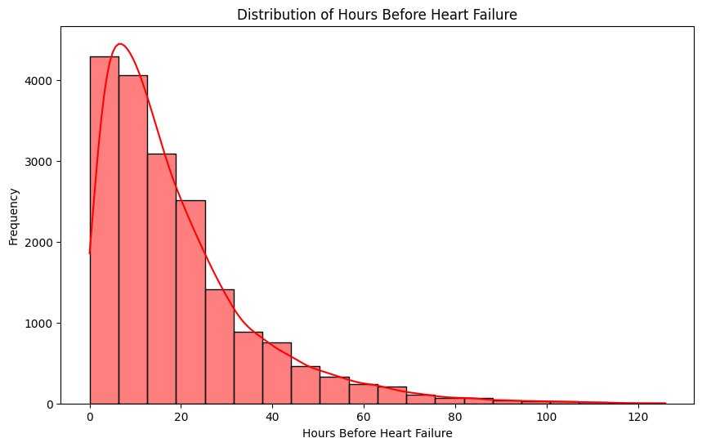
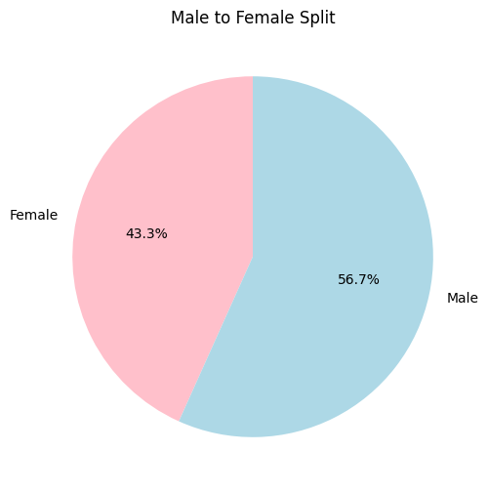
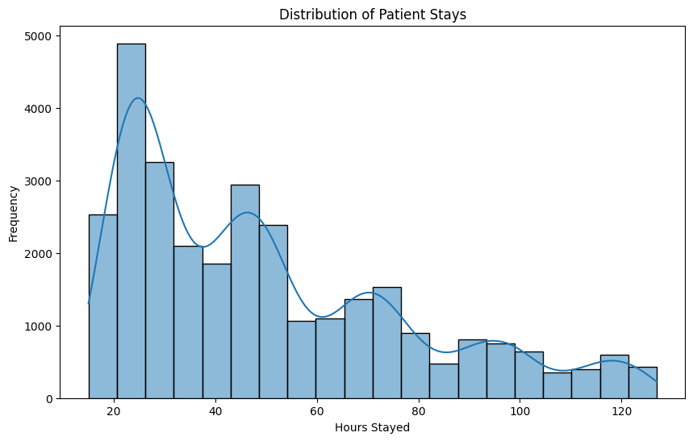
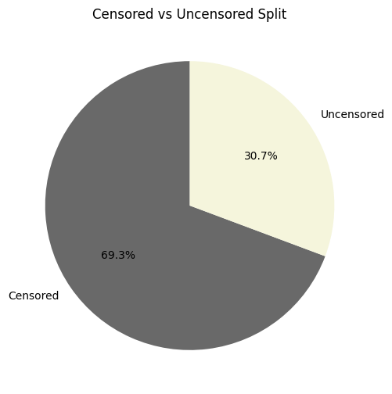
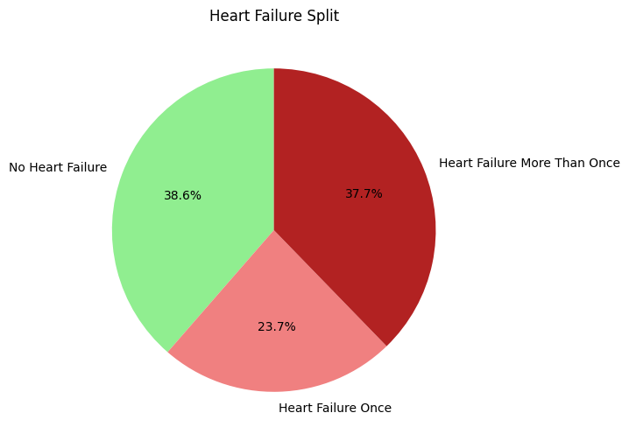
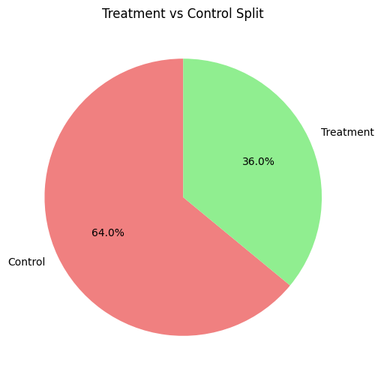




Patient Demographics
Population
Avg Time before 1st failure: 19 hours, 0 min, 36 sec
Min hours before 1st failure: 0 hours, Num min: 213
Max hours before 1st failure: 126 hours, Num max: 1
Time
Treatment
Heart Failure
Num without heart failure: 11,706
Num with one heart failure: 7,173
Num with multiple heart failures: 11,444
Average Age: 75
Num Treated: 10,909
Num Untreated: 19,414
Average length of stay: 50 hours, 4 minutes, 12 seconds
Num patients with min stay (15 hours): 231
Num patients with max stay (127 hours): 51
Num censored patients: 9,310
Num uncensored patients: 21,013
Num Male: 13,123
Num Female: 17,000

Slide 8
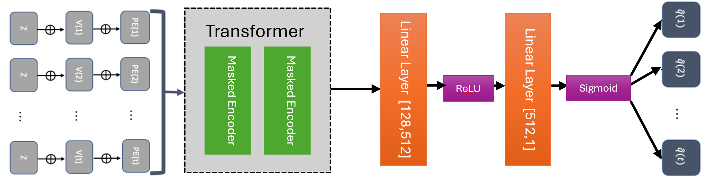
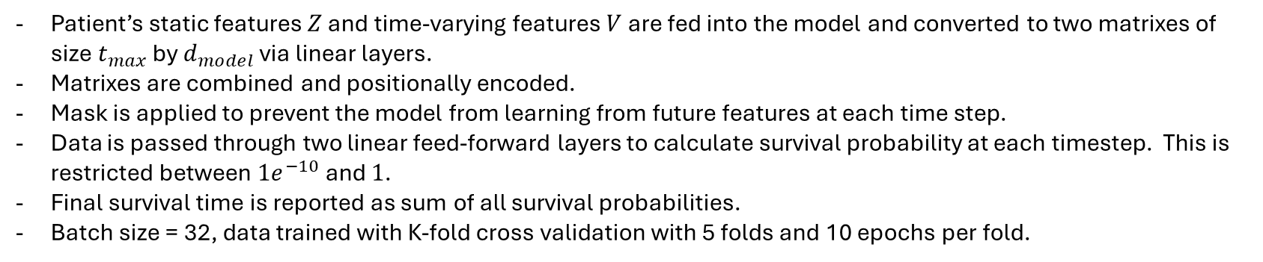
Model
Patient’s static features $Z$ and time-varying features $V$ are fed into the model and converted to two matrixes of size $t_{max}$ by $d_{model}$ via linear layers.
Matrixes are combined and positionally encoded.
Mask is applied to prevent the model from learning from future features at each time step.
Data is passed through two linear feed-forward layers to calculate survival probability at each timestep. This is restricted between $1e^{−10}$and $1$.
Final survival time is reported as sum of all survival probabilities.
Batch size = 32, data trained with K-fold cross validation with 5 folds and 10 epochs per fold.

Slide 9
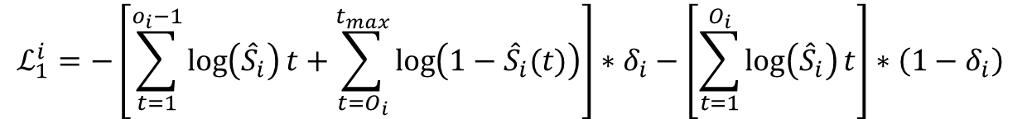
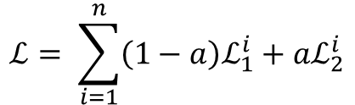
Loss Function ( Modified Cross-Entropy Loss)
$$ℒ= \sum_{i=1}^{n}{\left(1−a\right)ℒ_{1}^{i}}+aℒ_{2}^{i}$$
With:
$$ℒ_{1}^{i}=−\left[\sum_{t=1}^{o_{i}−1}{\log\left({\hat{S}}_{i}\right)t}+\sum_{t=O_{i}}^{t_{max}}{\log\left(1−{\hat{S}}_{i}(t)\right)}\right]∗δ_{i}−\left[\sum_{t=1}^{O_{i}}{\log\left({\hat{S}}_{i}\right)t}\right]∗\left(1−δ_{i}\right)$$
$$ℒ_{2}^{i}=\left|O_{i}−{\hat{T}}_{i}\right|∗δ_{i}+\max\left(0,O_{i}−{\hat{T}}_{i}\right)∗\left(1−δ_{i}\right)$$
Where $δ_{i}$ = 0 for censored patients, 1 otherwise, and ${\hat{S}}_{i}$ is estimated survival probability

Slide 10
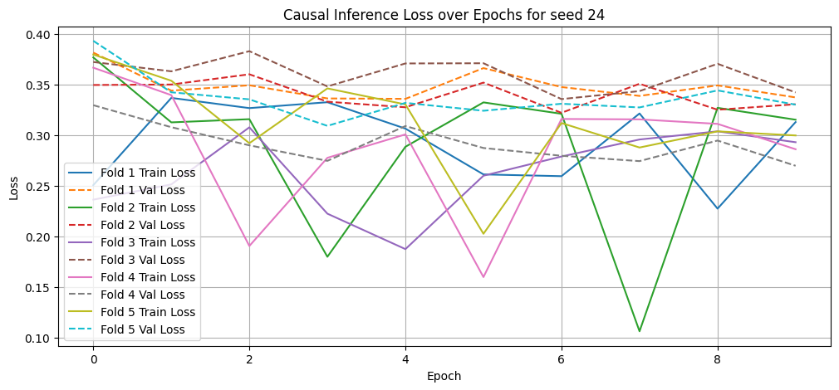
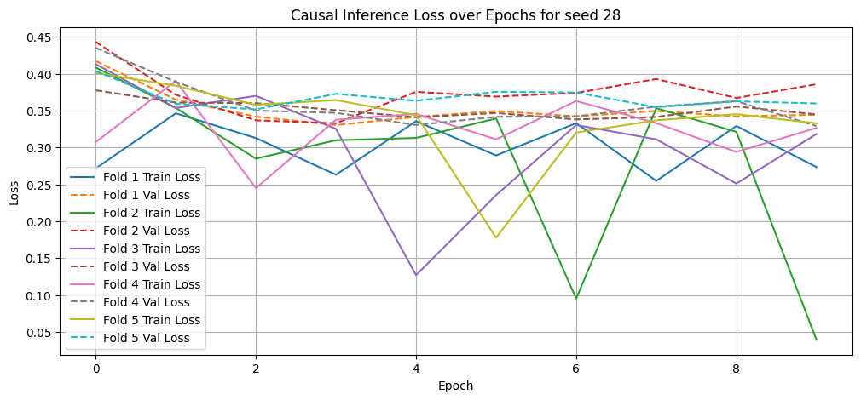
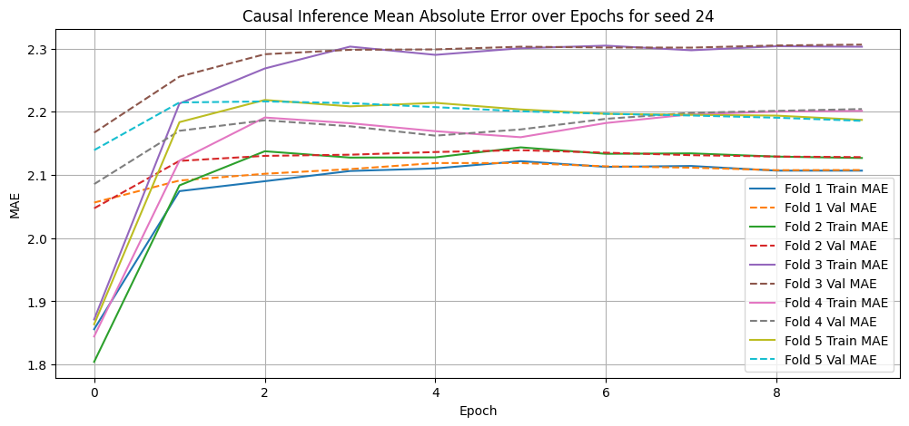
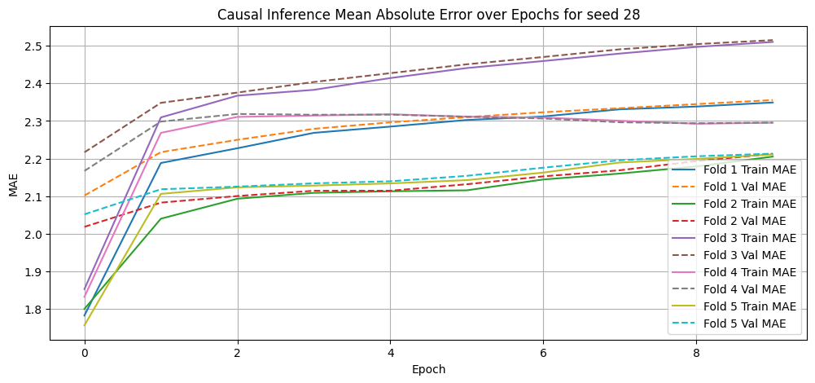
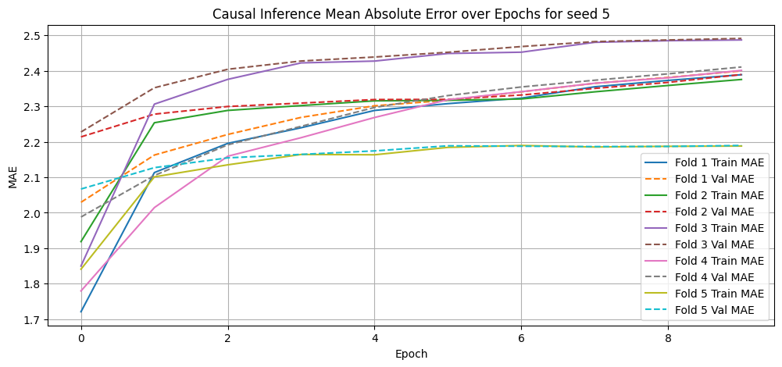
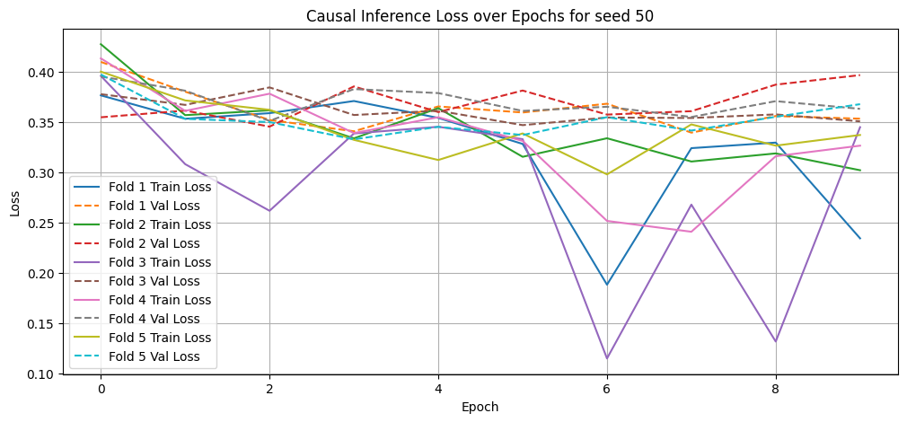
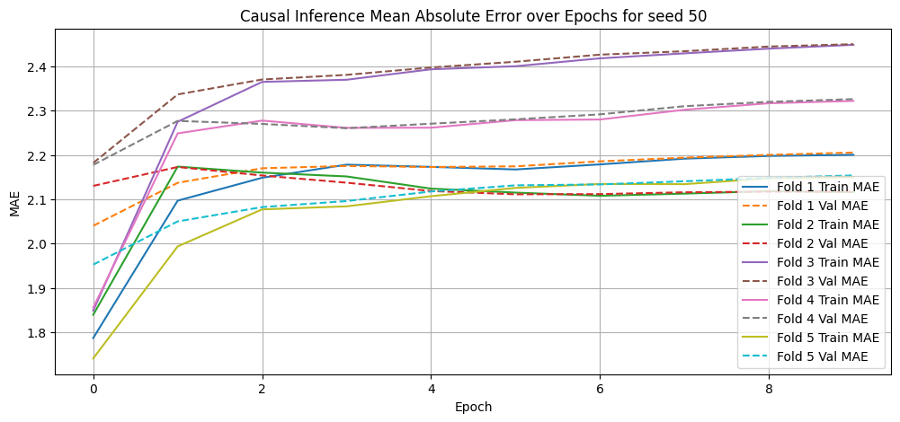
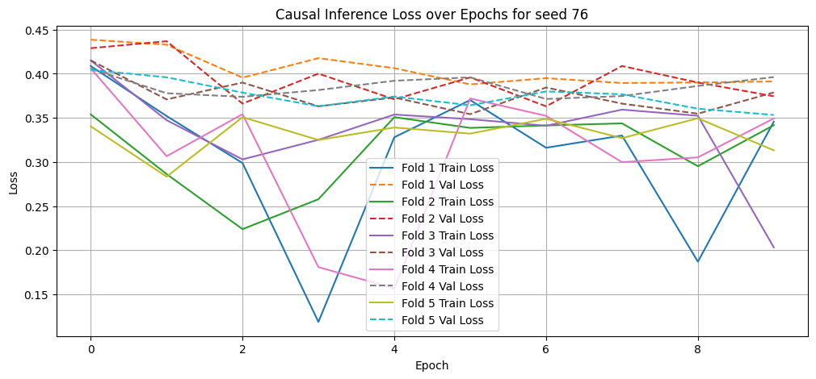
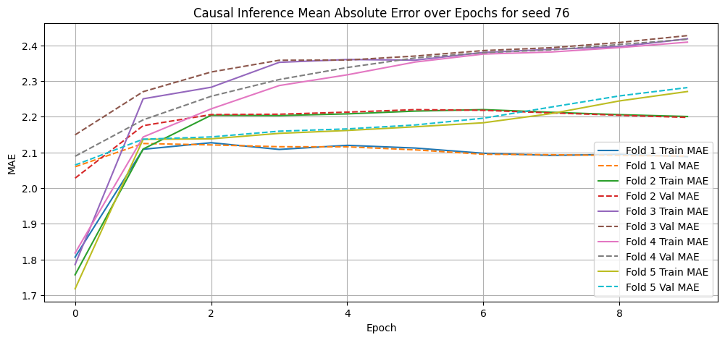
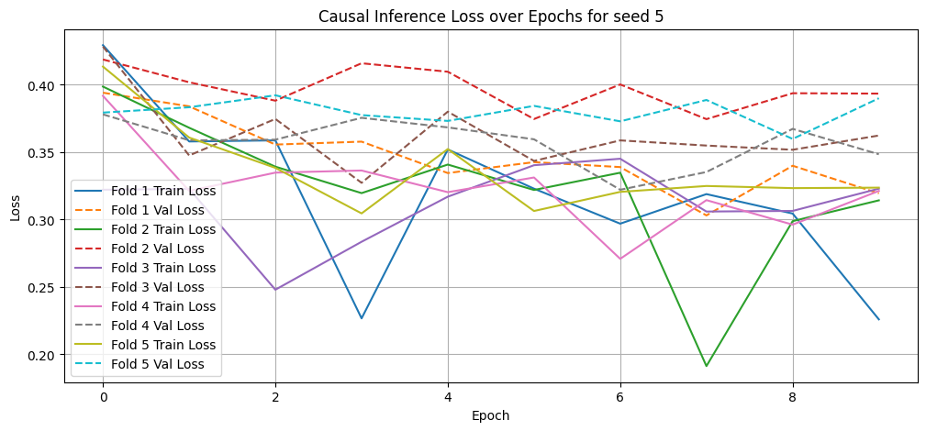
Loss and MAE Curves
Data Seed
5
24
28
50
76
Avg Train MAE: 2.2153
Avg Val MAE: 2.2548
Avg Train MAE: 2.1870
Avg Val MAE: 2.2256
Avg Train MAE: 2.1764
Avg Val MAE: 2.2112
Avg Train MAE: 2.2483
Avg Val MAE: 2.2903
Min Train Loss: 0.0392
Min Val Loss: 0.3291
Avg Train MAE: 2.1464
Avg Val MAE: 2.1761
Min Train Loss: 0.1188
Min Val Loss: 0.3533
Min Train Loss: 0.1149
Min Val Loss: 0.3330
Min Train Loss: 0.1913
Min Val Loss: 0.3031
Min Train Loss: 0.1061
Min Val Loss: 0.2698
Training Time: 1 hour, 58 min, 56.80 sec
Training Time: 1 hour, 56 min, 52.36 sec
Training Time: 1 hour, 59 min, 24.44 sec
Training Time: 1 hour, 55 min, 39.57 sec
Training Time: 1 hour, 55 min, 34.91 sec

Slide 11
Comparison of Results
Tau | Paper’s ATE | Our ATE | Difference
8 hours | 0.265 | 0.323 | 0.062
12 hours | 0.572 | 0.418 | -0.154
16 hours | 0.946 | 0.521 | -0.425
Average Treatment Effect for cutoff times (tau) averaged across five trials.
Our model is fairly accurate for predicting the ATE early on.
The model begins to diverge from the expected ATE as cutoff time increases. Our model indicates the compounding effect of treatment lessens over time.
Possible causes:
Our model has fewer layers than the paper’s model (for sake of compute time).
Our model has a much smaller MAE than the paper’s, indicating some overfitting towards the training set.
Our model is initialized on a different random seed than the paper’s (42 vs 0)
Though the difference caused by this seed is likely negligible.

Slide 12
Conclusion
We believe the paper is feasible to replicate.
We warn future students attempting to replicate this paper to consider the time commitment needed to train, test, and evaluate the model.
We trained the model using Google Colab’s T4 GPU for acceleration. Training took approximately 2.5 hours (30 minute per fold).
Prediction following training took approximately 6 minutes using the T4 GPU, 20 minutes otherwise.
We attempted using the dynamic survival transformer to predict patient mortality to determine its effectiveness in other healthcare scenarios.
Model’s accuracy was around 50%, showing that dynamic survival transformers are not universally applicable.
Suggestions for further reproductions:
Utilize non-default parameters for MIMIC Extract to obtain new datasets to train and test with.
Evaluate how the model performs when tested on data from newer versions of the MIMIC-III dataset. How would this impact the data preprocessing phase?

