Slide 2
GPS Satellites
GEO Satellite
L1 Only
C
up
C
L1
down
L1/L2
38
3
6
From WRSs
Redundant
WRS
WMS
GES

Slide 3
GPS Satellites
GEO Satellite
L1 Only
C
up
C
L1
down
L1/L2
38
3
6
From WRSs
Redundant
WRS
WMS
GES

Slide 4
GPS Satellites
GEO Satellite
L1 Only
C
up
C
L1
down
L1/L2
38
3
6
From WRSs
Redundant
WRS
WMS
GES

Slide 5
GPS Satellites
GEO Satellite
L1 Only
C
up
C
L1
down
L1/L2
38
3
6
From WRSs
Redundant
WRS
WMS
GES
WAAS Reference Station
• Collect GPS Navigation Data
• Collect GEO Navigation Data
• Collect Satellite Ranging
• Collect Ionospheric Data
WAAS Master Station
• Generates Ranging Corrections
• Generates Ionospheric Corrections
• Generates Integrity Data
• Generates SIS and O&M Messages
Ground Earth Station
• Signal Generation and Control

Slide 6
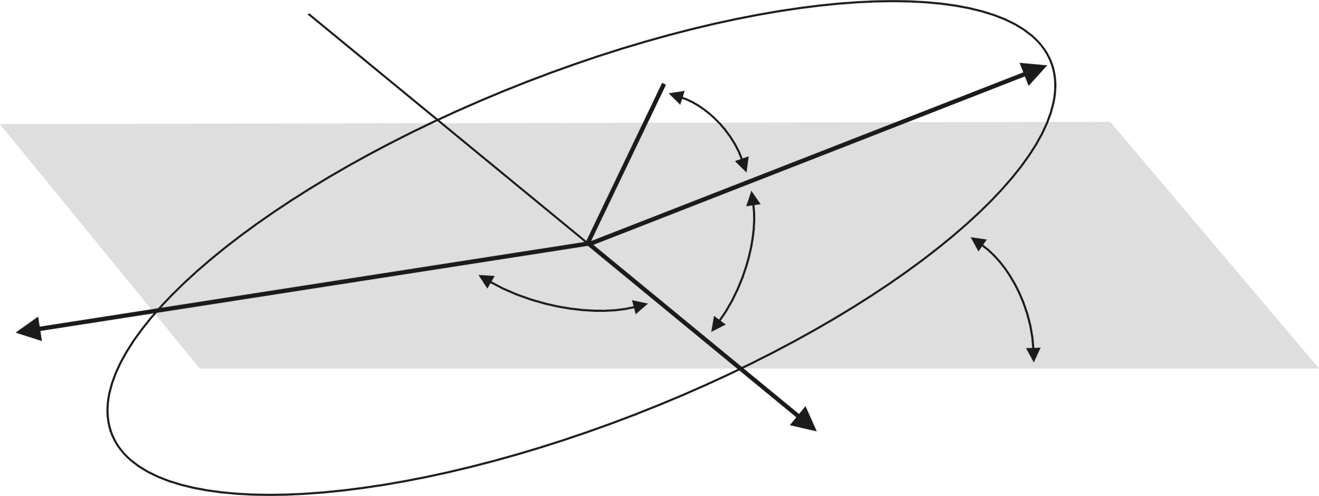


Equatorial
Plane
Perogee
f
a(1-e)
Inclination
Angle
Ascending node
Lines of nodes is the
intersection with the
equatorial plane
Toward
vernal equinox

