Slide 1
GPS/WAAS

Slide 2
Agenda
Basics of GPS
WAAS
  How it works
  What can it do for me?
  Approaches (LPV, LNAV/VNAV)
  SIDs, STARs, Q-Routes, and T-Routes
What’s next?
  Performance-based National Airspace System
Q&A

Slide 3
The Usual Caveats
Valid for navigation in the US National Airspace System
Does not invalidate or change ANYTHING required by your POI or in your OpSpec
Does not supersede ANYTHING in your POH/AFM
Some equipment requires specific operational mitigations

Slide 4
FAA Mission
Provide the safest, most efficient aerospace system in the world
Navigation services goal
Provide safe, cost effective navigation services to meet operational needs of the aviation customer

Slide 5
The National Airspace System (NAS)
18,000 airports
750 control facilities
4,000 commercial flights per day
100,000 commercial passengers per day
Plus thousands of Part 91 operations every day

Slide 6
GPS Basics
Nominal 24 GPS satellites in low earth orbit
Each satellite transmits data message
Airborne receiver processes message to determine position/velocity/time
Navigation function; either in FMS or in GPS (stand-alone)
Linear, not angular

Slide 7
Receiver Autonomous Integrity Monitoring (RAIM)
Calculates your position vs. satellites to determine if sufficient for navigation
Considers known satellite failures
RAIM check for approaches (not en route)
Required for GPS

Slide 8
Operational Requirements
AC 90-100, para 8(5) “If TSO-C129 equipment is used to solely satisfy the RNAV requirement, GPS RAIM availability must be confirmed for the route of flight.”

Slide 9
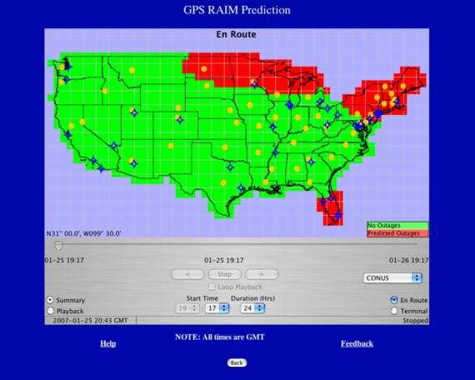
www.RAIMPrediction.net

Slide 10
NOTAMS
GPS outages
  Usually military
Satellite outages
  Used in RAIM prediction

Slide 11
With Approved GPS, I can:
File RNAV
Fly an LNAV approach
Fly an RNP/RNAV approach
Fly a GPS approach
…but I can’t file a GPS alternate
…and GPS is supplemental

Slide 12
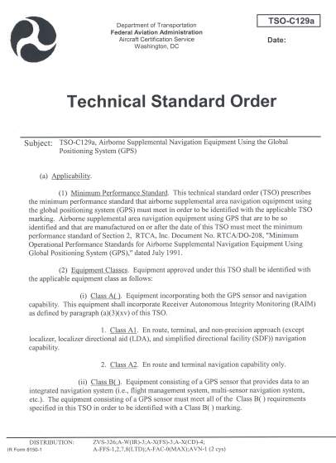
Primary or Supplemental Navigation?
GPS is considered supplemental
  TSO C-129 “Airborne Supplemental Navigation Using GPS”
  Must have equipage satisfactory for the route of flight

Slide 13
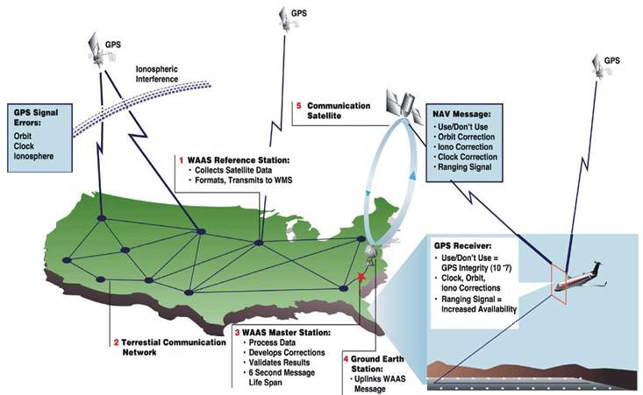
How WAAS Works

Slide 14
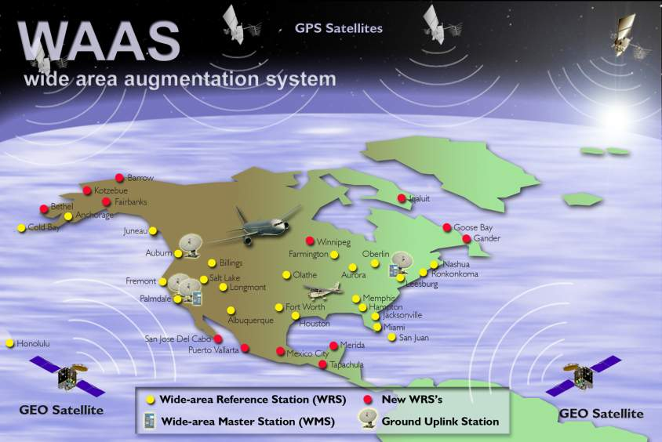
WAAS System

Slide 15
WAAS Capabilities
Why WAAS?
  Enhances en-route navigation performance over GPS alone
  Enhances non-precision approach capability over GPS alone
  Allows WAAS equipped users to fly more than 2,891 published LNAV/VNAV procedures to minimums as low as 300 feet
  Allows WAAS equipped users to fly new LPV procedures
  Can use GPS for an alternate (LNAV only)
  Advanced missed approach
Better than 99.99% availability of system
95% availability in CONUS of approach with vertical guidance
  200’ minimum (maybe)
WAAS specific approaches (LPV)
  646 LPV approaches published, with 300 new expected in 2007

Slide 16
With WAAS, I can:
Skip the RAIM check!
Fly an LNAV/VNAV approach
Fly an LPV approach
Use GPS/WAAS entirely
…and I can file a GPS alternate
  But using the LNAV minima line
  WAAS is not supplemental

Slide 17
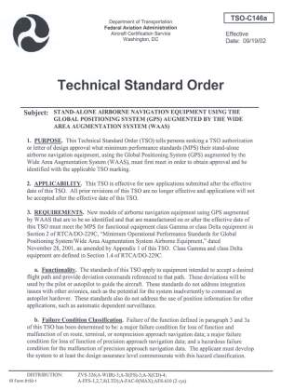
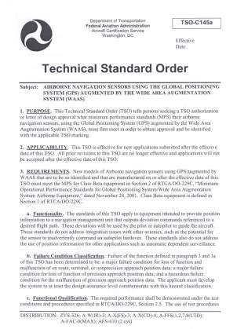
WAAS
TSO-C146 “Stand-Alone Airborne Nav Using GPS Augmented by WAAS)
TSO-C145 “Airborne Nav Sensors Using GPS Augmented by WAAS”

Slide 18
Instrument Approach Update
NDBs being reduced
No new funding for ILS
Expansion of LPVs

Slide 19
Localizer Performance with Vertical Guidance (LPV)
Flies like an ILS (but better!)
Minimums down to 200’
Why isn’t it a precision approach?
What about the pilot test standards?

Slide 20
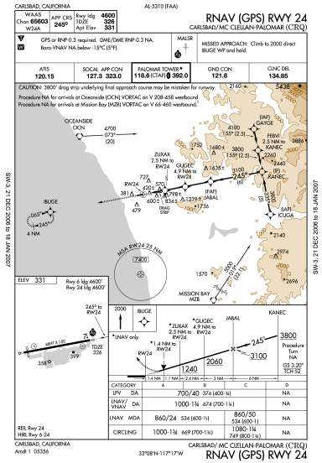
Charting with LPV Minimum Line
WAAS Channel Number
WAAS Approach ID: W24A
W: WAAS
24: Runway 24
A: 1st WAAS Approach
To Rwy 24
Temperature Restriction
Does Not Apply to WAAS
Equipment
LPV Minimum Line

Slide 21
LPV Production Schedule
On the web: gps.faa.gov
  Click button: GPS/WAAS

Slide 22
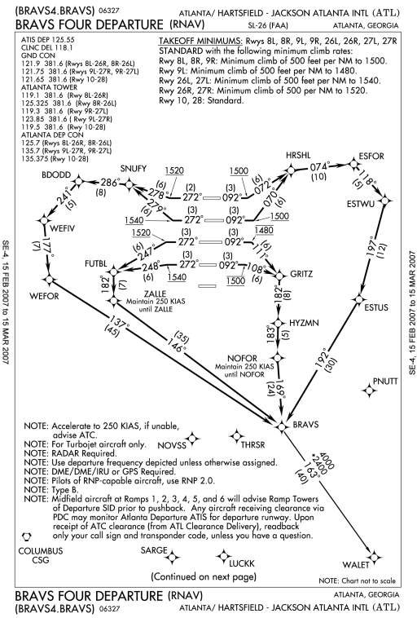
Standard Instrument Departure

Slide 23
Early Problems with SIDs
Position update
Autopilot engagement
Proper runway selected

Slide 24
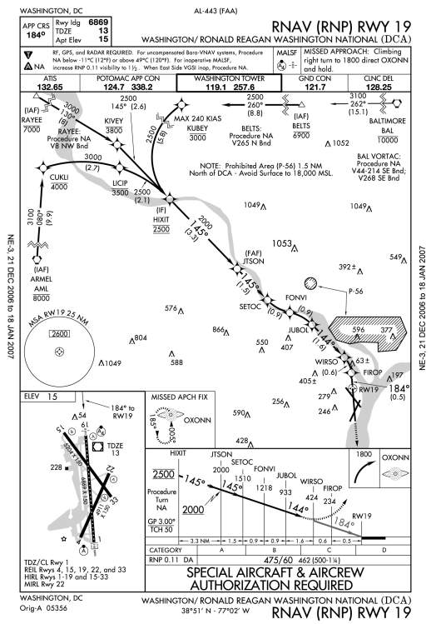
Here is what’s coming!

Slide 25
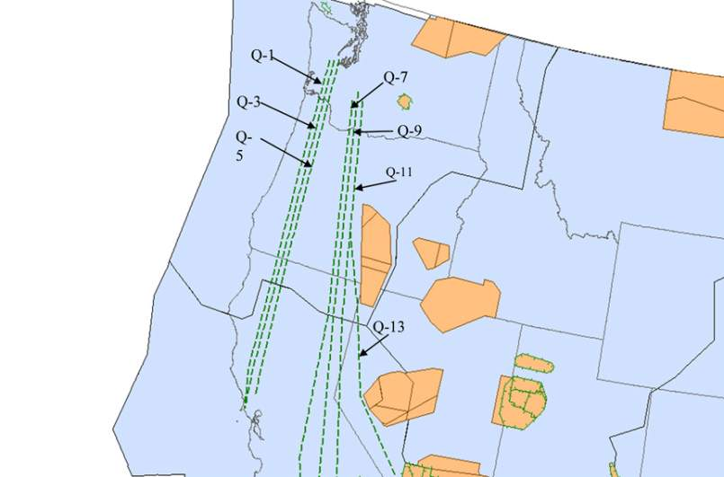
Q-Routes

Slide 26
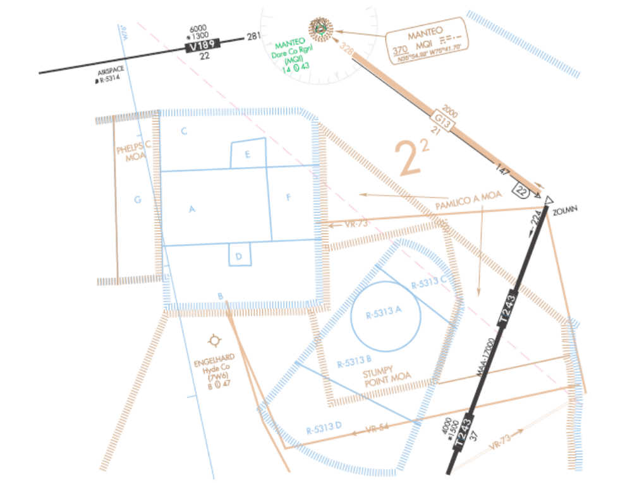
T-Routes

Slide 27
Coming Soon…
LP approaches
Helo point in space approaches

Slide 28
Why All the Changes?
Ask anyone who regularly flies into O’Hare, JFK, ATL
  Capacity
  Safety
  Oh, and money!
Seen any new airports under construction?
Heard about the anticipated number of VLJs?

Slide 29
Nav Aid Cost
VOR
  Install = $250,000
  20-year life cycle cost = $1,100,000
ILS
  Install = $1,200,000
  20-year life cycle cost = $2,700,000
Neither figure considers cost of real estate

Slide 30
Where is this leading?
GPS is biggest change to hit aviation since the jet engine!
2007 – decision for drawdown of VORs
My personal guess -reduce by 60% over 10 years
NDBs are already being divested

Slide 31
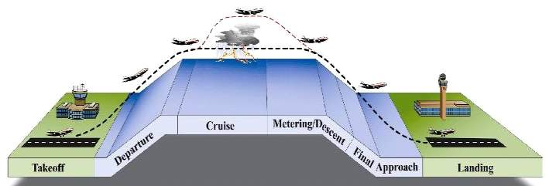
Performance-Based Navigation
Complete transition by 2025
Consistent with ICAO global vision
Operational capability based on GPS and augmentations
Enhance safety, capacity, efficiency
Reduce costs
Efficient, Flexible Routing
Vector
Vector
-
-
Free
Free
Streamlined
Streamlined
Arrivals
Departures
Arrivals
Departures
All
All
-
-
Weather
Weather
Approaches
Approaches
Notes:
Performance-based navigation is an end-to-end system of concepts and applications based on performance standards without dependence upon specific technologies or equipment
It fully utilizes the capabilities of all aircraft navigation equipment to operate safely and efficiently in conjunction with external signals provided by ground or space based systems
FAA approved GPS for operational use over 10 years ago. GPS and its augmentations are key enabling technologies toward implementation of performance based services. They provide this capability in the most cost-effective manner considering the unaffordability of the aging ground based infrastructure
GPS does not have the integrity, availability, or accuracy required for precision approaches. This is the main reason FAA has spent over $1B delivering WAAS service and $150M in the development of LAAS.
FAA continues to provide support to DoD to ensure the long-term interests of civil & military aviation are addressed. FAA participates on the acquisition team for the GPS-III Program as evaluators and technical advisors
The FAA continues to support development of ground-based augmentation (GBAS) using the Local Area Augmentation System (LAAS). The LAAS program continues to work with DoD’s joint precision approach and landing system (JPALS) program to ensure system interoperability and sharing of lessons learned.

Slide 32
Required Navigational Performance (RNP)
Major change in technical approach – not sensor specific
Complete “system” will be RNP certified
  Aircraft, nav system, autopilot to provide containment and alerting
RNP 2 miles en route, 1 mile terminal, 0.3 for approach

Slide 33
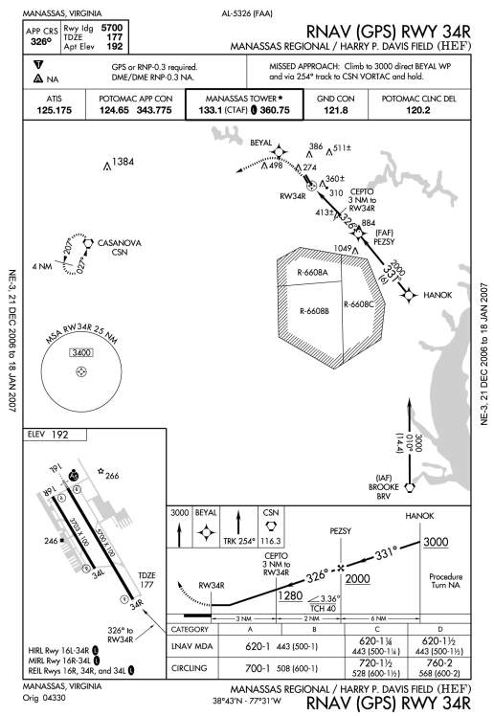
RNP 0.3 DME/DME NA

Slide 34
Larry’s Forecast
Satellite-based navigation
More takeoff-direct routing
ILS-like accuracy en route throughout the NAS
Skeleton framework of VORs as mitigation for possible GPS jamming/obstruction
  Until we work out a jam-proof system

Slide 35
In the future, you will:
Have to intimately understand the workings of your GPS receiver
  Incredibly capable, but it’s a computer!
Spend more time as a “systems operator”
You will either love it, or hate it, but it’s here to stay!

Slide 36
Three Major FAA Planning Documents
Operational Evolution Plan
  www.faa.gov/programs/OEP
Roadmap for Performance Based Navigation
  www.faa.gov/ats/rnp
Next Generation Air Transport System

Slide 37

The Next Generation Air Transportation System (NextGen) Plan Defines A System That Can Meet Demands For The 21st Century
Trajectory-Based Operations
Performance-Based
Operations and Services
Precision Navigation
Weather Integration
Network-Centric
Information Sharing
Surveillance Services
Equivalent Visual Operations
Super Density Operations
Layered, Adaptive Security
Capabilities
Notes:
The 108th Congress passed Vision 100 – Century of Aviation Reauthorization Act (PL 108-176). This created a unique coalition of public and private partnerships (Joint Program Development Office (JPDO)). The JPDO is the organization responsible for the development of NextGen
NextGen is based on nine core capabilities. Two capabilities that are important to this group are Precision Navigation (GPS and augmentations) and Surveillance Services (ADS-B)
The JPDO is evaluating plans to modernize GPS to ensure there is consistency with NextGen.
The FAA has worked collaboratively with DoD to define the aviation needs for GPS-III.
It is understood that any additional requirements that are unique to the civil community beyond the current baseline will be funded by the civil community. L5 is included in the current baseline.

Slide 38
Navigation Evolution Customer Council (NECC)
Council made up of government and industry members
Created by director of navigation services to:
  Implement the navigation evolution roadmap
  Adjudication of roadmap comments
  Develop roadmap updates
  Liaison between policy-makers and the aviation community

Slide 39
Contact me at:
  Larry.Ctr.Oliver@FAA.GOV
  (202)-385-4593

