Slide 1
Data analysis for ramen ratings
Shibo Cao
CS544 Final project presentation

Slide 2
Information on the dataset
2580 observations of Ramen in this dataset
Variables:
Review #: Unique identifiers for each ramen surveyed [Numeric, from 1 to 2580]
Brand: brand name of the ramen product [String]
Variety: Detailed information of each ramen product [String]
Style: package genre of ramen (e.g. cup, pack, etc) [String]
Country: Country of origin of ramen product [String]
Stars: Rating of Ramen [Numeric, range from 0 to 5]
Top Ten: Only if the ramen product was ranked Top 10 from 2012-2016 [String]
After preprocessing of data: 2575 observations (5 of them contained incomplete information)

Slide 3
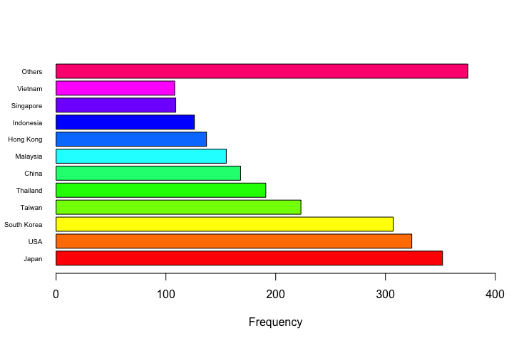
Categorical analysis: Country
37 countries in total
all the countries with less than 100 products in the dataset - “Others”

Slide 4
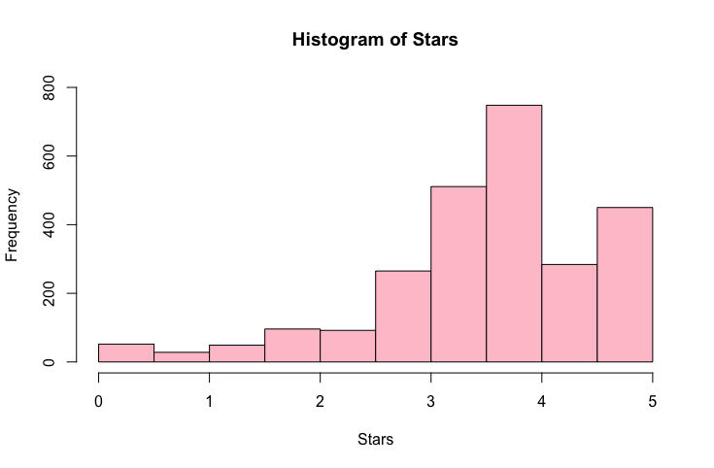
Numerical analysis: Stars
Mean = 3.765175
Median = 3.74
Mode = 4
Variance = 1.031527
Standard deviation = 1.015641

Slide 5
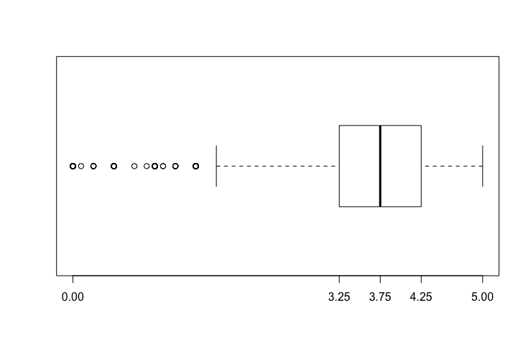
Numerical analysis: Stars (CTD)
Five number summary = 0.00 3.25 3.75 4.25 5.00
IQR = 1
Outlier range: 0 – 1.75
Number of outliers = 156

Slide 6
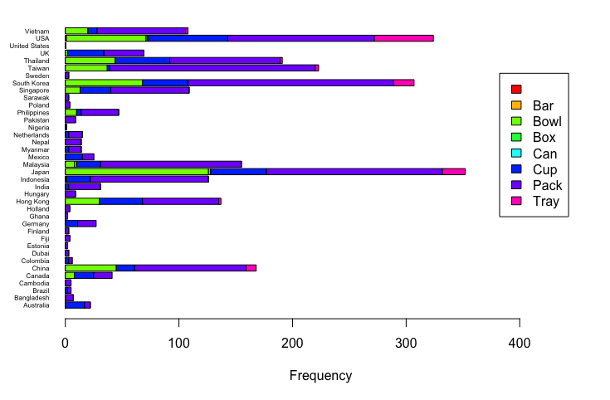
Bivariate analysis: Country & Style

Slide 7
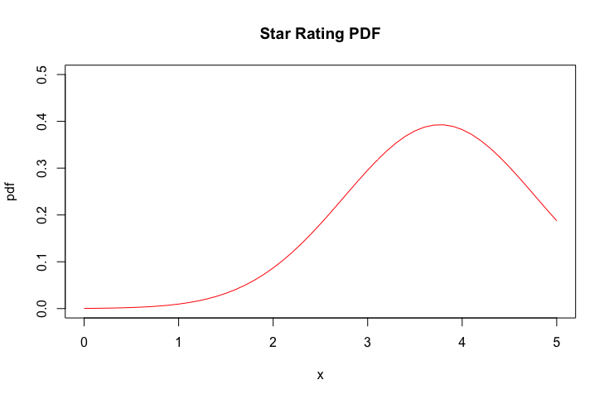
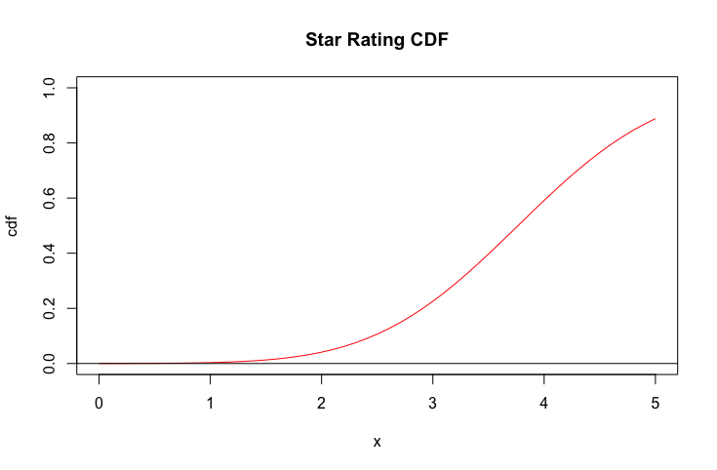
Numerical distribution: Stars

Slide 8
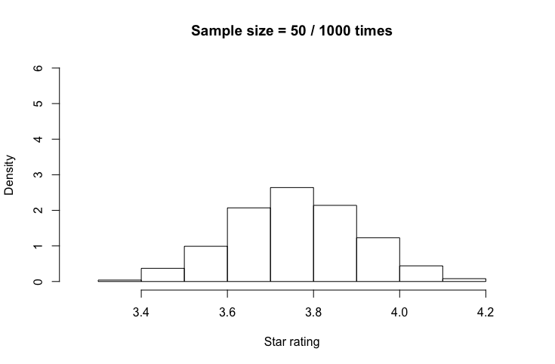
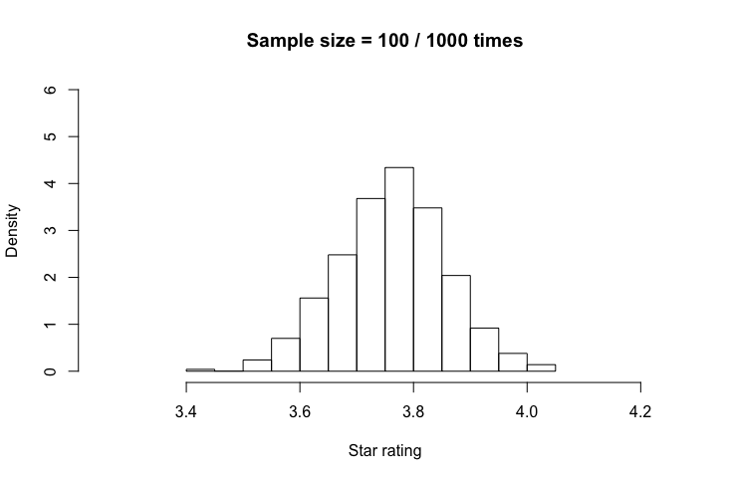
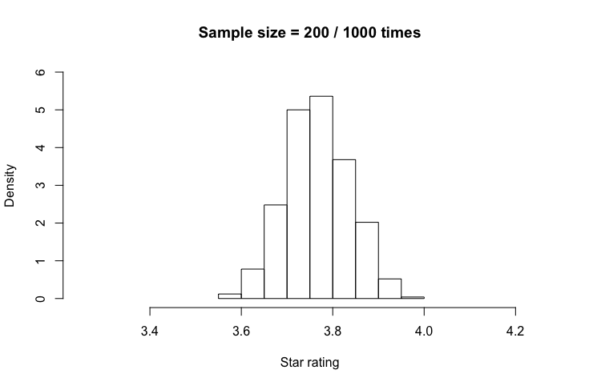
Central limit theorem: sampling 1000 times
Sample size = 50
Sample size = 100
Sample size = 200

Slide 9
Sampling methods: Draw 100 samples
Sample 1: Simple Random Sampling
Mean = 3.807
SD = 0.9384605
Sample 2: Systematic Sampling
Mean = 3.573232
SD = 1.137898
Sample 3: Unequal Stratified Sampling (based on Style)
Mean = 3.70202
SD = 0.8253917
Sample 4: Cluster Sampling
Mean = 3.5205
SD = 1.235667

Slide 10
Comparison of Top Ten using Tibble
Compare the count of ramen from each country every year in descending order:
2012: Indonesia – 3; Japan – 3; Hong Kong – 1; Singapore – 1; South Korea – 1
2013: Singapore – 2; Indonesia – 1; Japan – 1; South Korea – 1; Thailand – 1; USA – 1
2014: South Korea – 3; Malaysia – 2; Japan – 1; Singapore – 1; Thailand – 1
2015: Malaysia – 4; Japan – 1; Taiwan – 1; Thailand – 1
2016: Singapore – 3; China – 1; Myanmar – 1; Taiwan – 1
Compare the count of ramen for each country (2012 ~ 2016)
Singapore – 7;
Japan – 6;
Malaysia – 6;
South Korea – 5;
Indonesia – 4;
Thailand – 3;
Taiwan – 2;
China – 1;
Hong Kong – 1;
Myanmar – 1;
USA – 1

Slide 11
Thank you!

