Slide 1
SatNOGS a global open source ground station network
2015-09-10 - 7th European Cubesat Symposium
Pierros Papadeas et al.

Slide 2
Hello
We are a group of satellite enthusiasts, makers and developers based in various hackerspaces around the world
Core team in Athens, Greece
A Libre Space Foundation project
Started February 2014

Slide 3
What is SatNOGS?
A full ground station stack
A network (server-client) model for coordinating ground station jobs
An extensible platform that is focused on modularity
A global open source community developing the above

Slide 4
Another Ground Station (network)?
No complete open source stack
No community (ecosystem) around it
Existing solutions either too expensive or too undocumented (and closed)
Other network approaches abandoned

Slide 5
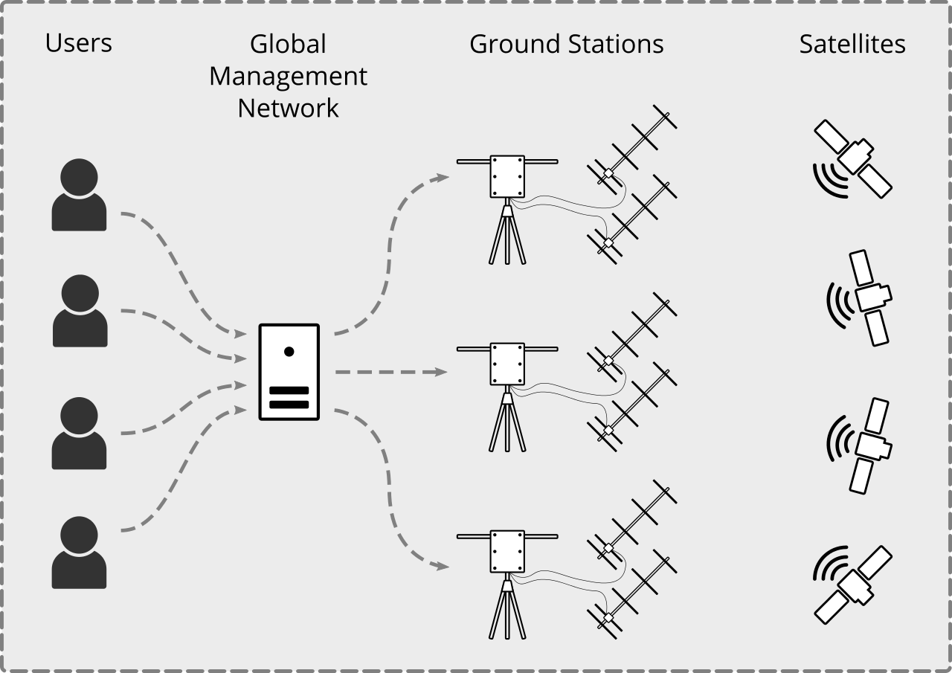

Slide 6
Rotator
Fully open source and built from readily available materials
3 iterations so far
2 configurations available (X-Y or Alt/Az)
Specifications
  20 deg/sec
  Holding torque 64Nm, Rated torque ~2Nm

Slide 7
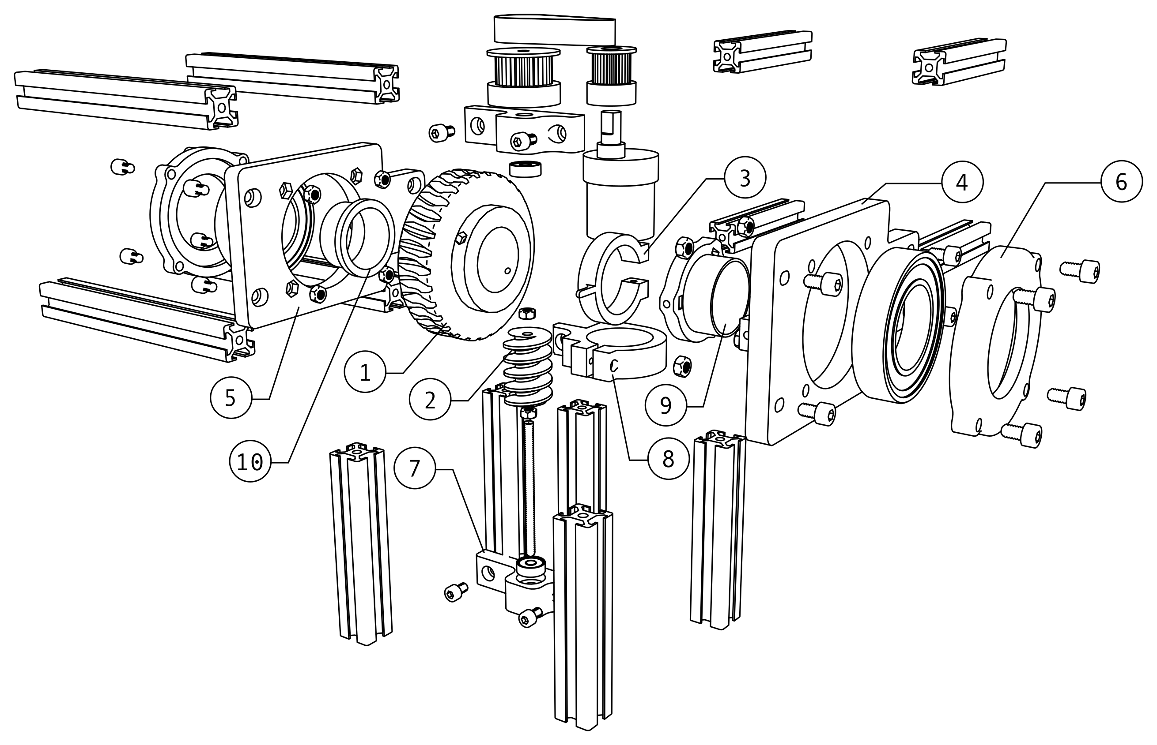

Slide 8
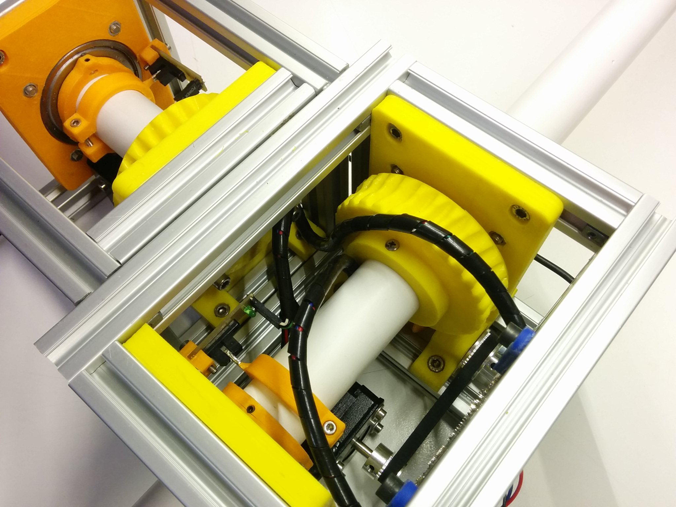

Slide 9
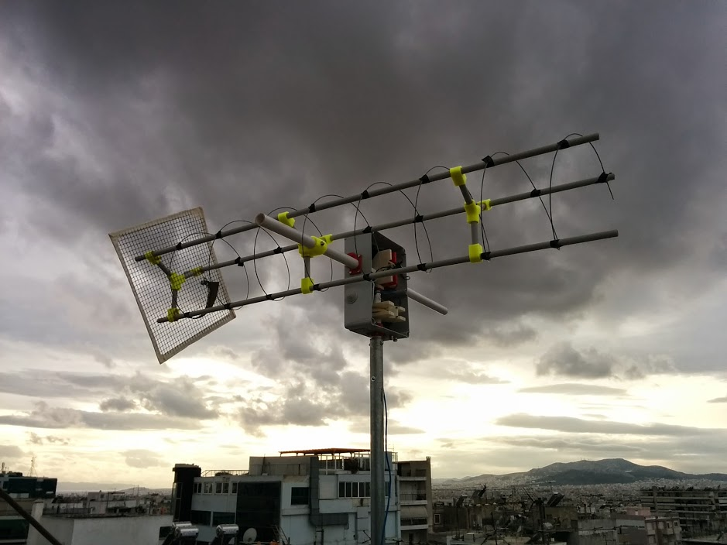

Slide 10
Focus on modularity
Rotator+RF controlled through HAMLIB
  RigCtl & RotCtl
Replace any part of the stack with COTS equipment
  Antennas, LNAs, rig (radios), gnuradio supported SDRs, rotators, controllers

Slide 11
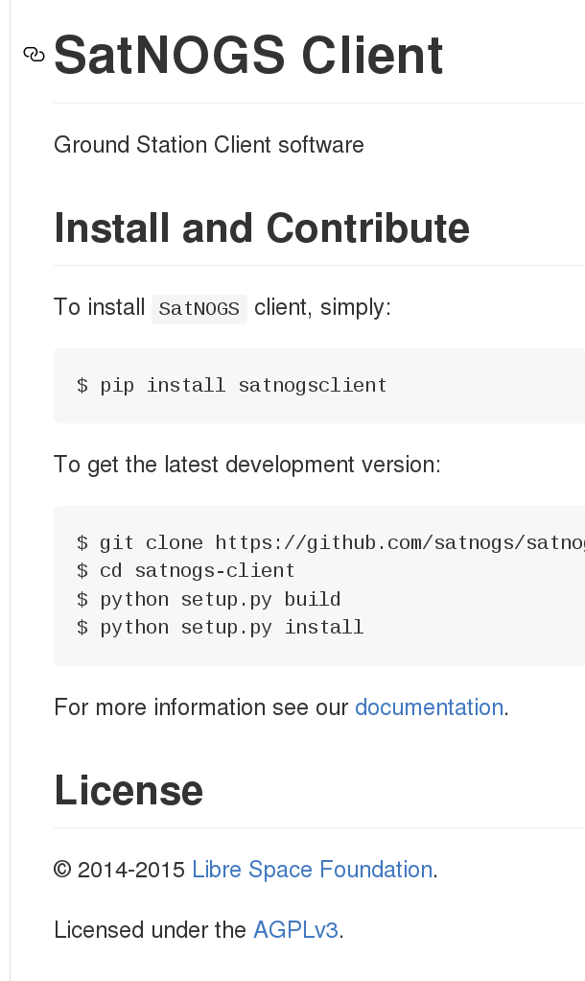
SatNOGS client
Two modes of operation:
  Connected to Network
  Single operator mode (local or remote)
Python scheduler for polling and executing
jobs
Web interface for monitoring
Works with most SDRs (gnuradio) and also
facilitates pol-switching, antenna selection,
decoding, and raw IQ recording
Can run on embedded platfroms, server or
PC

Slide 12
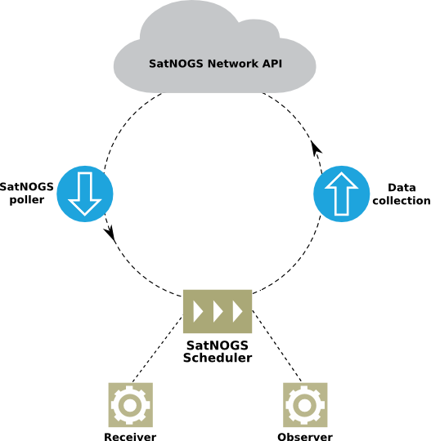

Slide 13
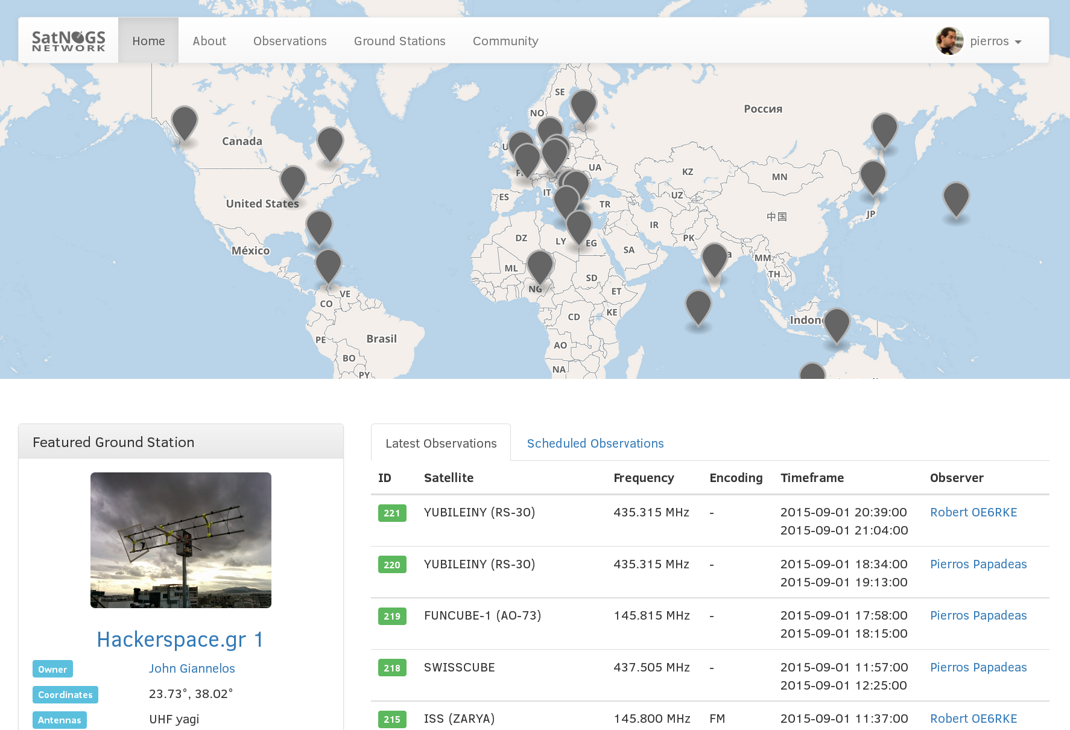

Slide 14
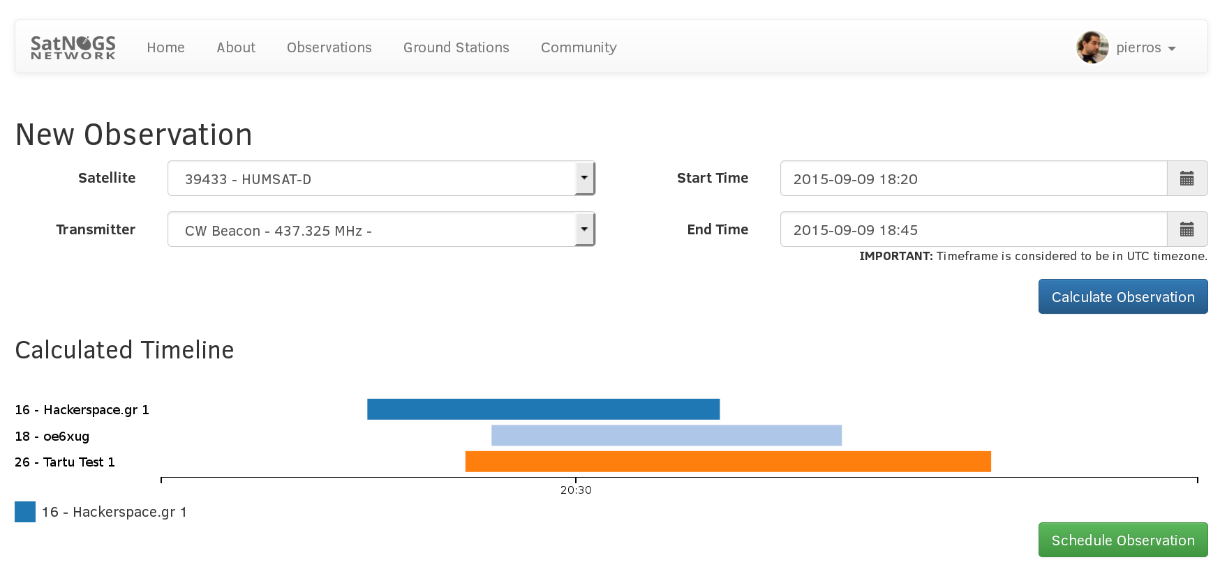
Scheduling a job

Slide 15
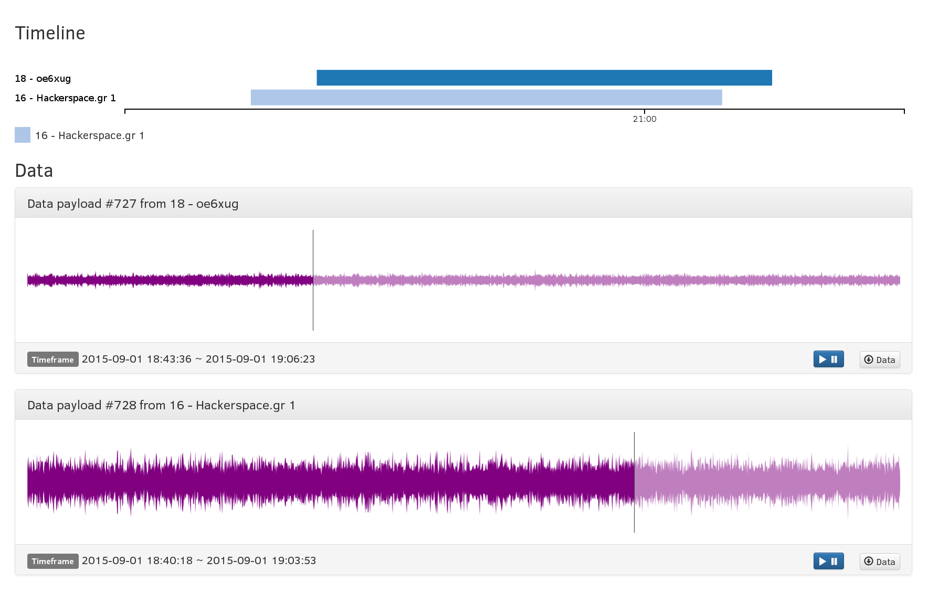
Results are in

Slide 16
network.satnogs.org
Python/Django based service
API for client scheduling and auto-provisioning
Pyephem for calculations and custom scheduling
Check network-dev.satnogs.org

Slide 17
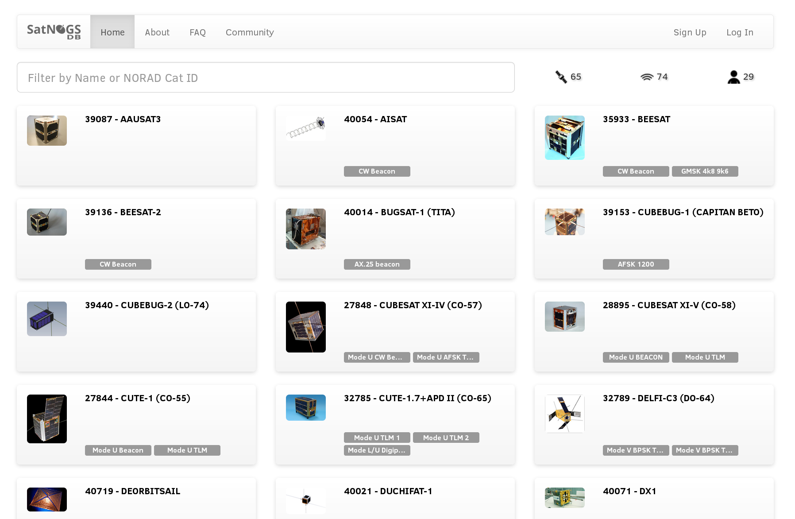

Slide 18
SatNOGS DB
Crowdsourced transmitter information
Python/Django based open source app
db.satnogs.org

Slide 19
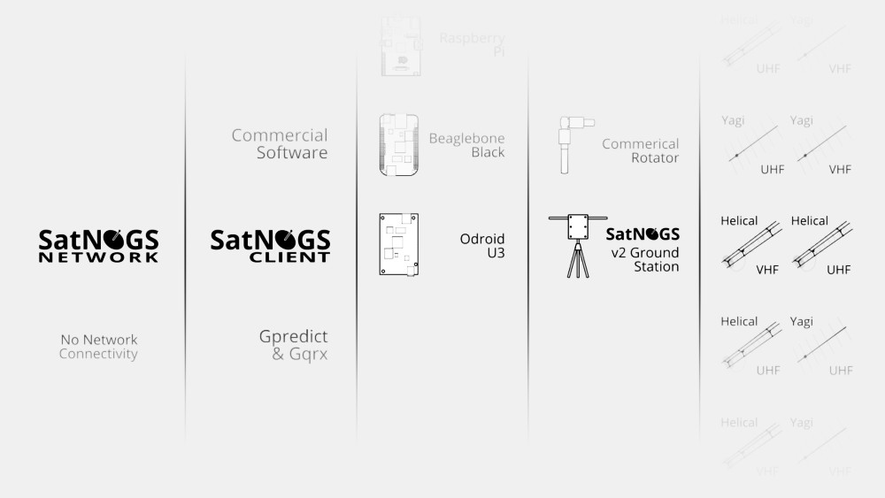

Slide 20
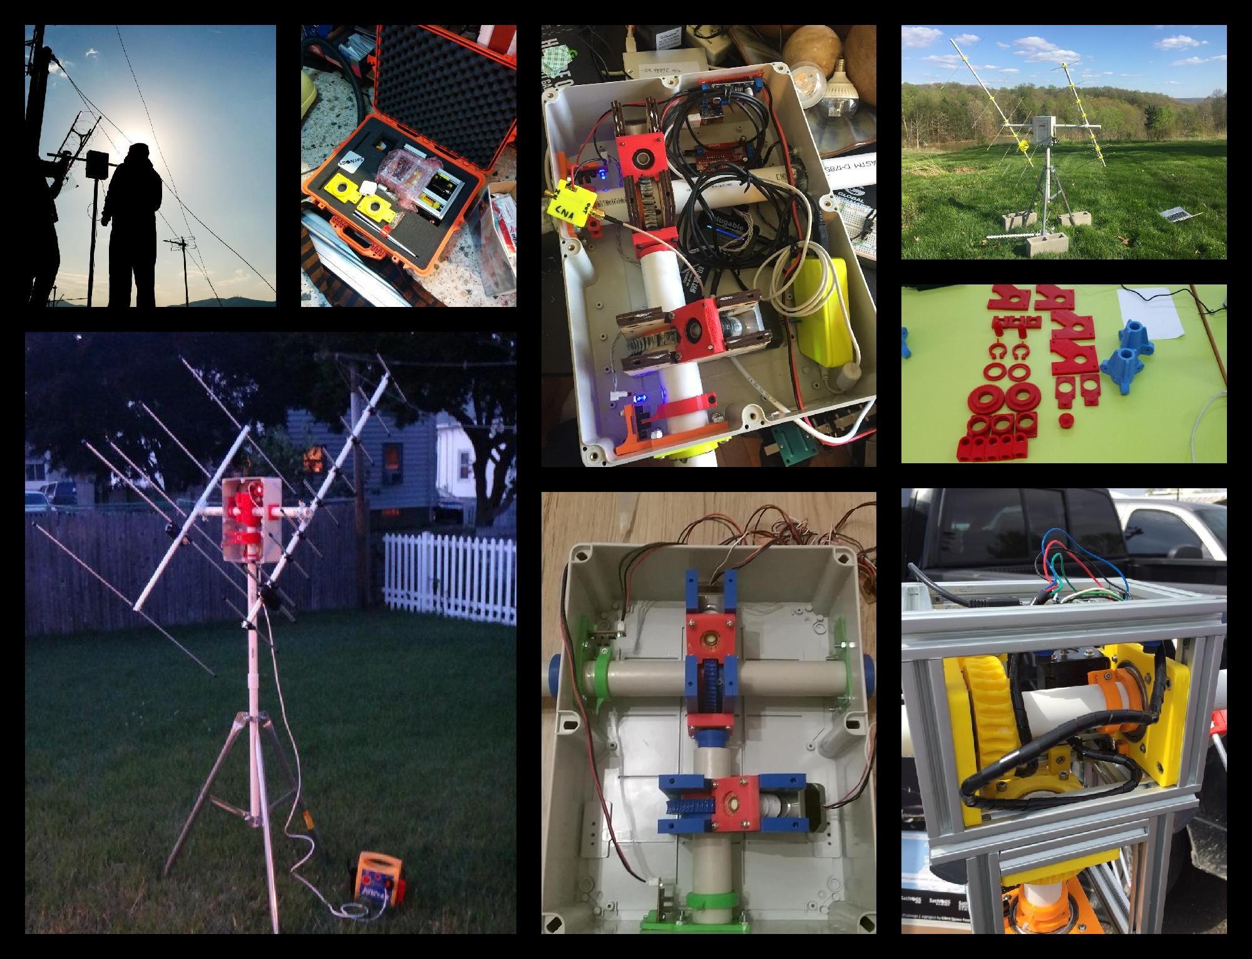

Slide 21
Future Work
Focus on UX for TX operations
Move to higher bands (S, Ku, C)
Achieve continuous tracking

Slide 22
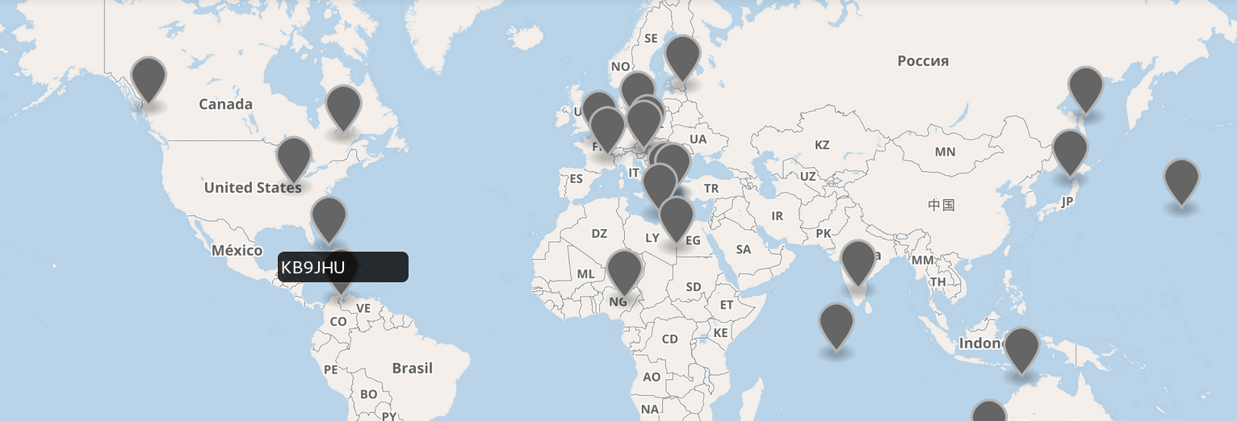
More stations!
Join the network today! Check satnogs.org for details.

Slide 23
Thanks!
Website: satnogs.org
Email: info@satnogs.org
Forum: community.satnogs.org
Code: github.com/satnogs
Network: network.satnogs.org
DB: db.satnogs.org

