Slide 1
BIA660
Web Analytics
Predicting the NBA Using Twitter
Instructor: Rong Liu
Student: Chieh Shih
Ping-Lun Yeh
Ming-Ting Hsieh

Slide 2
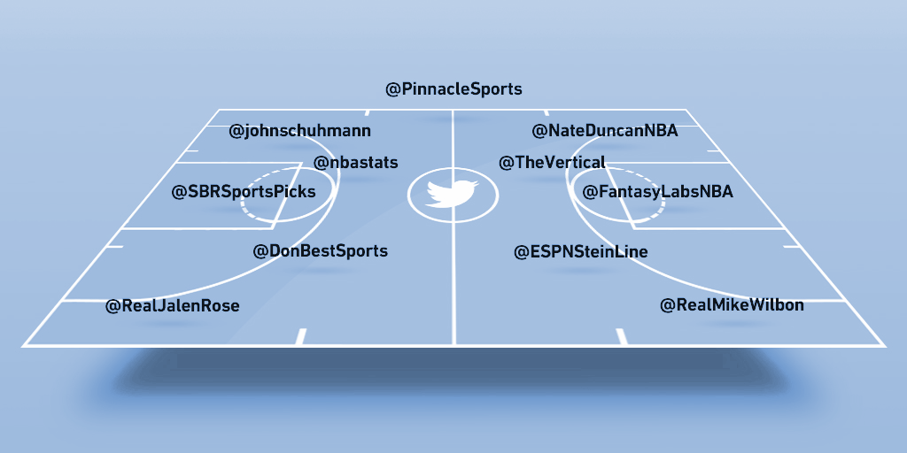
Content
Motivation
Introduction
Flow Chart
Text Analysis
Methodology
Conclusion

Slide 3
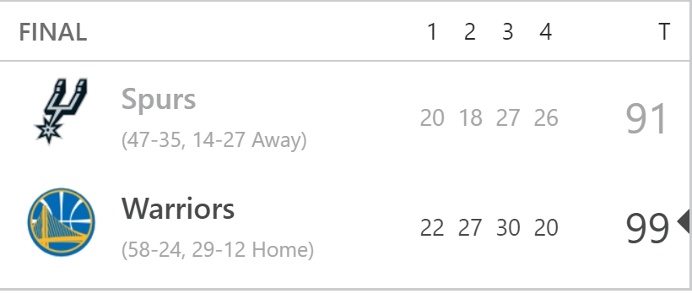
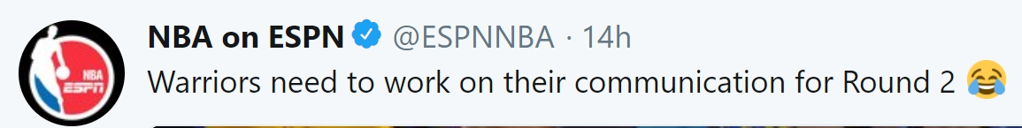
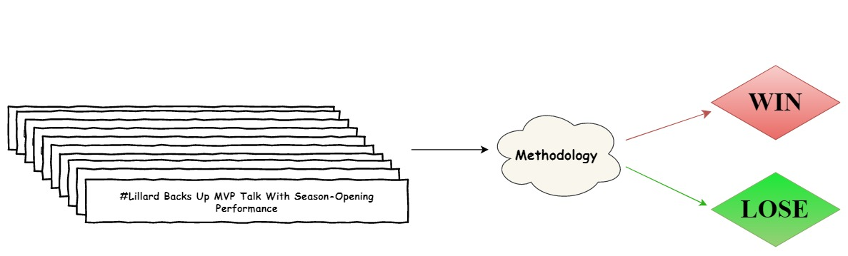
Motivation
?

Slide 4
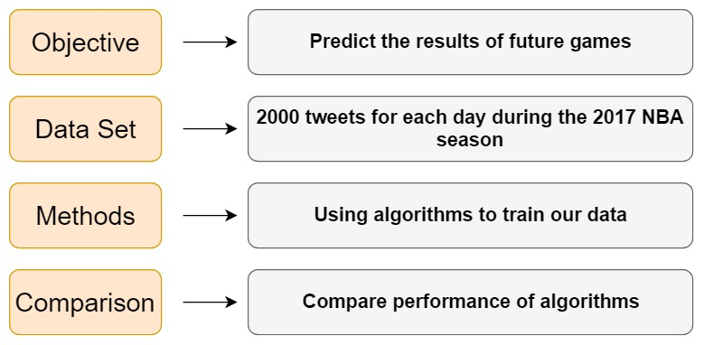
Introduction
Notes:
This is outline of our research. Our objective is that we are going to predict the
results of future games. In our data set, we used 2000 tweets per day during the entire 2017 NBA
season. Then, we used some algorithms to train these tweets. At last, we compared
each performance of every algorithm.

Slide 5
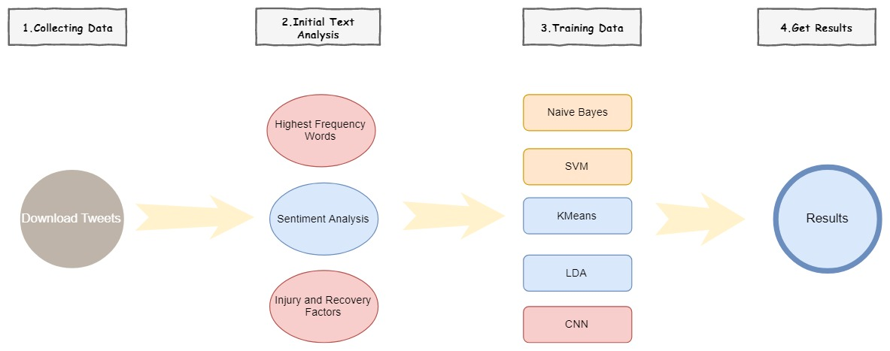
Flow Chart

Slide 6
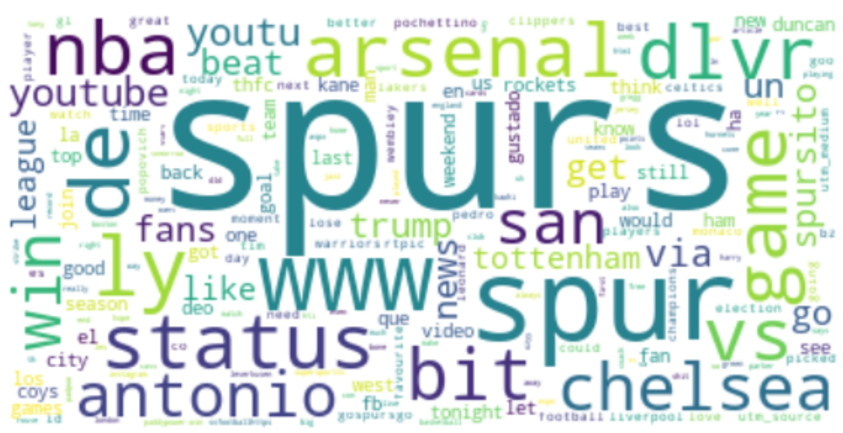
Initial Text Analysis
High Frequency Words
Injury Words
Sentiment Analysis

Slide 7
Introduction Methodology
Supervised Learning Methods (Naive bayes, SVM)
Unsupervised Learning Methods (K-means, LDA)
Supervised Learning Methods II (CNN)
Notes:
Let’s talk about algorithms we use to classify and predict the game’s result. So we have five algorithms. Three of them are supervised learning. Two of them are Unsupervised learning.

Slide 8
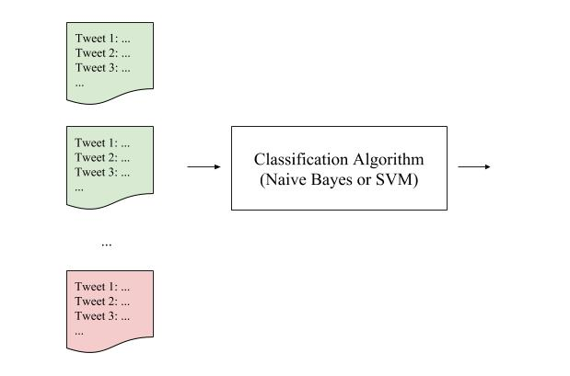
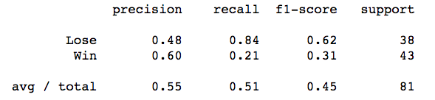
Supervised Learning - Naive bayes, SVM
Example: Thunder
Label
Game 1
2016/10/26
Win
Game 2
2016/10/28
Win
...
Game 5
2016/11/03
Lose
Notes:
First of all we introduce supervised learning, which is naive bayes and SVM. Here is an example of Thunder. We labeled entire tweets of that day as win or lose depend on the game’s result.
To predict the games’ result, we collect a day tweet as an input and labeled it

Slide 9
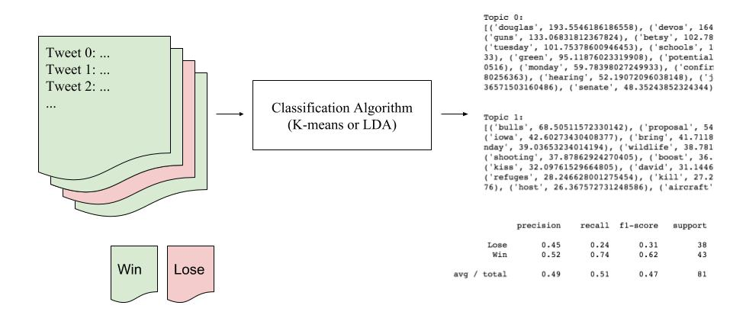
Unsupervised Learning - K-means, LDA
Label :
Notes:
The flow that we use to predict game’s result is very similar to previous one. We have Unsupervised learning
we just calculate twice
When we check the real answer we just pick the higher value

Slide 10
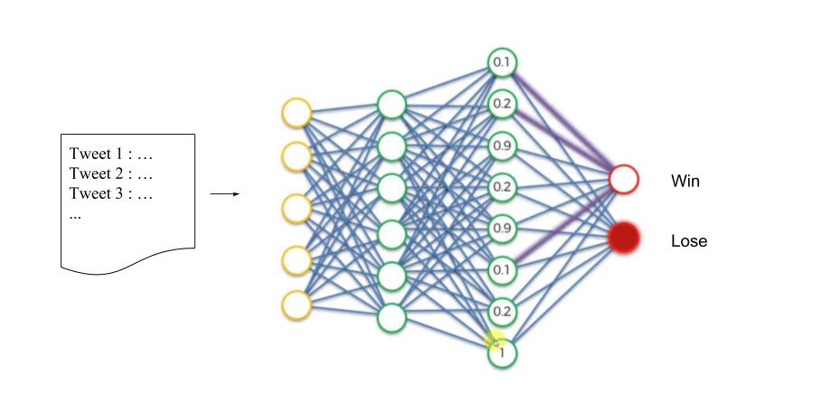
Supervised Learning II - Convolutional neural network
How to use CNN to predict the game’s result?
Notes:
The basic idea is to convert sentiment table to Image

Slide 11
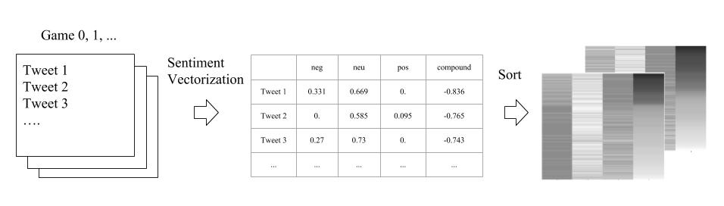
Supervised Learning II - CNN (1)
Step1. Make the Sentiment Table and Convert to Image
Notes:
The basic idea is to convert sentiment table to Image

Slide 12
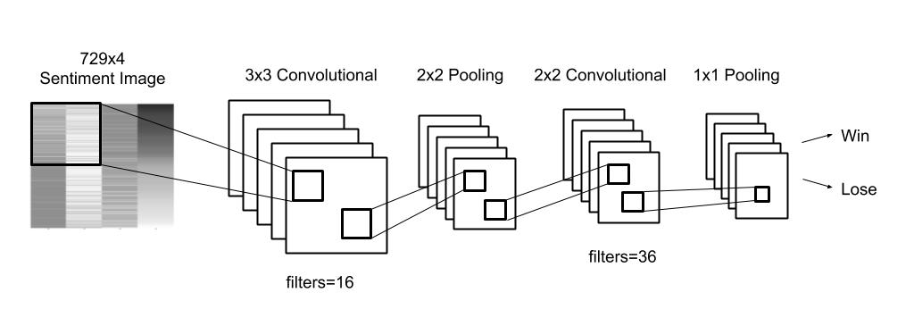
Supervised Learning II - CNN (2)
Step2. Build CNN Structure

Slide 13
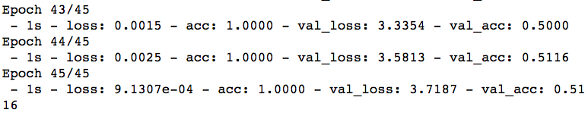
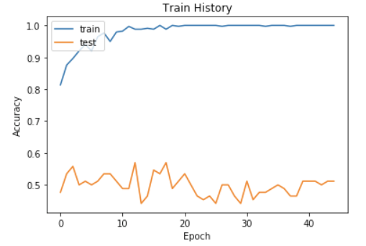

Supervised Learning II - CNN (3)
Step3. Training data
Batch_size=20
Train on 169 samples, validate on 43 samples

Slide 14
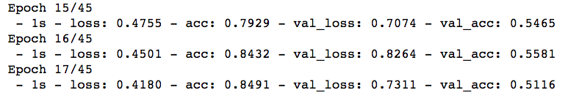

Supervised Learning II - CNN (3)
Step3. Training and Early Stopping
EarlyStopping(monitor='val_loss', patience=10)
Batch_size=20
Train on 169 samples, validate on 43 samples

Slide 15
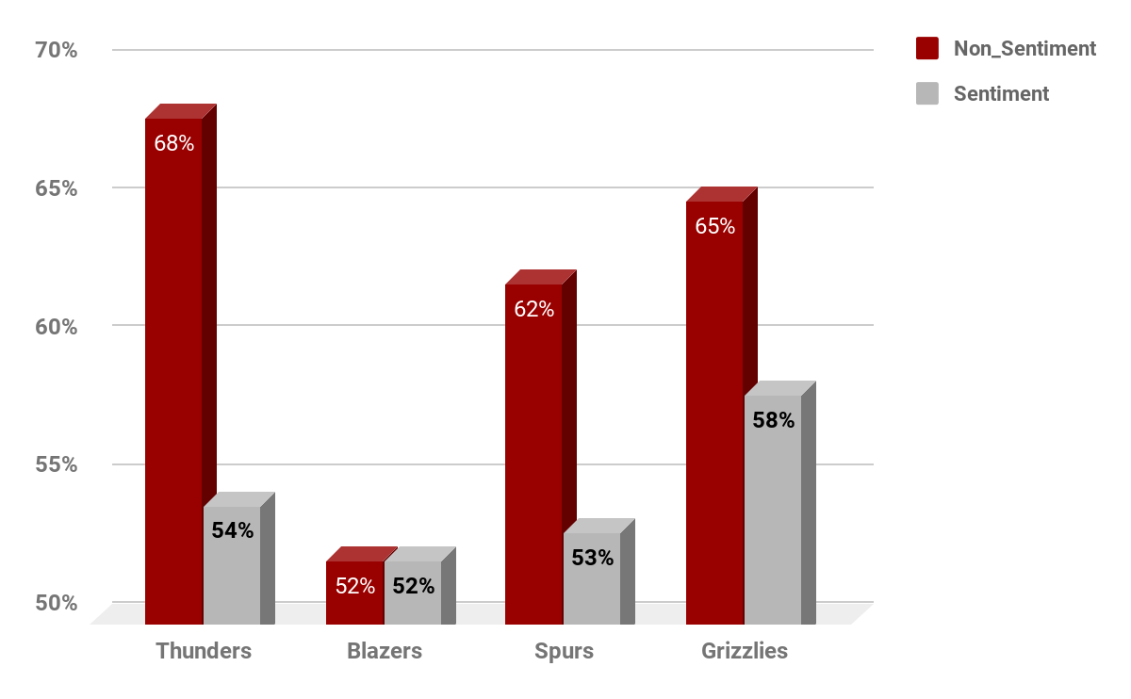
Sentiment Analytics - Naive Bayes (NB)
Notes:
Since we have no ideas about which methodology will get the best performances, we decided to test with all of them under different kinds of situation and then we can compare the accuracies of each algorithm.
First of all, we took four teams as our demonstrations. And then we use these teams to test with Naïve Bayes methodology whether with sentiment or without sentiment analysis.

Slide 16
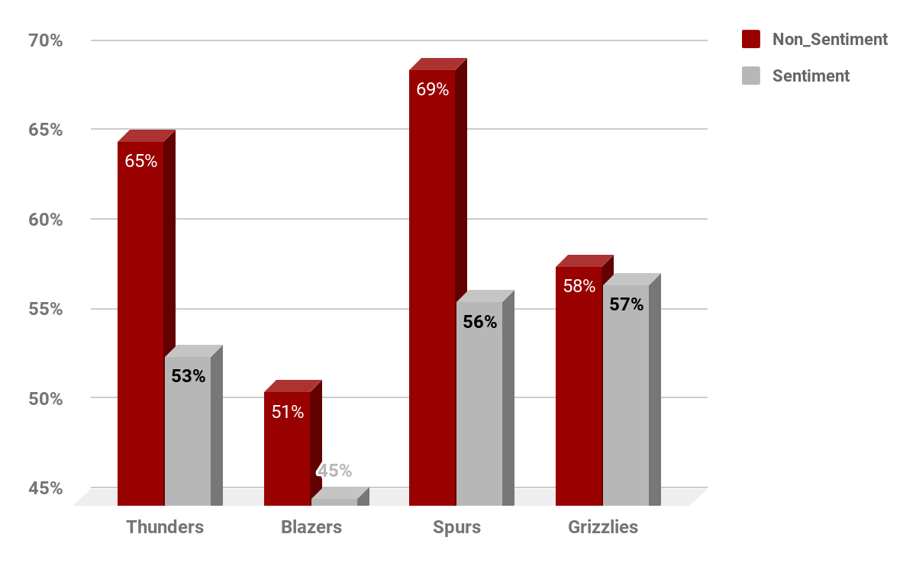
Sentiment Analytics - Support Vector Machine (SVM)

Slide 17
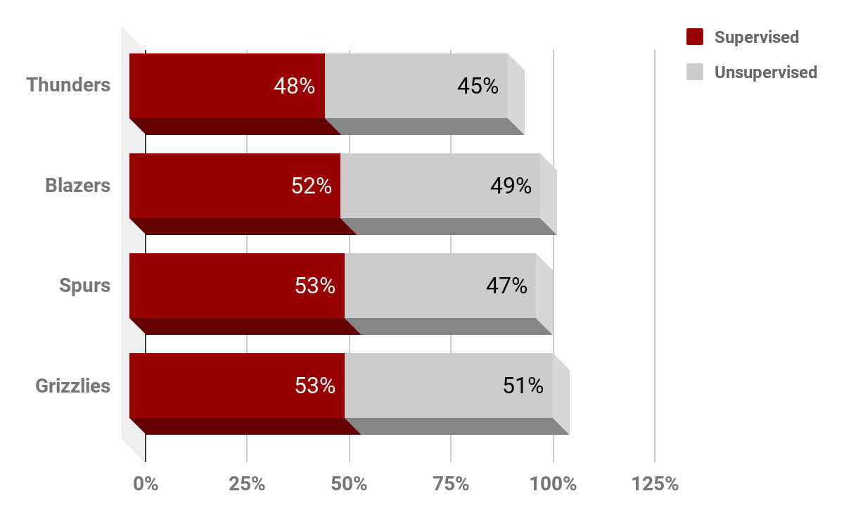
Supervised v.s. Unsupervised Learning
Notes:
and then we try to find the relationship between supervised and unsupervised learning,
and we find that the accuracy of supervised learning is a little bit higher than unsupervised learning.

Slide 18
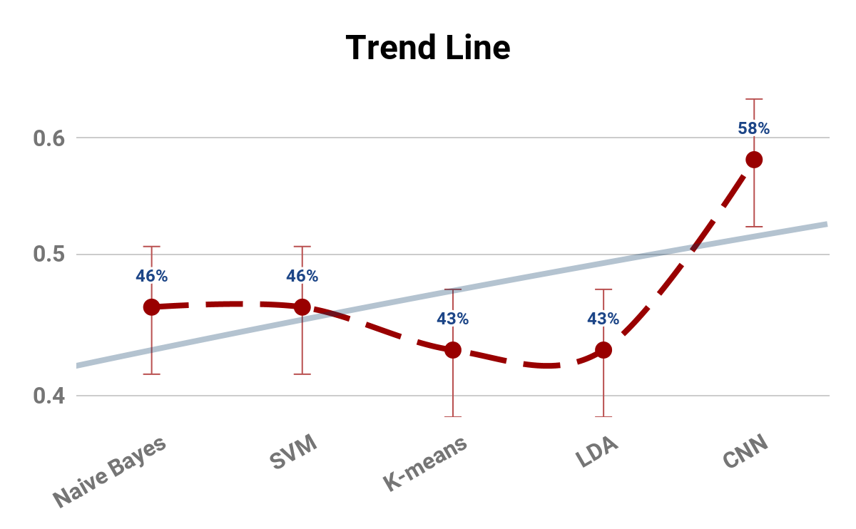
Comparison Between Each Algorithm
Take four teams as our sample dataset.
Notes:
finally, we compared these five algorithms with the same sample dataset. As u can see, the accuracies of each methodology is a little bit lower except CNN algorithm, which has about 58% accuracy. So, we can say, in this case CNN has the highest accuracy.

Slide 19
Conclusion
Higher Accuracy v.s. Lower Accuracy
01
Sentiment Analysis
Non_sentiment Analysis
02
Unsupervised Learning
Supervised Learning
03
Other Algorithms
(NB, SVM, K-means, LDA)
Convolutional Neural Networks (CNN)
Notes:
First of all,

Slide 20
Q & A
Thank you for listening !!

