Slide 1
VoterDB - Vote From Home Solution
Keiffer, Miguel, Cameron

Slide 2
NoSQL to Relational Database Workflow
Storage: HDFS
Extract: Apache Flume
Transformation: Apache Spark
Load: Sqoop

Slide 3
Extraction with Flume
On election day, data comes from different sources; Flume will ensure that all relevant information is captured as it becomes available.
We will use Flume to extract real-time data fetched from official APIs provided by social media companies.
Raw, captured data is then stored in HDFS. The raw data is then processed as soon as it can.
Flume will help with real-time ingestion, ensuring that information is available for analysis and decision-making as soon as possible.
Data Transformation and Enrichment: Often, data collected during elections may need to be transformed or enriched before being stored or analyzed. For example, raw data from social media may need to be cleaned, filtered, and structured before it's useful for analysis. Flume can be integrated with other tools or custom components to perform these transformations in-flight.

Slide 4
Transformation with Apache Spark
Spark provides powerful data cleaning capabilities, allowing us to perform operations such as filtering out irrelevant data, handling missing values, correcting errors, and standardizing data formats.
We will use Apache Spark to enrich voter data with demographic information, electoral district boundaries, election results, and sentiment analysis scores from social media data.
Spark's rich set of transformation functions and libraries enable us to perform complex data transformations easily. With these transformations we can take unstructured NoSQL raw data and format it in a way that is schema-compliant with our relational SQL database.

Slide 5
Storage with HDFS
It perfect for elections because it can process up to 2 GB per second
HDFS is designed to support large datasets, which for elections like Presidential is very useful.
We will utilize HDFS to store both raw and transformed data.
Raw data will reside in HDFS until needed for transformation
Transformed data will also reside in HDFS until it is ready to be loaded into relational database.

Slide 6
Loading with Sqoop
We will use Apache Sqoop to transfer our transformed social media data from HDFS to our relational database.
The data is transferred using Sqoop export.
Sqoop has fault tolerance with its use of the MapReduce mechanism.
Parallel processing allows for even faster data operations.

Slide 7
Person Layer
Holds demographic information about people
  Gender
  Email, Phone
  Occupation
  Edu Degree
Externally links to Social Account, Voter Info, Candidate and Personal Preferences.
Cameron

Slide 8
Person Identity Layer
Used to track a person's preference or view on a given topic.
3 main topic categories:
  Religious
  Social View
  Political View
  Social Mate
Preferences table is a generic lookup table for religious, social or political preference records.
View intensity table quantifies a person's sentiment toward a particular topic.
View intensity is based on:
  Frequency of interaction
  Nature of interaction
Cameron

Slide 9
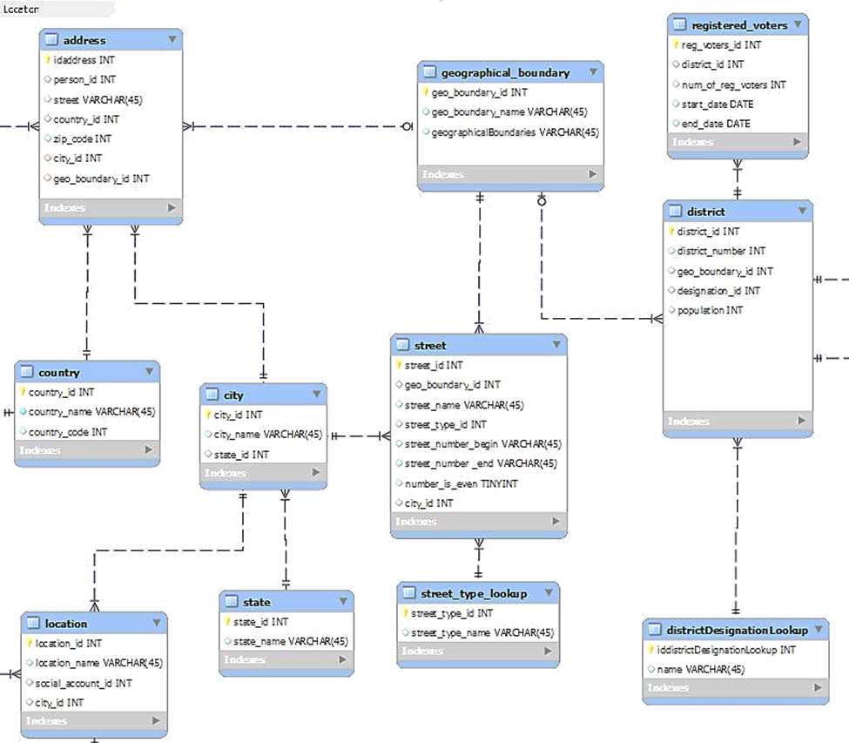
Location Layer
This layer deals with addresses, general locations (i.e., library, café, school), districts, and how addresses are sorted into its respected districts
-Keiffer

Slide 10
General Address Tables
The left part of the location layer will contain tables that are more related to addresses such as street, city, state, and country.
The location table will store locations that social media accounts are linked to. This will allow us to query what locations are associated to certain accounts

Slide 11
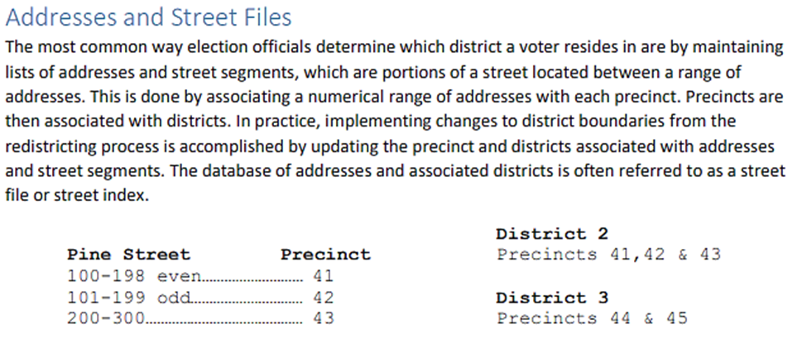
Districts
The right side of the layer will deal and interact more with the election/ballot field of the database.
This contains data on districts such as number of voters in each time frame, and geographical boundary.
The geographical boundaries are determined by which street addresses are location within it. This will be a range of street numbers depending on whether it is odd or even.

Slide 12
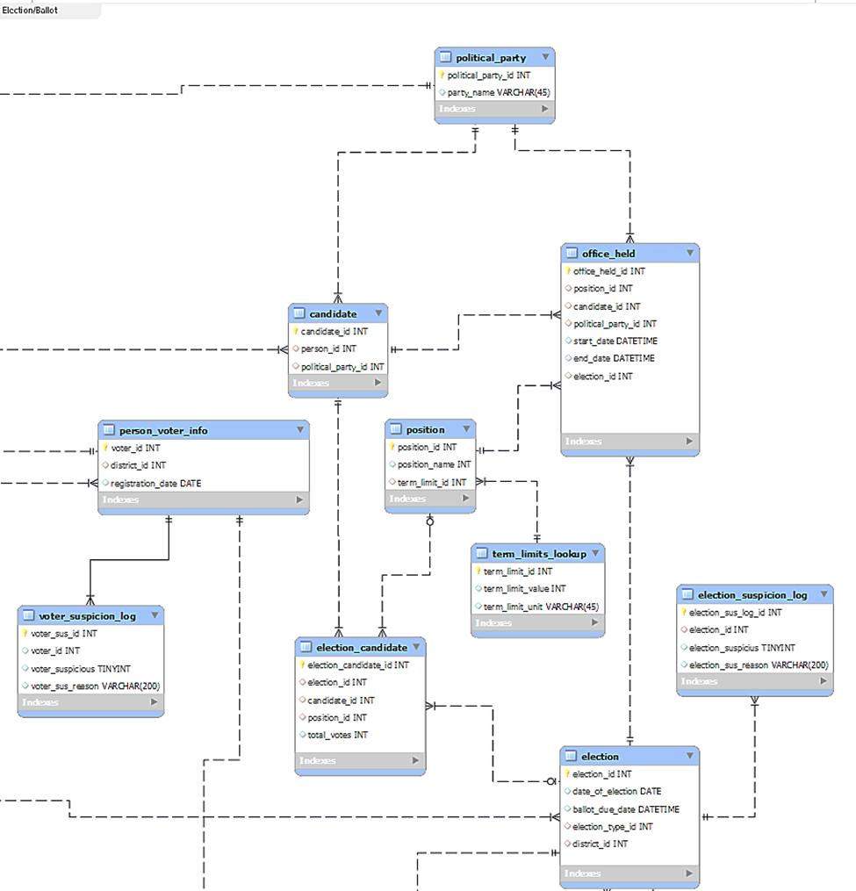
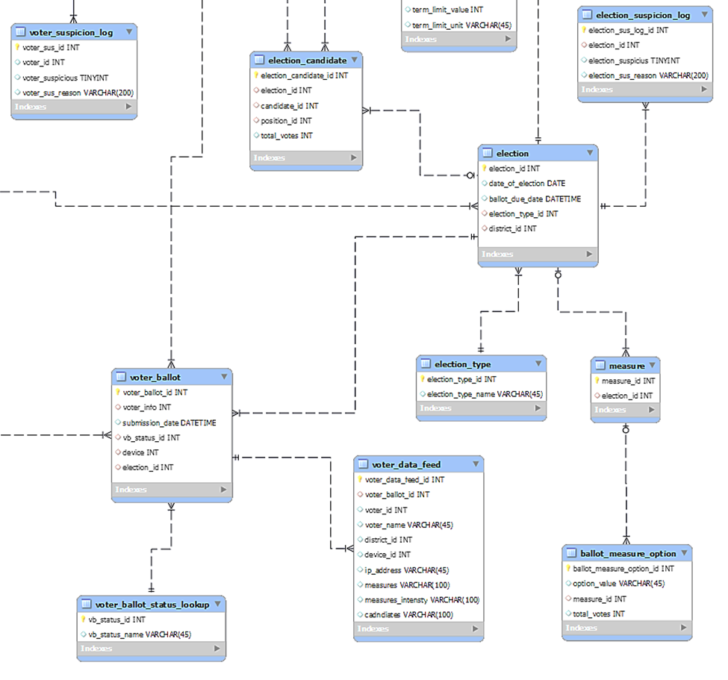
Election / Ballot Layer
TOP BOTTOM -Keiffer

Slide 13
Top section
The top section mainly deals with individual voters as well as candidates
The table related to the candidates hold information such as the position they are running for in each election, the term limits, their political party, and the history of offices held by the candidate.
There is also the voter table which holds basic information to be used in the ballot table which is in the bottom section, but there is a special table that acts as a flag table if there is any suspicious activity.

Slide 14
Bottom section
The bottom section deals mainly with election information along with voter ballots.
There is a ballot that acts as a gateway for our data feed to distribute ballot date into election data.
The election related data will contain candidates and how many votes they have as well as measures and they vote results.

Slide 15

Social Media
Hold personal information about Indvidual's social media activities:
Track the different social accounts a person have
Can give a good picture about how that person stand in different topics.
Help to make electoral prediction or tendencies on how that person could vote in the next election
Miguel

Slide 16

How can predict?:
By tracking different social events such as :
Event Nature
Hashtag
Event Types
Social Actions
Also, by tracking purchases, can give some ideas about the social environment in which that person lives
Miguel

Slide 17
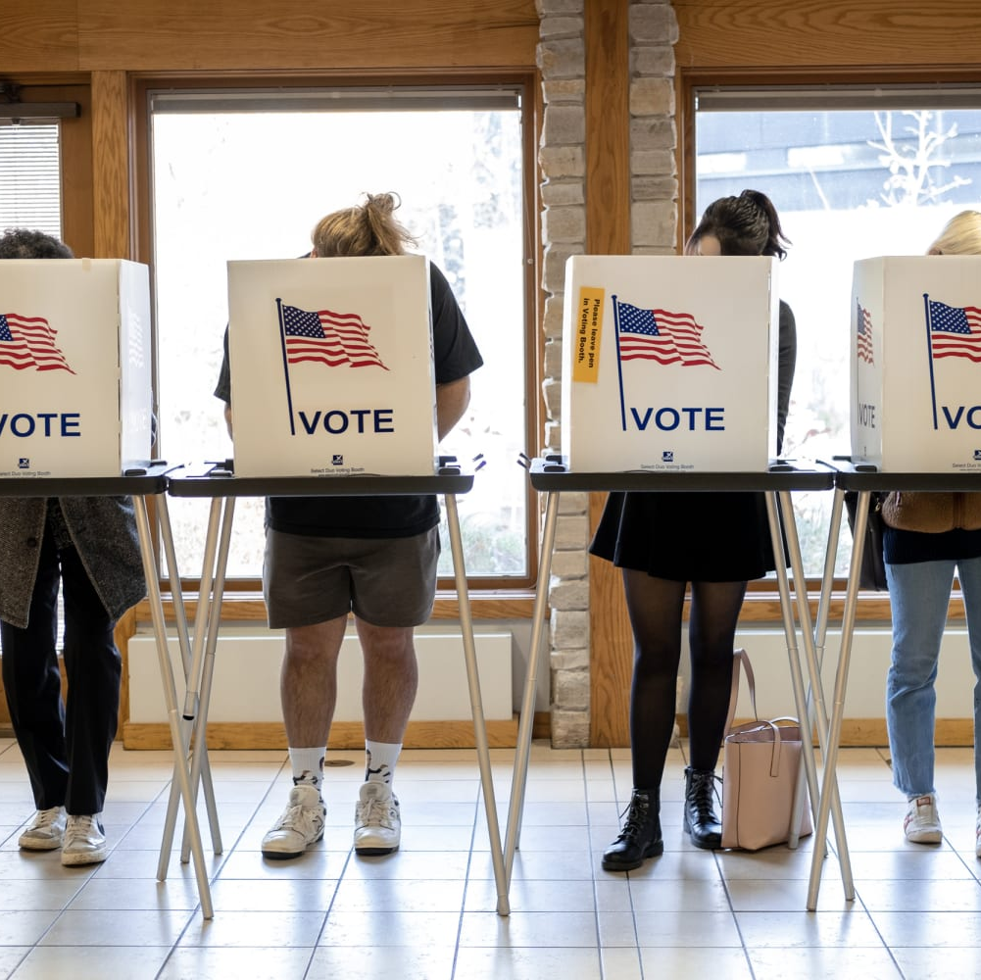
Social Media and Elections
It helps to compare what people say publicly on social media with the election result and establish a relationship between those parameters. It can determine the consistency between the voter and the person inserted into society.
Even though the person and the voter are the same individual, sometimes how they vote and how they express themselves publicly are not consistent.
Miguel

Slide 18

Devices
Hold information about different devices where actions or events were made.
It can do that by tracking IP addresses, and device types such as laptops, tablets, phones, among others.
Miguel

Slide 19

Stored Procedures

Slide 20
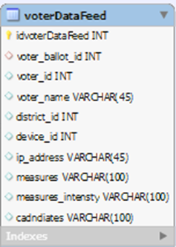
Parsing voter_data_feed
Voting once – checks to make sure there is only 1 vote cast per voter in each election. If the person has already voted more than once, flag the voter_id for suspicious behavior.
Voter information matches in system – check to see that the information submitted by the voter matches the information stored within the system to ensure that the person voting is the actual person. The information includes voter_id, voter_name, and district_id

Slide 21
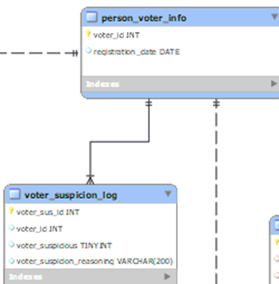
Parsing voter_data_feed cont.
Checking device_id – the device_id is logged when the use submits a vote, and there is a light check to see if the voter_id is linked to a social_account that has used that device in their logs before
Processing measures votes – There will be two fields in which the measure vote will passed, which are 2 arrays in measures and measures_intensity. Each index of the array with respectively corresponds to the other, with the measures array containing the measures to be voted on and measures_intensity array containing if the voter has either approved or rejected the measure.
Process candidate votes – This field will contain an array of names that the voter has voted for. If their name appears, then it means that is the candidate the person votes for. But the procedure needs to check that those candidates are actual candidates in the system for the designated election. The procedure also needs to check that each candidate is running for a different position in the specific election ballot.

Slide 22
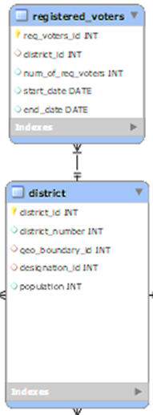
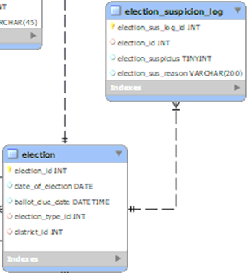
Check number of voters in district
This procedure will check to make sure that the amount of voter ballots submitted per election.
  Using the information from the elections table, I can count the amount of submitted ballots and cross check the information with the number of registered voters in the district at the time of the election.
  If there are some discrepancies with the number of total ballots regardless if it was accepted, flag the election for further review from a person

Slide 23
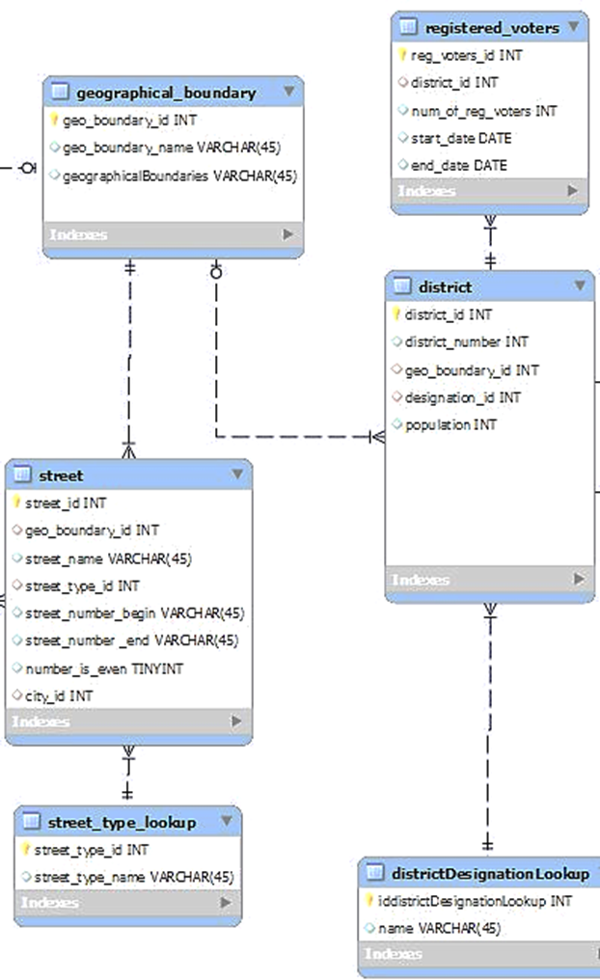
Check that person addresses are still within geographical boundaries
This procedure will ensure that each voter’s district matches actual district geographical boundaries. So, whenever an update with geographical boundaries is made, it automatically parses through voter registered addresses to ensure that they are still in the correct district. If they are not, update the district to match the proper district.

Slide 24

Queries

Slide 25
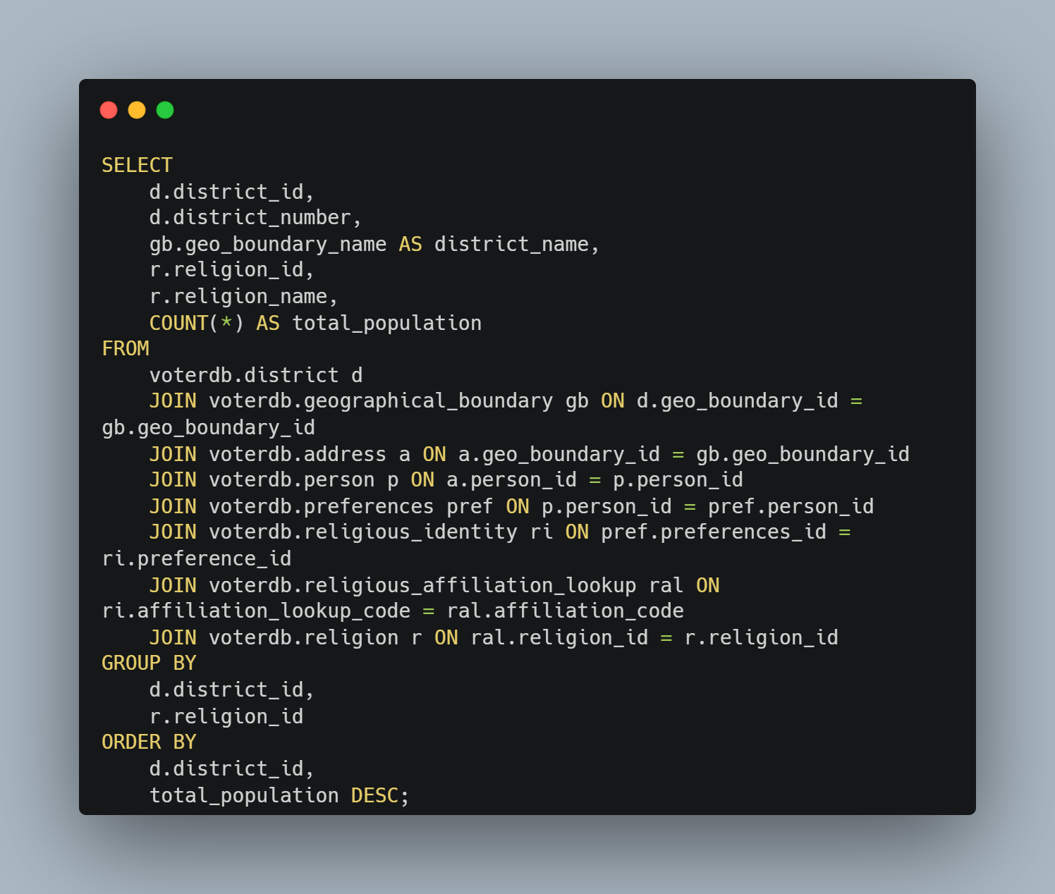
Query
Most discussed religions by district.
Cameron

Slide 26
Social Media Query
This query will connect the person table with their different social account, and what their saying, thinking or liking in the social media.
SELECT
p.firstname, p.lastname,
sp.name AS social_platform,
sa.user_name AS username,
se.content, se.event_time
FROM
social_event se
JOIN social_account sa ON se.account_id = sa.social_account_id
JOIN person p ON sa.person_id = p.person_id
JOIN social_platform sp ON sa.social_platform_id = sp.social_platform_id;
Miguel

Slide 27
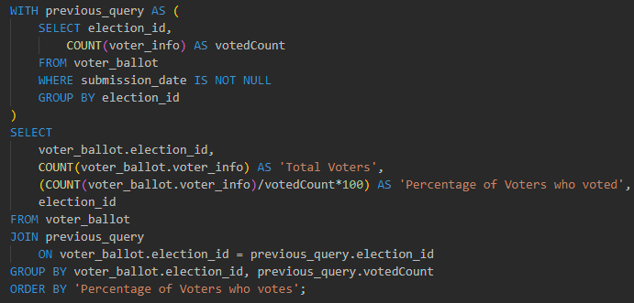
Checking percentage of voters who voted in an election
This query will return the percentage of voters who voted in each election and ordered in ascending order.
keiffer

