Slide 1

University Result PDF Parser
Department of Information Technology
Dharmsinh Desai University College Road, Nadiad-387001
April – 2018
Prepared by
Shubham Dhanetia (IT032)
Internal Guide:
Prof. H.B. Prajapati
Department of Information
Technology
Faculty of Technology
DD University

Slide 2


Project Purpose
To parse the student result pdf file and store the data in excel files

Slide 3


Development Tools
Windows Form Application
Software : Visual Studio 2017
Library : Regex , ItextSharp,Interlop Excel

Slide 4
SYSTEM FLOW
1
Input File
2
Applying Series of Filters
3
Generate Excel Files

Slide 5
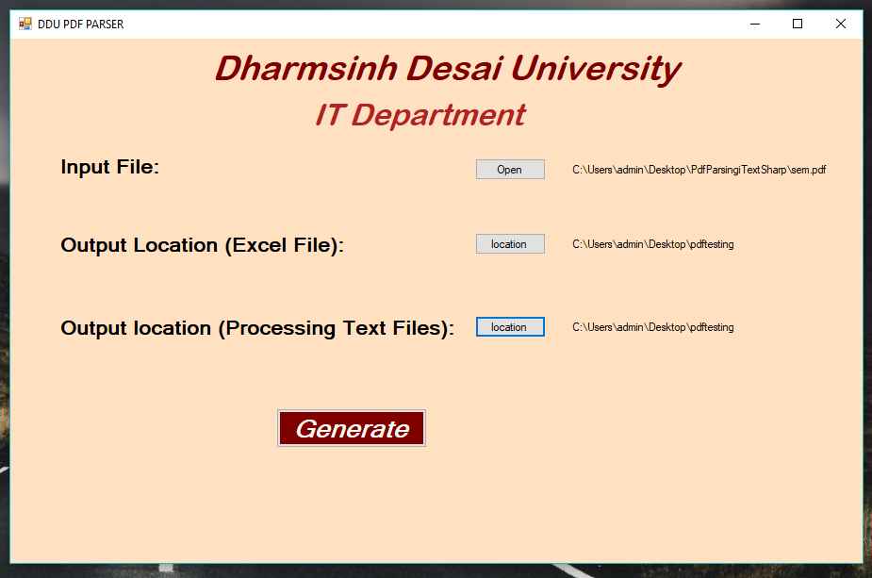
Input File and Output Location

Slide 6
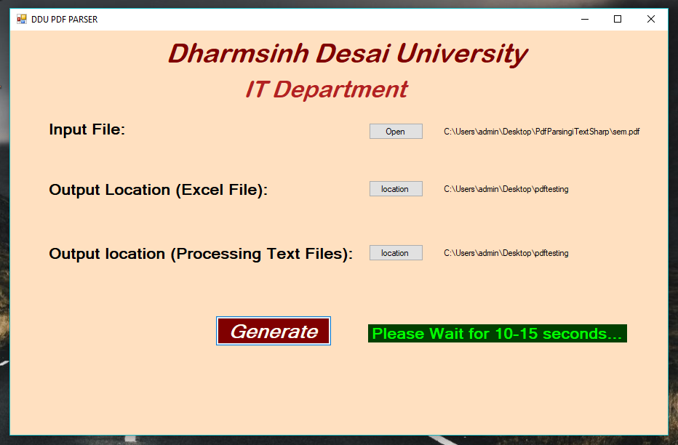
Processing….

Slide 7
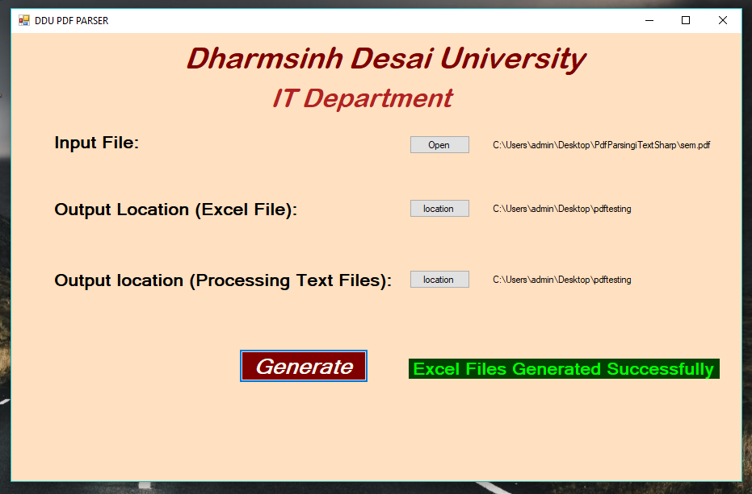
Excel Files Generated Message

Slide 8
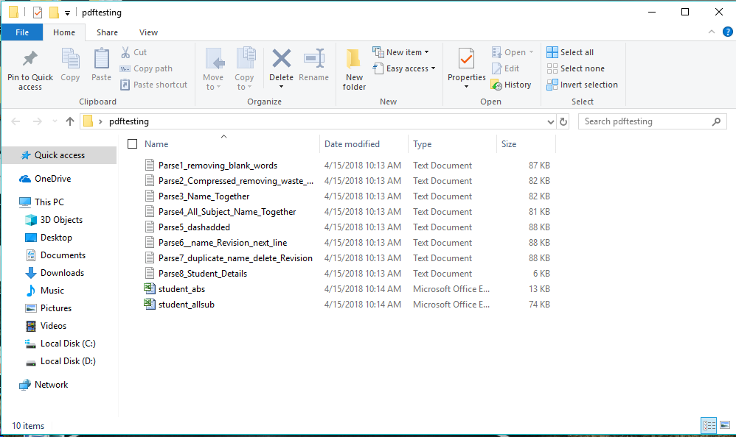
Output Files

Slide 9
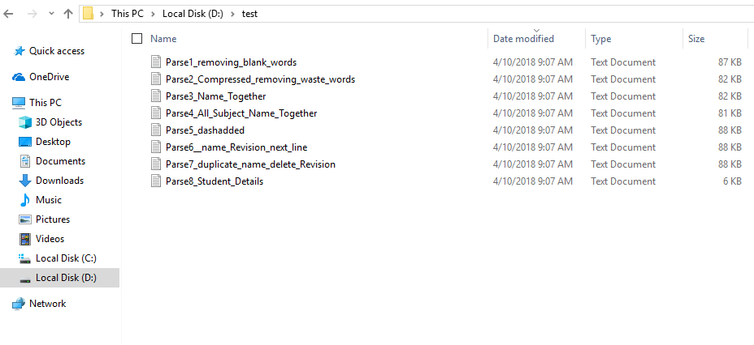
Processing Filter Files For Pattern Analysis

Slide 10
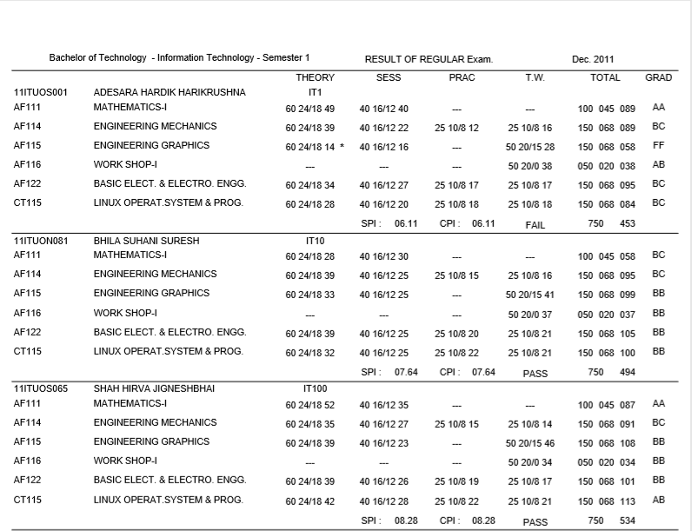
Input Result PDF File Format

Slide 11
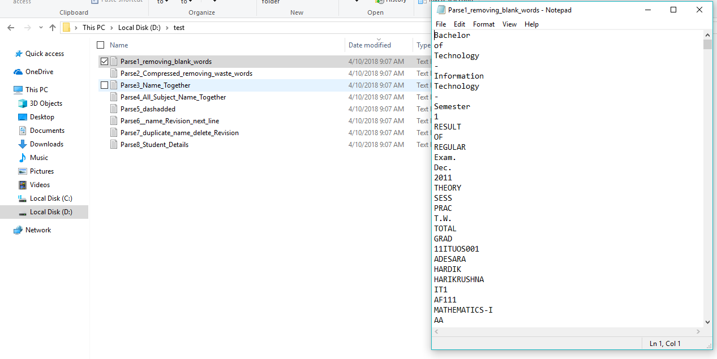
Step 1: Transform into Words

Slide 12
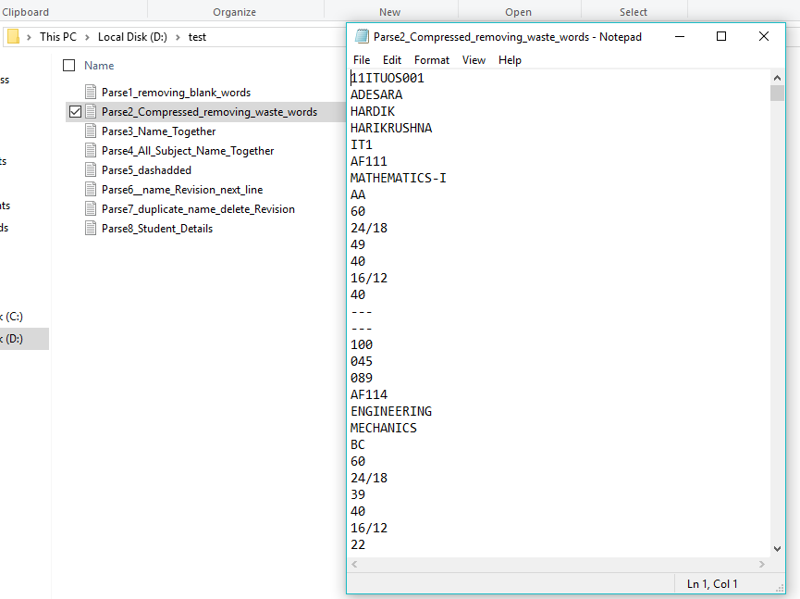
Step 2: Removing unwanted words

Slide 13
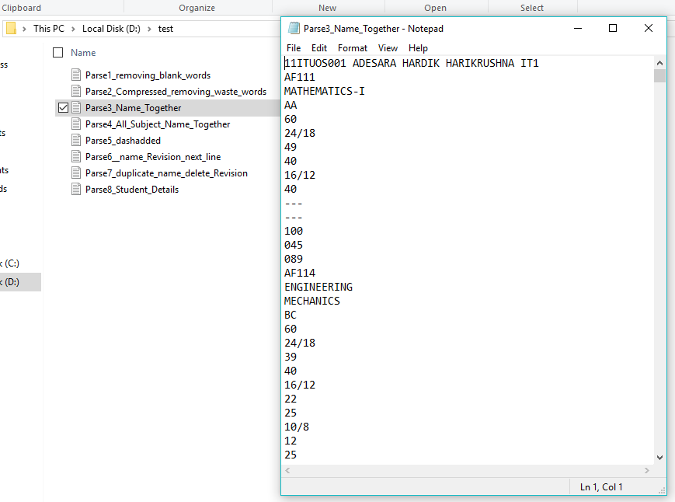
Step 3: Student Name Together

Slide 14
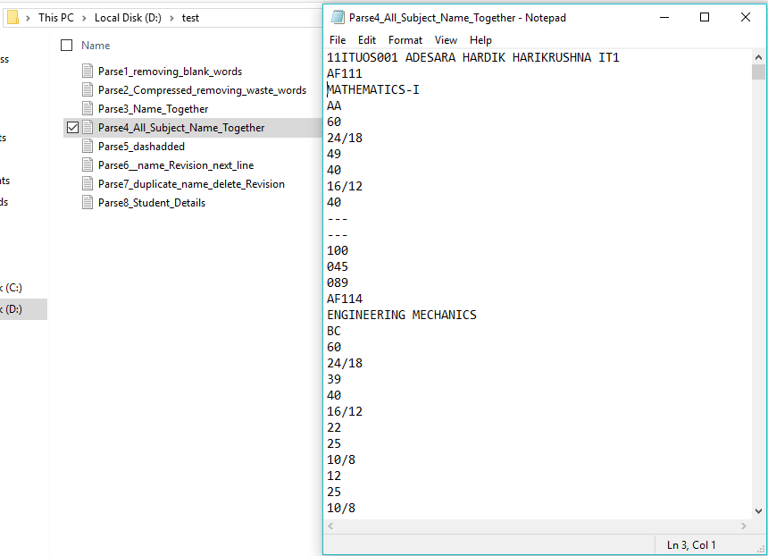
Step 4: Subject Name Together
PRACTICAL
TERM WORK

Slide 15
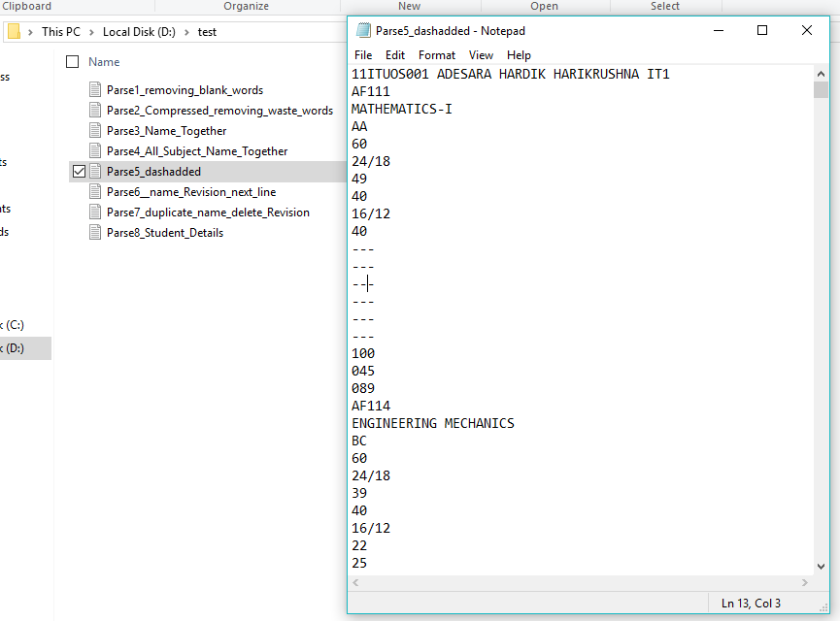
Step 5: Adding (+2) “---” whenever a “---” is encountered
Practical Total Marks
Practical Criteria
Practical Scored
Same for Term Work

Slide 16
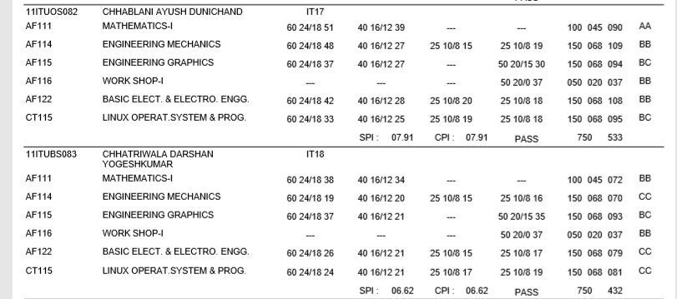
Step 6: Surname is in next line issue
Problems in Result PDF File
Surname in
Next Line

Slide 17
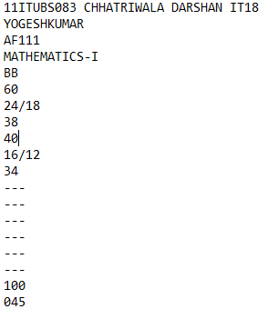
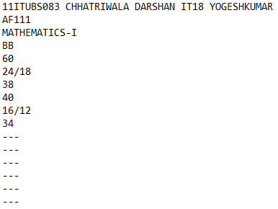
Step 6: Surname in Next Line Issue Solved

Slide 18
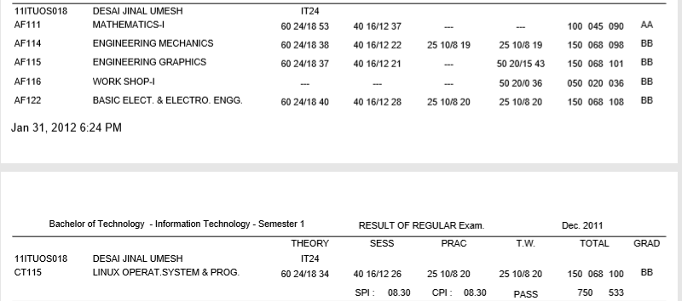
Step 7: Duplicate Student Name Deletion
This Problem is Solved in this Step
Result Splits
In Footer for
Some Student

Slide 19
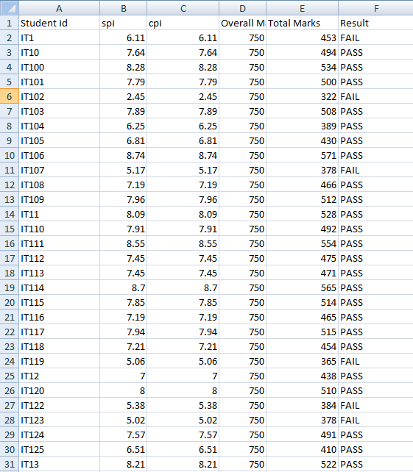
Step 8: Creating the Excel files
Abstract Student Record Excel File

Slide 20
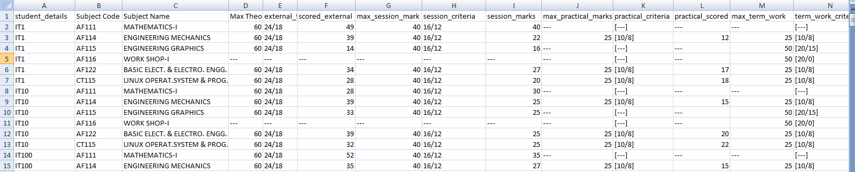
Step 8: Creating the Excel files
Student Total Record Subject Wise

Slide 21
Conclusion
I am here by to conclude that I have successfully implemented the PDF Parsing Project

Slide 22

Shubham Dhanetia

