Slide 1
CSI Governance Plan
History and context

Slide 2
Governance Plan/Bylaws -- CSI
Through the short history of CSI, the drafting and revisions of the bylaws have always been a collaborative endeavor.
Various iterations of the governance structure empower the Bylaws Committee to advise the college community to revise different provisions of the bylaws.
Bylaws Committee
(2.1.1) Conduct ongoing review of the Governance Plan of the College and to recommend revisions to the Plan.
Memberships include administrators, elected faculty representatives, HEO, student and full time instructional staff
The bylaws have always been revised with specific reasons and goals.

Slide 3
Approved by the Board of Trustees
The current bylaws and all previous versions of the CSI’s governance plan were approved by the CUNY Board of Trustees.
https://policy.cuny.edu/wp-content/uploads/sites/6/page-assets/documents/faculty-staff/CFSAAgenda041618-002-61.pdf
The proposed amendments to the Governance Plan of the College of Staten Island (“the College”) were approved on March 19, 2018 by referendum of the Instructional Staff conducted at the initiative of the President and are recommended by the President.
Act Adopted by the Board of Trustees on October 26, 1981, Cal. No. 6.B. Amended by the Board of Trustees on January 26, 1987, Cal. No. 9.C; June 29, 1987, Cal. No. 6.D.; February 26, 1990, Cal. No. 5.A.; May 28, 2002, Cal. No. 7.B.; June 24, 2002, Cal. No. 8.C.; November 27, 2006, Cal.No. 6.E.; and November 23, 2009, Cal. No. 6.A.

Slide 4
Governance: President Springer tenure 1994-2007
Discussion for amendments to the bylaws was started in 1998
Took 3 years to complete the whole process in 2002, with careful deliberation and participation of the college community
That bylaws committee was chaired by the provost, with many faculty and staff serving on the committee
2006, an amendment was made to change to adopt the bicameral body – The College Council and the Faculty Senate. With the Faculty Senate to be responsible for academic matters like curriculum, programs requirements, admissions standards and tenure and promotion. The College Council adds to the faculty senate to include staff and students to discuss wider college issues, like budget, strategic plan and athletics.

Slide 5
Governance: President Morales 2007-2012, extended into President Fritz tenure
Discussion started in 2008 or even earlier
The current Governance Plan was finally adopted in May 2018
The bylaws committee, an elected body, met for years.
The bylaws committee provided continued updates to the college community through the years.
The rationale for change was based on the establishments of the Schools. The previous bylaws hardly had any representation from deans, facultyand staff from the schools. To ensure equitable representation, the bylaws were revised.
Next is an email from 2009, showing how deliberative the process was.

Slide 6
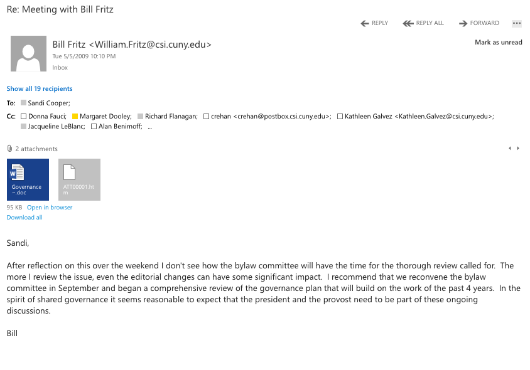

Slide 7
Governance: Interim President Bill Fritz 2012-14 President 2014-present
The current governance plan was revised and adopted in May 2018.
The new proposal was announced to the college community by President Fritz on March 3, 2021.
The Bylaws committee was not consulted.

Slide 8
Article V of the Current Governance Plan
A proposal to alter any provision of Articles I through III may be initiated by the President or by a two-thirds vote of the College Council. Such proposals shall then be submitted to a referendum of the instructional staff. The proposed amendment is to be deemed adopted if approved by a majority of those voting (provided that at least 30% vote), by the President, and by the Board of Trustees.
Let’s look at the words ALTER and AMENDMENT

Slide 9
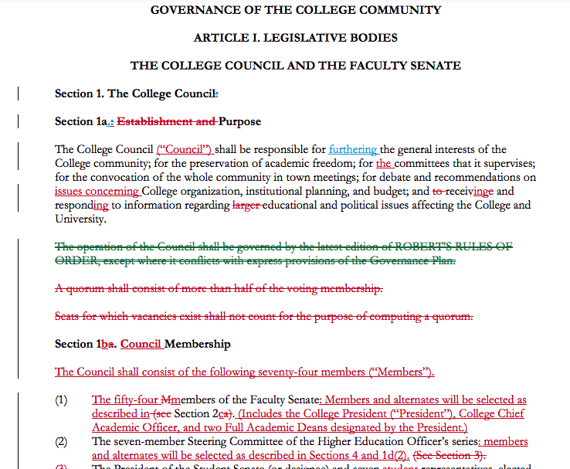
Example: Bylaws document, 2018

Slide 10
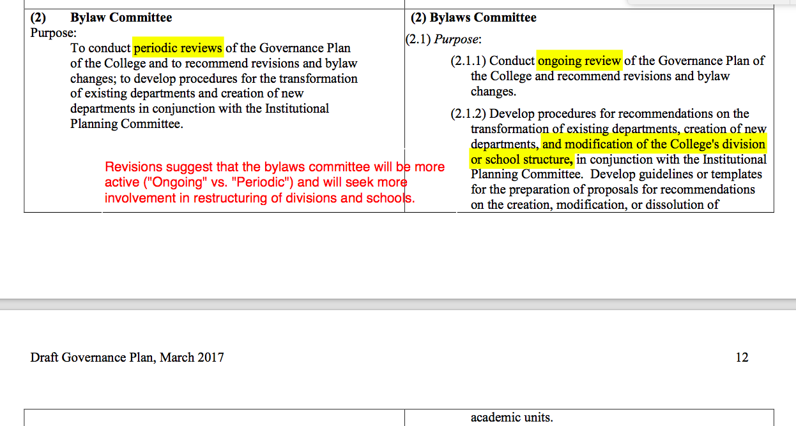
Example of working documents of the CSI bylaws (2017)

Slide 11
How to define ALTER?
to change something, usually slightly
Printed on the cover page of the current Governance Plan:
“LAST REVISION: MAY 9, 2018”

Slide 12
How to define Amendment
An Amendment is an addition, not a replacement
For example:
The Bill of Rights with the ten amendments were added to the Constitution; the Bill of Rights did not replace the Constitution of United States.
When the 15th and 19th Amendments were passed, African Americans and Women became eligible to vote, but it did not take away the rights of White men to vote.
President Fritz's proposal replaces the current governance plan; it is not an amendment.

Slide 13
The proposal from President Fritz
College of Staten Island Governance Plan Draft of: March 3, 2021
No before and after comparison was provided.
It is a wholesale replacement of, not an amendment to, the current Governance Plan of 2018

Slide 14
A word or two about Shared Governance
From the same source quoted on the email from President Fritz on March 3rd, 2021
Leach, William. Shared Governance in Higher Education: Structural and Cultural Responses to a Changing National Climate. The Center for Collaborative Policy. 2008. https://pdfs.semanticscholar.org/dfac/92e32ef98ba211c0dfc8790bfd5c49c32e16.pdf?_ga=2.109630528.417210235.1615363330-1810048700.1615363330
Quoting Tierney&Hagedorn 2003
ʺApathy and lack of trust are the most significant barriers to meaningful faculty participation. Individuals related that meaningful involvement is difficult when the faculty voice is not respected and shared governance is not taken seriously.
Respect trumps resources. ….individuals placed a higher value on genuine respect by the administration for creating effective faculty involvement in governance.ʺ (Leach:6)

Slide 15
Tierney (2004, 214‐15) concludes
ʺParadoxically, the way to improve governance is usually not through an intensive restructuring of the organization but through paying attention to the culture of the organization… Quality comes about not because higher education has finally designed the one best governance system but because an organizationʹs participants are able to effectively interpret the culture of the organization.ʺ (Leach:15)

Slide 16
Links to current 2018 Governance Plan
https://webdocs.csi.cuny.edu/campus_info/pdfs/Governance_Plan.pdf
https://www.csi.cuny.edu/about-csi/csi-glance/policies-procedures-and-governance
Faculty - Teaching Instructional Staff
College of Staten Island Governance Plan

Slide 17
More from Leach
While advocating strong management, Duderstadt also forcefully describes the importance of recruiting faculty into the administration: ʺI believe it absolutely essential that experience with academic values and the activities of teaching and scholarship must permeate all levels of university governance. Furthermore, this experience can be provided only by those who have toiled in the vineyards of teaching and research as faculty members.ʺ (p. 151)

Slide 18
Calls for Genuine Influence
“A number of scholars have lamented the lack of genuine authority vested in many faculty senates. A common theme is that effective shared governance requires faculty to have sufficient voice and influence to participate meaningfully in policy matters. For example, in a regression analysis based on his survey of 2,053 faculty and administrators at 588 institutions, Minor (2003, 971) finds that the five strongest predictors of perceived senate effectiveness are ʺ(a) high levels of faculty involvement in the senate, (b) high levels of faculty interest in senate activity, (c) having significant influence over issues related to tenure and promotion, (d) having significant influence in the selection of the provost and president, and (e) having significant influence in setting strategic and budget priorities.ʺ” (Leach: 24)

