Slide 1

Don’t Panic Educational Suite

Slide 2

Don’t Panic Educational Suite

Slide 3

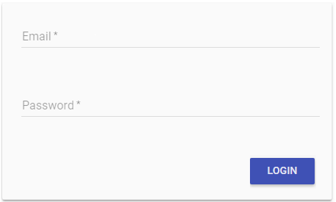
Don’t Panic Educational Suite

Slide 4

Don’t Panic Educational Suite

Slide 5

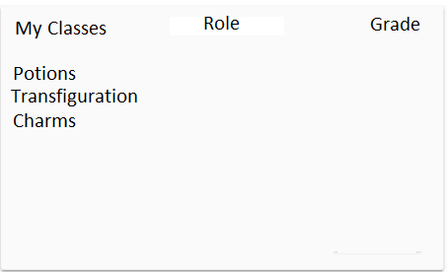
Hogwarts School of Witchcraft and Wizardry
Actions
Create New Class
Enroll In Class
Delete a Class

Slide 6
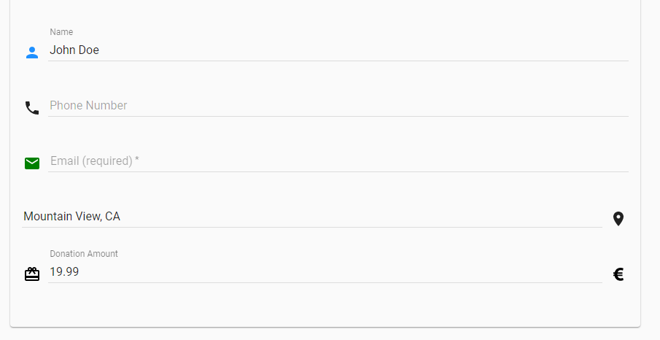

Hogwarts School of Witchcraft and Wizardry
Mock up for how a teacher would create a class. Field instead of the above would be things like Teacher Name, Class Name, Educational Institution, City/State etc… For students, a class ID and passcode would be required to register for a class

Slide 7
Hogwarts School of Witchcraft and Wizardry
Class Hub
Panic Button
Question Forum
Teacher Tools
Idea for how to navigate, assuming we decide to break up everything

Slide 8
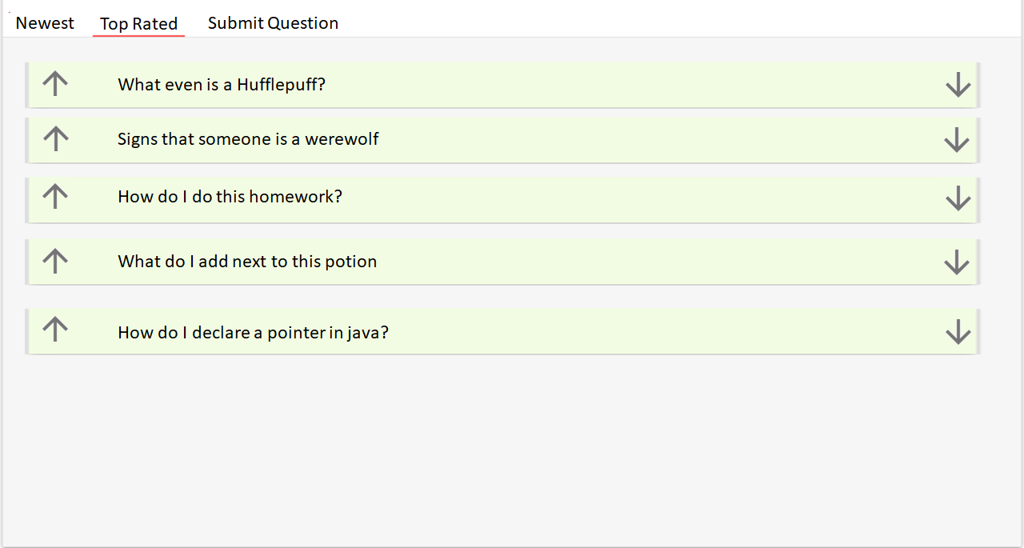
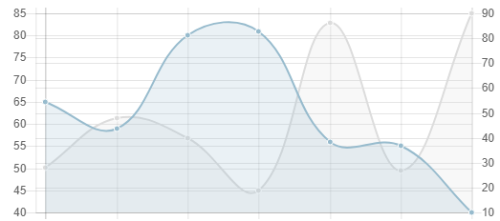
Hogwarts School of Witchcraft and Wizardry – Teacher View
Class ID: 8675309
Enable Class Enrollment
Generate Passcode
Current Student Count: 29
0 5 10 15 20 25 30 35 40 45 50 55

Slide 9
Hogwarts School of Witchcraft and Wizardry - Potions
Current Student Count: 29
0 5 10 15 20 25 30 35 40 45 50 55

Slide 10
Hogwarts School of Witchcraft and Wizardry - Potions
Current Student Count: 30
0 5 10 15 20 25 30 35 40 45 50 55

Slide 11
Android App

Slide 12
Hogwarts School of Witchcraft and Wizardry
Current Student Count: 30
0 5 10 15 20 25 30 35 40 45 50 55

Slide 13




Hogwarts School of Witchcraft and Wizardry
Newest
Top Rated
Submit Question
What even is a Hufflepuff?
Signs that someone is a werewolf
How do I do this homework?
What do I add next to this potion
How do I declare a pointer in java?

Slide 14



Hogwarts School of Witchcraft and Wizardry

