Slide 1

Word2vec Parameter Learning Explained
Jeong Hoon Choi
USCID: 5023184813
DSCI-560
Data Science Professional Practicum

Slide 2
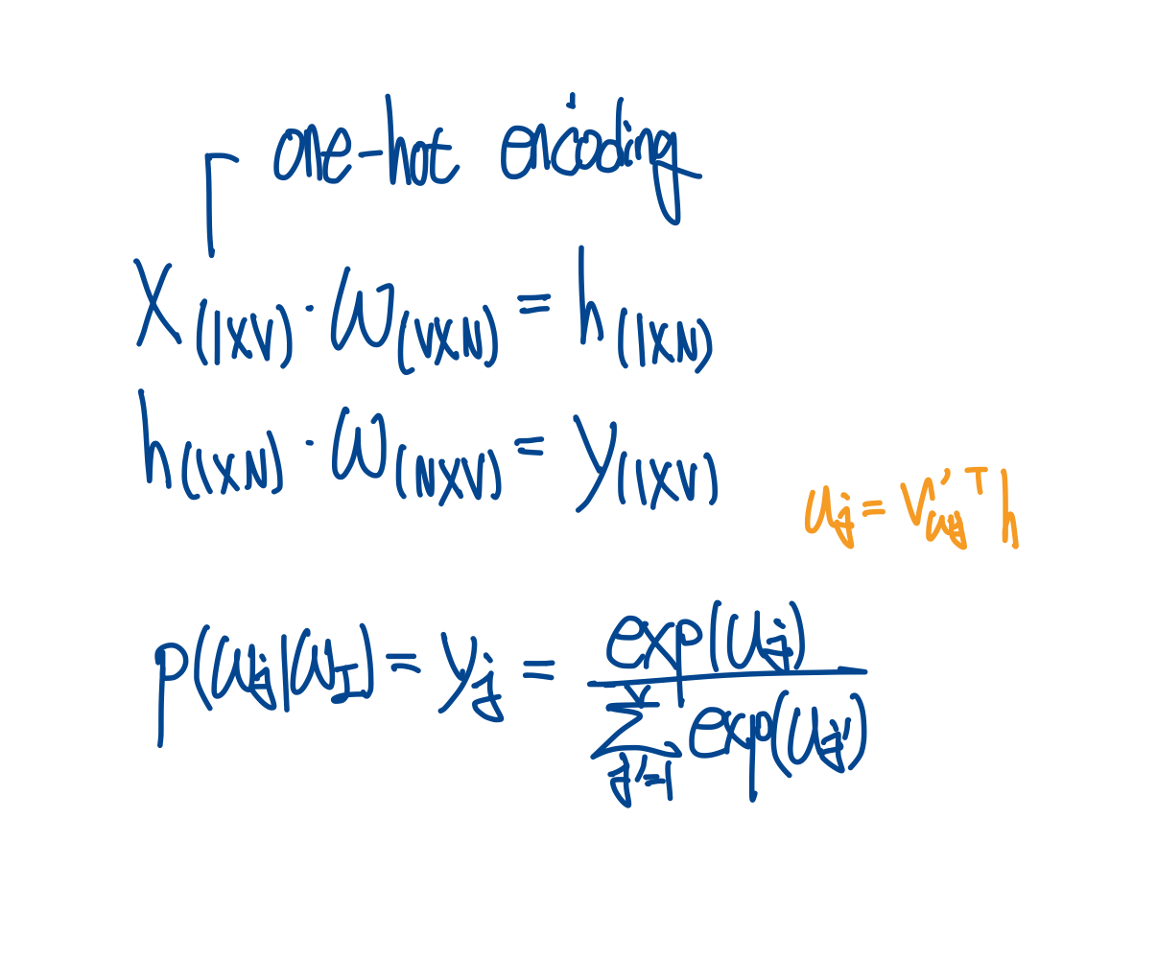
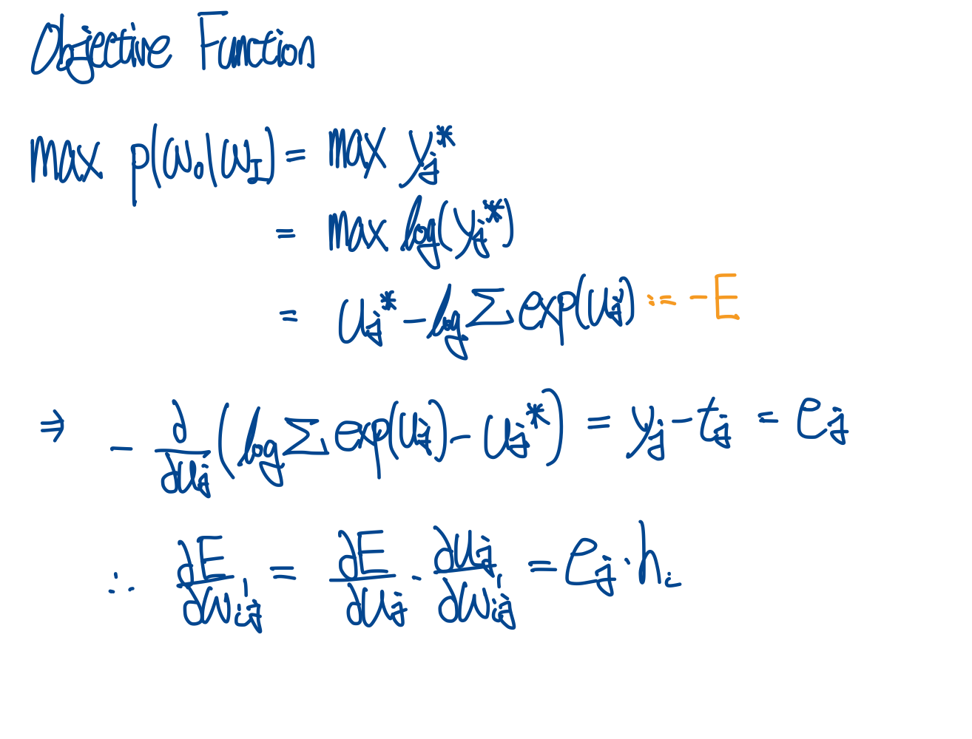
Continuous Bag-of-Word Model
Hidden -> Output Weights update

Slide 3
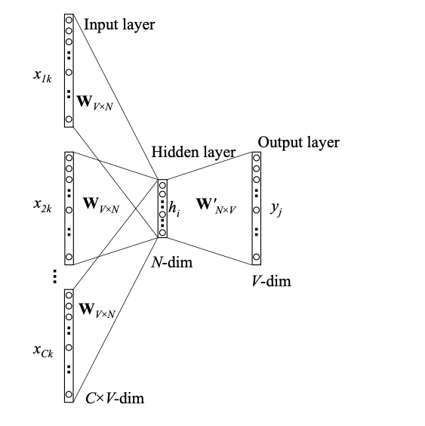
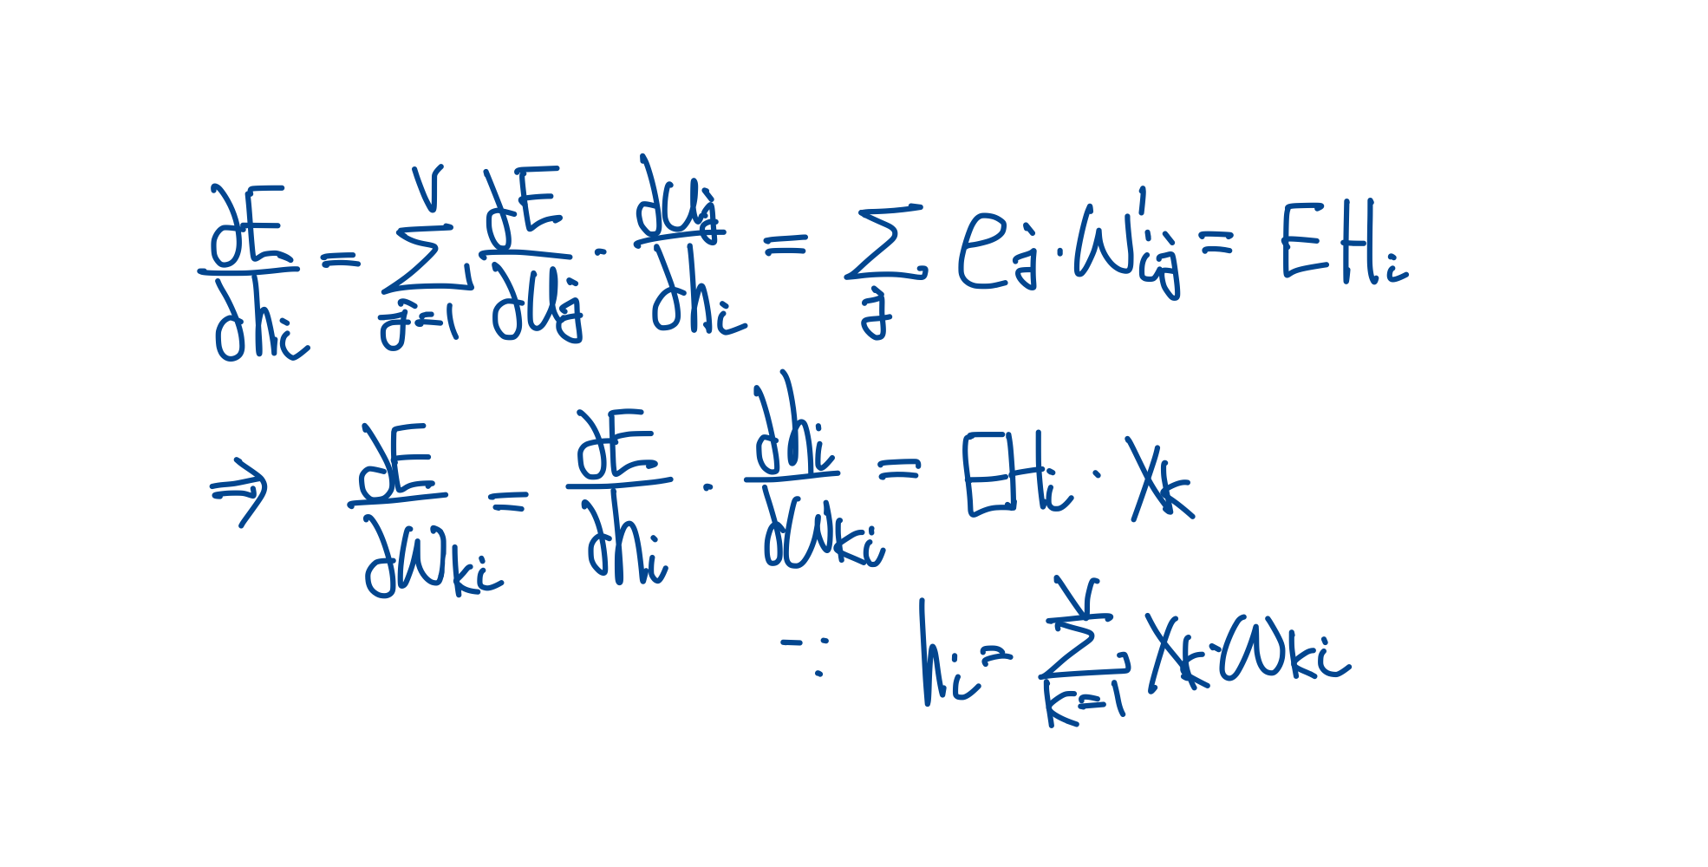
Continuous Bag-of-Word Model
Input -> Hidden Weights update
From Single-word Context to Multi-word Context
As with Single Word Context, for C Word Contexts, the input vector (One-Hot Encoding) can be thought of as C independent W_(V x N) weights and one W’_(N x V). Average vector as the output (hidden)
CBOW predicts the middle word for surrounding words (CONTEXT). In one-word and multi-word contexts, these correspond to the input. A model is created that predicts the middle word for the CONTEXT (one-hot encoding) and predicts the label.

Slide 4
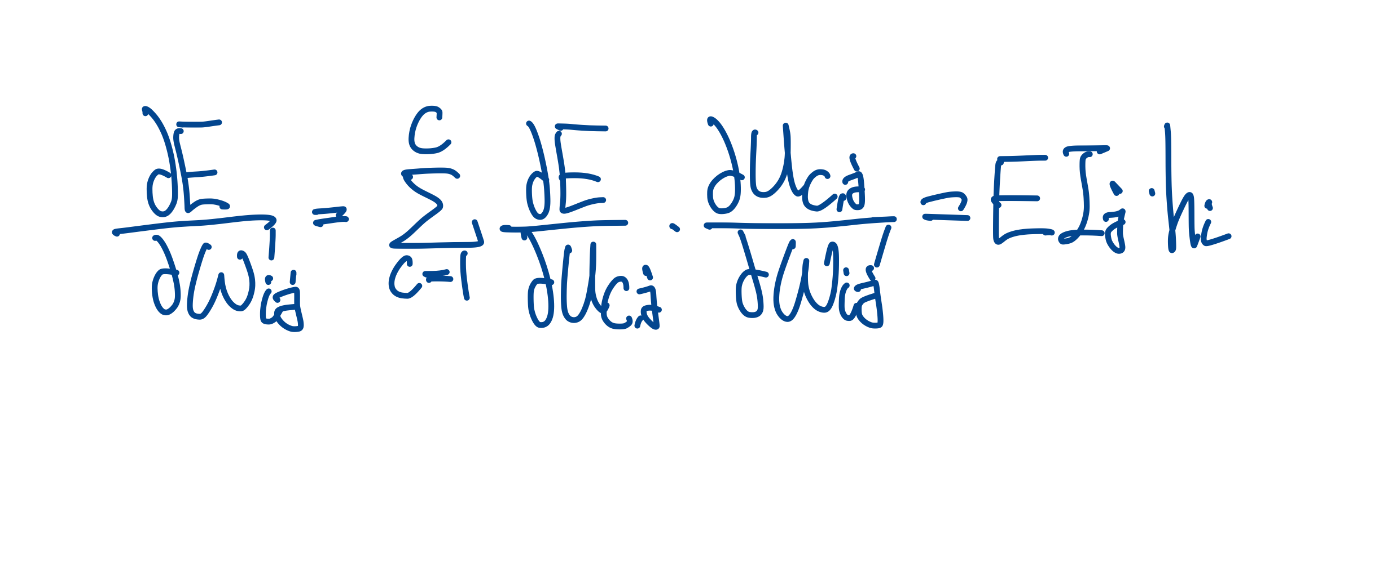
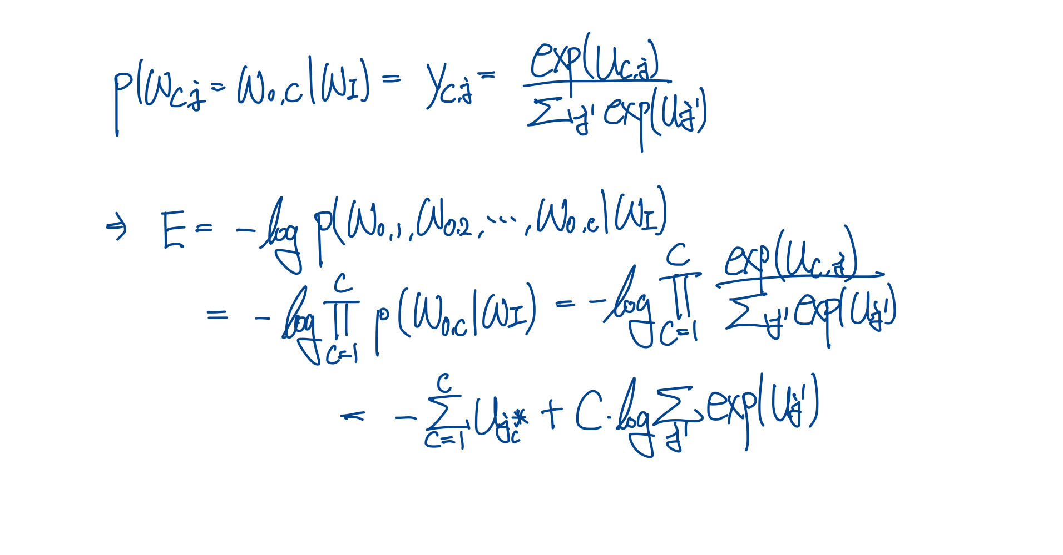
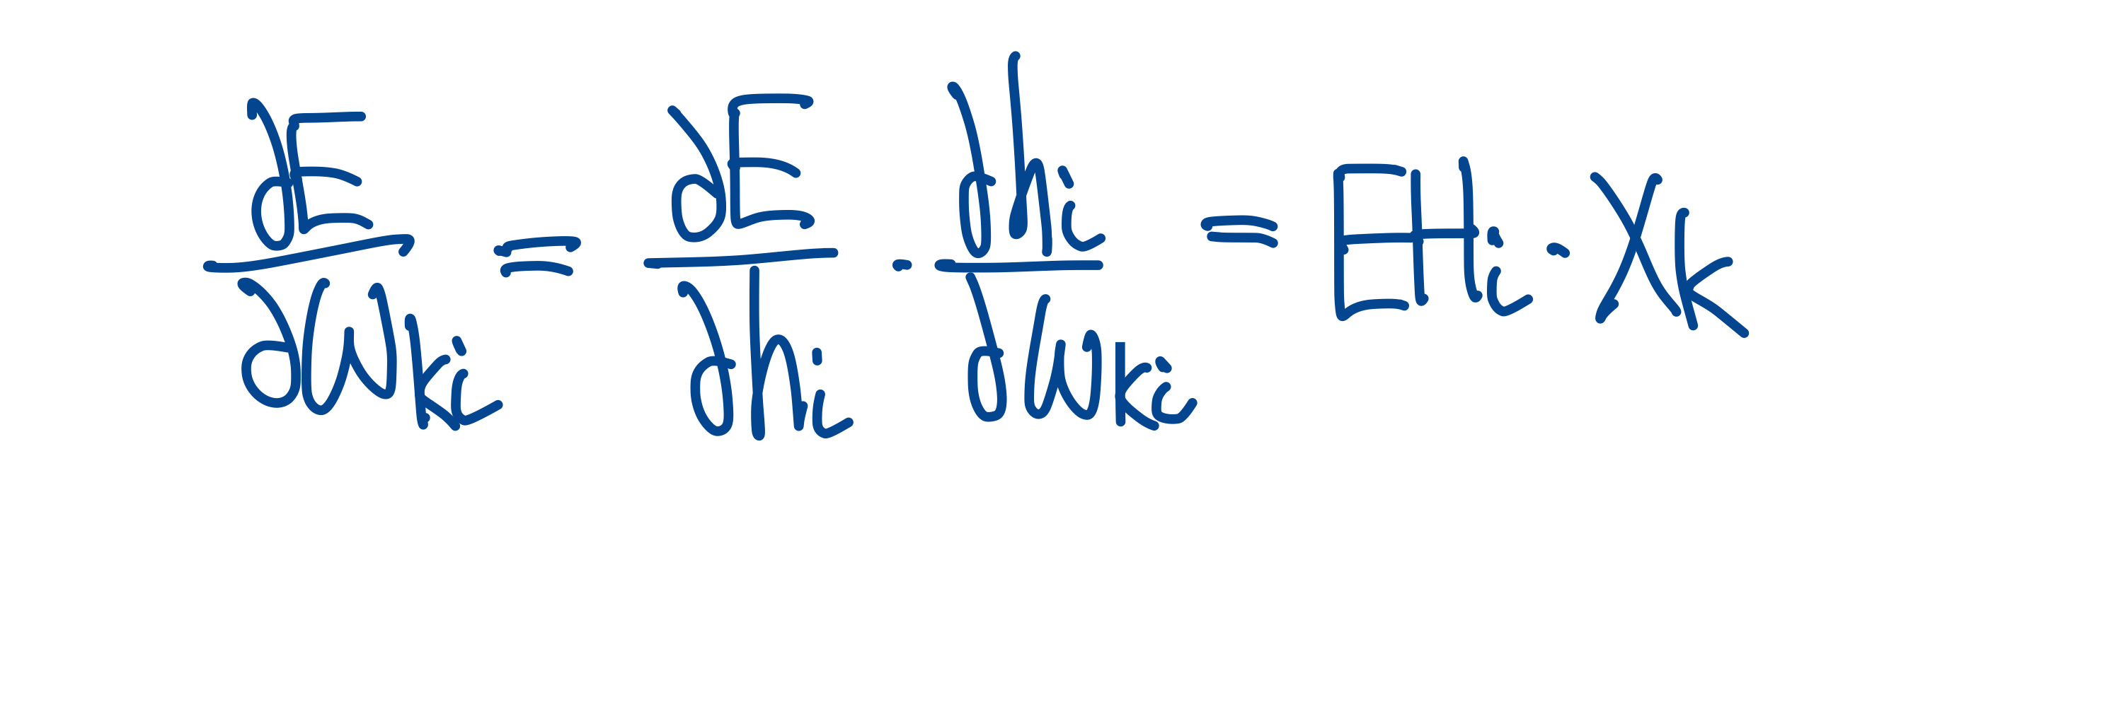
Skip-Gram Model
Hidden -> Output Weights update
Input -> Hidden Weights update
Same with CBOW

Slide 5
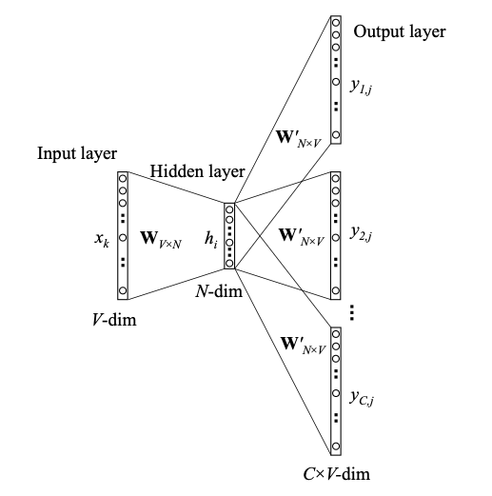
Skip-Gram Model
Conversely, the Skip-Gram model predicts the surrounding word CONTEXT for a given target word.
The input is the middle word (one-hot encoding), and the output is a one-hot encoding of the words corresponding to the CONTEXT.

Slide 6
Optimizing Computational Efficiency
Hierarchical Softmax
Binary tree: all words in the leaf (in complete binary tree if leaf has V nodes total nodes are (2 V - 1)
For every words has unique path from the root to the unit
Instead output vector representation for words inner units has an output vector
Probability of word is conditional probability of each node on the path
O(V) -> O(log V): height of binary tree

Slide 7
Optimizing Computational Efficiency
Negative Sampling
Instead of updating the weights for all words, we only perform weight updates for their samples.
Samples for the correct label (TARGET for CBOW, CONTEXT for Skip-Gram) must be included, but for other labels (Negative), random samples are sampled and training is performed.
O(V) -> O(K): K is negative sampling size

Slide 8
Question:
Numerically represent and explain the degree of performance improvement of the Word2Vec optimization methods described in the paper.
Answer:
Naïve CBOW or Skip-Gram Word2Vec:
The biggest computational bottleneck occurs when calculating the MLE term. For example, when calculating the term we need to calculate whole word probability given CONTEXT.
Hierarchical Softmax Optimization:
The root of a word is represented in binary tree format, and only the vectors of the nodes on the path are updated. Therefore, the operator of O(V) can be reduced to O(log V) because it is calculated only with the node vectors on the path.
Negative Sampling Optimization:
When calculating the loss, instead of calculating it for every word, we sample K negative terms that include the target and calculate it. This reduces the computational complexity from the existing O(V) to O(K), where V >> K.

