Slide 1
DSCI-560
Lecture 1: Introduction
Data Science Professional Practicum
Young Cho
Department of Computer Science
University of Southern California

Slide 2
The Goal
Solve A Real-World Problem
  Identify A Real-World Problem
  Plan Your Approach with Milestones
  Implement Your Solution
  Demonstrate/Evaluate Your Solution
  Present Your Solution
Implementing Solution
  Plan your Approach with Mitigation Plan
  A Milestone at a Time
  Document Your System
No Time to Waste

Slide 3
Logistics
Lectures
  Tuesday and Thursday at 9 AM - 10:50 AM
  Attendance is Mandatory
  Check IN and Check OUT
Instructor: Young Cho
Teaching Assistant: TBD
Web Site: Coursistant
  https://usc.xlearnedu.com
  Please log in for the assignments, announcements, and Q&A
  Select Forgot Password
Notes:
Key: usc2011

Slide 4
Grading
Attendance
Reading Assignment
Laboratory Assignments
Final Project

Slide 5
Project
Laboratory Assignment
  Individual or Team
  YouTube Video Recordings
Tools
  VMWare
  Linux Tools
  Database
  Amazon Web Services
  Google Cloud
  GitHub

Slide 6
Online Course Tools
Brightspace
  Announcements
  Laboratory Assignments
  Reading Assignments
Piazza for Q&A
  Post all of your questions and answers
  Coursistant will answer as quickly as possible
  Most of the time, it will give you sufficient assistant
  However, it is still learning and sometimes needs corrections

Slide 7
Laboratory Assignments
Submit Archive of Laboratory Results
  Report with Snapshots and Results
  Source Code and README instructions for code
  Usually Saturday 11:59 PM
YouTube demonstration video
  Usually, the following Monday 11:59 PM
Scoring
  On-time Submissions (no exceptions)
  Multiplied by 1.0 if on-time
  Multiplied by 0.5 if late
  Demonstration Videos on YouTube
  Internet Accessible Link to the Archive (ZIP) of all

Slide 8
Incorporating Videos in Presentation/Demo
Use Smartphone Camera
  Capture your audio and video
  Prove your work/progress
Screen Capture Software
  http://www.maartenbaert.be/simplescreenrecorder/
  https://www.ispringsolutions.com/ispring-free-cam
  https://getsharex.com/
  Or other screen capture software
Content
  Capture essential steps with result narrative
  Show the completed result of the Lab
  Include Powerpoint Slides for diagrams and tables, if needed

Slide 9
Reading Assignments
About 10 Assignments
  Submit Summary Slides on Blackboard
Summary PowerPoint Slides
  Summary slides of your understanding
  At least one hand-drawn diagram
  Summary tables, if possible
  Create an intelligent Quiz Question and Answer for the paper
  Usually, Due Tuesdays at 11:59 PM

Slide 10
Objectives
Apply principles studied in Data Informatics curriculum towards a real-world challenge
Understand the requirements and objectives of clients, how these vary, and how one must tailor a solution to the expectations of a customer.
Work in a team to accomplish a common goal
Meet aggressive deadlines in a team effort
Improve project-based presentation skills
Present and sell ideas to high-level management

Slide 11
What is Data Science
Artificial intelligence
Methods for computers to perform human tasks
Data Science
Field focused on methods for extracting knowledge and insights from data
Machine Learning
Mathematical models to learn from data
Expert Systems
Operate autonomously with human-specified rules
Deep Learning

Slide 12
Data Science Pipeline
Collect your own data
  Surveys
  Experiment
  Theory-based model
Search repositories
Gather Data
Define the problem

Slide 13
Data Science Pipeline
Check for missing data and other mistakes
Mapping and understanding the underlying structure of your data
Identify the most important variables in your dataset
Gain insight about your data:
  Is the data appropriate for your question?
  Are there any biases in the data?
Often involves visualizations
Critical data science step
Gather Data
Exploratory Data Analysis
Define the problem

Slide 14
Data Science Pipeline
Choose appropriate analysis for the question
If using ML and a trained model, is the training data similar to the data to be analyzed?
What are the pre-processing steps?
Data Preparation
Analysis
Gather Data
Exploratory Data Analysis
Define the problem

Slide 15
Data Science Pipeline
Data Preparation
Analysis
Evaluation
Gather Data
Exploratory Data Analysis
Is my analysis performing as expected?
Is the analysis allowing me to address the problem?
IT IS NOT ONLY ABOUT THE ACCURACY SCORE
Define the problem

Slide 16
Data Science Pipeline
Interpretation
Data Preparation
Analysis
Evaluation
Gather Data
Exploratory Data Analysis
Define the problem

Slide 17
Data Science Pipeline
Interpretation
Presentation of results
Data Preparation
Analysis
Evaluation
Gather Data
Exploratory Data Analysis
Who is my audience?
Visualization
Report
Oral briefing
Define the problem

Slide 18
Data Science Pipeline
Interpretation
Presentation of results
Data Preparation
Analysis
Evaluation
Gather Data
Exploratory Data Analysis
Other considerations:
Is my work fully reproducible?
How should I report the data/software/workflow?
Define the problem

Slide 19
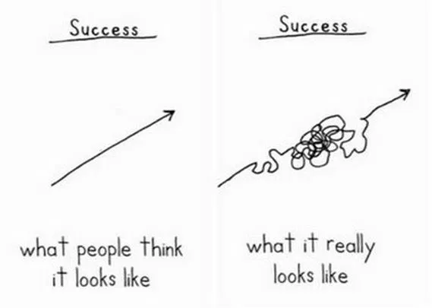
Failure is the Mother of Success
Progress is rarely linear
Missing/flawed data
Problems need to be more refined
Initial approach didn’t work
Initial hypotheses invalidated
Your goal is to learn how to move forward

Slide 20
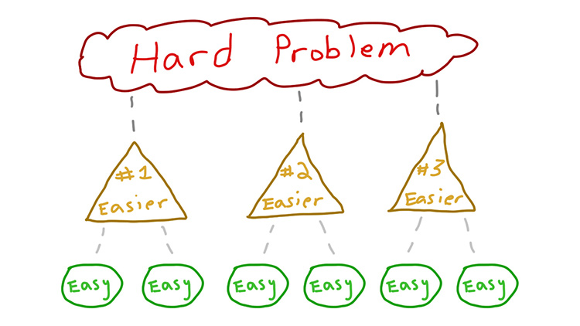

Debugging
List all the components involved. Think about where the weak link might be
Design a logical and simple troubleshooting process to find the problem
Ask for help. Ask the internet, ask your peers…
Research on your own

Slide 21
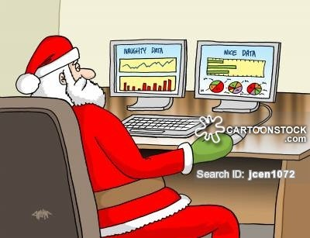
Data May Be the Problem
Data Should be Representative of the Problem
Data Should be Qualitatively the Same as the Training data
Data Should be Without Bias, Sufficiently Large, and Spans All Interested Range
All Data Needs Cleaning before being Usable

Slide 22

Product Problem
Context
  Company that has an on-line shopping site which would like to start to push products to customers as they browse the site
Data
  Data about the on-line purchases of customers for the last 5 years
  Profile data for some customers who are repeat customers: address, credit card, shipping preferences
  Data about customers who recommended products to their friends in order to get a discount
Cost
  When you push random products, 10% of customers do not like what is pushed to them and they leave the site
Challenges
  When you have a sale, many repeat customers buy many more items than usual
  There is no profile data for many customers that pay through a third-party service

Slide 23
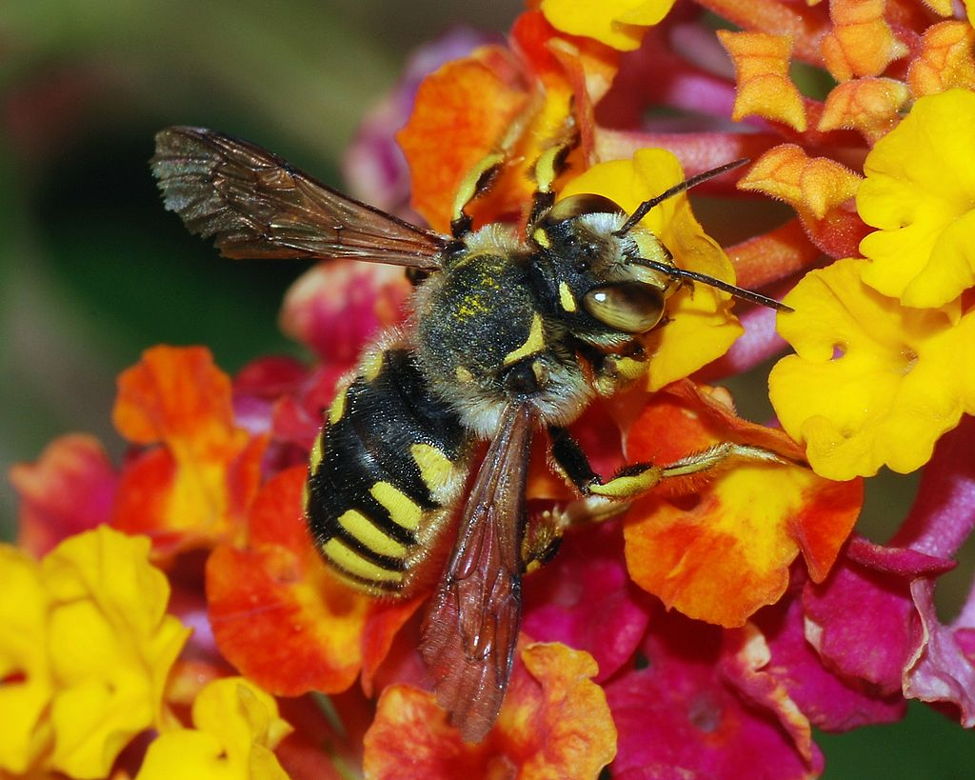
Bee Problem
Context
  Government of an island who would like to investigate how to reduce the bees so tourism can thrive again
Data
  Data available about the weekly water levels of all rivers and ponds for 30 years
  Medical reports of bee bites and pollen allergies for the last 20 years
  Climate data and population data, including rainfall and temperatures as well as pollen levels
  A lot of data about population, pollution, pesticide use, and bird populations (bee predators)
Challenges
  Two bee experts in the island, but they do not know anything about data science.
  What questions would you ask of them to help you figure out how to solve the problem?
  May release pesticides on crops
    Pesticides cost $1,000 per square kilometer
    Pesticides reduce the bee population for 3 months
  An environmental group that claims that the bee population can be reduced naturally by planting crops that have no flowers (eg corn, wheat, etc)

Slide 24

Fraud Problem
Context
  A bank, interested in detecting fraudulent activity in credit card customers
Data
  For each customer, there is detailed information from their card application about their address, salary and employment, and demographic
  For each customer, there is a record of all their transactions (date, charges, and vendor) for the last 4 years
  For 1% of customers, there is a flag that their credit card was reissued because of fraudulent use of their prior card
  Additional data available with fee, like census data for any zip code
Cost
  When a fraud goes undetected, the average loss to the company is $3K
  Reissuing a customer card costs $50
  When card is reissued and there is no fraud, 0.5% of customers cancel their card
Challenges
  Volume of the data
    There are 100M customers, with 30K transactions on average
  Some credit cards were reissued but no fraud took place once investigated

Slide 25

Disaster Relief Problem
Context
  A non-profit organization in a remote country who would like to understand where to send relief and in what form
Data
  Microblog data (eg twitter), where people are posting issues with bridges, roads, and general access to remote locations
  Many hospitals are emailing hourly reports, with number of beds occupied and available, medical inventory status, and medical personnel
Cost
  A number of coders have contacted your headquarters to volunteer their time to help with data analysis and any data collection needed
Challenges
  The remote country’s government seems open to take your advice for what roads need repair, what hospitals need more personnel, etc, but will ask for detailed justifications of all your recommendations

