Slide 1

Streaming Hierarchical Clustering for Concept Mining
Jeong Hoon Choi
USCID: 5023184813
DSCI-560
Data Science Professional Practicum

Slide 2
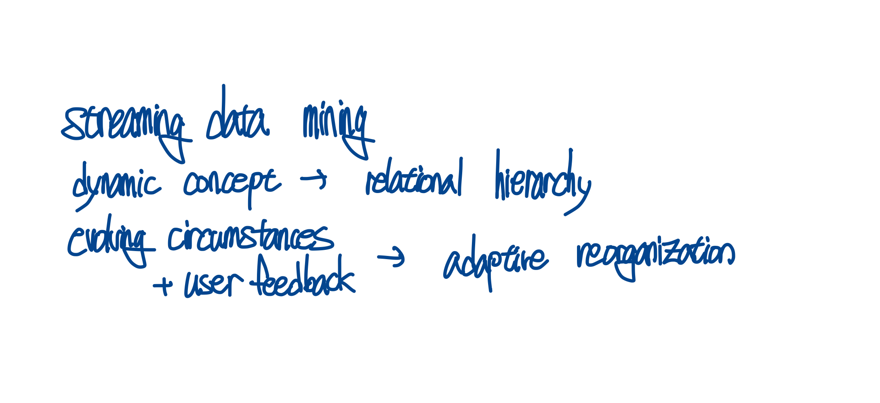
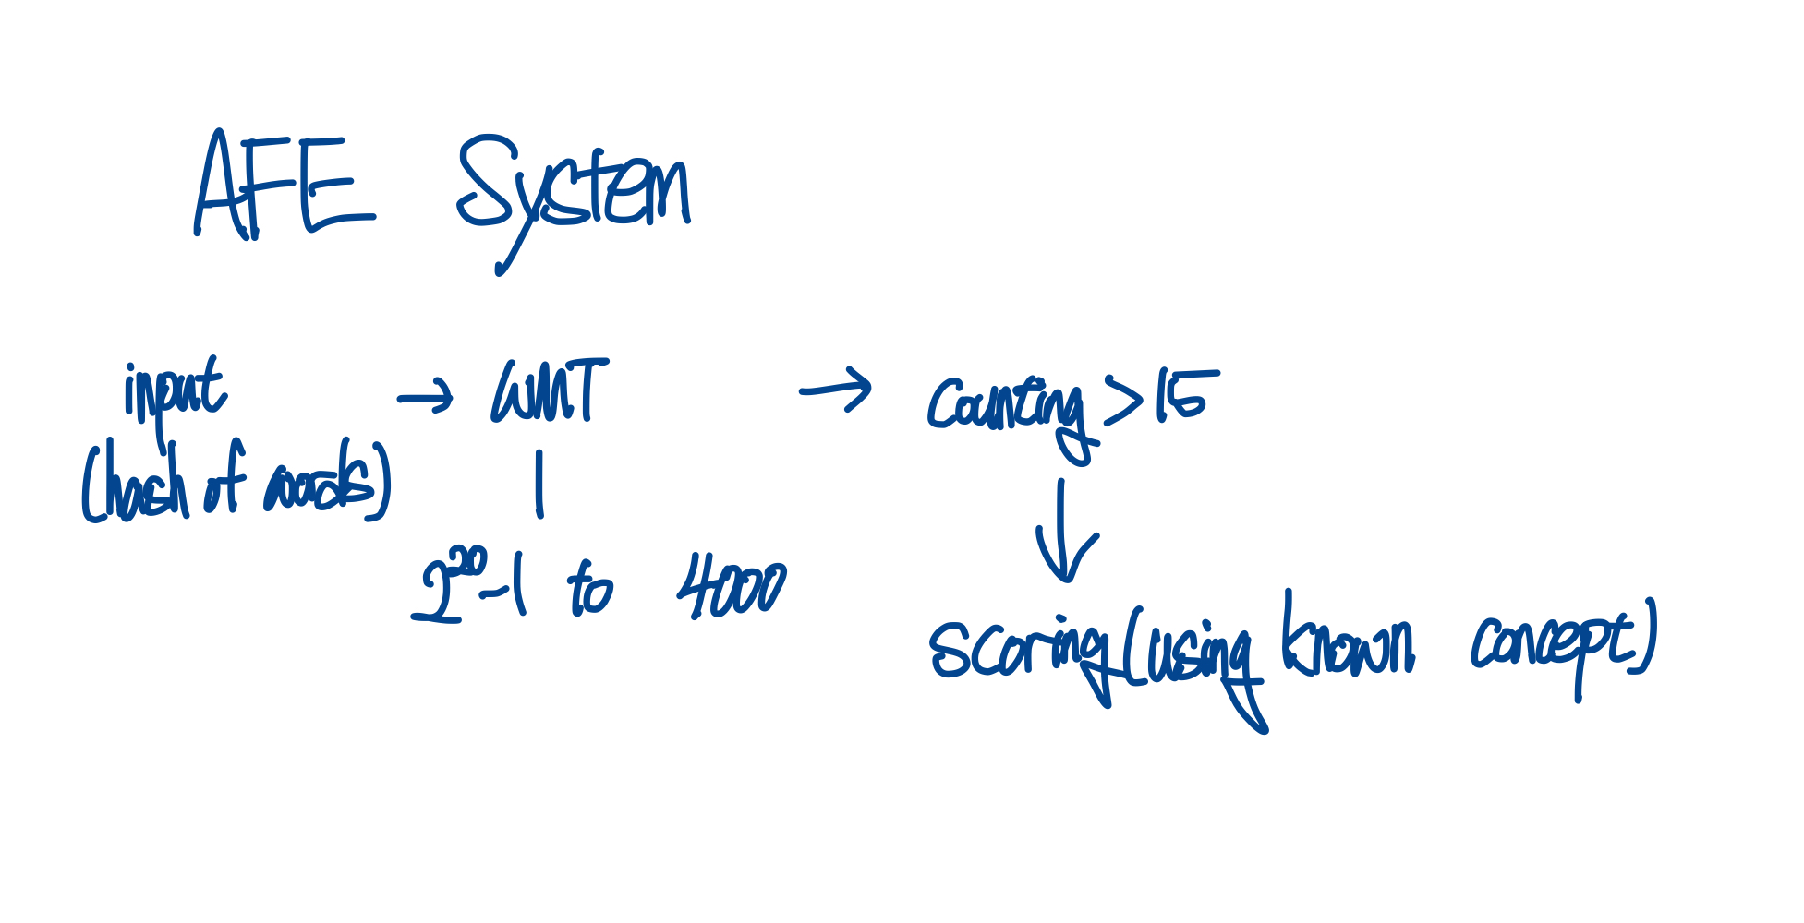
Introduction
Real-time concept mining of high-volume data streams
Dynamic organization of concepts into a relational hierarchy
Adaptive reorganization of the concept hierarchy in response to evolving circumstances and user feedback
AFE System (High Speed Content Classification System)
Input -> Word Mapping Table (2^20-1 to 4000) -> counting: c > 15 -> calculating score using known concept (vector)

Slide 3
Hierarchical Partitioning
Document clustering (bag-of-words)
Top-down divisive approach produces better result than bottom-up
= Divisive clustering
Distribution of hits to expectations: affinity of a document to a given collection

Slide 4
Hardware Design
Use of floating point dashed 8-bit integer system to reduce computational complexity
Pack 4000-dimension (from WMT) array of 8-bit byte into bitmap
Implement 32-dimension vector sum using 32 bit registers (integer calculation)
Calculate multiple dot products using 32-bit register and instructions.

Slide 5
Streaming Hierarchical Partitioning
Assume up-to m documents can be stored on memory (can fast access)
Similarity search using a tree structure, search for the most similar leaf(document) using a greedy approach.
Search for the most similar document and replace the existing document probabilistically based on p calculated through similarity. (This can partially fit concept drift and operates similarly to LRU)

