Slide 1

CleanML:
A Study for Evaluating the Impact of Data Cleaning on ML Classification Tasks
Jeong Hoon Choi
USCID: 5023184813
DSCI-560
Data Science Professional Practicum

Slide 2
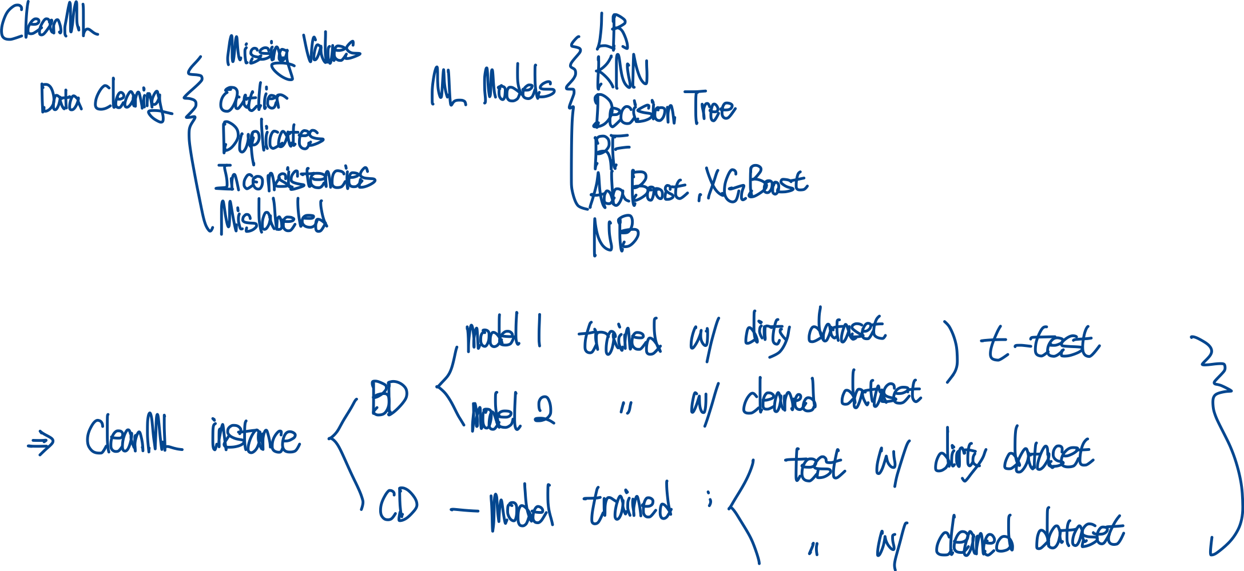
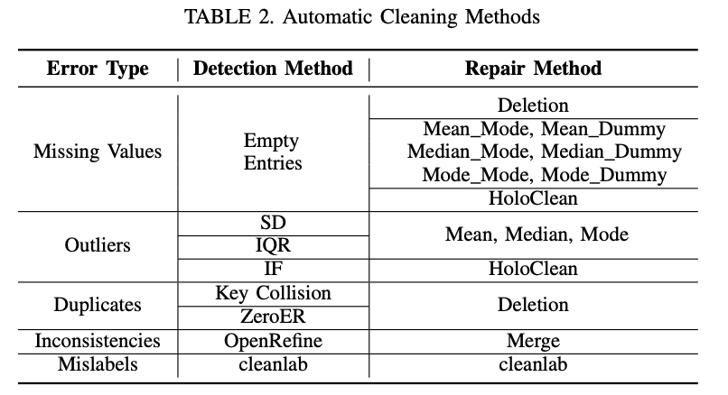
CleanML: Introduction & Related Work
Framework to assessment performance of ML between data cleaning
The results for each dataset, data cleaning technique, model, and scenario are stored in relational database R1, R2, and R3.

Slide 3
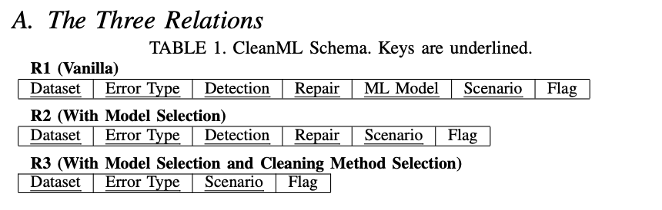
CleanML: Database Schema
Flag: P, N, S (t-test results for 20 experiments)
Relation R1: Vanilla
How does cleaning some type of error using a detection method and a repair method affect a ML model for a given datasets?
Relation R2: Model Selection
How does cleaning some type of error using a detection method and a repair method affect the best ML model for a given dataset?
Relation R3: Model Selection + Cleaning Method Selection
How does the best cleaning method affect the performance of the best model for a given dataset?

Slide 4
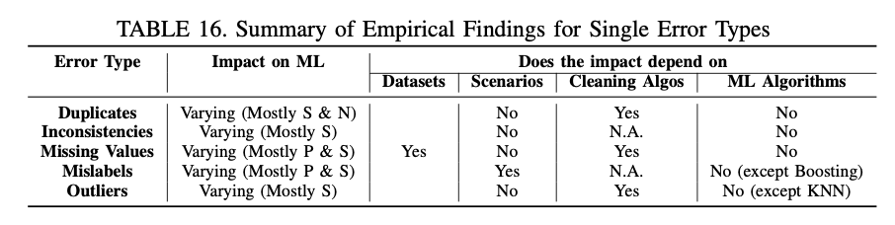
CleanML: Analyzed Database
Missing Values: imputation >= deleting missing values
Outliers: cleaning has insignificantly affected the performance
Mislabels: cleaning has positive or insignificant impacts
Inconsistencies: no significant impact (unlikely to have negative impact)
Duplicates: cleaning is more likely to have insignificant or negative impacts than positive impacts
Impact of cleaning on ML is inconsistent, depends on datasets
Better data cleaning than developing specific robust ML models

Slide 5
Question: What method did the author use to compare data cleaning and machine learning performance, and why?
Answer:
The author stored the machine learning performance data in a relational database for analysis.
This allowed for comparison of results across various combinations, and instead of simply comparing accuracy, the results were explained in terms of the given conditions P, N, and S.

