Slide 1

Deep learning-based NLP data pipeline for HER-scanned document information extraction
Jeong Hoon Choi
USCID: 5023184813
DSCI-560
Data Science Professional Practicum

Slide 2
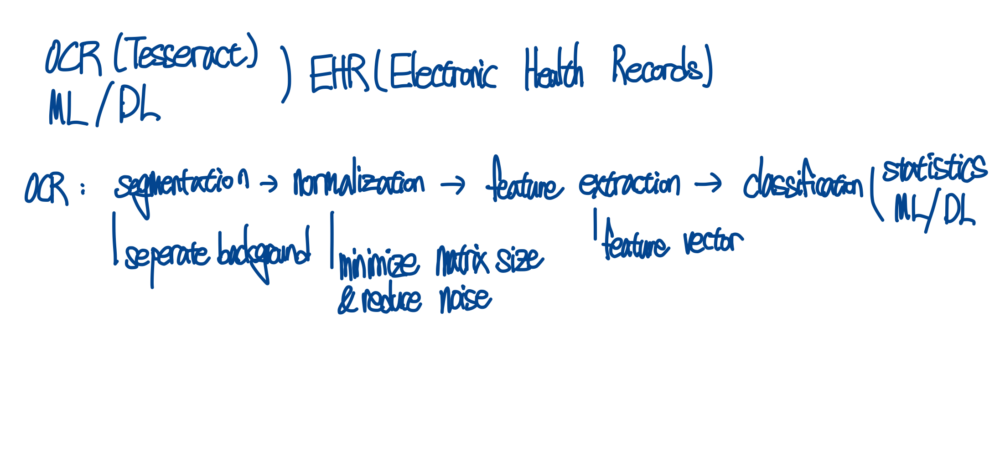
Introduction & Related Work
OCR is continuously evolving, incorporating methods such as Statistical Models (Machine Learning) and Deep Learning (i.e., LSTM).
Traditional OCR involves the processes of segmentation, normalization, feature extraction, and classification.
OCR technology and evaluation methods are less developed for the medical domain compared to other domains, and this paper studies OCR methods for EHR (Electronic Health Records)

Slide 3
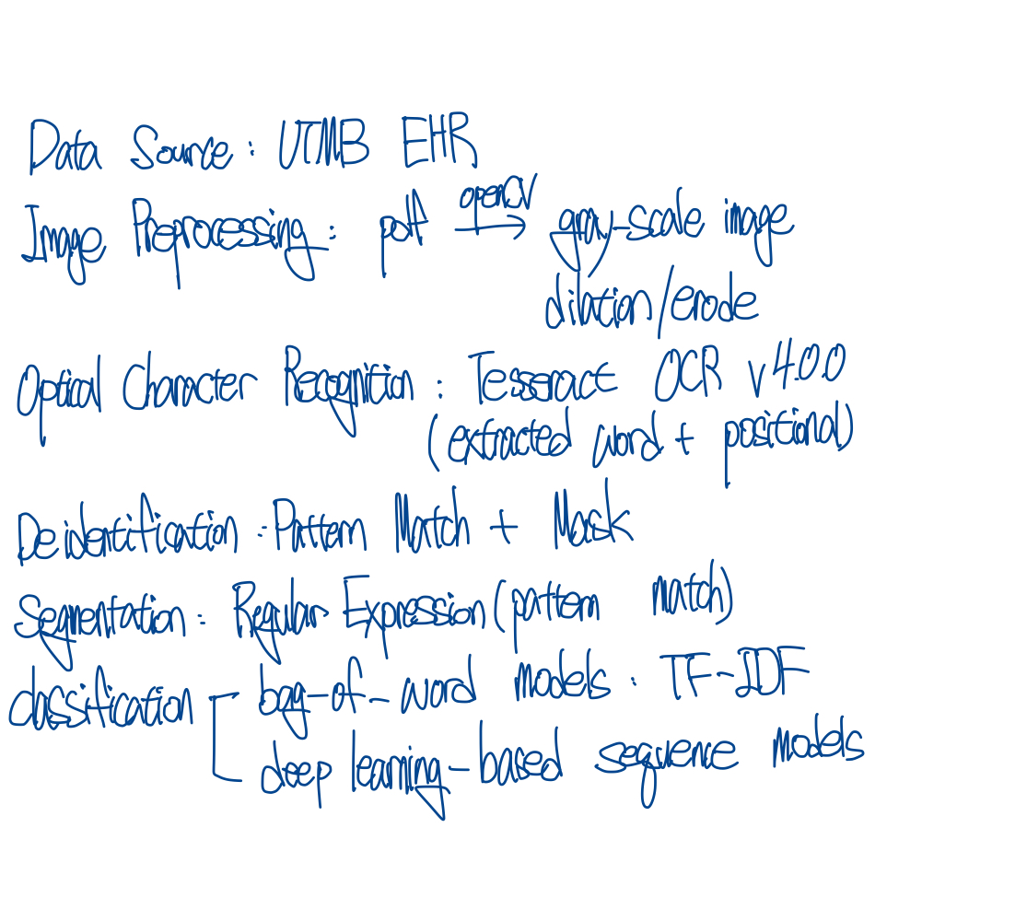
Methods
Data source: UTMB HER
Preprocessing: OpenCV
OCR: Tesseract v 4.0.0
Deidentification
Segmentation
Classification

Slide 4
Results
Reports take many forms, including narratives in printed text, images, tables, and handwritings
While it extracts data from text and tables well, its accuracy is relatively low for images and handwriting
Overall accuracy is higher for deep learning-based sequence models than for bag-of-words models
The ClinicalBERT model showed the best performance even with a small amount of training data

Slide 5
Question: What is the structure of the Deep Learning-based sequence model used in the paper?
Answer:
The architecture used in the paper has two main inputs.
It takes the words extracted from the previous OCR process and their positional information to create a sequence of appropriate token size, which is then fed into a sequence model.
Separately, structed data such as positional information and page numbers are fed into a feedforward neural network (FFNN).
Finally, the outputs of these two modules are processed through another FFNN to produce three labels (AHI, SaO2, Other).

