Slide 1
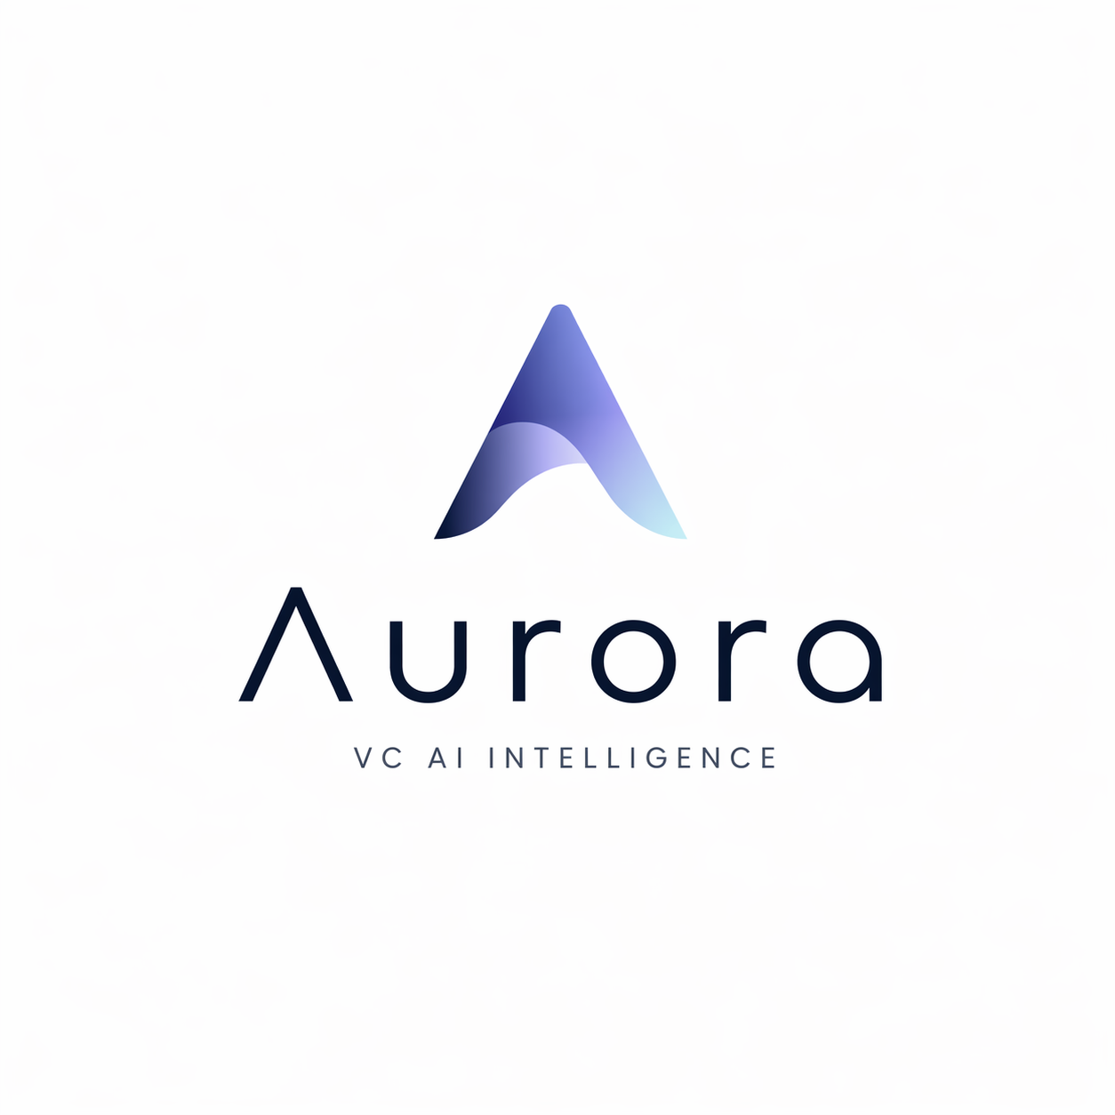
2026
// VC AI INTELLIGENCE //
DSCI 560 • GROUP 15 • FINAL PRESENTATION

Slide 2


Slide 3
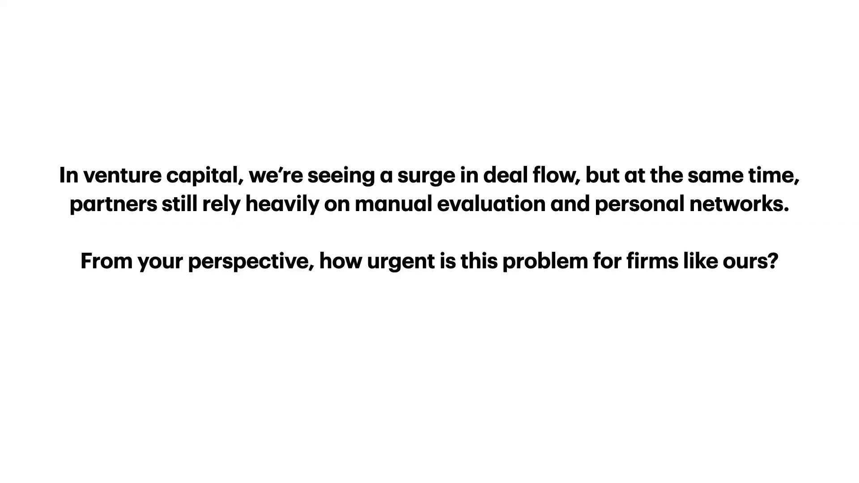

Slide 4

01 // THE STATUS QUO
Inside a VC partner's week
How time, attention, and paperwork actually break down.
01
02
03
04
47%
31%
9.9
20-40
TIME SPENT
TIME SPENT
AVG STARTUPS
DOCUMENTS
Working with
portfolio companies
Sourcing &
screening new deals
Tracked per partner
simultaneously
Generated per portco
every year
Source: Gompers, Gornall, Kaplan & Strebulaev (2020); industry benchmarks.
AURORA // VC AI INTELLIGENCE
DSCI 560 // GROUP 15

Slide 5



01 // THE STATUS QUO
Validated with a practicing VC
How repetitive is document handling in your day-to-day work?
// INTERVIEW · 03:42 · LIVE RECORDING
MARK // VC PARTNER
Early-stage portfolio
AURORA // VC AI INTELLIGENCE
DSCI 560 // GROUP 15

Slide 6
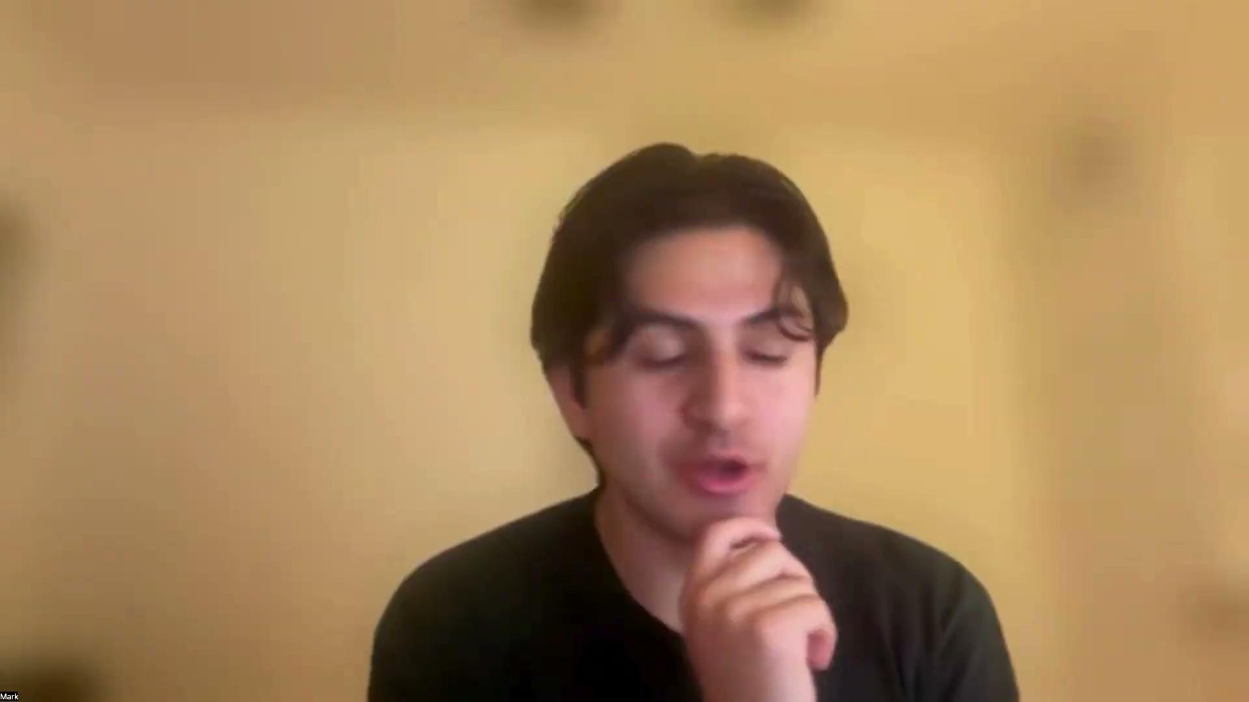

Slide 7
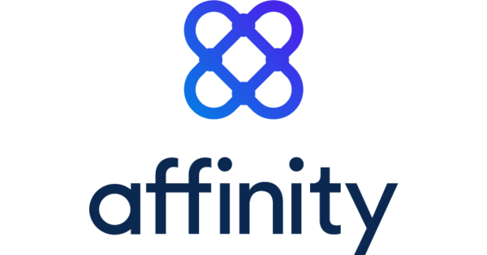



02 // COMPETITIVE LANDSCAPE
Today's tools cover only a slice of the work
Affinity dominates relationship CRM — but leaves deal sourcing, portfolio management, and risk gaps open.
THREE CRITICAL WORKFLOWS
Deal Sourcing
PARTIAL
Graph-based only
Relationship-graph CRM. File storage. Team handoff.
Portfolio Managing
DIRECT MARKET SIZE
GAP
Static file storage
$2B
est.
Risk Detection
COVERAGE
MISSING
Not addressed
Relationship Graph • File Storage
AURORA // VC AI INTELLIGENCE
DSCI 560 // GROUP 15

Slide 8


03 // OUR APPROACH
Aurora expands every workflow with AI
From static CRM to an intelligent layer across sourcing, management, and risk.
01
02
03
Deal Sourcing
Portfolio Managing
Risk Detection
External RAG over web, news & market data to surface opportunities continuously.
AI semantic understanding of investor updates, board materials & ad-hoc reports.
AI-based risk analysis across portfolio signals, flagging issues before they escalate.
// External RAG
// Semantic RAG
// Risk AI
EXPANDED TAM
$2B CRM + $3B Market Intel + $5B Risk Mgmt = $10B
AURORA // VC AI INTELLIGENCE
DSCI 560 // GROUP 15

Slide 9





04 // ARCHITECTURE · PORTFOLIO
Portfolio Managing
VECTOR RAG + MEM0
Documents in, contextual answers out — grounded in your firm's own portfolio data.
QUERY
RETRIEVE
VC PARTNER
AURORA
VECTOR STORE
ANSWER
Asks question
Semantic engine
Embeddings + MEM0
Grounded,
cited
INGEST // Updates · Decks · Reports
STACK
AWS DynamoDB // Snowflake: snowflake-arctic-embed-l-v2.0
AURORA // VC AI INTELLIGENCE
DSCI 560 // GROUP 15

Slide 10



05 // SOURCING + RISK
Deal Sourcing & Risk Detection
VECTOR + EXT RAG
Internal memory merged with live web signals to surface deals and flag risks as they emerge.
INTERNAL VECTOR
Firm memory
DEALS
QUERY
VC PARTNER
AURORA
Deal query
Hybrid RAG
EXTERNAL RAG
Web · News · Market
RISKS
STACK
AWS DynamoDB // Snowflake arctic-embed-l-v2.0 // Brave Search MCP
AURORA // VC AI INTELLIGENCE
DSCI 560 // GROUP 15

Slide 11




06 // SYSTEM ARCHITECTURE
End-to-end system architecture
A managed-AWS stack: React Native frontend, WebSocket sessions routed to Lambda, chat persisted in DynamoDB.
01
02
03
04
FRONTEND
API GATEWAY
COMPUTE
STORAGE
React Native
AWS Gateway API
AWS Lambda
AWS DynamoDB
// Group chat
// AI private chat
// AI group chat
// File upload
// Maintain WebSocket
// Route to Lambda
// Session data
// Query routing
// RAG orchestration
// LLM invocation
// Store chat history
// Session data
// User records
> REQUEST FLOW: CLIENT → GATEWAY → LAMBDA → DYNAMODB
AURORA // VC AI INTELLIGENCE
DSCI 560 // GROUP 15

Slide 12
07 // REFERENCES
References
[01]
Taj, H. M. · 2025
How Do Venture Capitalists Make Decisions? by Paul Gompers, William Gornall, Steven Kaplan, and Ilya A. Strebulaev — An In-Depth Review.
LinkedIn
[02]
Affinity · 2026
Affinity — CRM for Private Capital and Relationship Intelligence Platform.
affinity.co · Accessed April 2026
[03]
Market Research Future · 2026
Venture Capital Market Size, Share, and Forecast Report to 2035.
marketresearchfuture.com · Updated April 6, 2026
// END OF TRANSMISSION // THANK YOU
AURORA // VC AI INTELLIGENCE
DSCI 560 // GROUP 15

