Slide 1

XPS Analyzer
04/25 Lab Meeting
04/25 Lab Meeting
KHU SpondLab
최 정 훈

Slide 2
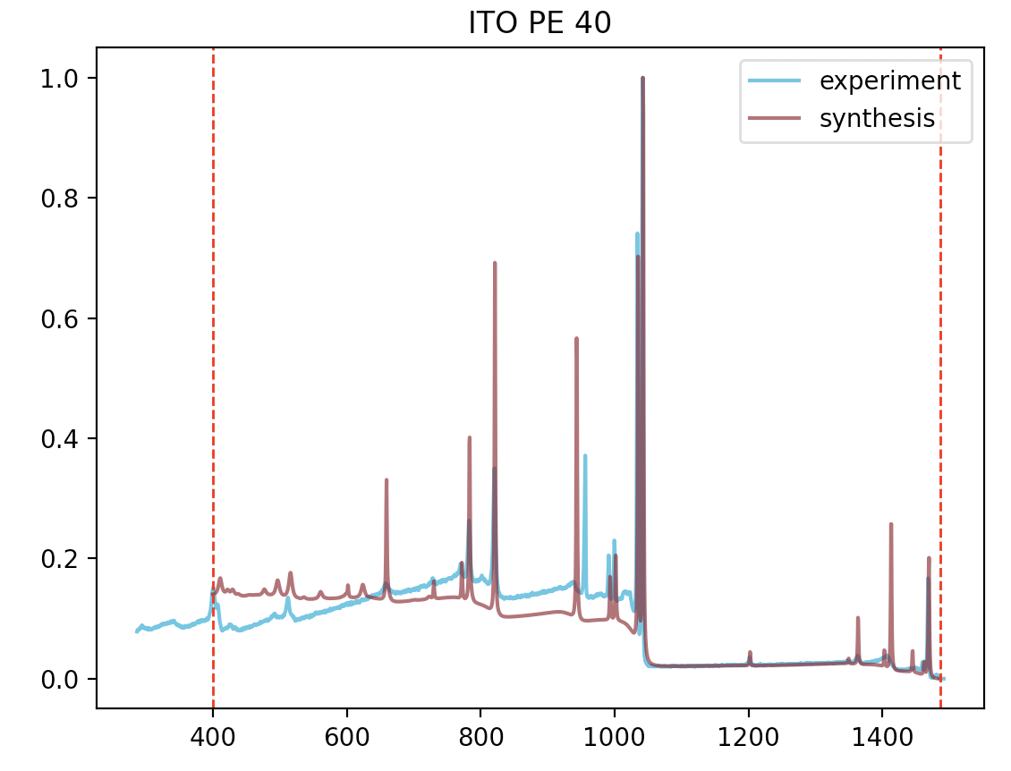
Lab Meeting
SPOND
Notes:
https://iopscience.iop.org/article/10.1088/2632-2153/ab5da6

Slide 3
Lab Meeting
SPOND
Experiments try 4
Synthesis try 4
XPS Analysis result
In : 71.5 %
O : 16.2 %
Na : 7.5 %
Ti : 2.7 %
Ne : 1.0 %
Ni : 0.7 %
C5O contamination : 7.98 [A]
XPS Analysis result
In : 65.5 %
O : 21.9 %
Na : 4.9 %
Ti : 4.4 %
Sn : 1.4 %
Ne : 1.2 %
C5O contamination : 22.97 [A]
XPS Analysis result
In : 49.0 %
O : 45.3 %
Sn : 4.2 %
Na : 1.3 %
C5O contamination : 1.87 [A]
XPS Analysis result
In : 59.0 %
O : 40.1 %
Sn : 0.5 %
C5O contamination : 1.96 [A]
XPS Analysis result
In : 61.7 %
O : 25.0 %
Na : 8.1 %
Ti : 4.3 %
C5O contamination : 21.78 [A]
XPS Analysis result
O : 50.6 %
In : 43.8 %
Sn : 4.9 %
C5O contamination : 1.93 [A]
XPS Analysis result
In : 51.3 %
O : 45.6 %
Sn : 2.2 %
C : 0.8 %
C5O contamination : 1.81 [A]
XPS Analysis result
In : 79.7 %
O : 13.7 %
Na : 4.6 %
Ti : 2.0 %
C5O contamination : 22.21 [A]
Notes:
https://iopscience.iop.org/article/10.1088/2632-2153/ab5da6

Slide 4
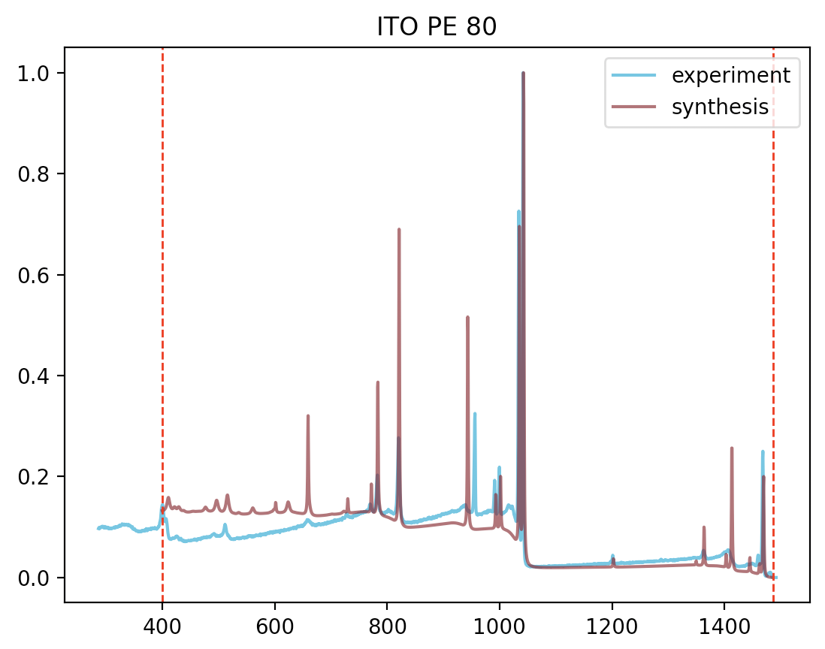
Lab Meeting
SPOND
Notes:
https://iopscience.iop.org/article/10.1088/2632-2153/ab5da6

Slide 5
Lab Meeting
SPOND
Experiments try 4
Synthesis try 4
XPS Analysis result
In : 67.6 %
O : 16.0 %
Ti : 7.6 %
Na : 7.2 %
C5O contamination : 3.75 [A]
XPS Analysis result
In : 56.8 %
O : 39.6 %
Sn : 2.7 %
Ru : 0.5 %
C5O contamination : 1.72 [A]
XPS Analysis result
O : 49.1 %
In : 45.4 %
Sn : 4.7 %
C : 0.5 %
C5O contamination : 1.90 [A]
XPS Analysis result
In : 63.1 %
O : 20.9 %
Ti : 12.0 %
Na : 3.0 %
C5O contamination : 14.28 [A]
XPS Analysis result
In : 54.8 %
O : 26.3 %
Ti : 12.7 %
Na : 5.6 %
C : 0.5 %
C5O contamination : 11.95 [A]
XPS Analysis result
In : 51.7 %
O : 42.5 %
Sn : 4.3 %
Na : 1.2 %
C5O contamination : 1.87 [A]
XPS Analysis result
In : 61.2 %
O : 37.8 %
Sn : 0.5 %
C5O contamination : 1.89 [A]
XPS Analysis result
In : 80.4 %
O : 11.0 %
Ti : 6.5 %
Na : 2.0 %
C5O contamination : 14.47 [A]
Notes:
https://iopscience.iop.org/article/10.1088/2632-2153/ab5da6

Slide 6
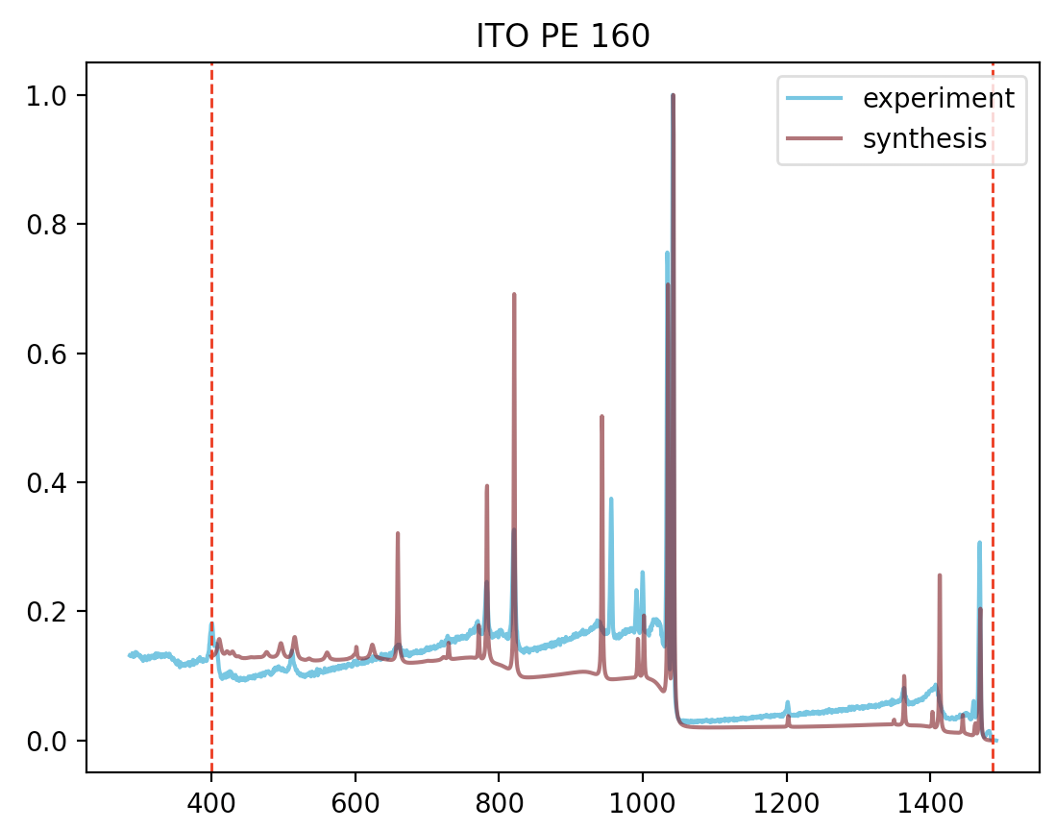
Lab Meeting
SPOND
Notes:
https://iopscience.iop.org/article/10.1088/2632-2153/ab5da6

Slide 7
Lab Meeting
SPOND
Experiments try 4
Synthesis try 4
XPS Analysis result
In : 62.3 %
O : 17.6 %
Na : 9.8 %
Ti : 6.4 %
Sb : 1.1 %
Ga : 0.9 %
Bi : 0.7 %
C5O contamination : 4.03 [A]
XPS Analysis result
In : 65.7 %
O : 19.2 %
Ti : 9.1 %
Na : 4.6 %
Sn : 0.7 %
C5O contamination : 6.71 [A]
XPS Analysis result
In : 53.7 %
O : 41.7 %
Sn : 3.1 %
Na : 1.1 %
C5O contamination : 1.86 [A]
XPS Analysis result
In : 53.7 %
O : 41.7 %
Sn : 3.1 %
Na : 1.1 %
C5O contamination : 1.86 [A]
XPS Analysis result
O : 48.3 %
In : 46.7 %
Sn : 4.1 %
C : 0.6 %
C5O contamination : 1.88 [A]
XPS Analysis result
In : 62.4 %
O : 36.8 %
C5O contamination : 1.86 [A]
XPS Analysis result
In : 58.9 %
O : 22.6 %
Na : 9.6 %
Ti : 8.4 %
C5O contamination : 5.07 [A]
XPS Analysis result
In : 79.3 %
O : 13.8 %
Na : 3.5 %
Ti : 3.0 %
C5O contamination : 5.97 [A]
Notes:
https://iopscience.iop.org/article/10.1088/2632-2153/ab5da6

Slide 8
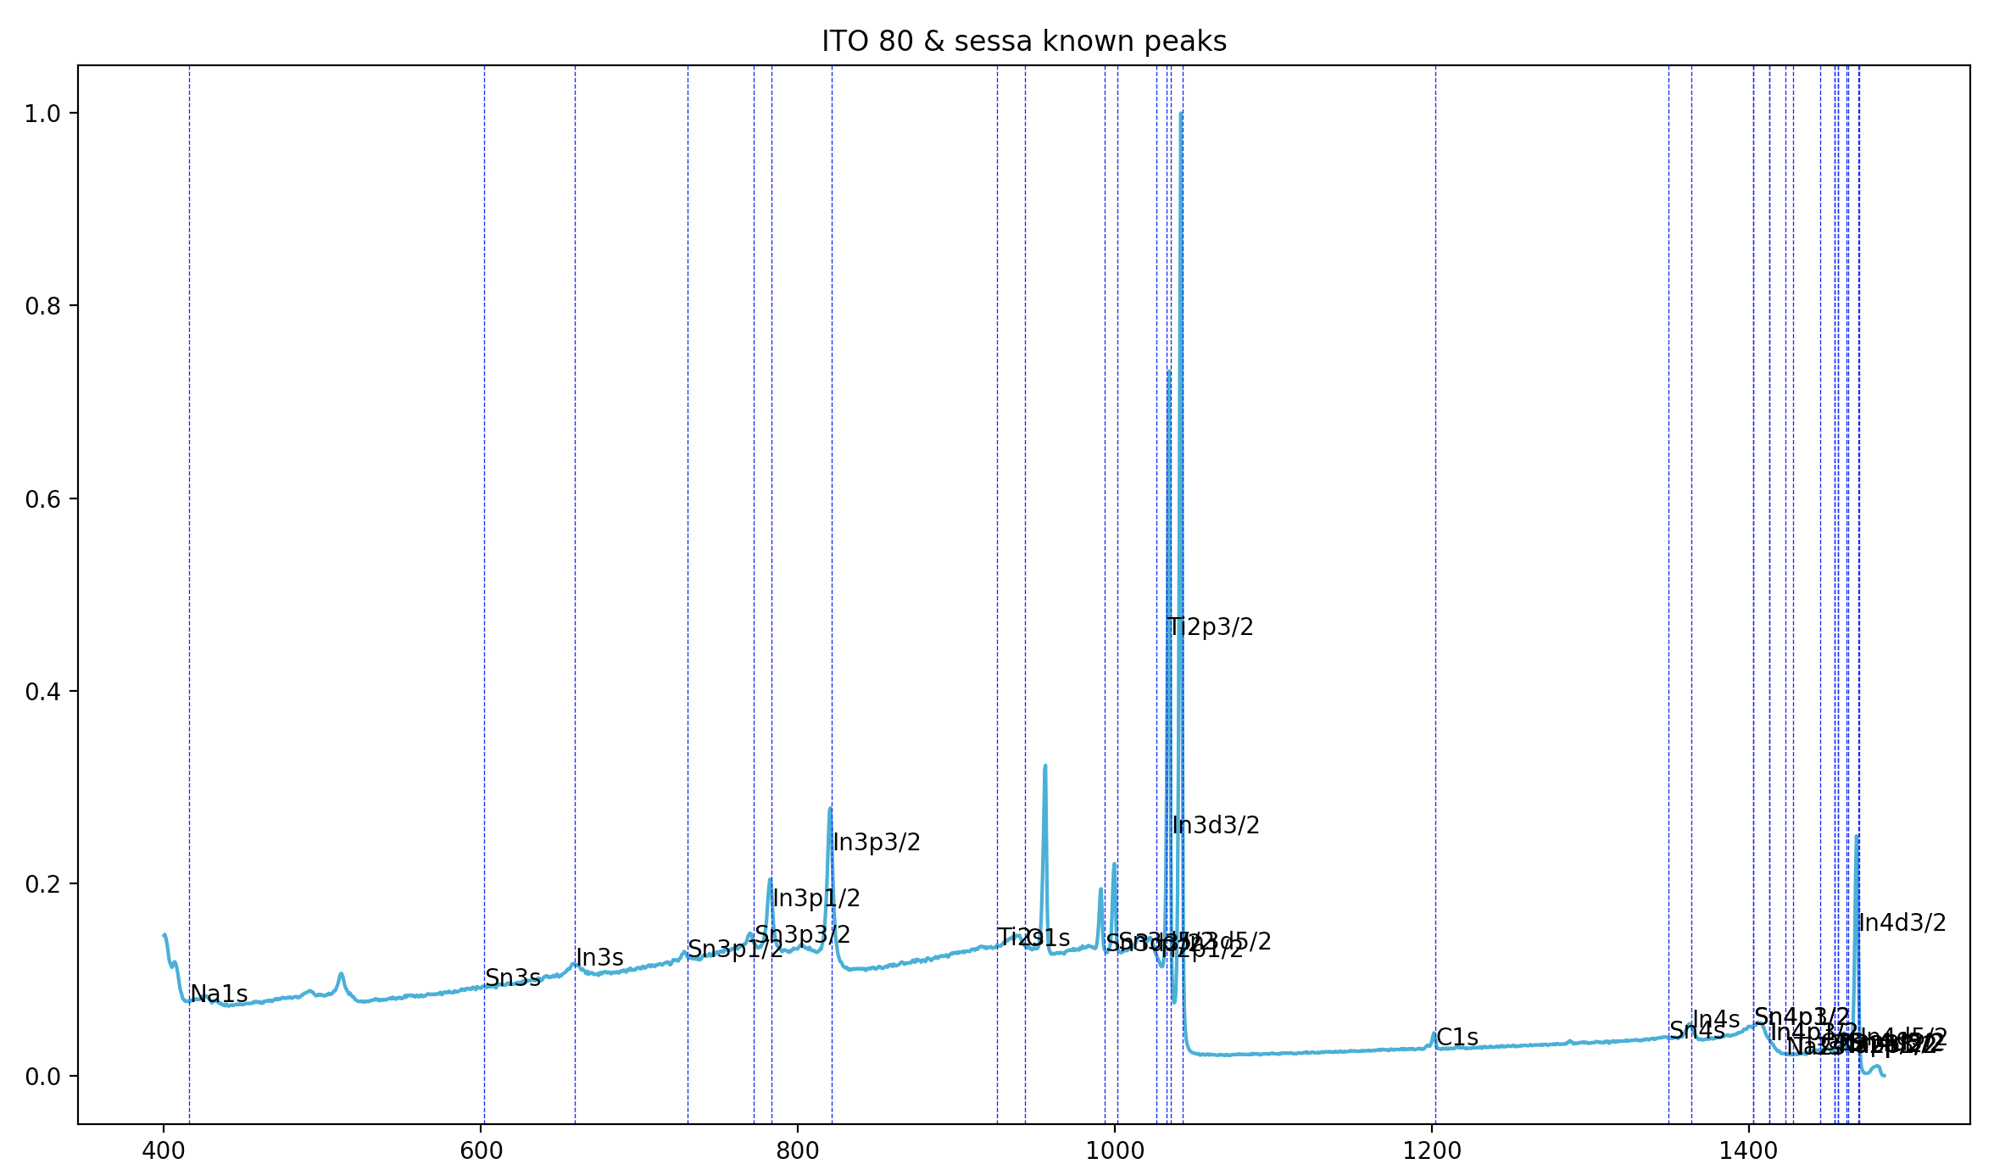
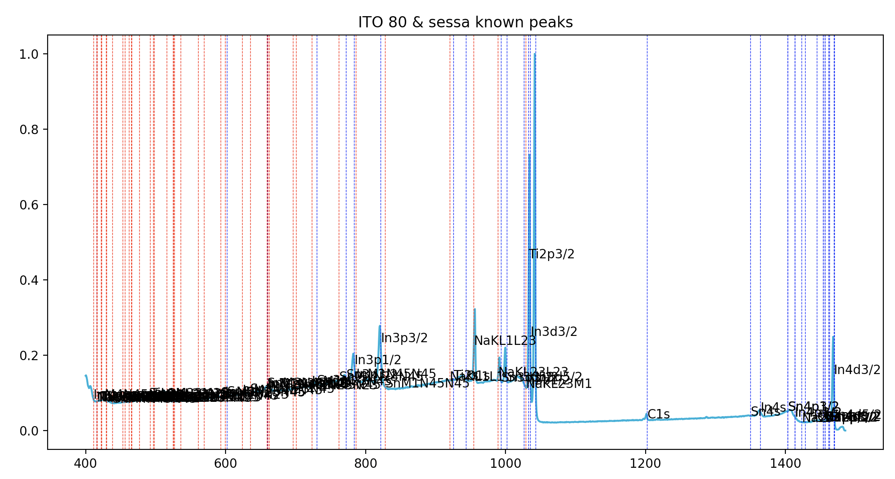
Lab Meeting
SPOND
Notes:
https://iopscience.iop.org/article/10.1088/2632-2153/ab5da6

Slide 9
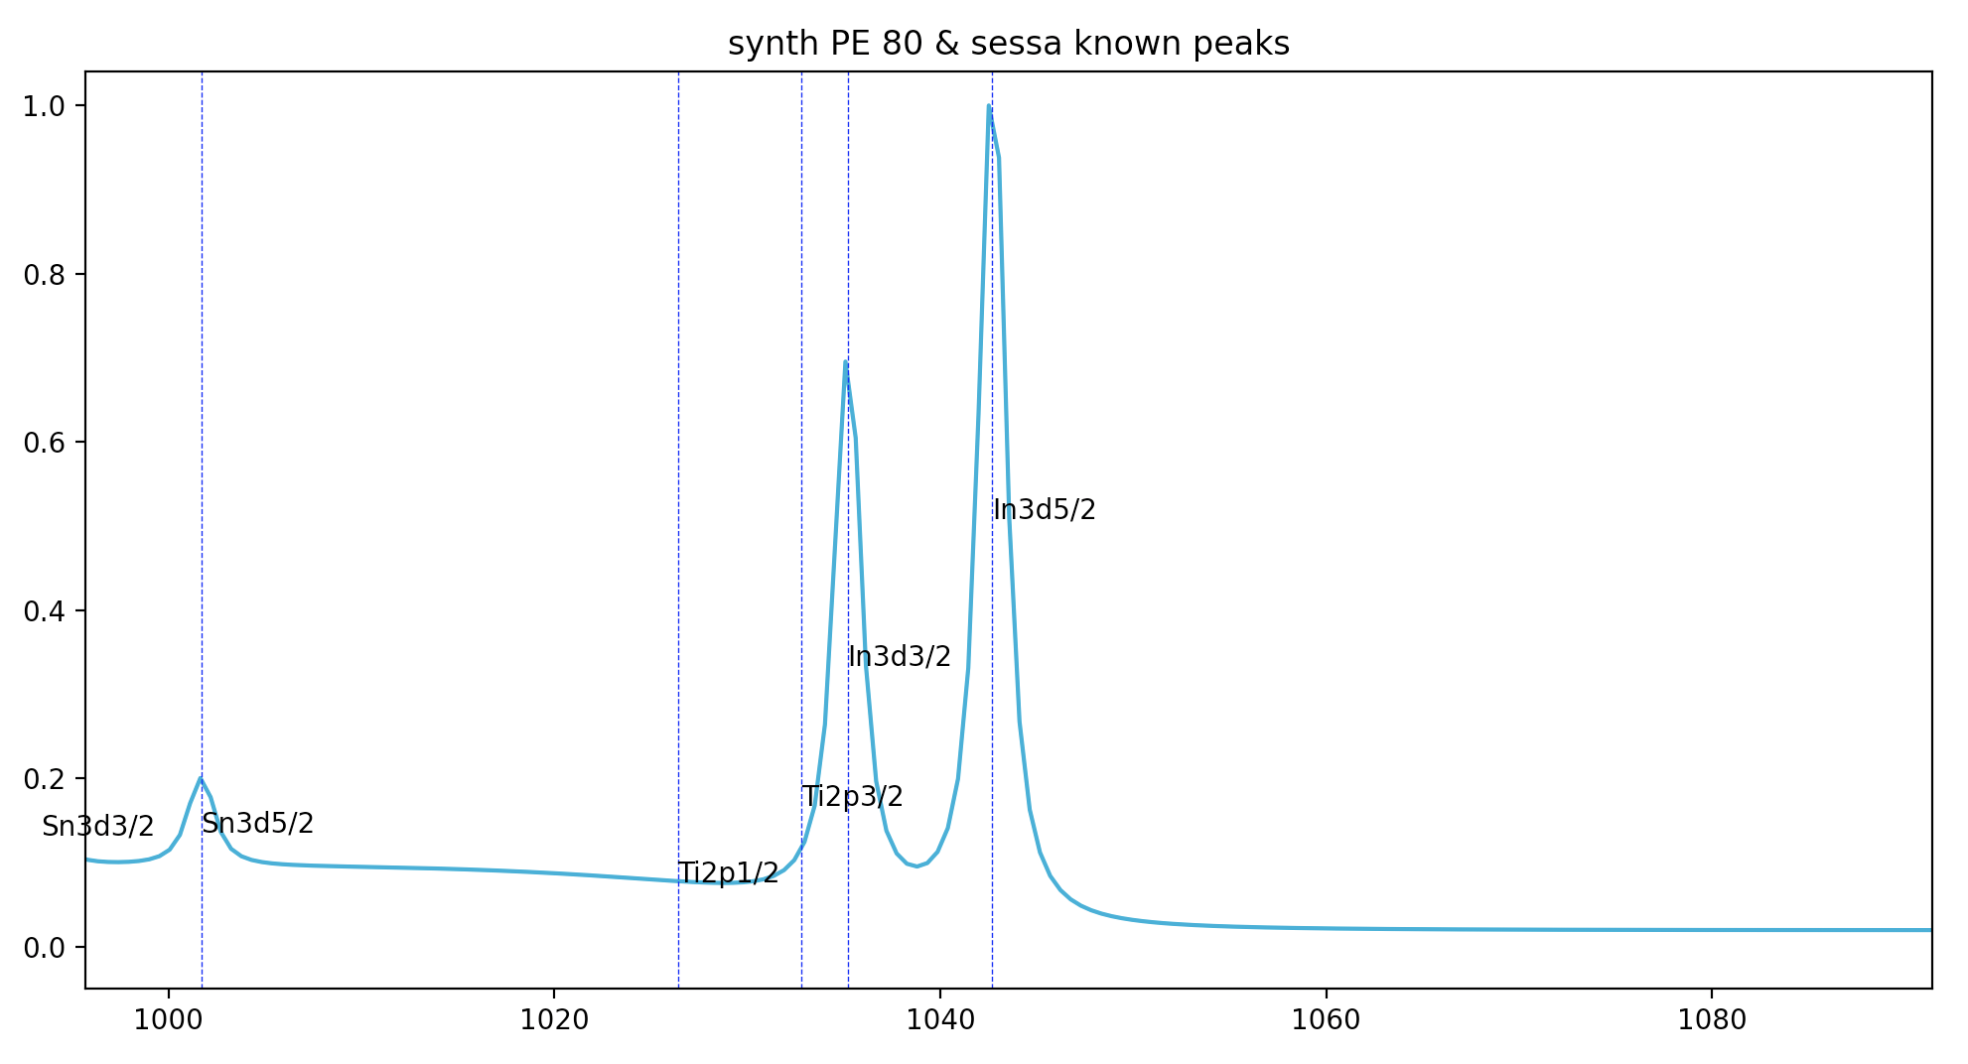
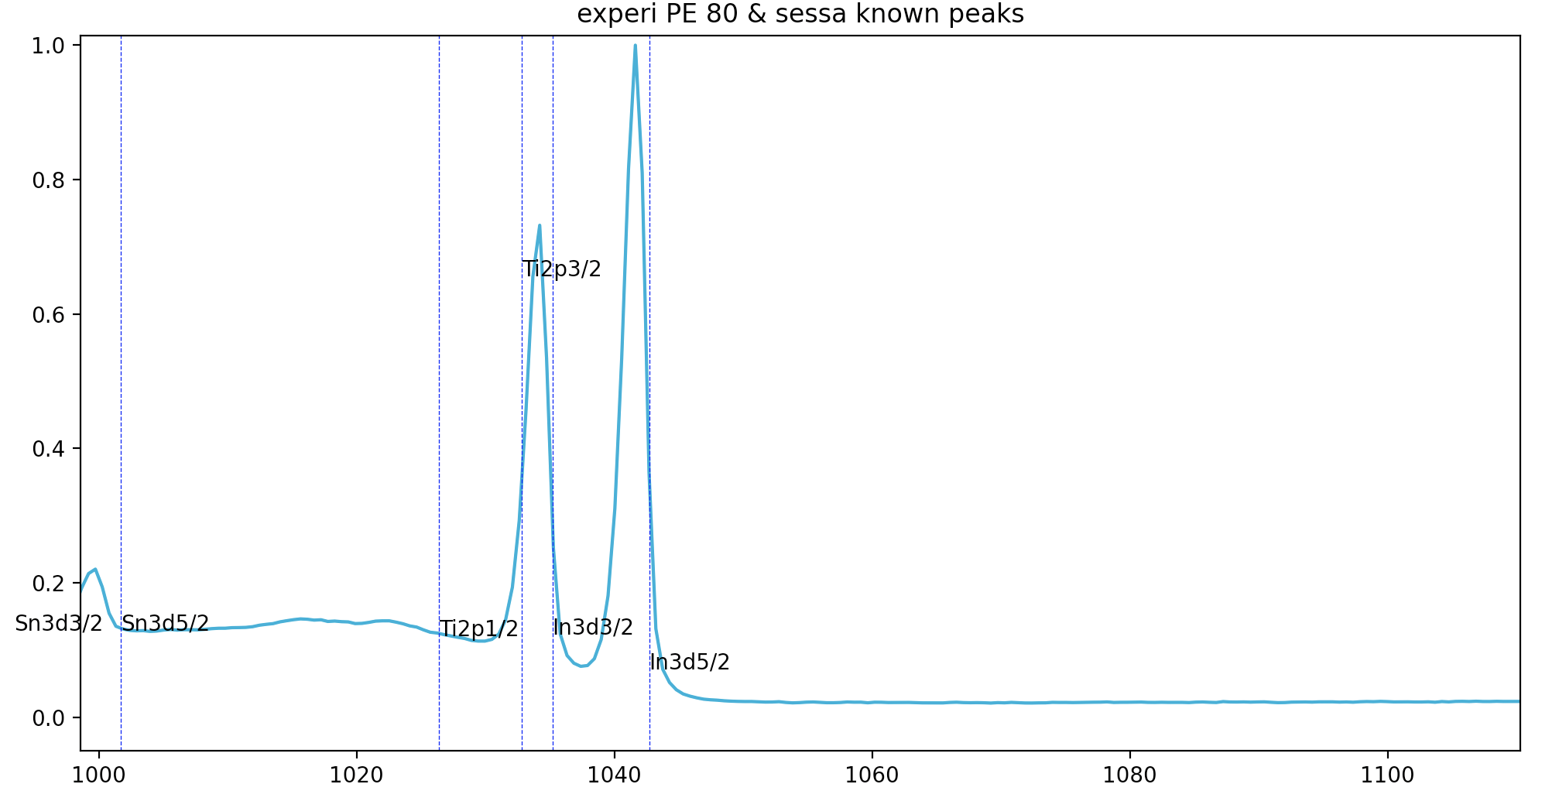
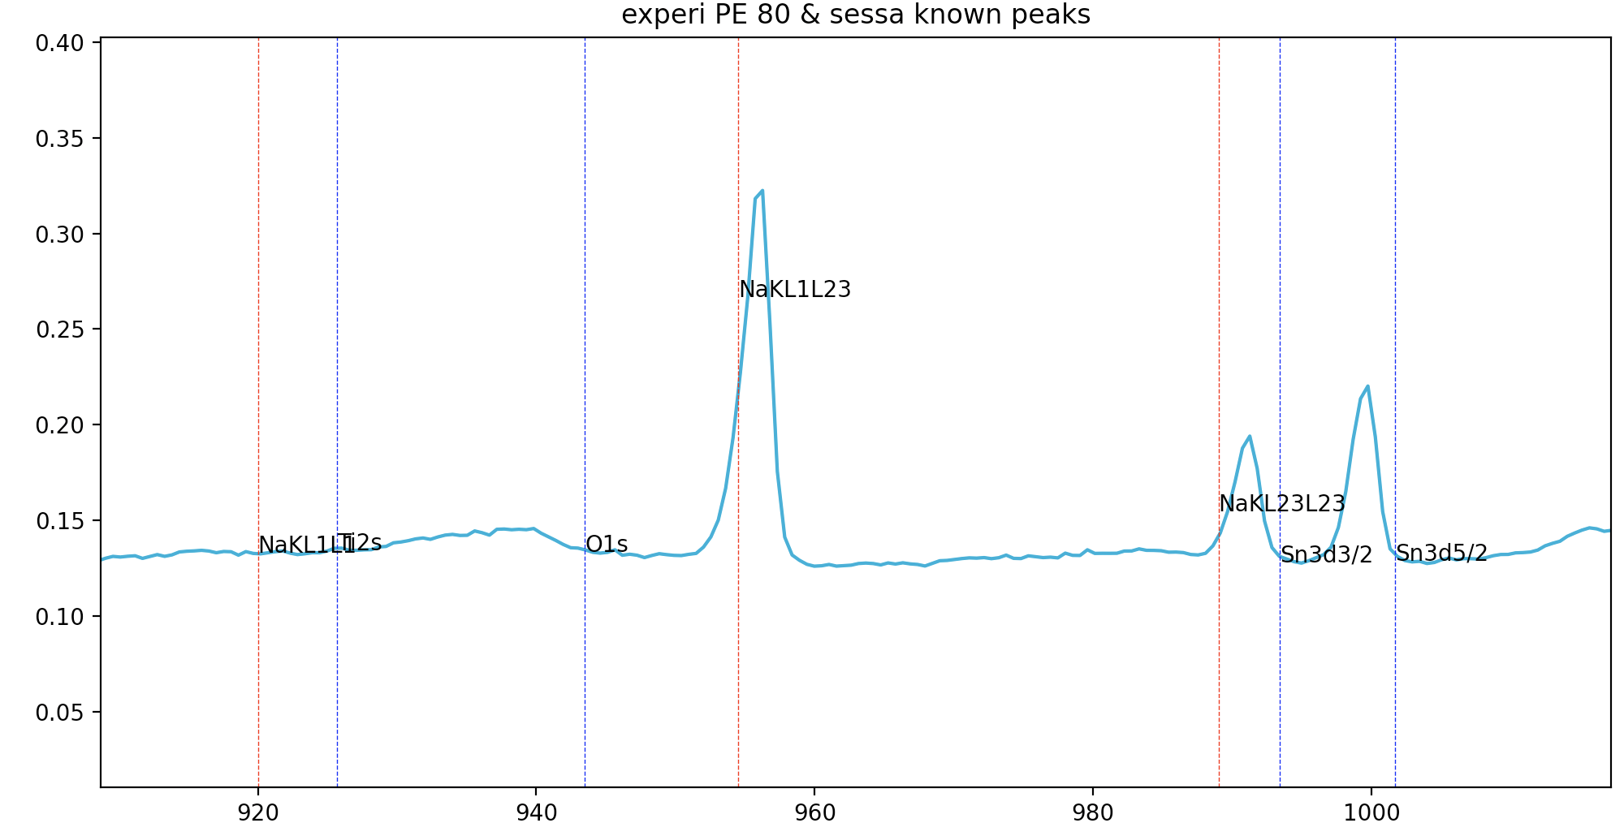
Lab Meeting
SPOND
Notes:
https://iopscience.iop.org/article/10.1088/2632-2153/ab5da6

