Slide 1
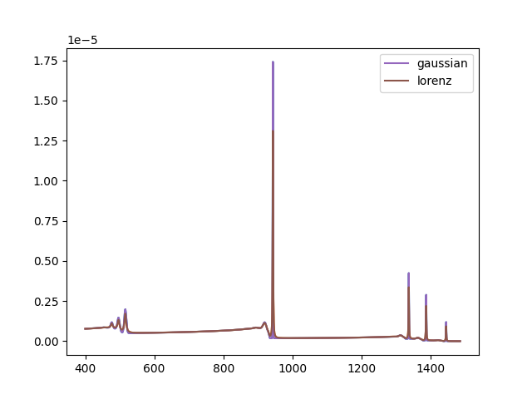
1) SiO2 Lorentz(default) & Gaussian

Slide 2
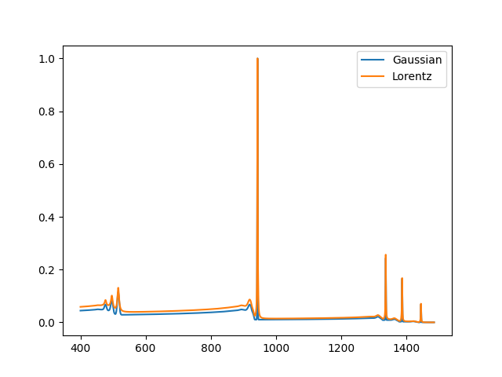
1) SiO2 Lorentz & Gaussian Normalize

Slide 3
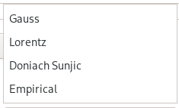
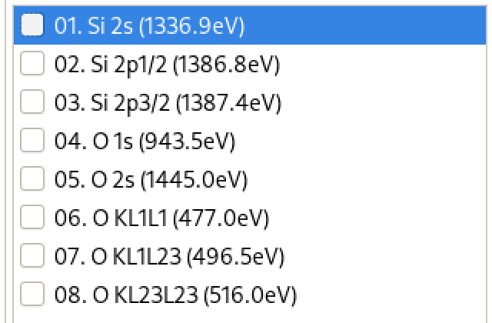
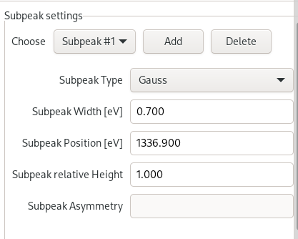
1)

Slide 4
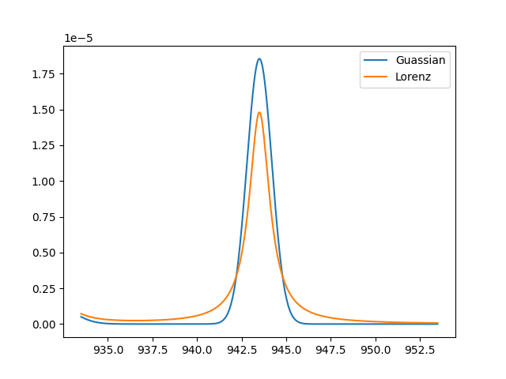
1) Gaussian & Lorentz O1s peak

Slide 5
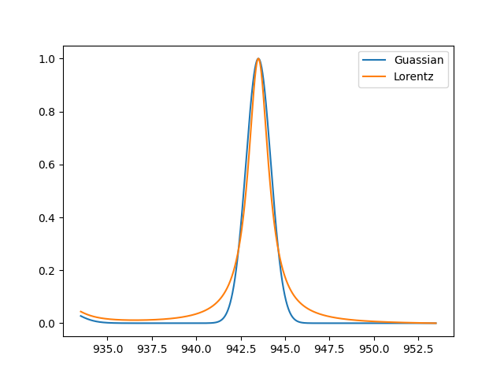
1) Gaussian & Lorentz O1s peak normalize

Slide 6
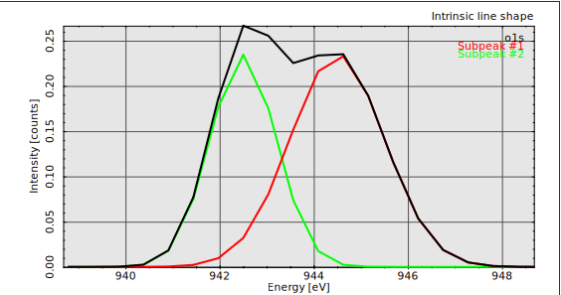
1) O1s subpeaks
 | Subpeak width | Subpeak Position
Subpeak #1 (Gaussian) | 1.0 | 944.50
Subpeak #2 (Gaussian) | 0.7 | 942.50

Slide 7
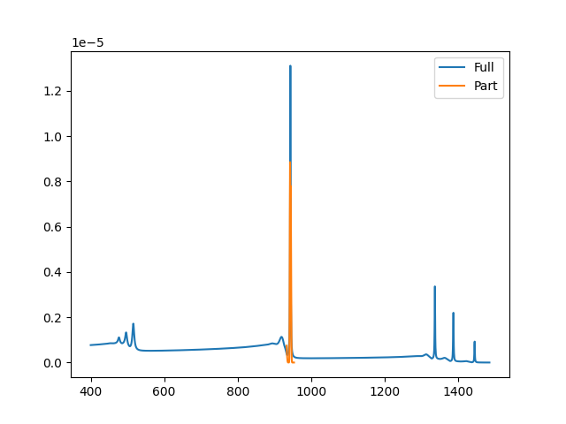
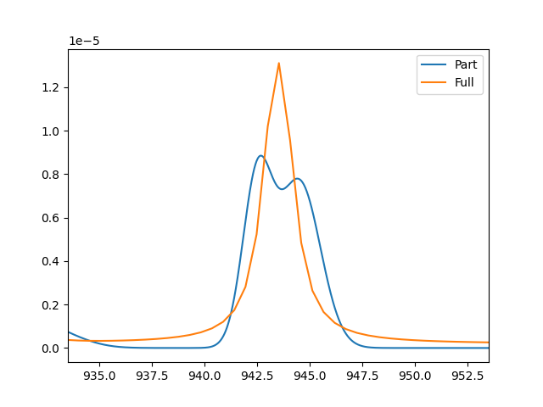
1) O1s subpeaks

Slide 8
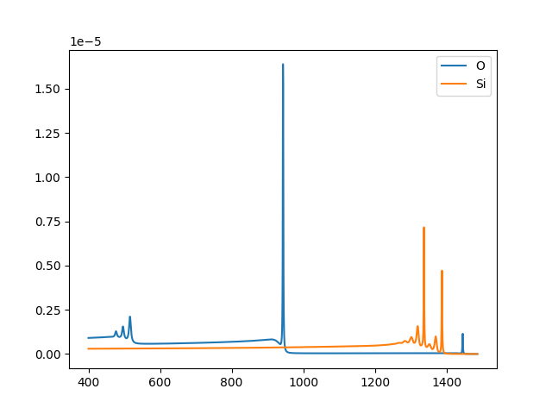
2) Si & O

Slide 9
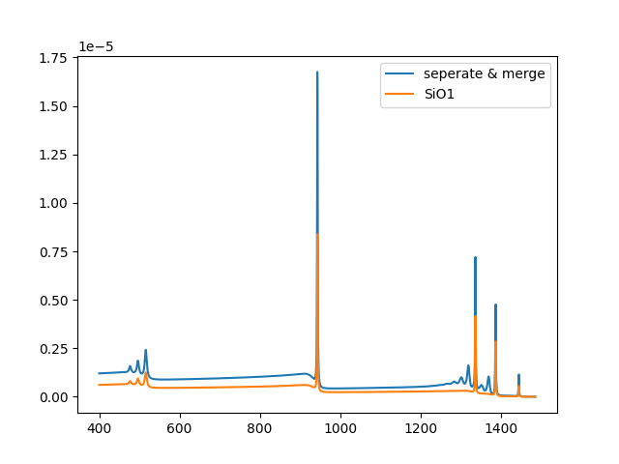
2) Si + O & SiO

Slide 10
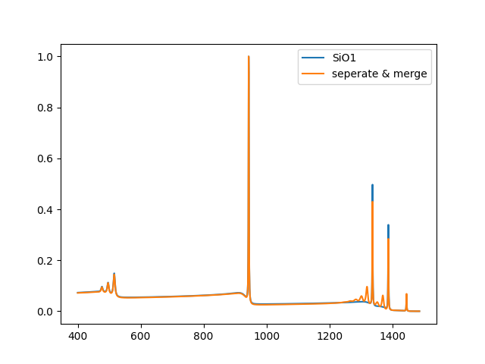
2) Si + O & SiO normalize

Slide 11
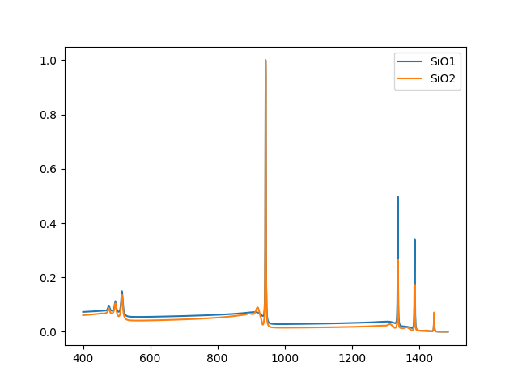
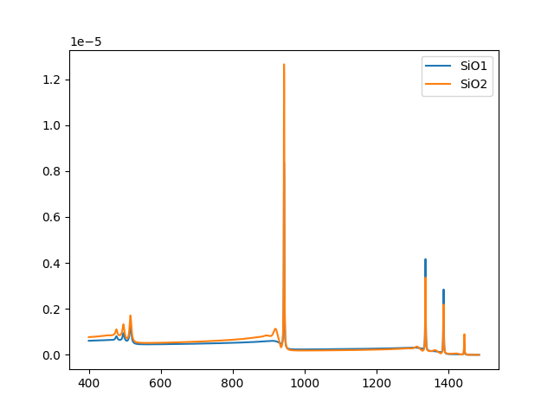
2) SiO & SiO2

Slide 12
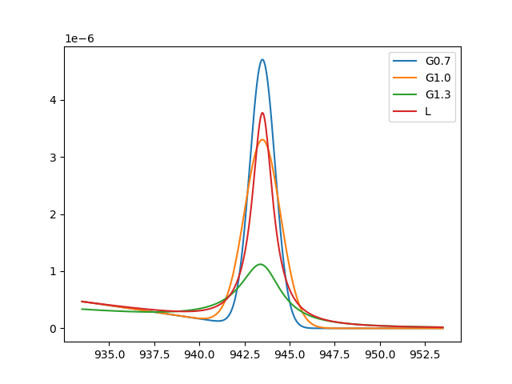
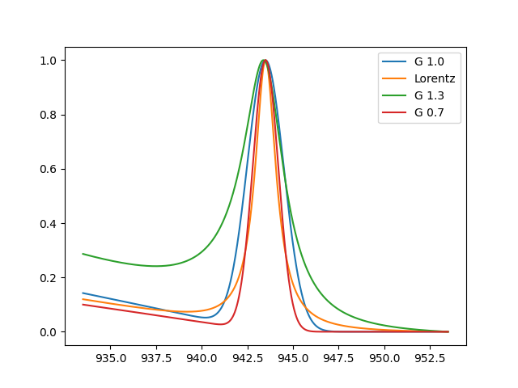
3) k100 o1s Lorentz & Gaussian

