Slide 1

InfraWorks KFT
Final Exam Project
Team Members:
Tóth Richárd (PM)
Schäfer Kristóf,
Date: 2026

Slide 2
The Project Vision
Architecture: Three-tier (Core, Distribution, Access) hierarchy.
Redundancy: Dual ISP, redundant firewalls and Core switches.
Segmentation: Floor-by-floor separation and dedicated DMZ for servers.
Technologies: HSRP for fault tolerance, LACP for bandwidth.

Slide 3


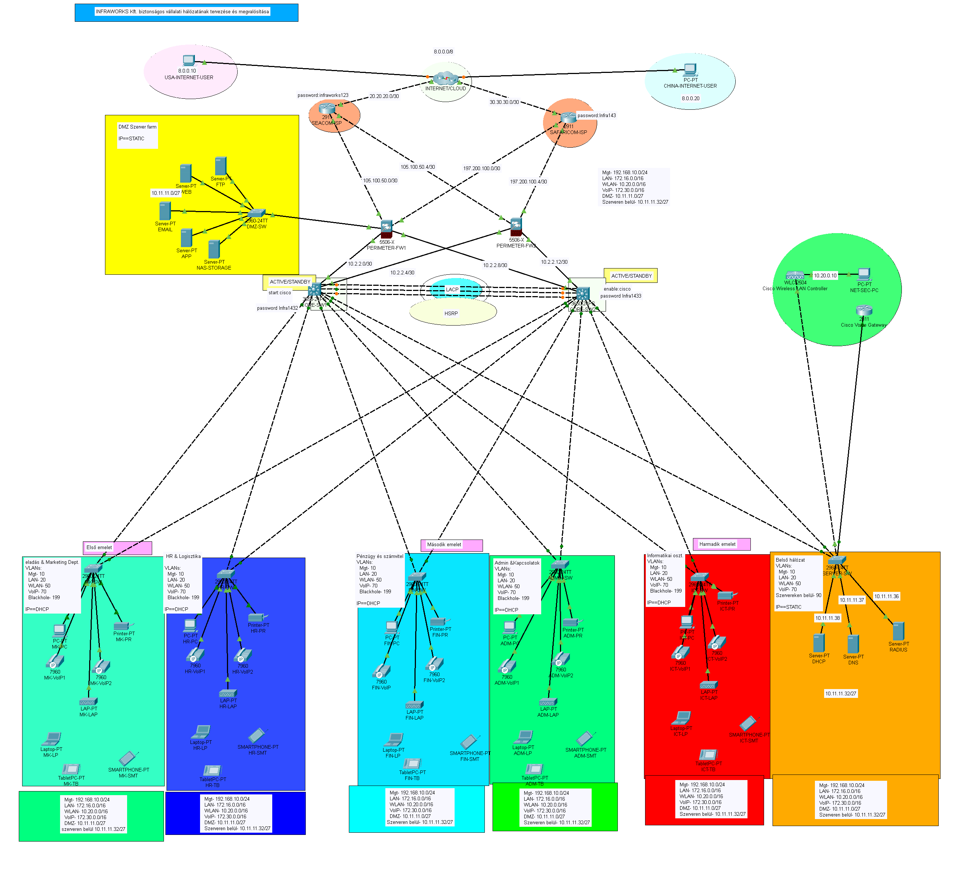
A Projekt Layout Overview

Slide 4
What's Included in the Topology

Slide 5
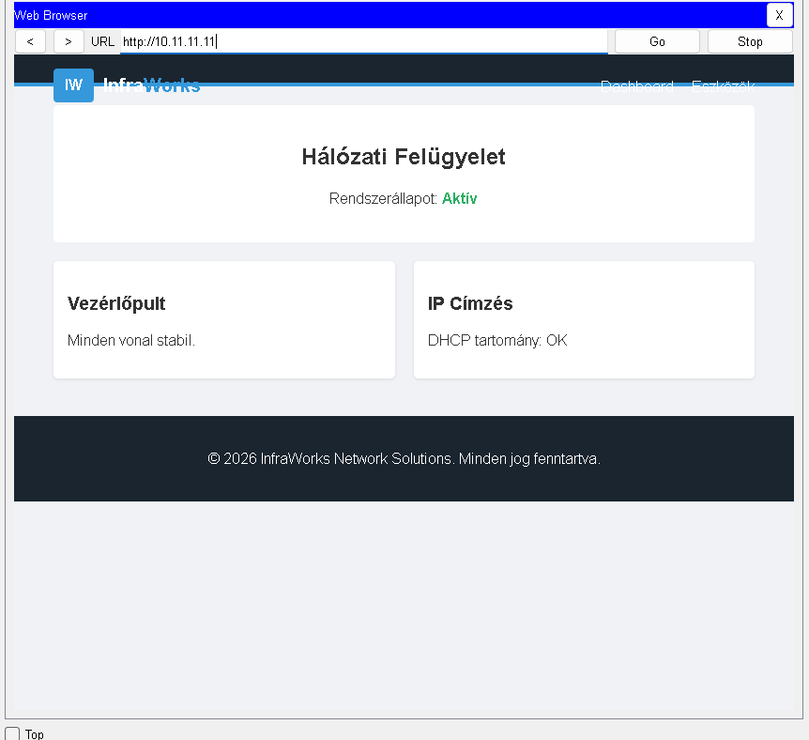
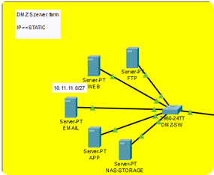
2. DMZ (Demilitarized Zone)
DMZ Network Summary
Function: Isolation of public servers from the internal network.
Device: Cisco 2960 (Dedicated DMZ-SW).
Network: 10.11.11.0/27 (Mask: 255.255.255.224).
Range: 10.11.11.1 – 10.11.11.30.
Servers:
WEB: Website (HTTP/S)
EMAIL: Mailing (SMTP/IMAP)
FTP: File Transfer (SFTP)
APP: Business Apps (API)
NAS-STORAGE: Central Storage (NFS/SMB)
Security: VLAN-based segmentation + Firewall restriction toward internal network.
Goal: Secure isolation of public services (WEB, EMAIL, FTP, APP, NAS) from the internal network.

Slide 6
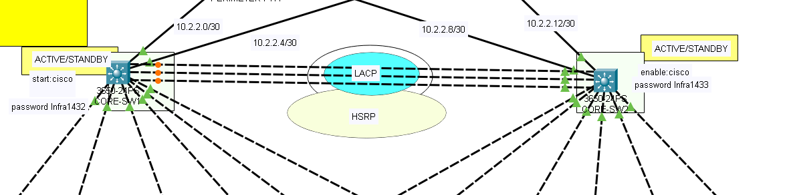
3. The Network "Brain" – Core Network Redundancy and Control
Devices: 2x Cisco 3560 Multilayer Switch (CORE-SW1, CORE-SW2).
Applied Technologies:
LACP (EtherChannel): Bundling multiple links for high bandwidth.
HSRP: Virtual default gateway (Gateway) for continuous operation.
WLAN Controller (WLC): Central unit for all floor-level Wi-Fi access points.

Slide 7
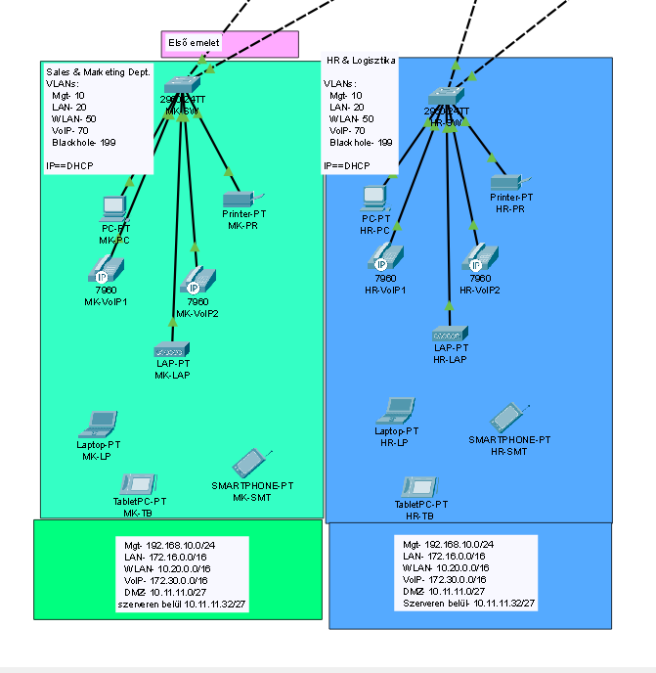
First Floor (Blue & Green Block) – Sales, HR and Logistics
Departments: Sales & Marketing, HR & Logistics.
Endpoint Devices:
Wired PCs and Laptops.
Network Printers (MK-PR, HR-PR).
Mobile Devices (Tablets, Smartphones).
Communication: IP phones at every desk (VoIP network).
Wi-Fi: Dedicated access points (Access Points).

Slide 8
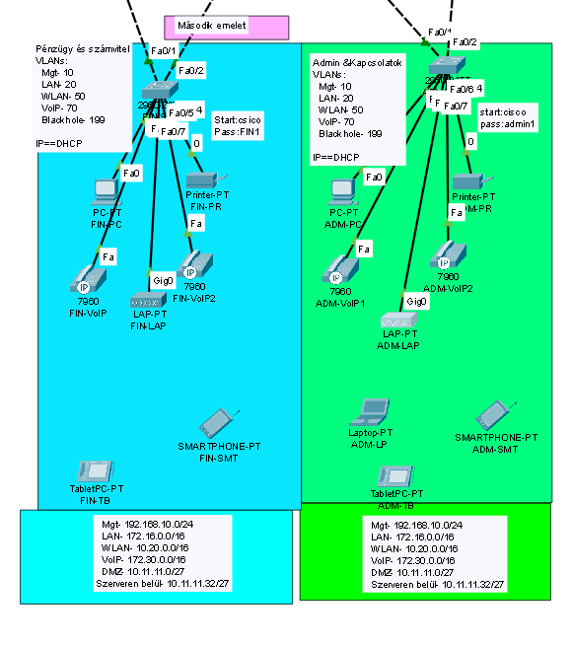
Departments: Finance & Accounting, Admin & Relations.
Structure: Identical to the first floor matching structure (standardized deployment).
Network: VLAN-based segmentation for data protection.
Devices: Dedicated Access Switches (FIN-SW, ADM-SW) providing for uplink to the Core .
.
2. Floor (Light Blue/Light Green

Slide 9
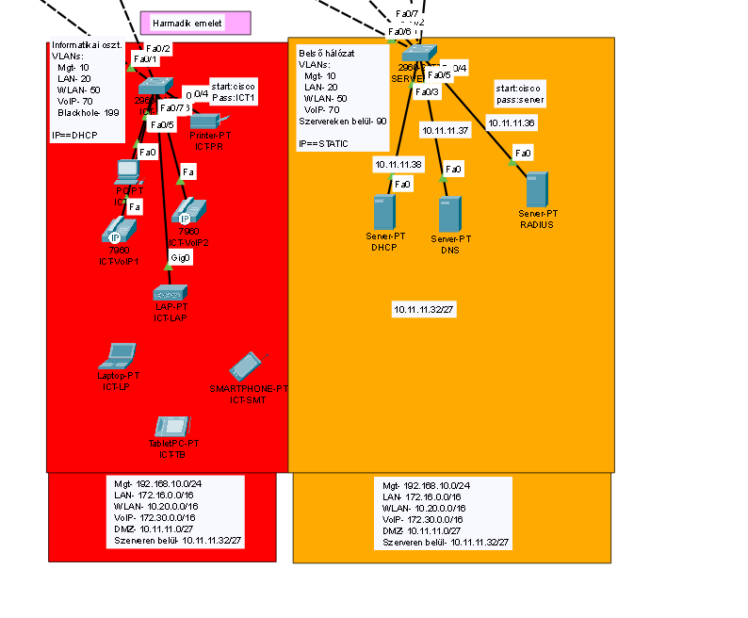
IT Department (ICT): Operational oversight and development.
Internal Network Services (Server-SW):
  DHCP Server: Automatic IP address assignment to clients.
  DNS Server: Internal and external name resolution.
  RADIUS Server: User authentication and network security (AAA).
Third Floor and IT Hub (IT Department and Internal Servers)

Slide 10
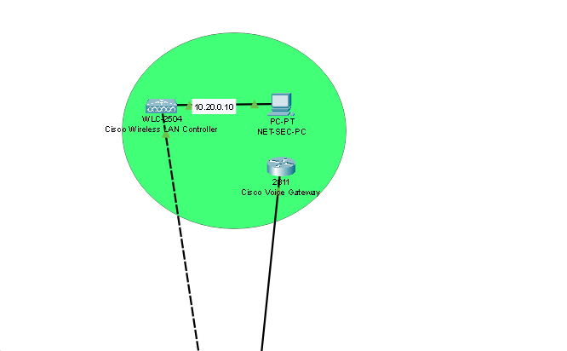
Management Network (Green Zone)
NET-SEC-PC (10.20.0.10): Central administrative workstation for network monitoring.
WLC-2504: Cisco Wireless LAN Controller corporate Wi-Fi network and APs.
2811 Voice Gateway: Cisco router for VoIP (VoIP) traffic and PBX services.
This zone provides isolated access, separate from the DMZ- and internal network, for configuring network infrastructure (WLAN, Voice, Security)

Slide 11
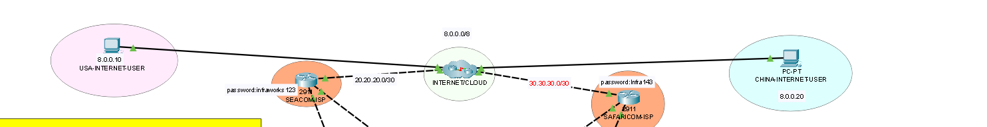
External Connectivity and Internet (INTERNET/CLOUD)
Central Cloud: The network connects via 8.0.0.0/8 to connect to the outside world
USA-INTERNET-USER (8.0.0.10): Remote US client access.
CHINA-INTERNETUSER (8.0.0.20): Remote Chinese client access.
Connections: Central routers (e.g., via 20.20.20.0/30 and 30.30.30.0/30 subnets) handle routing between sites and the internet.

Slide 12
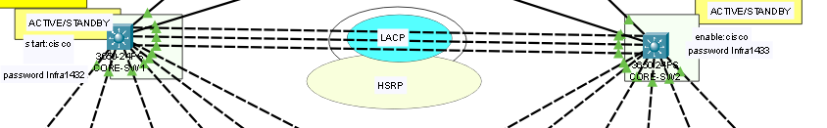
The Core Network (The "Heart" of the Network)
The two main switch (CORE-SW1 and CORE-SW2) handle the heavy lifting.
HSRP (Redundancy): Like a spare tire. If one switch fails, the other immediately takes over, and employees won't even notice the outage.
LACP (Bonding): Multiple cables are bundled between switches for faster data throughput, and if one cable fails, alternate paths remain.

Slide 13
We created network virtual machines using the Oracle VirtualBox application

Slide 14
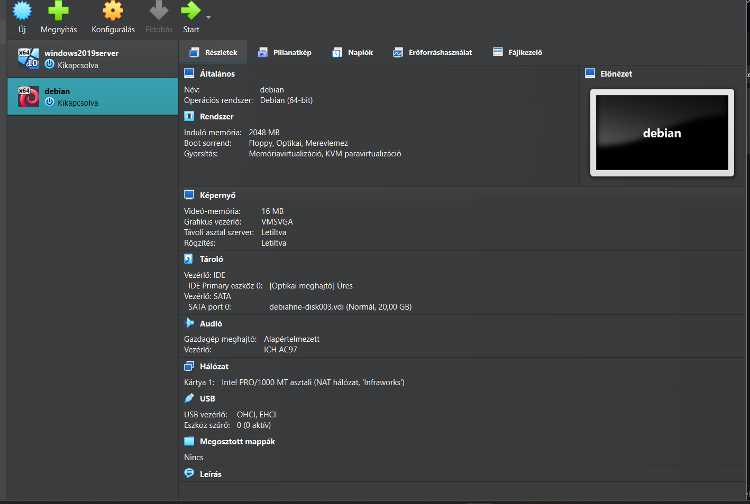
Virtual Machines Used
Windows Server 2019
System: Windows Server-based environment with a graphical interface.
Network Config: Static IP address for reliable connectivity.
Debian
System: Debian Linux-based server with a custom user account.
Network Config: Static IP address configured for reliable connectivity.

Slide 15
Active Services:
Web Server: Apache installed with HTTP(unencrypted) and secure HTTPS (encrypted) protocol support.
File Sharing: Samba service configured for cross-platform data access.
Data Protection: Automated backup configured using cron scheduler.

Slide 16

Windows Server 2019 Infrastructure
Installation: Administrator environment and IPv4 configuration.
Directory: Active Directory and DNS service installation.
DHCP: Automatic IP address assignment to clients.
Resources: Centralized file and printer sharing.
Security: Scheduled backup (Backup Schedule) configuration.

Slide 17
Debian/Linux Server
System Environment: Debian OS installed with a custom user account and NAT network integration.
Network Basics: Static IPv4 address configuration for fixed and reliable service access.
Web Service: Apache web server with HTTP and secure HTTPS protocol support.
File Management: Samba service for seamless data exchange between Linux and Windows platforms.
System Security: Automated data backup process using cron task scheduler.

Slide 18
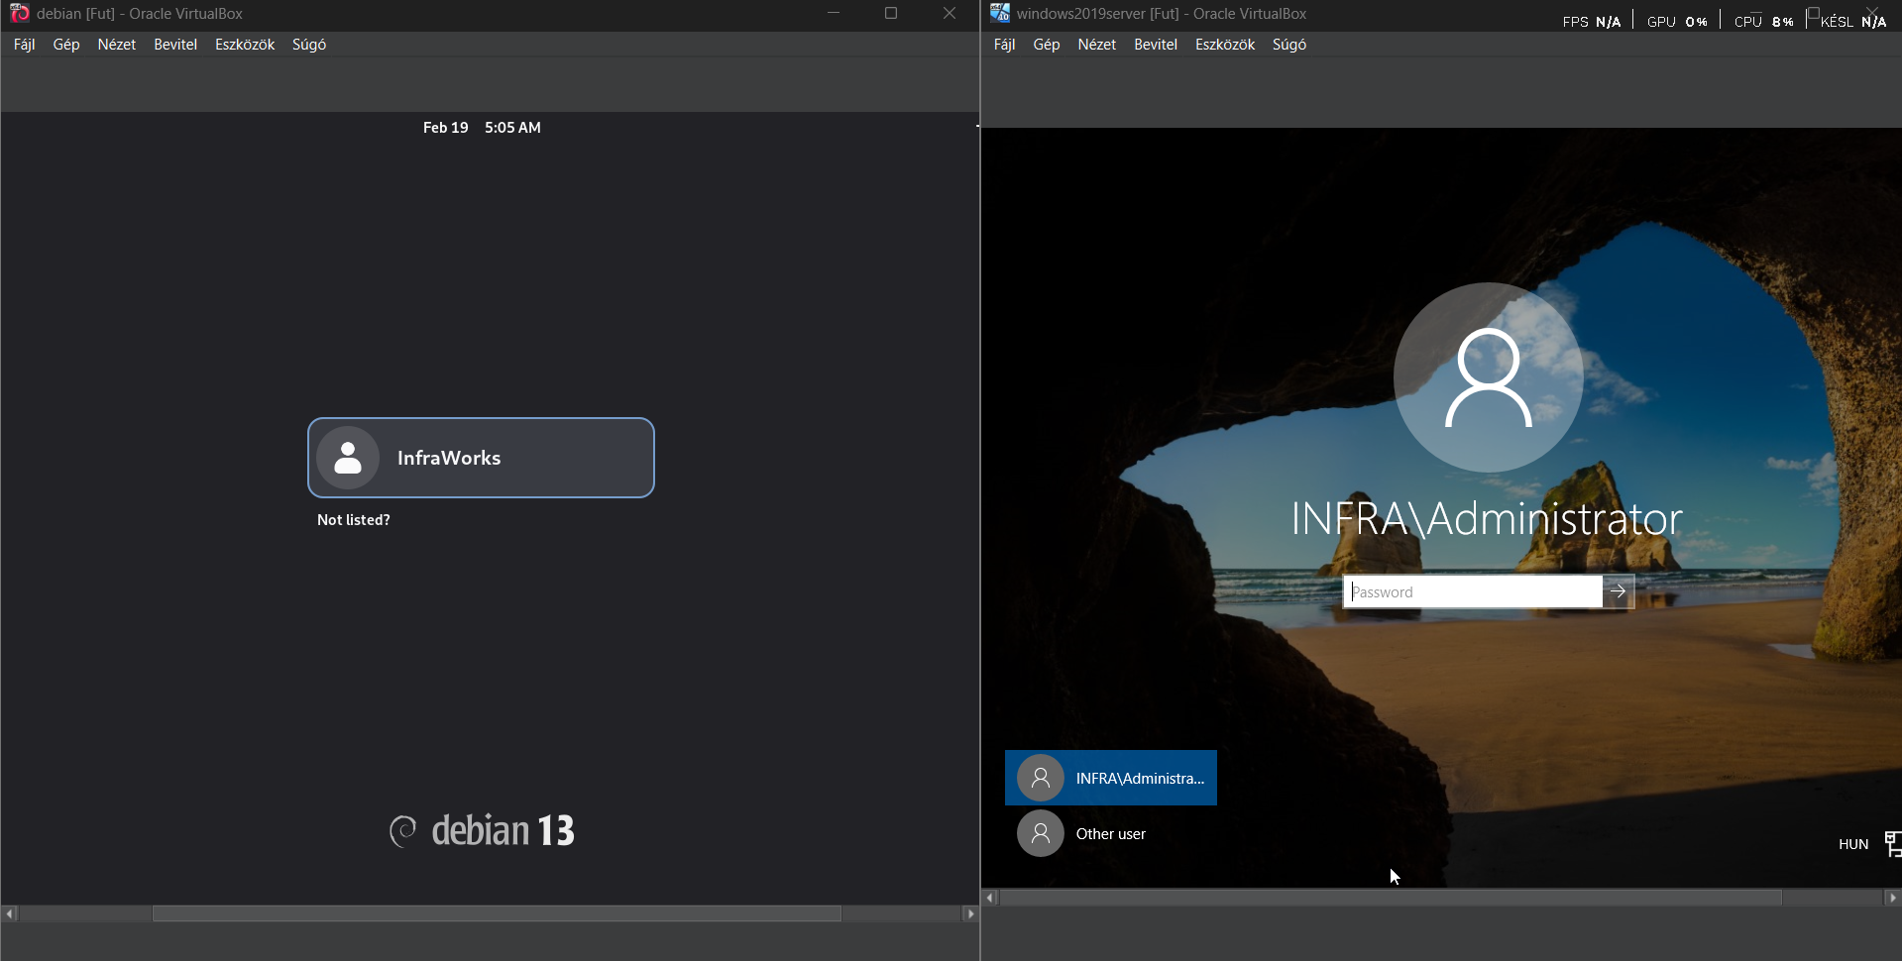
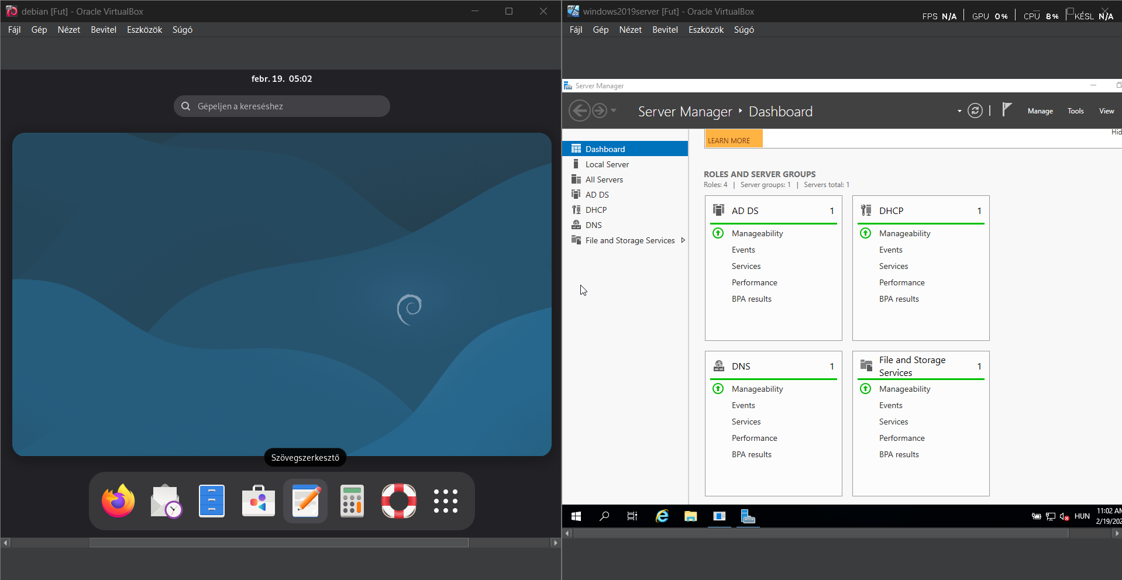
Network Virtual Machines in Action
windows
Debian

Slide 19
GIT – Version Control
What is it? Software, that saves for files' different states.
What is it used for?:
Traceability: Every change and responsible party is logged.
Rollback (Rollback): In case of errors, at any time you can revert to a previous, working version.
Teamwork: Multiple people can work on the same for project without, overwriting each other's work.

Slide 20
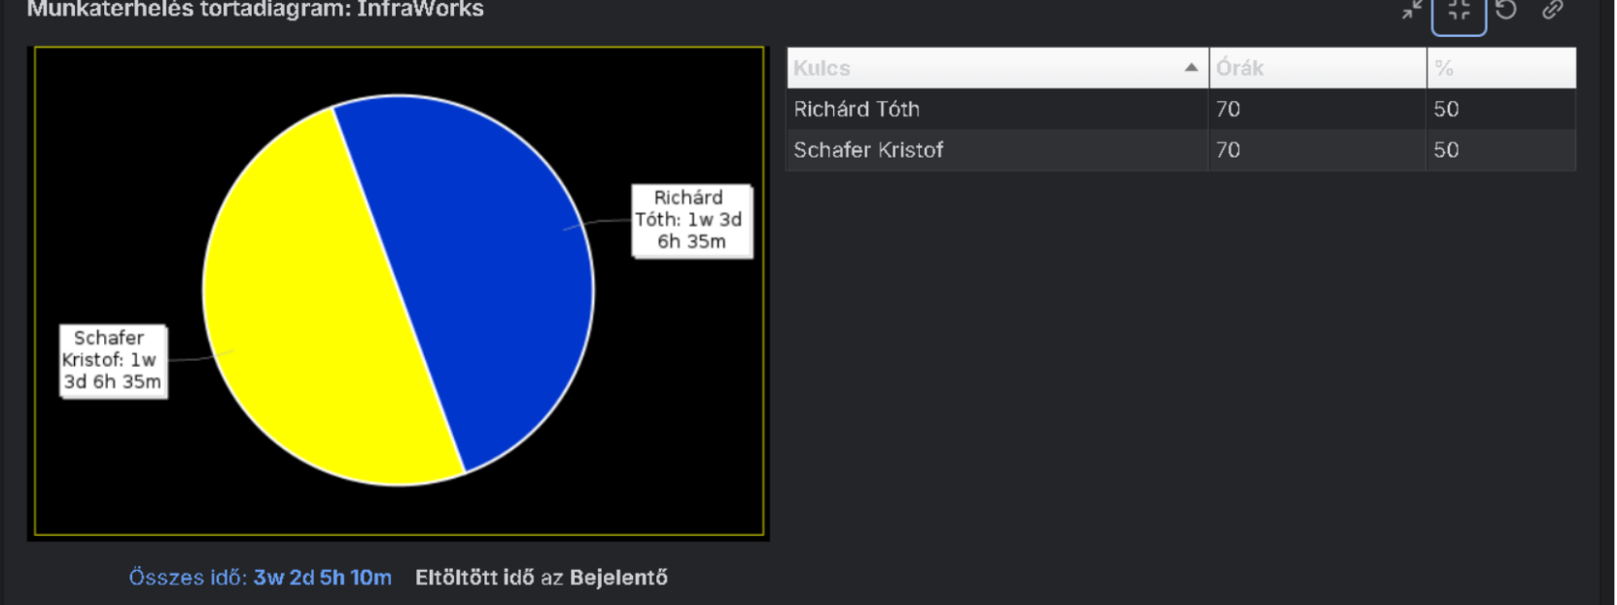
JIRA – Project Management and Issue Tracking
What is it? A task management and process tracking framework.
How did we use it?
Task Assignment: Scheduling work items (e.g., cabling, procurement, installation).
Issue Tickets (Tickets): Recording and managing problems that arise during implementation.
Status Tracking: Monitoring progress with "To Do", "In Progress" and "Done" columns.
Deadlines: Meeting milestones and delivery dates.

Slide 21
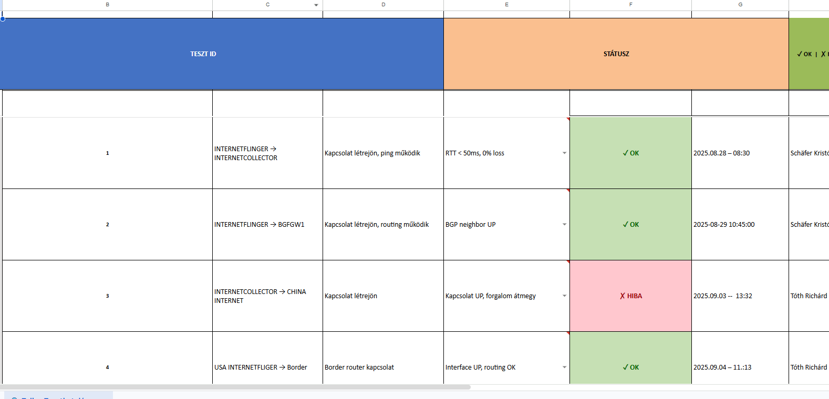
Testing

Slide 22
Thank You for Your Attention!

