Slide 1






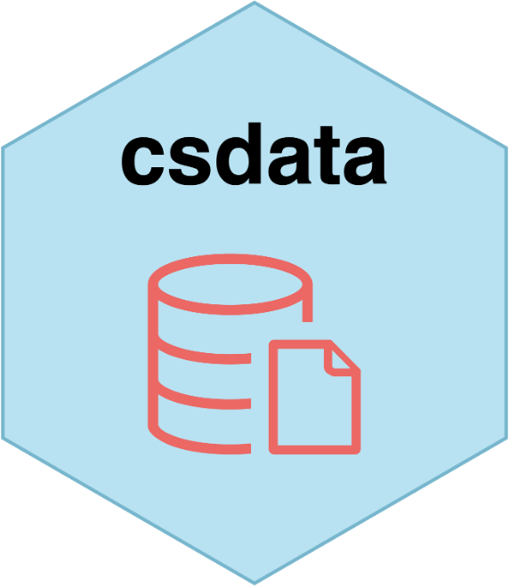








csverse
Historical data
Public health surveillance
Structural data
Analysis planning and file organization
Helper functions
CC BY SA • hello@csids.no • Learn more at csids.no/packages.html • Updated: 2022-11-17

Slide 2














Public health surveillance
Structural data
Analysis planning and file organization
Helper functions
CC BY SA • sykdomspulsen@fhi.no • Learn more at docs.sykdomspulsen.no/packages • Updated: 2022-04-04

