Slide 1
Dominant Pathways of Exposure
Neighborhood | Adult Dominant Pathway(s) | Child Dominant Pathway(s)
DTK | Raw Produce, Street Food | Open Drain, Raw Produce, Street Food
Medina Gounass | Raw Produce | Open Drain, Raw Produce
Rufisque Est | Raw Produce | Open Drain, Raw Produce
Sciap Liberte | Raw Produce | Raw Produce
Wakhinane | Raw Produce | Raw Produce

Slide 2
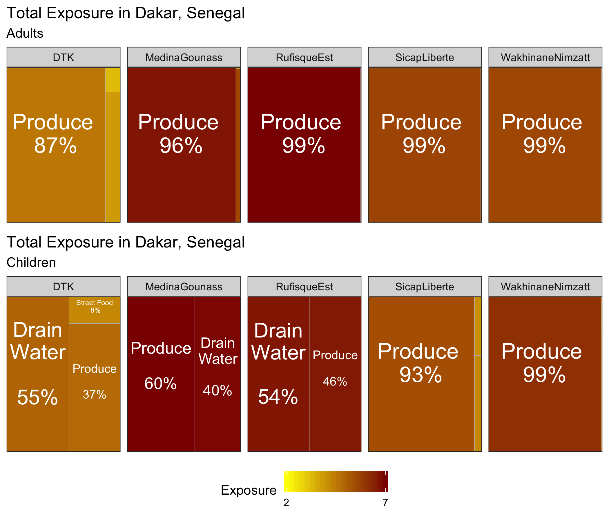
Exposure to Fecal Contamination for Adults and Children

