Slide 1

A smart, convenient and energy saving window management option

Slide 2
The concept
We aim to automate opening and closing your window in order to ventilate your room more efficiently
With a smart, scalable, multi-purpose and cost-effective solution
When you leave the window open for too long, it wastes a lot of energy
Having electrically controllable windows is very fun, but our automation also pays for itself after a while
Automated decision with multiple input parameters
Temperature in the room
Air quality in the room
Desired temperature (set by the user or got from an already smart system)
Outside weather (through WiFi)

Slide 3
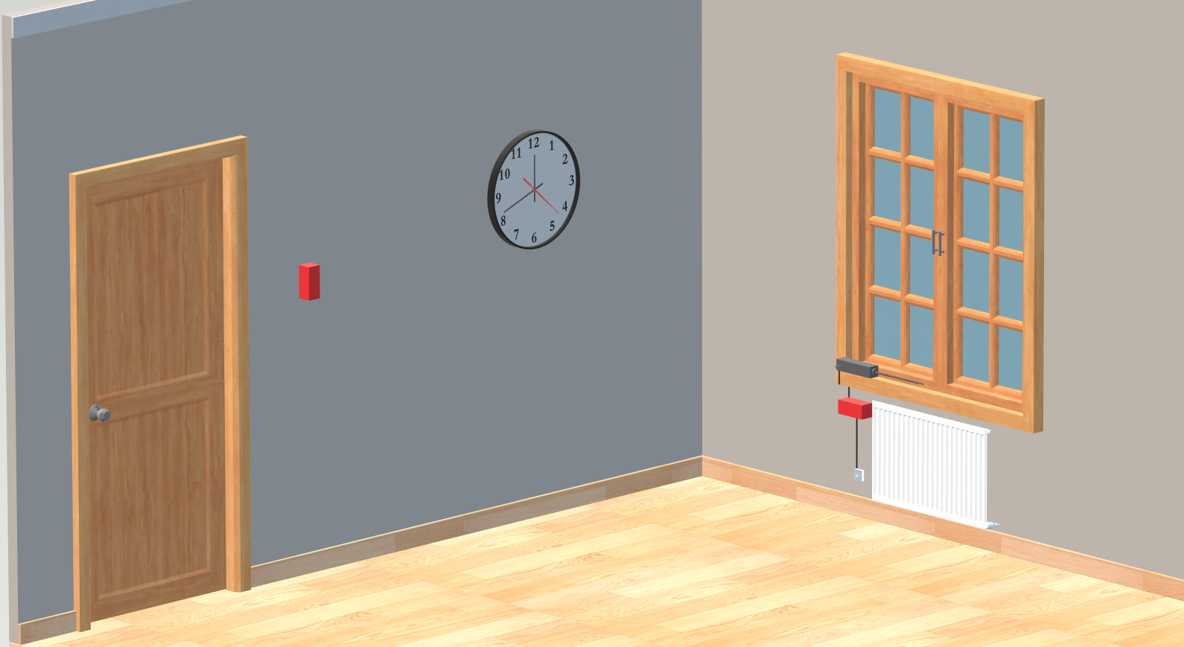

Slide 4
The system itself
Two types of devices: a Sensor and a Controller
Sensor: measuring temperature and air quality
Controller: opening and closing the window and communicating with the outside world through WiFi
Comm between devices: 433 MHz (Silicon Labs RF chip)
Scalable: you can use any number of devices
Expandable: you can add extra sensor through external headers (SPI)
Easy to use and integrate: the ESP32 is easily controlled through Home Assistant for example

Slide 5
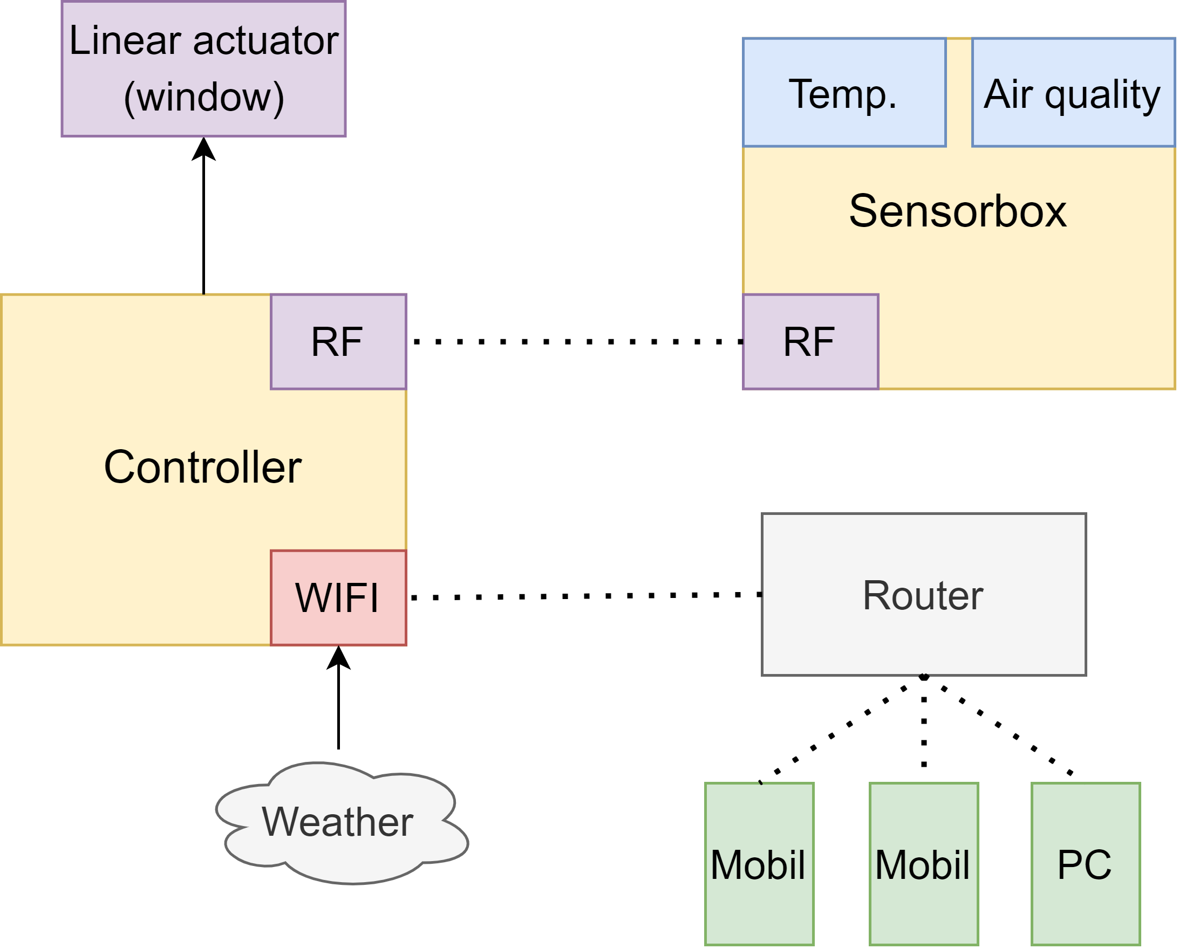

Slide 6
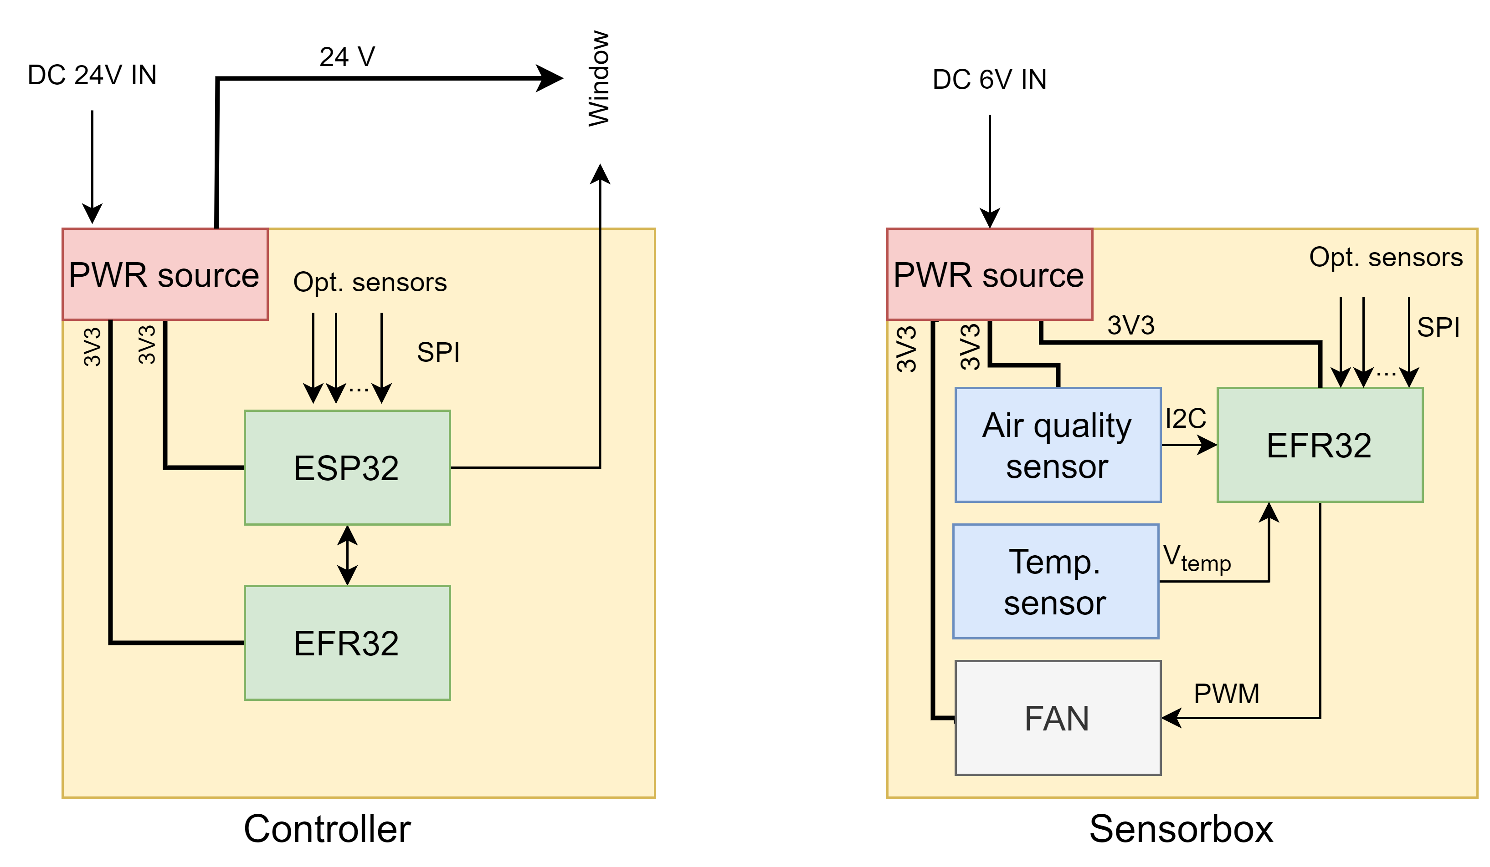

Slide 7
Costs, savings
If you can supply power to the window, the installation is basically free
The cost of the energy use is close to negligible
Sensor: 4 AAA batteries last for about 2.5-3 months (or plug in)
Controller: consumes about 6 Wh in a day
Very rough estimation: you can save around 60-85 EUR per year in a small apartment
Part cost for one pair of devices: 85 EUR
PCB + assembly cost for one pair of devices: ~70 EUR
So the system pays back its price in 2 years
Pretty good investment for a cool home automation project!

Slide 8
Easy to install
Scalable
Multi-purpose
Low consumption

Slide 9
