Slide 1

A smart, convenient and energy saving window management option

Slide 2
The concept
We aim to automate opening and closing your window in order to ventilate your room more efficiently
With a smart, scalable, multi-purpose and cost-effective solution
When you leave the window open for too long, it wastes a lot of energy
Having electrically controllable windows is very fun, but our automation also pays for itself after a while
Automated decision with multiple input parameters
Temperature in the room
Air quality in the room
Desired temperature (set by the user or got from an already smart system)
Outside weather (through WiFi)
Example: when it is raining outside (or when it is very cold compared to the desired temp), de device will be much more reluctant to open the window

Slide 3
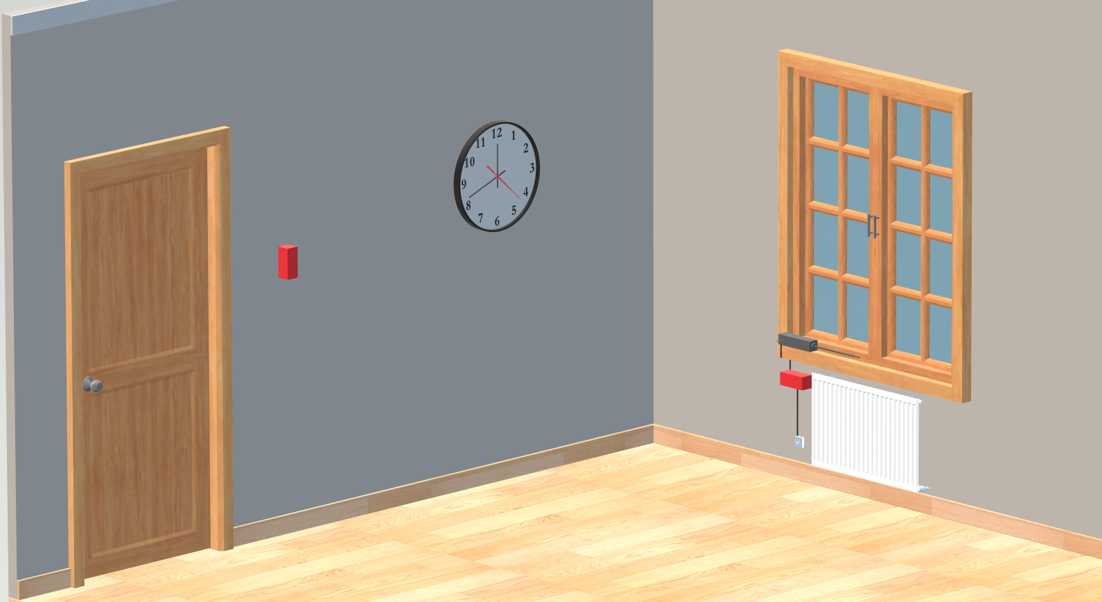

Slide 4
The system itself
Two types of devices: a Sensor and a Controller
Sensor: measuring temperature and air quality
VOC sensor (SGP40)
Controller: opening and closing the window and communicating with the outside world through WiFi
Comm between devices: 433 MHz (Silicon Labs RF chip)
This is more secure and uses less energy than having WiFi on every board
Scalable: you can use any number of devices
One Controller will be the gateway to the outside world through WiFi, everything else is internal communication in the network
Expandable: you can add extra sensor through external headers (SPI)
Easy to use and integrate: the ESP32 is easily controlled through Home Assistant for example

Slide 5
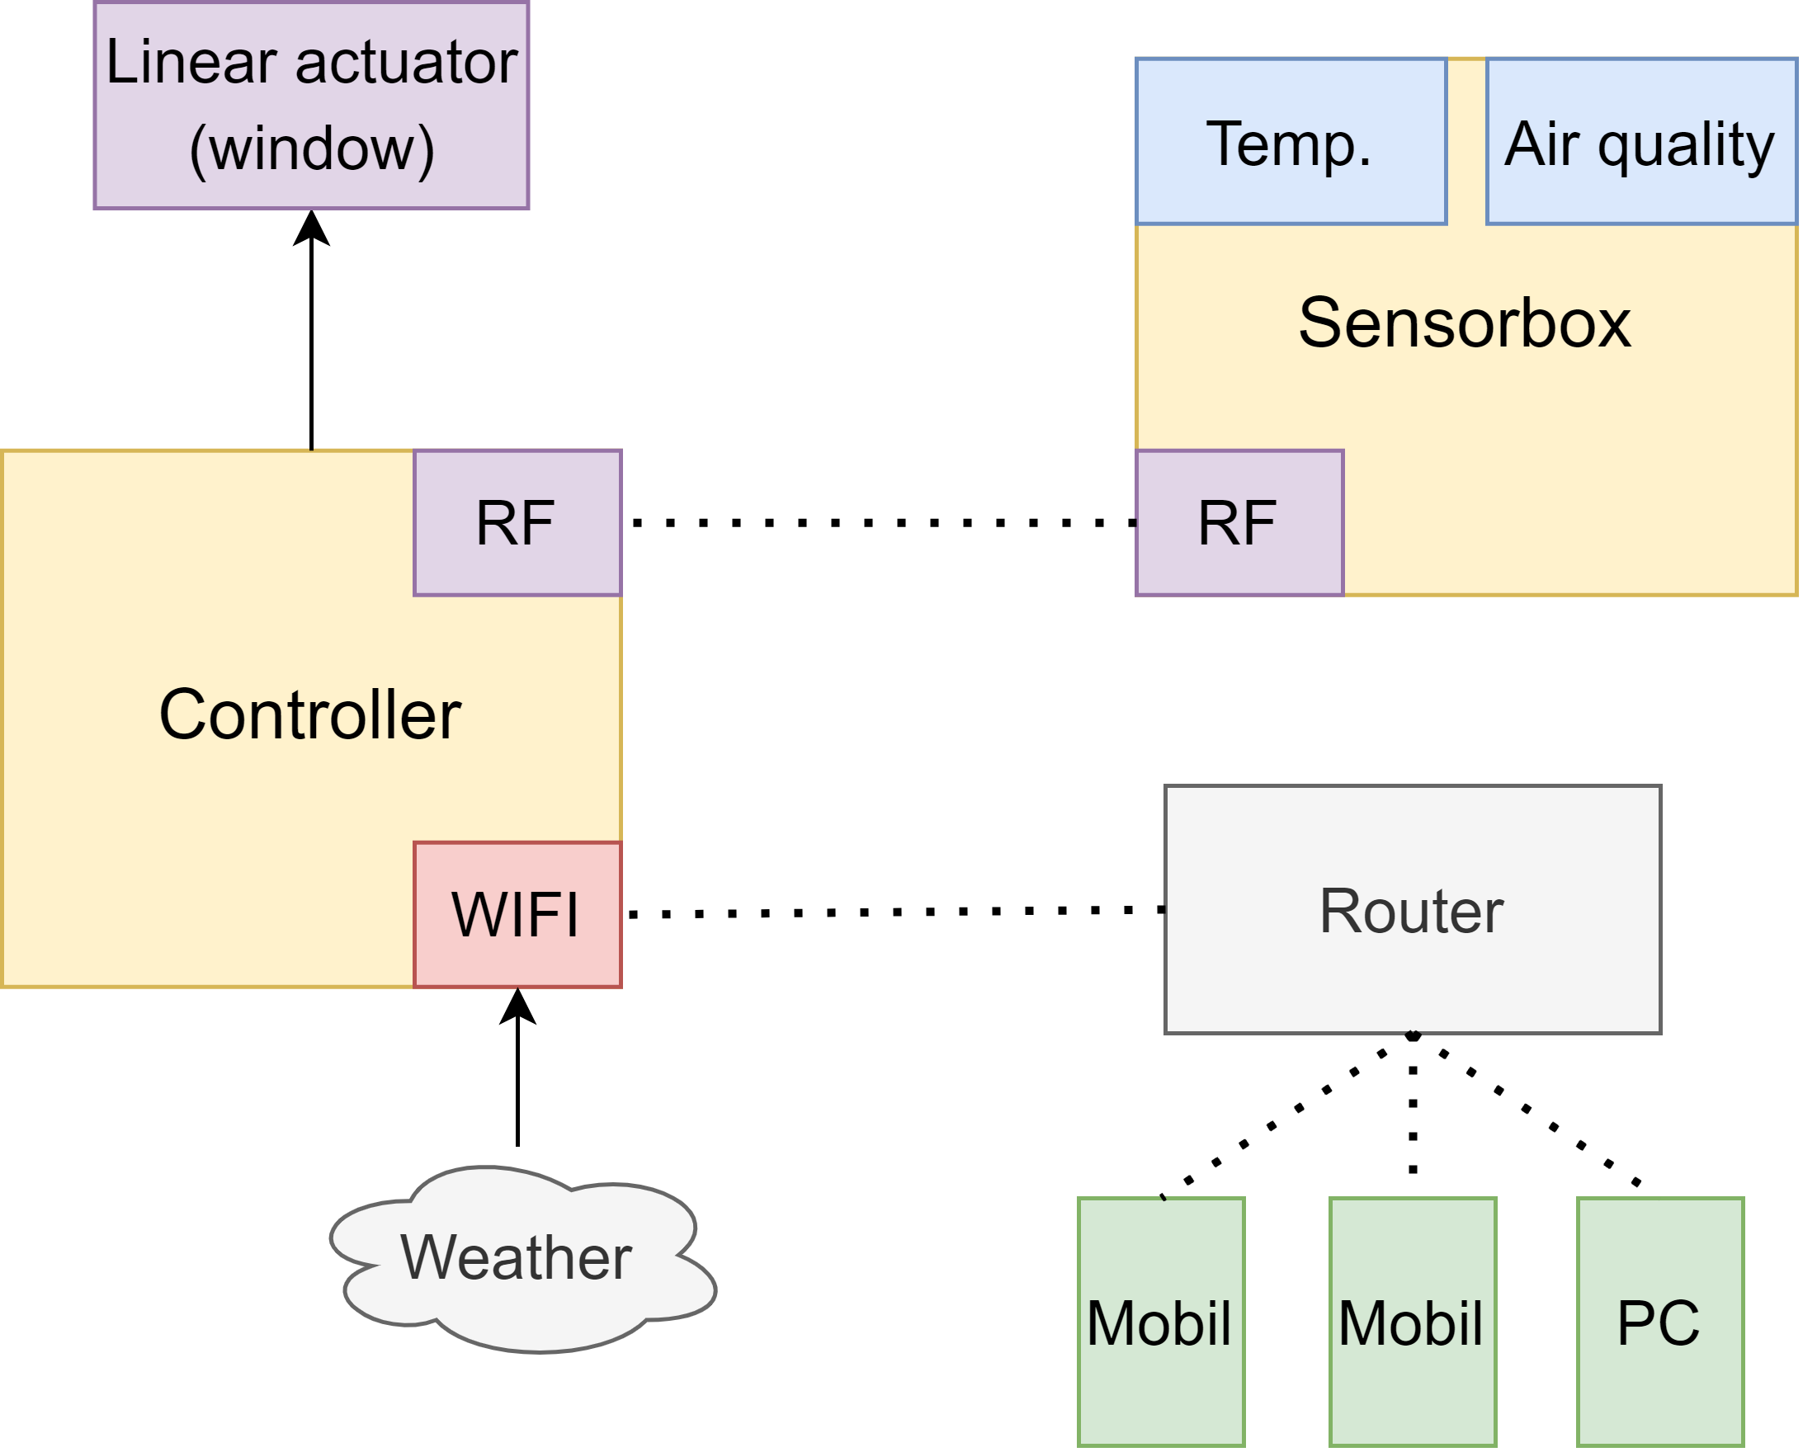

Slide 6
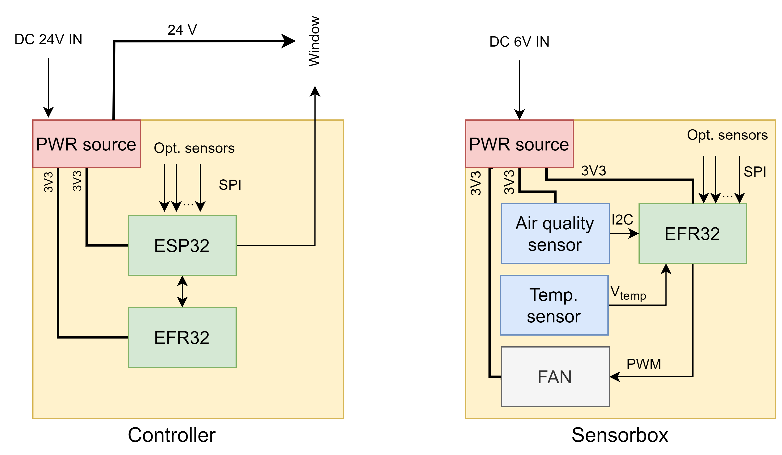

Slide 7
Costs, savings
If you can supply power to the window, the installation is basically free
The cost of the energy use is close to negligible
Sensor: 4 AAA batteries last for about 2.5-3 months (or plug in)
Controller: consumes about 6 Wh in a day
Very rough estimation: you can save around 60-85 EUR per year in a small apartment
Part cost for one pair of devices: 85 EUR
PCB + assembly cost for one pair of devices: 57 USD
So the system pays back its price in about 2 years
Pretty good investment for a cool home automation project!

Slide 8
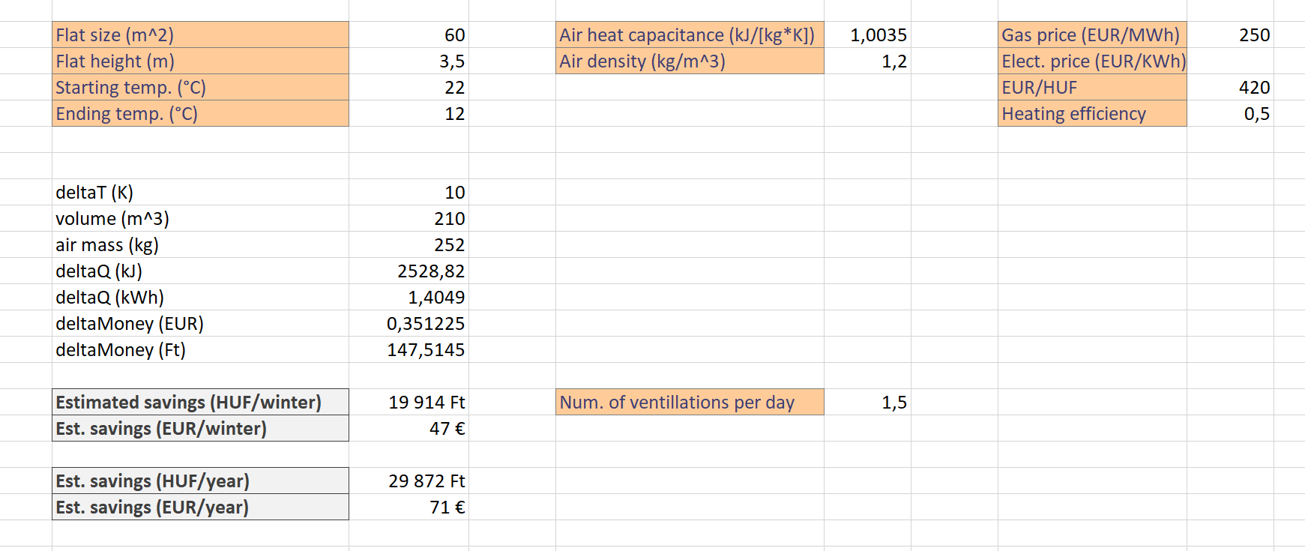

Slide 9
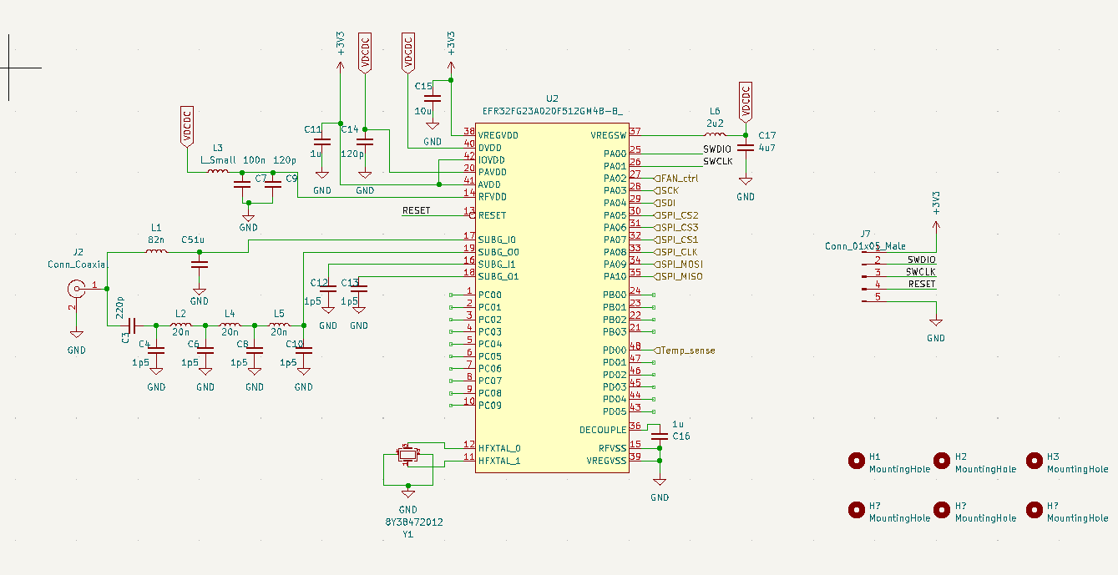
Schematic
Example: RF frontend

Slide 10
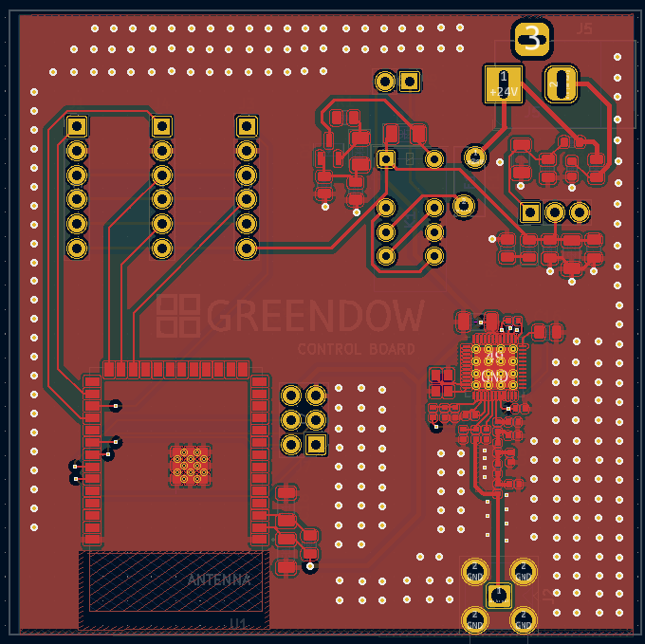
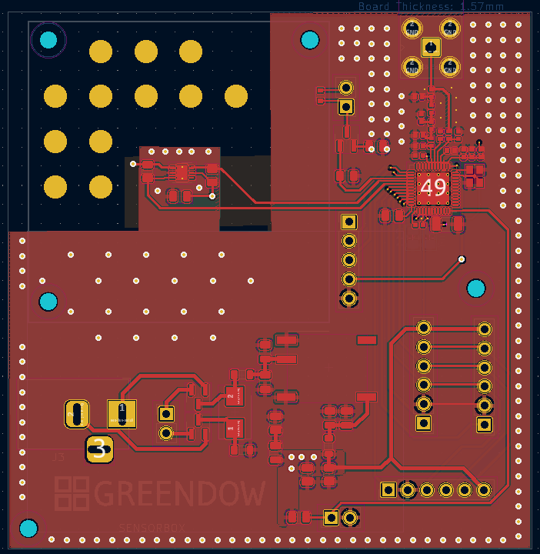
Layout

Slide 11
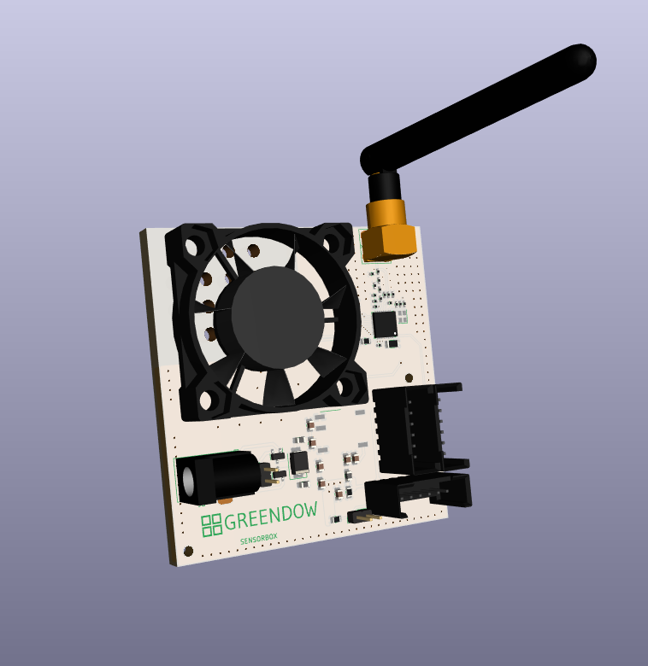
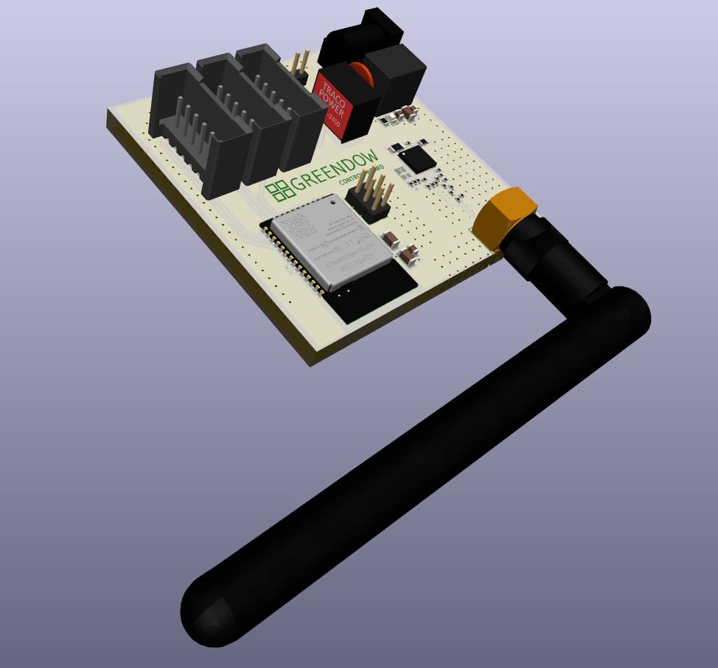
3D model

Slide 12
Easy to install
Scalable
Multi-purpose
Low consumption

