Slide 1

A smart, convenient and energy saving window management option

Slide 2
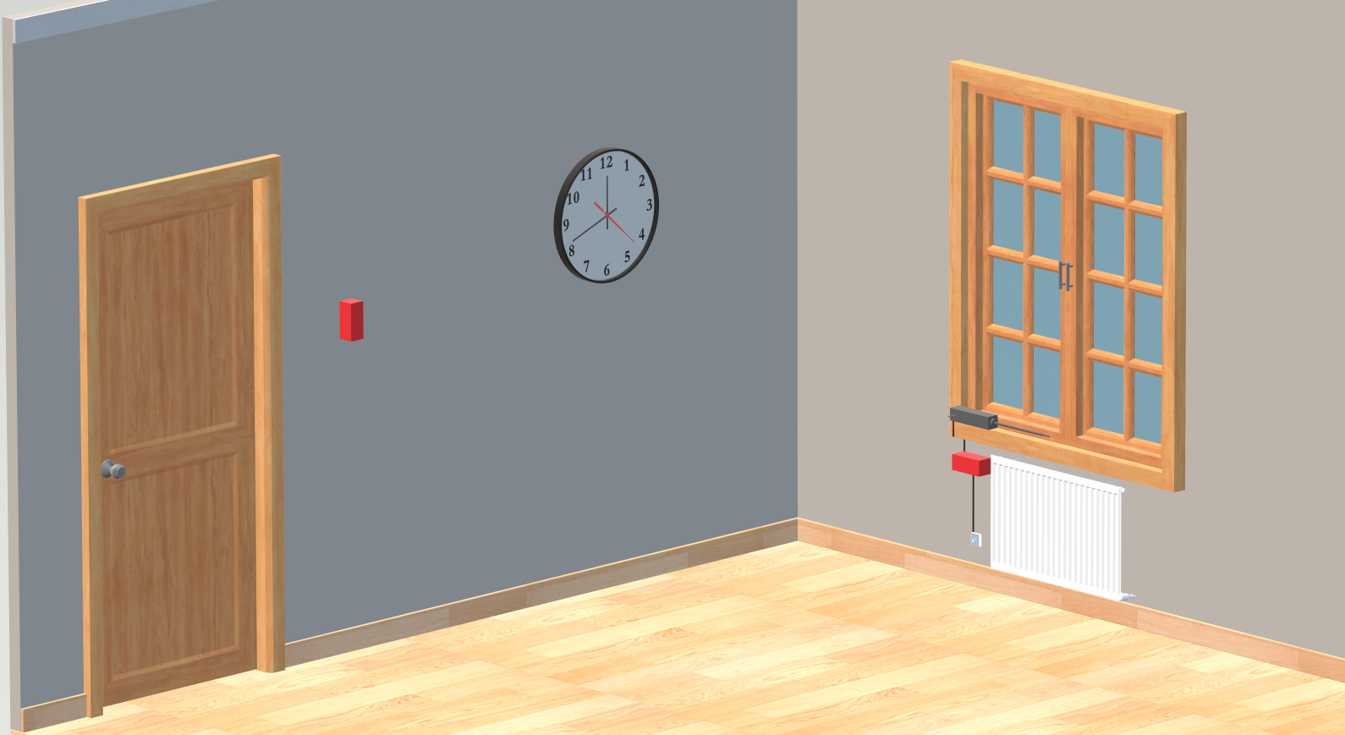

Slide 3
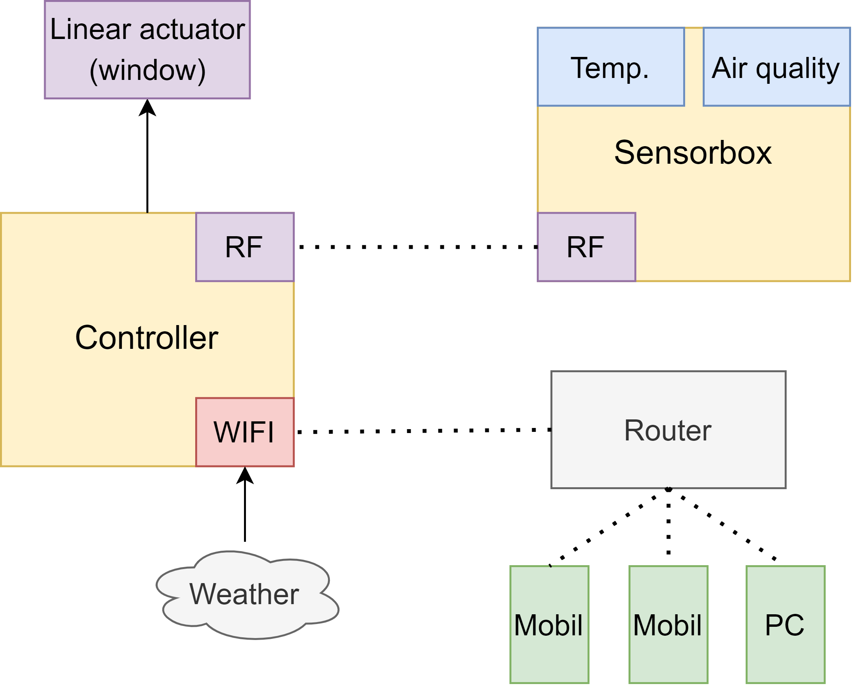

Slide 4
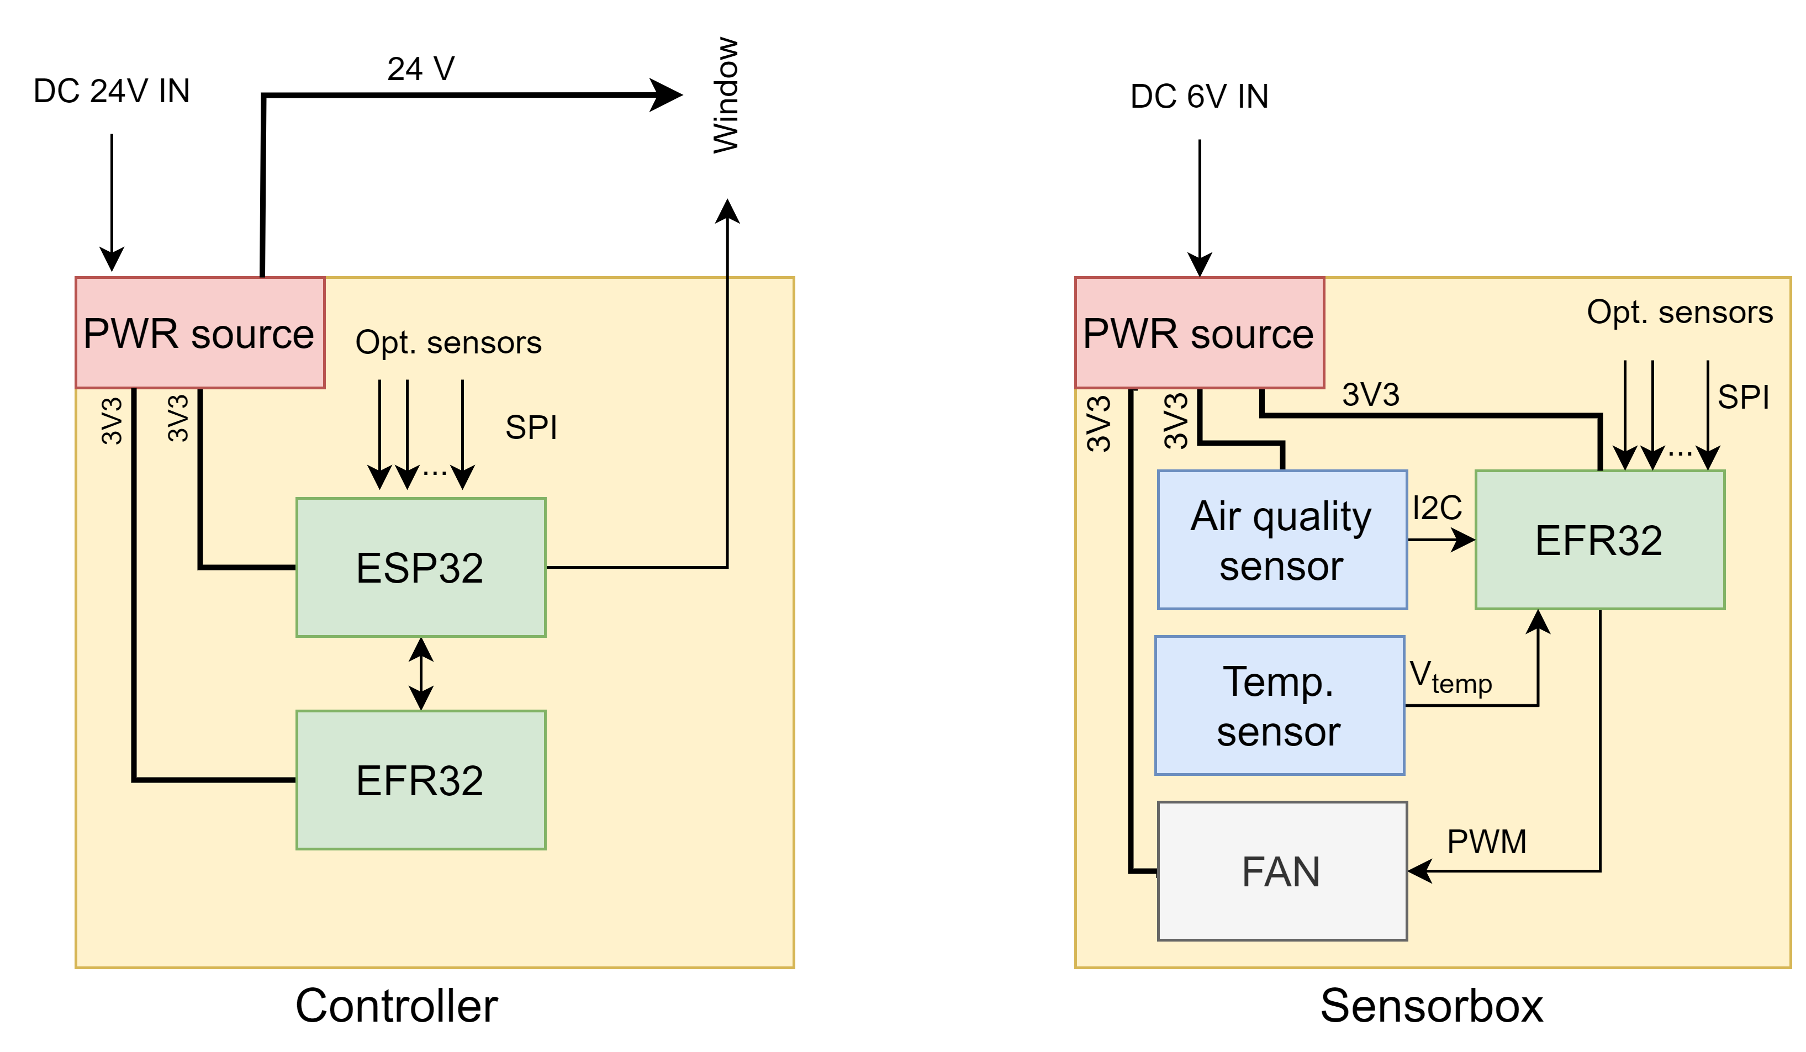

Slide 5
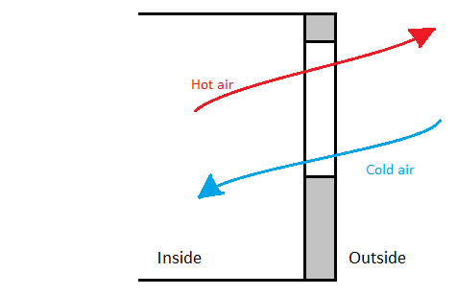


Slide 6
Easy to install
Scalable
Multi-purpose
Low consumption

