Slide 1
Sea Level Rise Impact
on Coastal Portugal
2025 – 2100
Methodology, Tools & Analytical Framework
MBA Data Science Capstone · Celso Simões · 2026
Sea Level Rise · Coastal Portugal · Celso Simões
1

Slide 2
What This Study Does
Scope & objectives
Question
What is the economic cost of sea level rise on Portugal's coastline between 2025 and 2100 — and which regions are most at risk?
Geography
339 km of exposed Atlantic coastline · 13 NUTS3 regions · 20 sea level rise thresholds (0.1 m to 2.0 m)
Scenarios
Three IPCC AR6 pathways — SSP1-2.6 (+0.40 m), SSP2-4.5 (+0.60 m), SSP5-8.5 (+1.00 m) — plus sensitivity testing
Output
Region-by-region economic exposure, risk classification, adaptation break-even analysis, and 5 interactive Tableau dashboards
Sea Level Rise · Coastal Portugal · Celso Simões
2

Slide 3
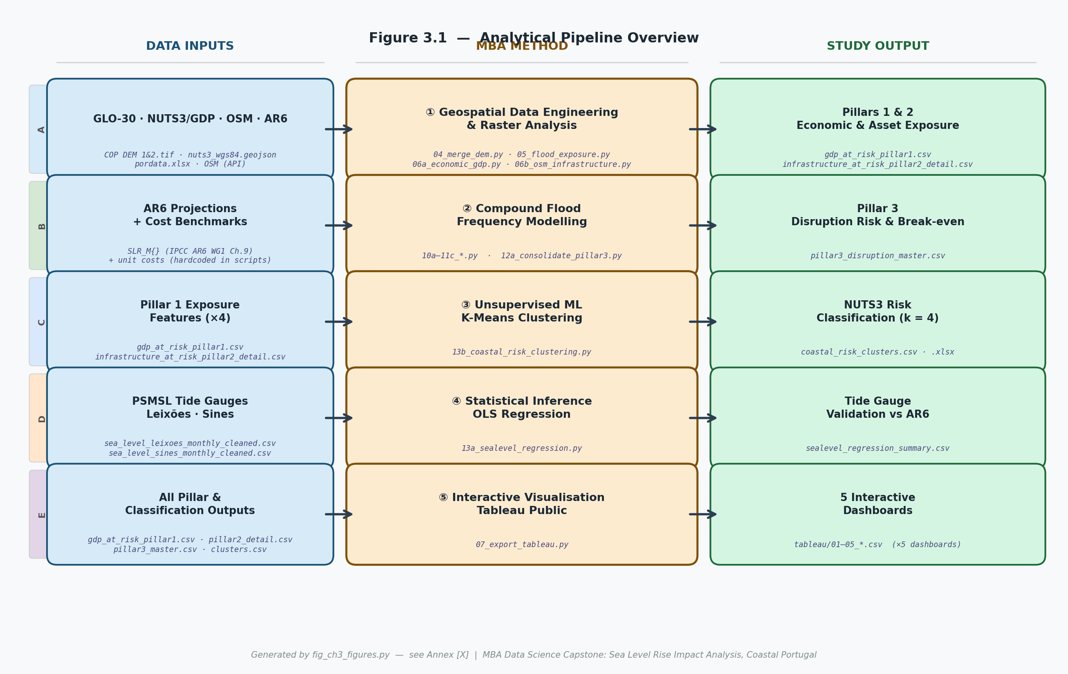
Analytical Pipeline
Five stages from raw data to interactive dashboards
Sea Level Rise · Coastal Portugal · Celso Simões
3

Slide 4
Data Sources
Four primary inputs — all open / publicly available
GLO-30 DEM
GDP & NUTS3
IPCC AR6
Tide Gauges
Copernicus ESA 30m Digital Elevation Model · 2 tiles covering coastal Portugal · foundation for all flood inundation modelling
Eurostat NUTS3 GDP data + OpenStreetMap infrastructure layer · economic exposure for Pillar 1 (GDP) and Pillar 2 (assets)
AR6 median SLR projections for Leixões & Sines · three emission scenarios · 0.06 m offset steps from 0.10 m to 2.00 m
PSMSL monthly records: Leixões (1956–2022) and Sines (1977–2022) · used to calibrate OLS trend and validate AR6 projections
Sea Level Rise · Coastal Portugal · Celso Simões
4

Slide 5
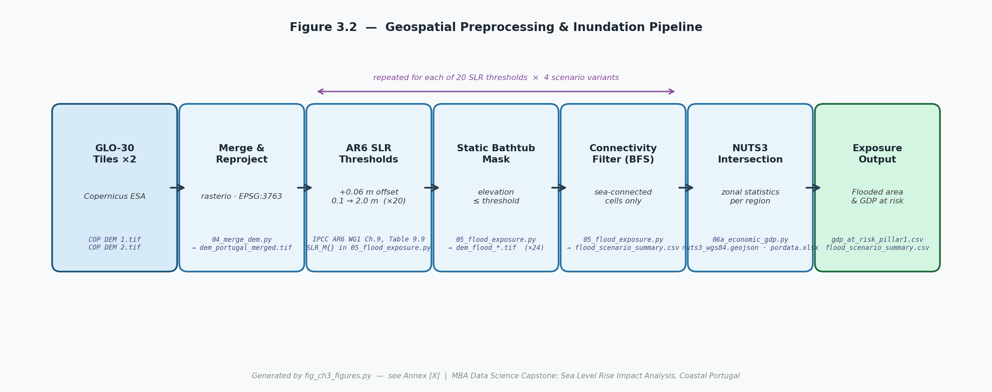
Stage 1 — Geospatial Processing
Python · rasterio · BFS connectivity filter · NUTS3 zonal statistics
04_merge_dem.py
05_flood_exposure.py
06a_economic_gdp.py
Merges & reprojects GLO-30 tiles to EPSG-3763 (Portugal national grid)
Applies static bathtub mask at each SLR threshold; BFS filter removes disconnected cells
Intersects flood mask with NUTS3 boundaries to calculate GDP and flooded area at risk
Sea Level Rise · Coastal Portugal · Celso Simões
5

Slide 6
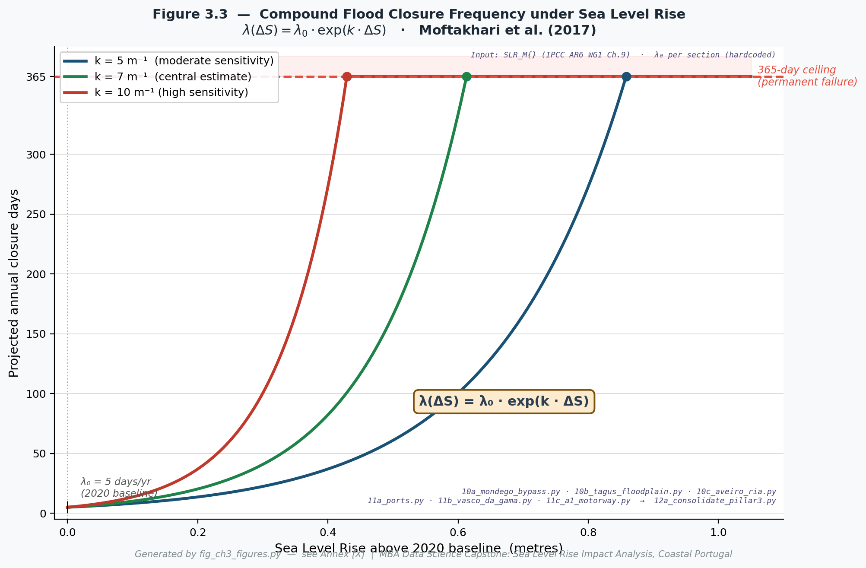
Stage 2 — Compound Flood Frequency Model
Moftakhari et al. (2017) · implemented in Python
How it works
λ
Each road/port section has a baseline flood frequency λ₀ = 5 days/year
⬆
As sea level rises by ΔS metres, frequency grows exponentially: λ(ΔS) = λ₀ · exp(k · ΔS)
k
Sensitivity parameter k = ln(2)/0.10 ≈ 6.93 m⁻¹ — frequency doubles every 10 cm of SLR
⚠
At 365 days/year the section reaches permanent failure — the ceiling effect amplifies costs nonlinearly under SSP5-8.5
Script: 10e_llt_*.py · 12e_consolidate_pillar3.py
Sea Level Rise · Coastal Portugal · Celso Simões
6

Slide 7
Python: Key Scripts & Their Purpose
No code — just what each script does and why it matters
Stage | Script / Module | What it does
04 – 06 | Data Engineering | Merge DEM tiles · reproject to national CRS · apply SLR thresholds · calculate GDP and infrastructure at risk per NUTS3
10e – 12e | Pillar 3 Cost Engine | Apply Moftakhari model per road/port section · accumulate closure days · convert to disruption cost using unit costs
Stage 3 | 13b_coastal_risk_clustering.py | Standardise four exposure features · fit k=4 clusters · validate with elbow method and silhouette score
Stage 4 | 13a_sealevel_regression.py | Fit linear trend to tide gauge monthly data · project to 2100 · compare against IPCC AR6 median projections
Stage 5 | 07_export_tableau.py | Compile all Pillar outputs into Tableau-ready CSVs · 5 dashboard data feeds covering risk, cost, and adaptation
Sea Level Rise · Coastal Portugal · Celso Simões
7

Slide 8
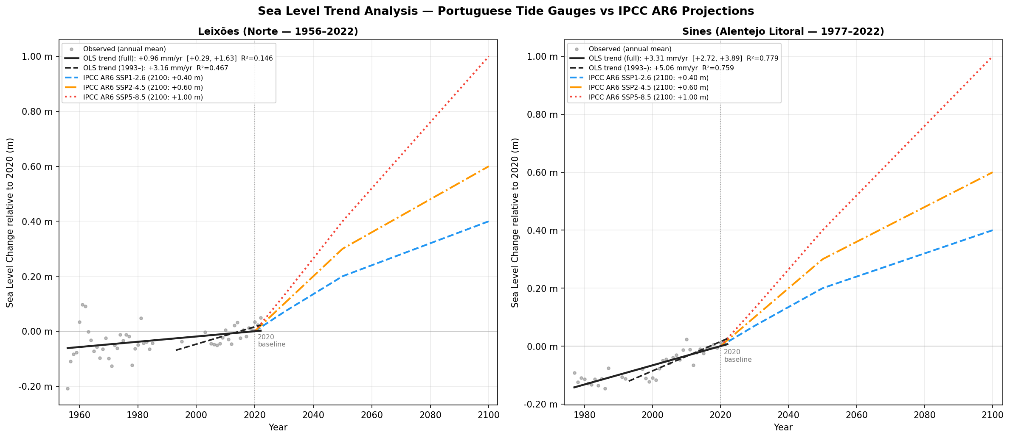
Statistical Inference — OLS Regression
Tide gauge validation · Leixões (1956–2022) and Sines (1977–2022)
+1.96 mm/yr
+3.11 mm/yr
+5.06 mm/yr
Leixões OLS trend (R² = 0.146)
Sines OLS trend (R² = 0.778)
AR6 SSP5-8.5 rate post-2025 (Sines)
Sea Level Rise · Coastal Portugal · Celso Simões
8

Slide 9
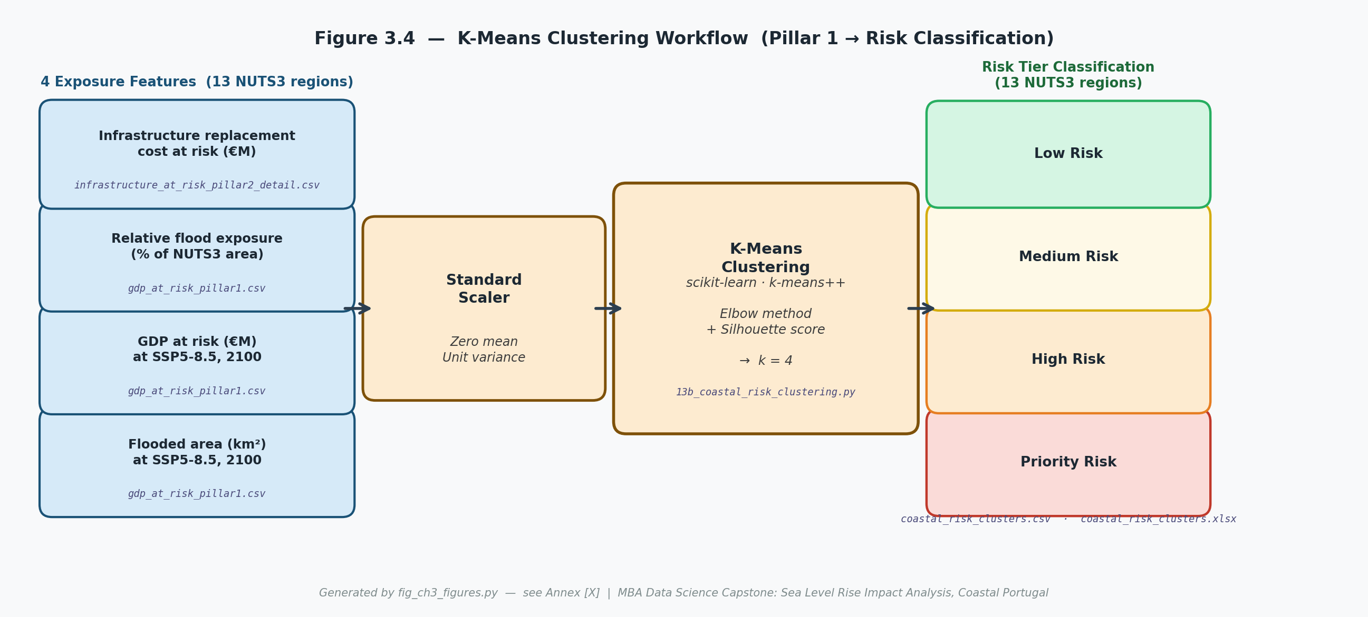
Machine Learning — K-Means Clustering
Unsupervised classification of 13 NUTS3 coastal regions into risk tiers
Why K-Means?
With 13 NUTS3 regions and four exposure dimensions, K-Means provides an objective, data-driven grouping free from arbitrary thresholds. The elbow method selected k = 4; silhouette score = 0.414 confirms meaningful separation. Features were log1p-transformed before standardisation to handle outlier regions (e.g. Lisboa).
Sea Level Rise · Coastal Portugal · Celso Simões
9

Slide 10
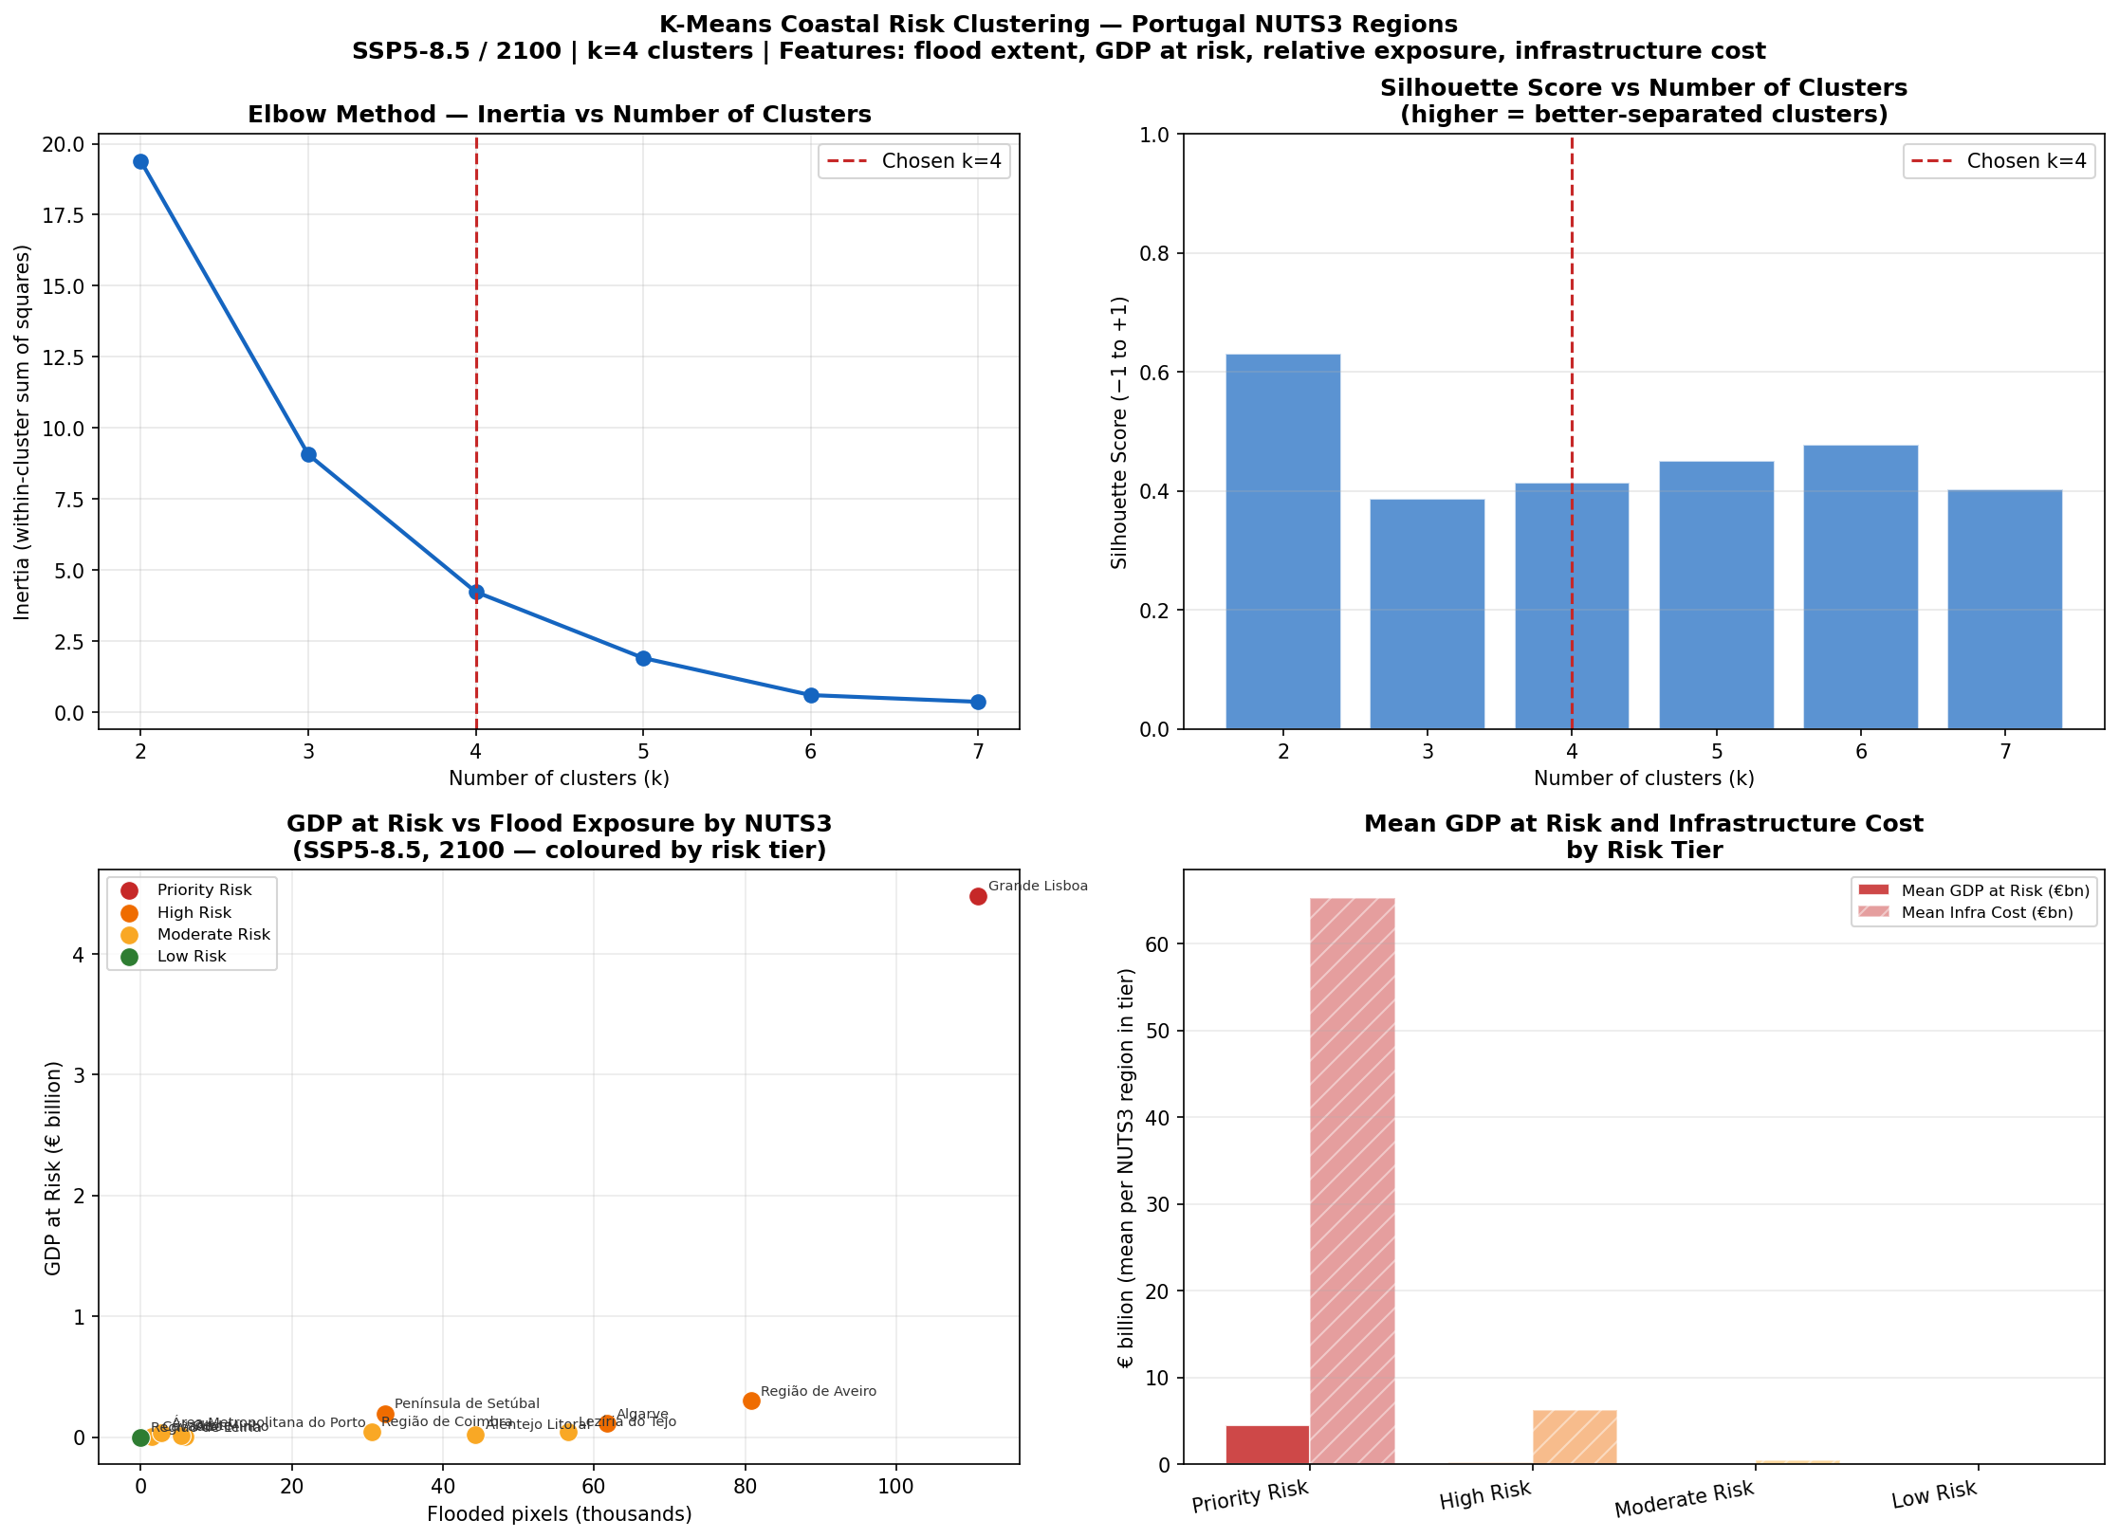
ML Results — Four Risk Tiers
Elbow + silhouette validation · k = 4 · SSP5-8.5 / 2100 features
Sea Level Rise · Coastal Portugal · Celso Simões
10

Slide 11
Economic Framework — Three Pillars
Comprehensive cost accounting from GDP flow to physical disruption
Pillar 1
GDP Flow at Risk
Pillar 2
Asset Stock at Risk
Pillar 3
Disruption Cost
Annual GDP lost proportional to the flooded share of each NUTS3 region. Quantifies economic output suppressed by inundation — the revenue a region cannot generate while under water.
Replacement value of infrastructure (roads, railways, ports, buildings) within the flood zone. Captures the balance-sheet exposure — what would need to be rebuilt after a flood event.
Operational cost of road and port closures modelled via compound flood frequency (Moftakhari). Converts closure-days to €M using section-level unit costs — the day-to-day economic friction.
06a_economic_gdp.py
06b_infrastructure.py
10e_llt_*.py · 12e_consolidate.py
Sea Level Rise · Coastal Portugal · Celso Simões
11

Slide 12
Tableau Public — 5 Interactive Dashboards
public.tableau.com/app/profile/celso.simoes · Sea Level Rise Impact Coastal Portugal
01
Coastal Risk Classification
K-Means risk tiers for all 13 NUTS3 regions. Filter by scenario; colour-coded map + scatter of GDP vs flood exposure.
02
SLR Scenario Overview
Side-by-side comparison of SSP1-2.6, SSP2-4.5, SSP5-8.5. Shows projected sea level, flooded area, and aggregate cost by year.
03
Economic Exposure (Pillar 1+2)
Stacked breakdown of GDP flow and asset stock at risk by NUTS3 region and scenario. Highlights Lisboa as dominant outlier.
04
Disruption Cost (Pillar 3)
Road and port closure days by section, converted to €M disruption cost. Cumulative curve by scenario from 2025 to 2100.
05
Adaptation Break-even
Break-even curves for 7 recommended adaptation options (Opt 3). Shows CAPEX threshold and earliest payback year under SSP5-8.5.
Sea Level Rise · Coastal Portugal · Celso Simões
12

Slide 13
Key Results
What the methodology revealed
€
€5.1 billion aggregate disruption cost — SSP5-8.5
Under the high-emission scenario, cumulative road and port disruption cost across all NUTS3 regions reaches €5.1B by 2100. Under SSP2-4.5 it falls to €0.6B — a 9× difference driven by the threshold effect.
⚠
Lisboa dominates — Priority Risk region
Lisboa's combination of high GDP density and flood exposure places it in the Priority Risk cluster. Its Pillar 1+2 exposure alone accounts for the majority of national aggregate cost.
✓
7 adaptation options reach break-even before 2045
Under SSP5-8.5 (Opt 3 level), all seven recommended sections achieve positive net present value by 2045 at a 1.5% discount rate. Mondego and Tagus flood barriers offer the earliest payback.
~
OLS validates AR6 projections within uncertainty bounds
Historical tide gauge trends (Leixões: +1.96 mm/yr; Sines: +3.11 mm/yr) are consistent with AR6 low-scenario trajectories, providing empirical grounding for the modelled SLR pathway assumptions.
Sea Level Rise · Coastal Portugal · Celso Simões
13

Slide 14
Limitations & Robustness Checks
Honest accounting of model assumptions and boundaries
Static bathtub
Flood inundation uses a static DEM mask, not a dynamic hydrological model. It likely overestimates connectivity in some areas and underestimates surge dynamics.
λ sensitivity
The λ parameter governs cost nonlinearity. Sensitivity analysis shows results are robust to λ ∈ [5, 10] under SSP1/SSP2 but diverge significantly under SSP5-8.5 near the ceiling — a known and disclosed limitation.
GDP proxy
GDP at risk is estimated by the flooded land share of NUTS3 GDP — a spatial proportionality assumption. It does not model sectoral composition or economic resilience.
Adaptation costs
Pillar 3 unit costs are drawn from literature (Portuguese infrastructure benchmarks). They are not project-specific quotes and carry ±30–50% uncertainty.
k=4 clusters
With only 13 observations, cluster stability is limited. The silhouette score (0.414) indicates meaningful but not strong separation. Results should be interpreted directionally.
Sea Level Rise · Coastal Portugal · Celso Simões
14

Slide 15
What This Work Demonstrates
Open-source Python alone — rasterio, scikit-learn, statsmodels — can produce publication-quality geospatial and economic analysis at national scale
Unsupervised ML (K-Means) objectively classifies coastal risk without expert-defined thresholds, producing actionable regional rankings
Statistical inference (OLS on tide gauges) grounds the model in empirical observation and validates the IPCC projection pathway selected
Interactive Tableau dashboards make the findings accessible to policymakers who need to act — not just academics who need to publish
The cost of doing nothing is unbearable: under SSP5-8.5, unchecked disruption costs reach €5.1 billion by 2100 — adaptation pays for itself well before mid-century
Sea Level Rise · Coastal Portugal · Celso Simões
15

