Slide 1
Rising Waters,
Mounting Costs
The Economic Impact of Sea Level Rise on Coastal Portugal · 2025–2100
Celso Simões | MBA Data Science
Pillar 1: Economic Exposure · Pillar 2: Asset Exposure · Pillar 3: Infrastructure Disruption Risk

Slide 2
WHY PORTUGAL. WHY NOW.
Portugal's coastline is one of Europe's longest.
And one of its most exposed.
943 km
12
2025–2100
Mainland coastline
Coastal NUTS3 regions
Study horizon · 75 years
Rising seas don't just flood land — they disrupt economies, destroy assets,
and shut down the infrastructure that keeps Portugal moving.

Slide 3
A Three-Pillar Risk Assessment
IPCC AR6 Risk Framework: Hazard × Exposure × Vulnerability → Risk (Ara Begum et al., 2022)
PILLAR 01
PILLAR 02
PILLAR 03
Economic Exposure
Asset Exposure
Disruption Risk
GDP at risk of inundation by SLR threshold — annual economic flow metric
Replacement cost of buildings and infrastructure within the static flood zone
Cumulative operational disruption cost at 8 critical sections, 2025–2100
€5.30 bn at risk
SSP5-8.5 · 2100
€82.84 bn in assets
SSP5-8.5 · 2100
€130.1 bn cumulative
no adaptation · SSP5-8.5

Slide 4
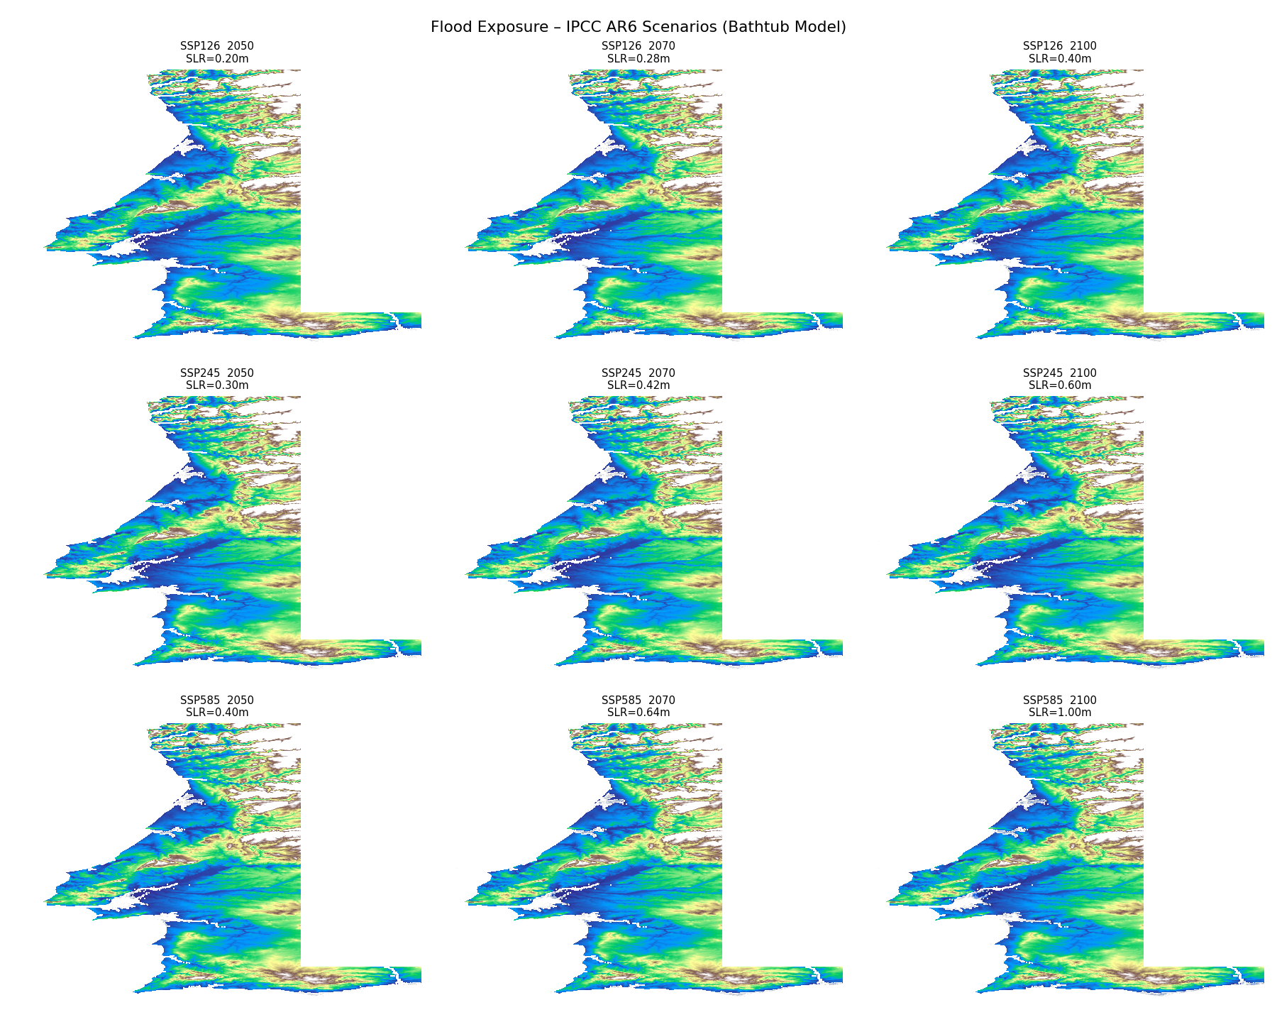
Three Scenarios — One Trajectory That Matters Most
Scenario | SLR by 2050 | SLR by 2100 | Narrative
SSP1-2.6 | +0.20 m | +0.40 m | Ambitious mitigation — Paris Agreement target
SSP2-4.5 | +0.30 m | +0.60 m | Intermediate — current policy trajectory
SSP5-8.5 ★ | +0.40 m | +1.00 m | High-emissions — upper-bound risk scenario (primary analysis)
Geoid sensitivity: +0.15 m correction (Minderhoud & Seeger, 2026) applied as a parallel sensitivity variant. Under SSP5-8.5, this raises the no-adaptation total to €216.9 bn and advances all break-even years by 4–8 years.
Sources: IPCC AR6 WG1 Table 9.9 (Fox-Kemper et al., 2021) · PSMSL tide gauges Leixões & Sines · Copernicus GLO-30 DEM

Slide 5
What is Exposed: GDP and Physical Assets
PILLAR 1 — ECONOMIC EXPOSURE
PILLAR 2 — ASSET EXPOSURE
€5.30 bn
€82.84 bn
GDP at risk · SSP5-8.5 · 2100 · annual flow metric
Infrastructure replacement cost · SSP5-8.5 · 2100 · asset stock metric
€1.16 bn
SSP1-2.6 (low-emissions, 2100)
€82.01 bn
Buildings — 99% of total exposure
€6.35 bn
With geoid offset (+19.8%)
99,244
Building units within the flood zone
84.5%
Concentrated in Grande Lisboa
€95.10 bn
With geoid offset (+€12.3 bn)
Note: Pillar 1 measures annual GDP flow at risk of disruption; Pillar 2 measures replacement cost of the physical asset stock. Complementary — not additive.

Slide 6
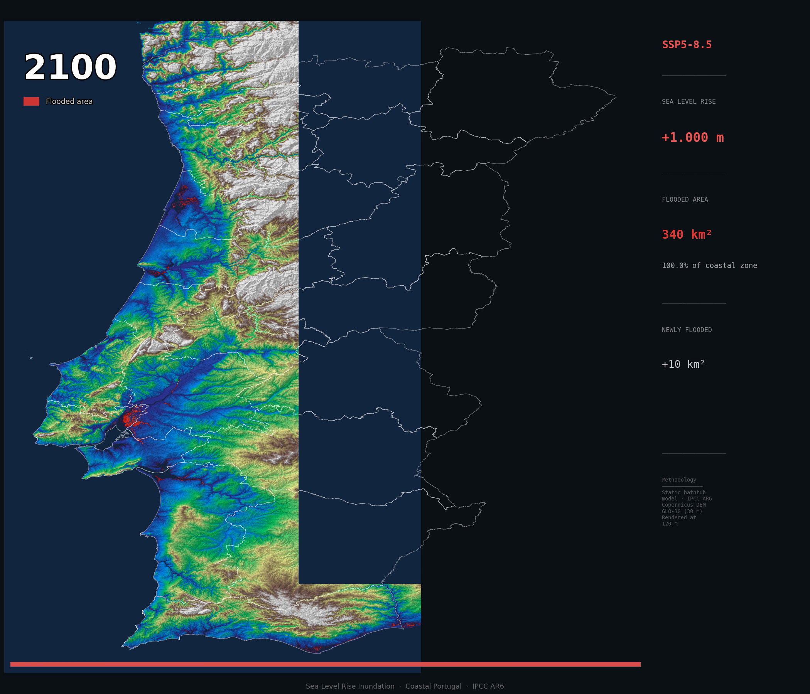
SSP5-8.5 · 2100 · Baseline
~340 km² of coastal Portugal within the static inundation zone · GDP at risk: €5.30 billion
Generated from Copernicus GLO-30 DEM + IPCC AR6 SLR projections. NUTS3 boundaries overlaid.

Slide 7
PILLAR 3 — CRITICAL INFRASTRUCTURE DISRUPTION RISK
€130.1 bn
Cumulative disruption cost · 8 critical sections · 2025–2100 · no adaptation · SSP5-8.5
By sector
Largest contributors
Railways (3 sections)
€56.7 bn
(44%)
Aveiro Ria railway
€30.0 bn
Ports (3 sections)
€55.4 bn
(43%)
Port of Lisbon
€27.3 bn
Port of Setúbal
€17.7 bn
Roads (2 sections)
€18.0 bn
(14%)
Tagus railway
€13.4 bn
A1 Motorway (Azambuja)
€10.9 bn
Geoid-adjusted variant: €216.9 bn · Uncertainty range: €65 bn (LOW) – €227 bn (HIGH) · Model: Moftakhari et al. (2017)

Slide 8
The Model is Not Fragile — It is Nonlinear
The flood-frequency compression parameter λ controls how quickly return periods shorten per cm of SLR. Tested across the Moftakhari et al. (2017) empirical range:
λ Parameter | λ value (m⁻¹) | SSP5-8.5 cumulative cost 2025–2100 | Regime
λ₁ (low) = ln(2)/0.15 · return period halves per 15 cm | ≈ 4.62 | ~ €40 billion | Pre-threshold
λ₂ (mid, default) = ln(2)/0.10 · Moftakhari et al. (2017) | ≈ 6.93 | €130.1 billion ★ | Central estimate
λ₃ (high) = ln(2)/0.07 · return period halves per 7 cm | ≈ 9.90 | > €500 billion | Threshold-dominated
Key insight: Under SSP1-2.6 and SSP2-4.5, sections remain in the pre-threshold regime — closure frequencies do not approach the 365-day ceiling — and cost sensitivity to λ is modest. Under SSP5-8.5, several sections enter the threshold-dominated regime: the ceiling effect amplifies λ sensitivity disproportionately. The wide range (€40 bn → > €500 bn) is a structural feature of the model's design, not an artefact. It confirms that section-specific λ calibration from Portuguese hydrological records is the highest-priority methodological improvement.

Slide 9
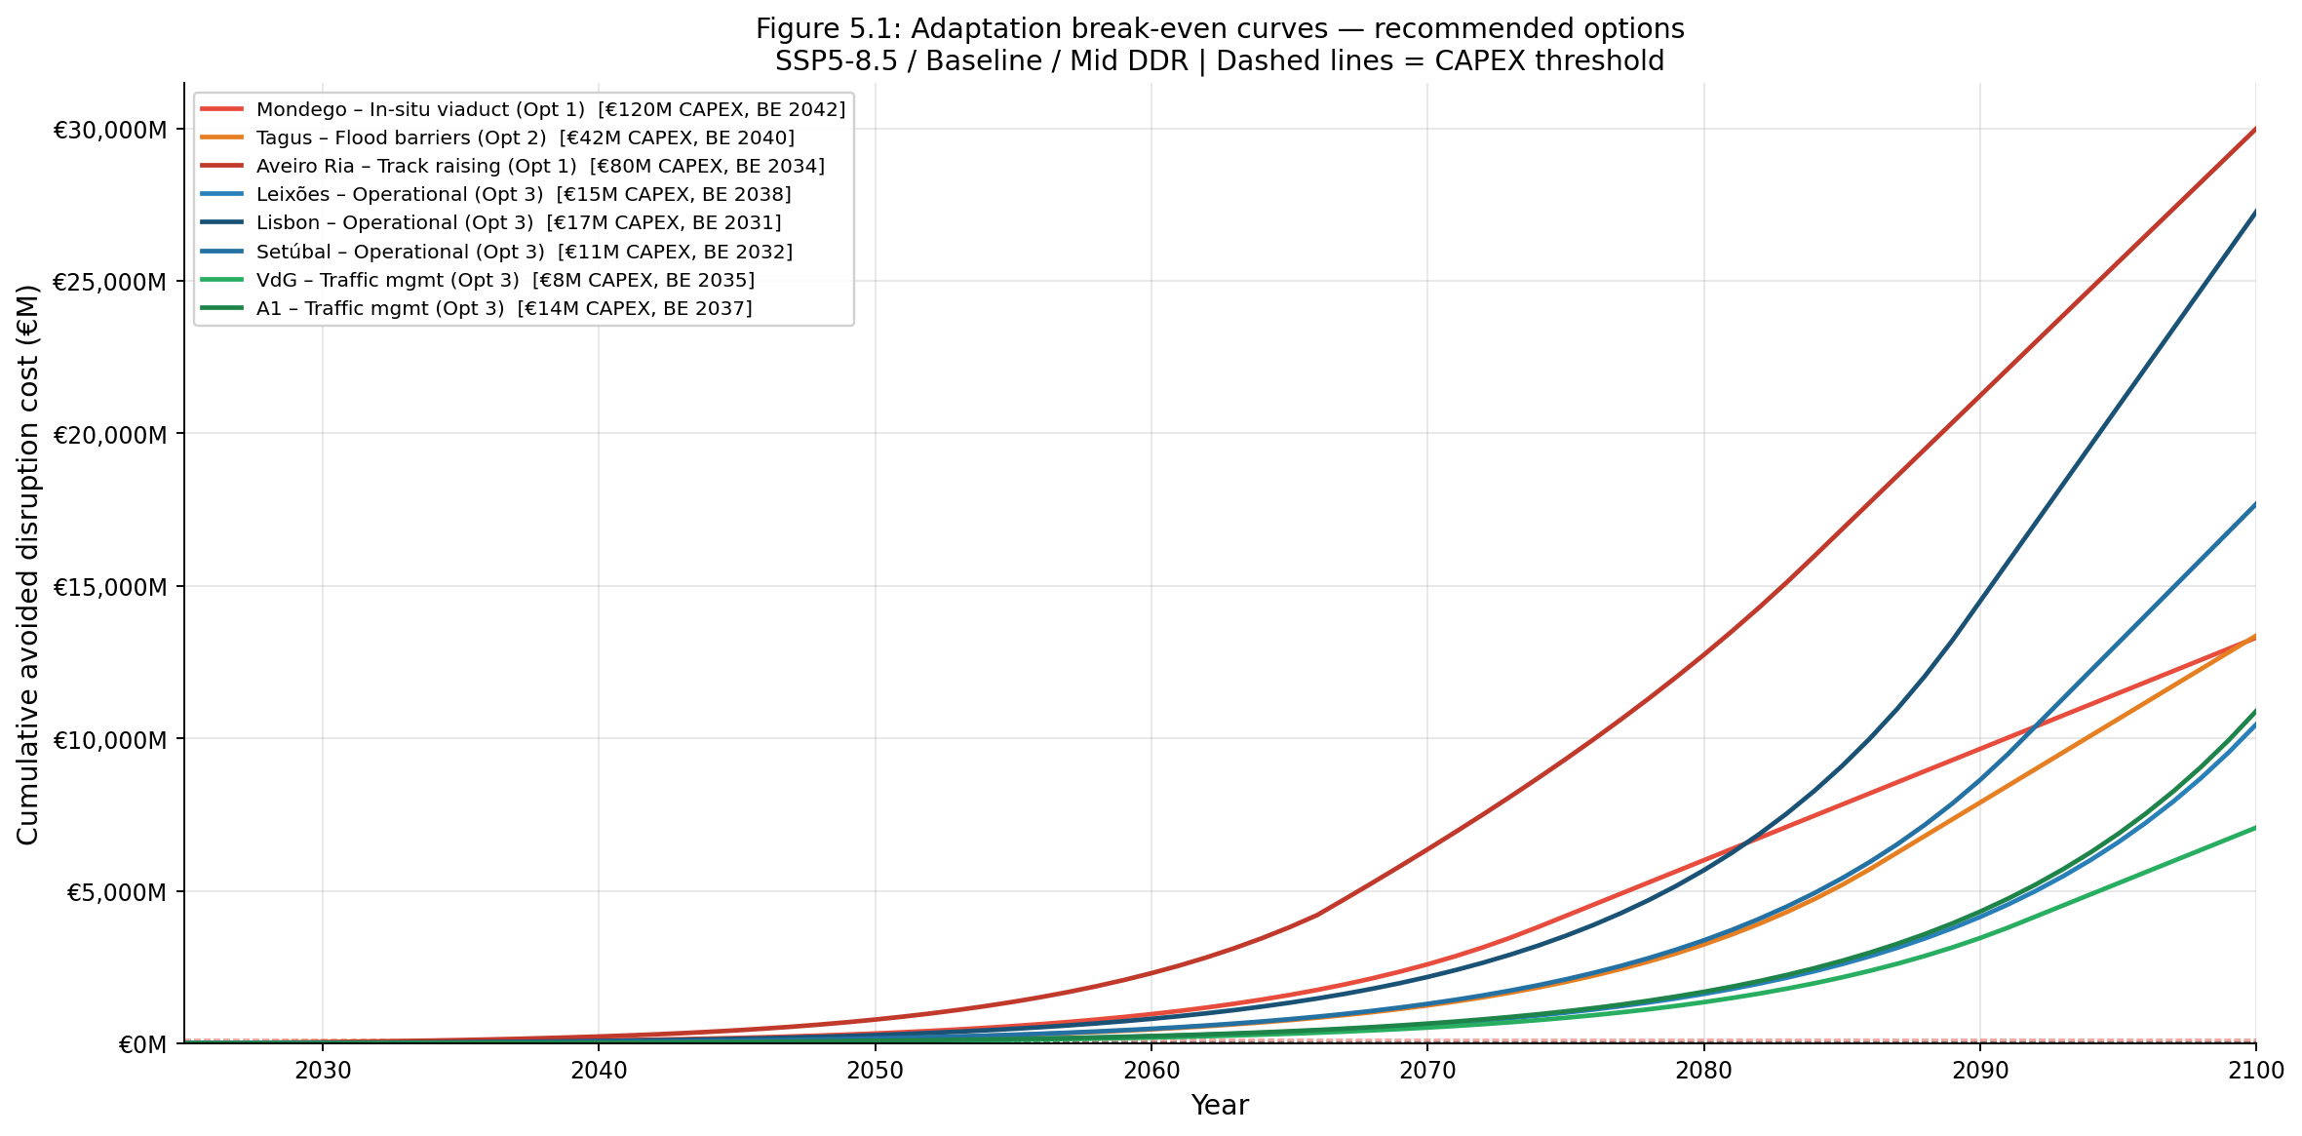
Adaptation Pays — And It Pays Early
Break-even window:
2029 → 2043
Across all 8 sections under
SSP5-8.5 / Baseline scenario
Geoid variant advances
every break-even by
4–8 years
Earliest: 2029
Aveiro +Geoid, SSP5-8.5
Figure 5.1: Cumulative avoided disruption cost vs. CAPEX — 8 sections × 3 options each, SSP5-8.5 baseline and +Geoid variant

Slide 10
THE ADAPTATION PORTFOLIO
The arithmetic is clear.
INVEST
AVOID
€307 M
€130.1 bn
vs
Mid-estimate portfolio CAPEX
across 8 sections
(range: €219 M – €402 M)
No-adaptation disruption cost
2025–2100 · SSP5-8.5 baseline
424 : 1
Potential avoided disruption cost
per € of adaptation investment

Slide 11
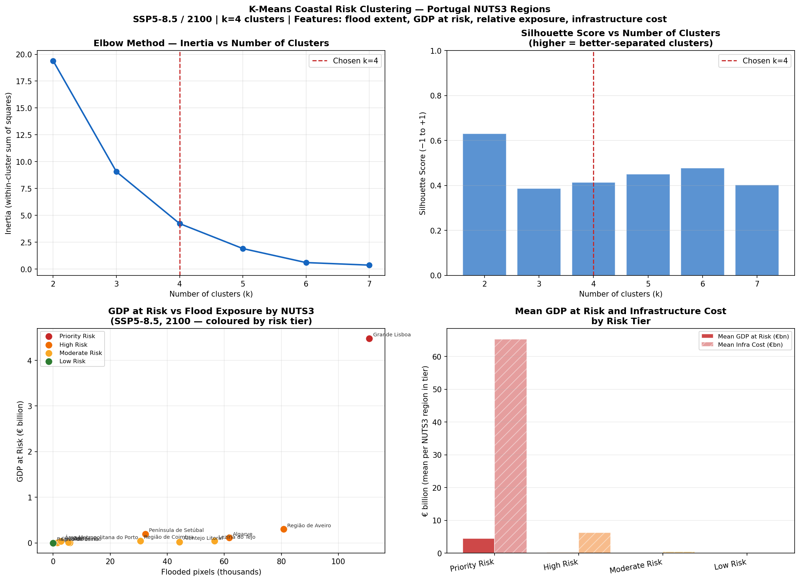
Not All Coast is Equal: Regional Risk Classification
PRIORITY
Grande Lisboa alone
€65.3 bn infra · €4.48 bn GDP at risk
HIGH
Aveiro · Setúbal · Algarve
Elevated asset stock, material exposure
MODERATE
7 regions incl. Porto
Large GDP, elevated terrain limits risk
LOW
Região de Leiria
Natural coastal barrier, minimal risk
K-Means (k=4) · 12 coastal NUTS3 regions · Features: flood extent, GDP at risk, fraction flooded, asset replacement cost · Silhouette: 0.414 · log1p pre-transformed

Slide 12
Limitations & Further Research
01
Static bathtub inundation
02
Uniform GDP allocation within NUTS3
No storm surge, tidal dynamics, or hydrodynamic routing. Exposure figures are conservative screening estimates, not damage forecasts. A hydrodynamic model would refine the Pillar 1 boundary.
GDP distributed evenly within each region. Materially underestimates urban exposure (Grande Lisboa) and overestimates rural exposure. GHSL population grids would improve precision.
03
λ calibrated on US tide gauges
04
Direct operational costs only
Moftakhari et al. (2017) used US Atlantic coast records. Section-specific λ calibration from Portuguese hydrological data is the highest-priority methodological improvement identified.
Second-order effects — supply chain propagation, modal shift, welfare losses — are not quantified. €130.1 bn is a conservative lower bound on the full economic cost of inaction.

Slide 13
"The cost of doing nothing
is unbearable to our economy
and future generations."
1.
€5.30 bn of GDP and €82.84 bn in physical assets lie within the 2100 inundation zone — today, under SSP5-8.5 baseline projections.
2.
Without action, €130.1 bn in cumulative disruption costs accrue across 8 critical infrastructure sections by 2100 (€216.9 bn with geoid offset).
3.
€307 M of targeted adaptation investment is indicated as cost-effective at every section. Break-even: 2029–2043. Implied return: 424:1.
Thank you
Celso Simões | MBA Data Science | c_elso17@hotmail.com

