Slide 1
Simulation for dataset generation
Steps | Description
1 | Import Robot, Table and Tray
2 | Import Tray Objects for the dataset
3 | Import virtual camera
4 | Define Control modes for the Robot
5 | Add basic gripper to the robot
6 | Perform grasping simulation using basic gripper
7 | Import suction gripper
8 | Perform grasping simulation using suction gripper
9 | Import Robotiq gripper
10 | Perform grasping simulation using Robotiq gripper
11 | Perform grasping simulation for Dex-net objects using suction gripper
12 | Perform grasping simulation for Dex-net objects using basic gripper
13 | Grasp Pose Generation

Slide 2
Simulation for dataset generation
Steps | Description
1 | Import Robot, Table and Tray
2 | Import Tray Objects for the dataset
3 | Import virtual camera
4 | Define Control modes for the Robot
5 | Add basic gripper to the robot
6 | Perform grasping simulation using basic gripper
7 | Import suction gripper
8 | Perform grasping simulation using suction gripper
9 | Import Robotiq gripper
10 | Perform grasping simulation using Robotiq gripper
11 | Perform grasping simulation for Dex-net objects using suction gripper
12 | Perform grasping simulation for Dex-net objects using basic gripper
13 | Grasp Pose Generation

Slide 3
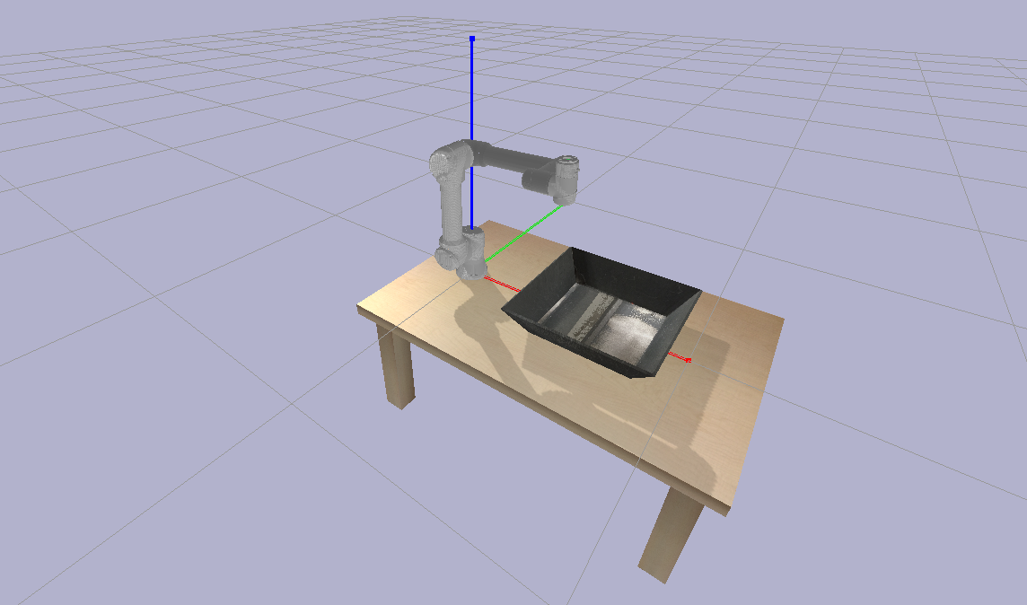

Slide 4
Simulation for dataset generation
Steps | Description
1 | Import Robot, Table and Tray
2 | Import Tray Objects for the dataset
3 | Import virtual camera
4 | Define Control modes for the Robot
5 | Add basic gripper to the robot
6 | Perform grasping simulation using basic gripper
7 | Import suction gripper
8 | Perform grasping simulation using suction gripper
9 | Import Robotiq gripper
10 | Perform grasping simulation using Robotiq gripper
11 | Perform grasping simulation for Dex-net objects using suction gripper
12 | Perform grasping simulation for Dex-net objects using basic gripper
13 | Grasp Pose Generation

Slide 5
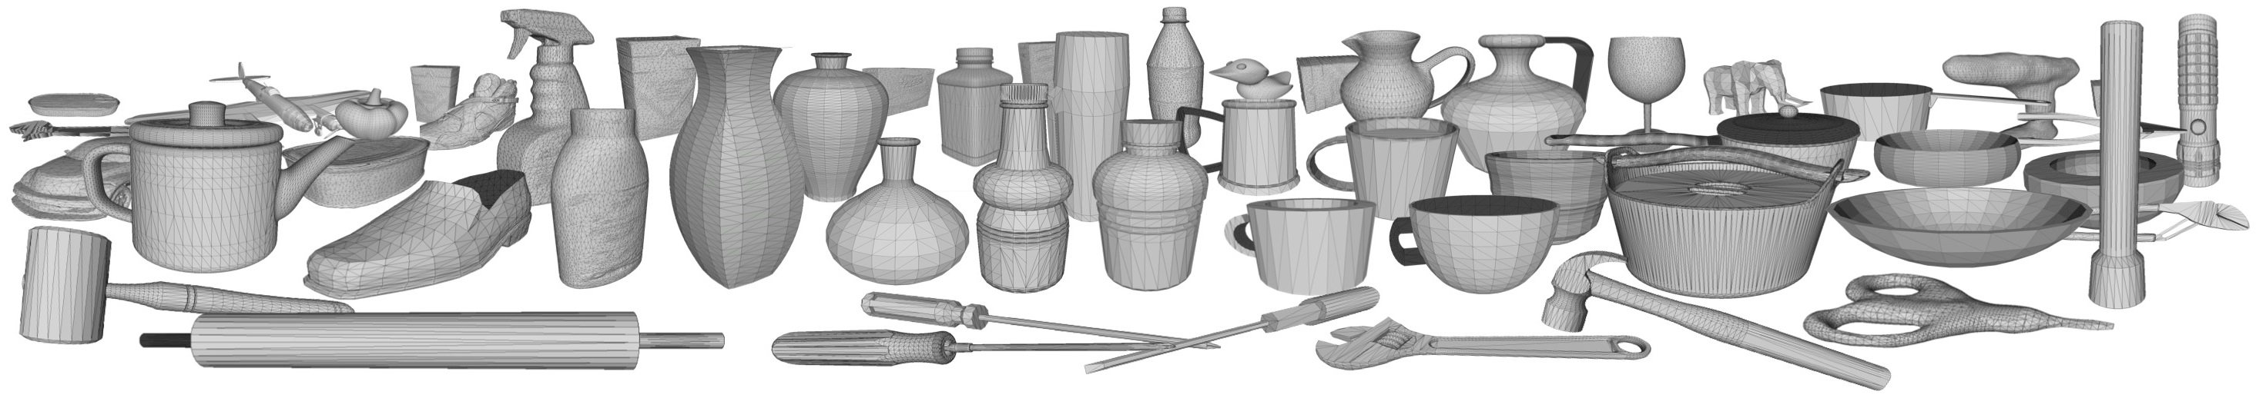
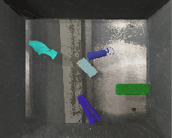
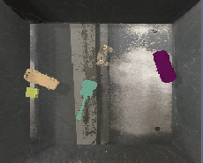
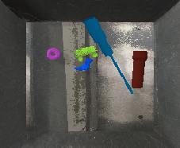
5 Random Objects from Dex-Net Dataset
Objects fall at random positions in the tray

Slide 6
Simulation for dataset generation
Steps | Description
1 | Import Robot, Table and Tray
2 | Import Tray Objects for the dataset
3 | Import virtual camera
4 | Define Control modes for the Robot
5 | Add basic gripper to the robot
6 | Perform grasping simulation using basic gripper
7 | Import suction gripper
8 | Perform grasping simulation using suction gripper
9 | Import Robotiq gripper
10 | Perform grasping simulation using Robotiq gripper
11 | Perform grasping simulation for Dex-net objects using suction gripper
12 | Perform grasping simulation for Dex-net objects using basic gripper
13 | Grasp Pose Generation

Slide 7
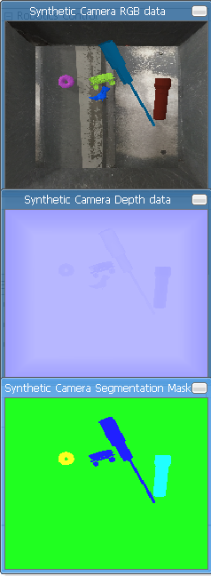
Virtual camera placed at 0.8 m height from the table

Slide 8
Simulation for dataset generation
Steps | Description
1 | Import Robot, Table and Tray
2 | Import Tray Objects for the dataset
3 | Import virtual camera
4 | Define Control modes for the Robot
5 | Add basic gripper to the robot
6 | Perform grasping simulation using basic gripper
7 | Import suction gripper
8 | Perform grasping simulation using suction gripper
9 | Import Robotiq gripper
10 | Perform grasping simulation using Robotiq gripper
11 | Perform grasping simulation for Dex-net objects using suction gripper
12 | Perform grasping simulation for Dex-net objects using basic gripper
13 | Grasp Pose Generation

Slide 9
End Effector Control- Sliders control position and orientation of the end effector

Slide 10
Joint Control- Sliders control the joint angles

Slide 11
* Object selected in the menu (1-5)
* Inverse Kinematics for the object position
* Robot performs grasping action
Grasp Control

Slide 12
Simulation for dataset generation
Steps | Description
1 | Import Robot, Table and Tray
2 | Import Tray Objects for the dataset
3 | Import virtual camera
4 | Define Control modes for the Robot
5 | Add basic gripper to the robot
6 | Perform grasping simulation using basic gripper
7 | Import suction gripper
8 | Perform grasping simulation using suction gripper
9 | Import Robotiq gripper
10 | Perform grasping simulation using Robotiq gripper
11 | Perform grasping simulation for Dex-net objects using suction gripper
12 | Perform grasping simulation for Dex-net objects using basic gripper
13 | Grasp Pose Generation

Slide 13
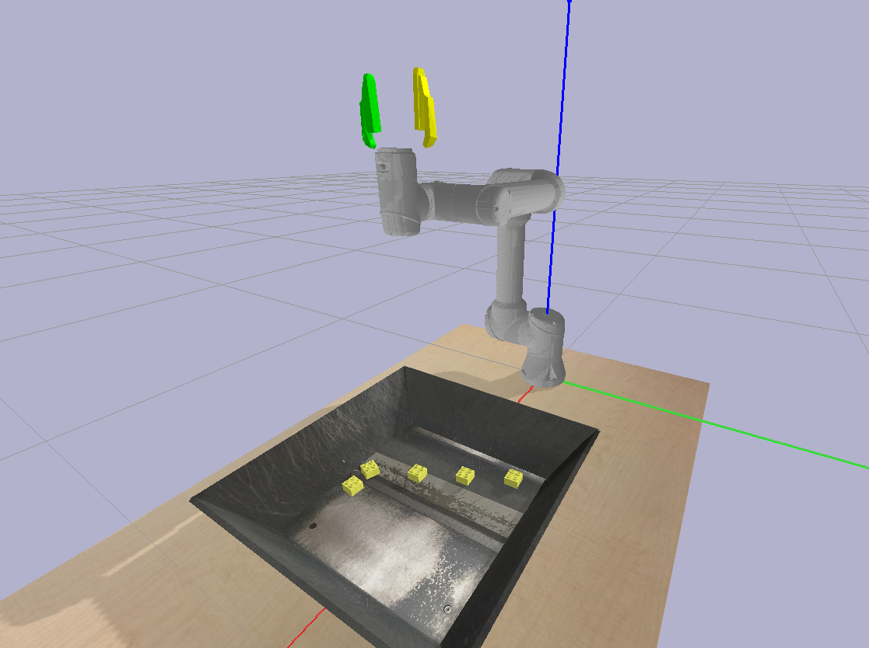

Slide 14
Simulation for dataset generation
Steps | Description
1 | Import Robot, Table and Tray
2 | Import Tray Objects for the dataset
3 | Import virtual camera
4 | Define Control modes for the Robot
5 | Add basic gripper to the robot
6 | Perform grasping simulation using basic gripper
7 | Import suction gripper
8 | Perform grasping simulation using suction gripper
9 | Import Robotiq gripper
10 | Perform grasping simulation using Robotiq gripper
11 | Perform grasping simulation for Dex-net objects using suction gripper
12 | Perform grasping simulation for Dex-net objects using basic gripper
13 | Grasp Pose Generation

Slide 15
* Move towards object
* Open gripper
* Close gripper
* Lift object
* Move outside the tray
* Open gripper
Grasp Control

Slide 16
Simulation for dataset generation
Steps | Description
1 | Import Robot, Table and Tray
2 | Import Tray Objects for the dataset
3 | Import virtual camera
4 | Define Control modes for the Robot
5 | Add basic gripper to the robot
6 | Perform grasping simulation using basic gripper
7 | Import suction gripper
8 | Perform grasping simulation using suction gripper
9 | Import Robotiq gripper
10 | Perform grasping simulation using Robotiq gripper
11 | Perform grasping simulation for Dex-net objects using suction gripper
12 | Perform grasping simulation for Dex-net objects using basic gripper
13 | Grasp Pose Generation

Slide 17
* Move towards object
* Activate constraint between
object and end effector
* Lift object
* Move outside the tray
* Deactivate constraint
Grasp Control

Slide 18
Simulation for dataset generation
Steps | Description
1 | Import Robot, Table and Tray
2 | Import Tray Objects for the dataset
3 | Import virtual camera
4 | Define Control modes for the Robot
5 | Add basic gripper to the robot
6 | Perform grasping simulation using basic gripper
7 | Import suction gripper
8 | Perform grasping simulation using suction gripper
9 | Import Robotiq gripper
10 | Perform grasping simulation using Robotiq gripper
11 | Perform grasping simulation for Dex-net objects using suction gripper
12 | Perform grasping simulation for Dex-net objects using basic gripper
13 | Grasp Pose Generation

Slide 19
Picking Dex-net objects using Robotiq gripper- First demo
(forces and closing angles need to be changed)

Slide 20
Simulation for dataset generation
Steps | Description
1 | Import Robot, Table and Tray
2 | Import Tray Objects for the dataset
3 | Import virtual camera
4 | Define Control modes for the Robot
5 | Add basic gripper to the robot
6 | Perform grasping simulation using basic gripper
7 | Import suction gripper
8 | Perform grasping simulation using suction gripper
9 | Import Robotiq gripper
10 | Perform grasping simulation using Robotiq gripper
11 | Perform grasping simulation for Dex-net objects using suction gripper
12 | Perform grasping simulation for Dex-net objects using basic gripper
13 | Grasp Pose Generation

Slide 21
Picking Dex-net objects using suction gripper
Problem : Dex-Net objects fall in different orientations. Uses a fix orientation constratint to pick

Slide 22
End effector is defined w.r.t. previous link
eTo= Object pose w.r.t. end effector
gTe= End-effector pose w.r.t. ground
gTo= Object pose w.r.t. ground

Slide 23
Picking Dex-net objects using suction gripper- Working demo

Slide 24
Simulation for dataset generation
Steps | Description
1 | Import Robot, Table and Tray
2 | Import Tray Objects for the dataset
3 | Import virtual camera
4 | Define Control modes for the Robot
5 | Add basic gripper to the robot
6 | Perform grasping simulation using basic gripper
7 | Import suction gripper
8 | Perform grasping simulation using suction gripper
9 | Import Robotiq gripper
10 | Perform grasping simulation using Robotiq gripper
11 | Perform grasping simulation for Dex-net objects using suction gripper
12 | Perform grasping simulation for Dex-net objects using basic gripper
13 | Grasp Pose Generation

Slide 25
Picking Dex-net objects using basic gripper- 3D Grasping Orientation fixed

Slide 26
Simulation for dataset generation
Steps | Description
1 | Import Robot, Table and Tray
2 | Import Tray Objects for the dataset
3 | Import virtual camera
4 | Define Control modes for the Robot
5 | Add basic gripper to the robot
6 | Perform grasping simulation using basic gripper
7 | Import suction gripper
8 | Perform grasping simulation using suction gripper
9 | Import Robotiq gripper
10 | Perform grasping simulation using Robotiq gripper
11 | Perform grasping simulation for Dex-net objects using suction gripper
12 | Perform grasping simulation for Dex-net objects using basic gripper
13 | Grasp Pose Generation

Slide 27
Approaches to generate grasp poses for Dataset
Approaches :
#1 :
Segmentation mask → One mask selected → Axes x and y defined → Mask simplified to one rectangle or a group of rectangles → Select one rectangle randomly → Align gripper jaw axis towards smaller dimension parallel to the tray →Open jaws and go down. Gripper depth information from depth image → Pick the object and give it a reward for successful picking → Repeat with another random rectangle → Learns the right size of rectangle to select.
Needed : object dimensions+poses and grasp poses+jaw opening+depth
#2 :
Intersect OBJ files with planes incrementally moving along the length. (Repeat along breadth)From each intersection, depth and width for gripper can be obtained. Orientation of the object can be obtained using intersection with a horizontal plane and connecting two end points to get a line. Set of all possible grasp poses is fed along with the heap point cloud/ image data to a CNN and the output will provide bunch of possible grasp poses for one object randomly chosen. A separate grasping simulation can be performed at different plane intersections and a variable will label it as good or bad grasp. Then the various grasp poses and object pose + GOOD/BAD Grasp can be fed to another neural network to predict which grasp pose of the newly predicted poses are GOOD. Use PyMesh slicing
Reference : https://arxiv.org/pdf/1710.02418.pdf

Slide 28
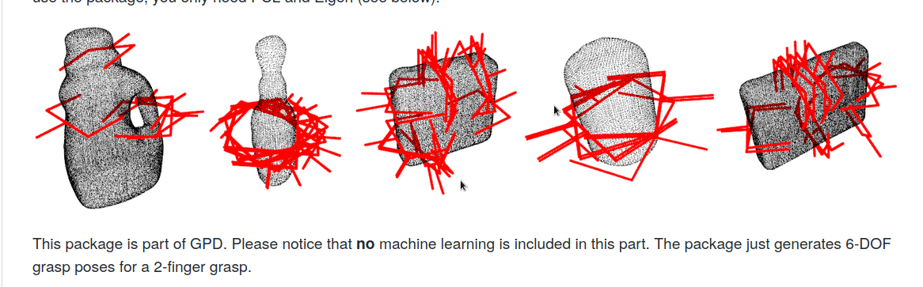
Approaches to generate grasp poses for Dataset
Approaches :
#3 : Generate Grasp poses from Point Cloud using https://github.com/atenpas/gpg and then perform grasping simulation at different poses to label good / bad grasps which are again fed to the neural net.
#4 :
https://www.doc.ic.ac.uk/~ejohns/Documents/ejohns-grasp-function-iros2016.pdf
#5 :
http://openaccess.thecvf.com/content_ICCV_2019/papers/Mousavian_6-DOF_GraspNet_Variational_Grasp_Generation_for_Object_Manipulation_ICCV_2019_paper.pdf
#6 : Some way to directly find grasp pose from Object poses in simulation

