Slide 1
Parallel and Distributed Computing PDC

Slide 2
Ultimate Goal
Faster, more effective programs by exploiting parallelism

Slide 3
What is parallelism?
“The term Parallelism refers to techniques to make programs faster by performing several computations at the same time. This requires hardware with multiple processing units. ”
https://wiki.haskell.org/Parallelism_vs._Concurrency

Slide 4
Sequential vs. Parallel Programs
Sequential
Parallel
Each instruction of whole program is executed serially, one at a time
One processing unit
At points in a program, execution of some instructions happens concurrently in time
Multiple processing units
We often start with sequential versions of programs and parallelize them to make them faster.
This enables us to solve larger problems.
We are interested in SCALE and scalability of our parallel implementations.

Slide 5
What enables us to create parallelism?
Parallel and Distributed Hardware with multiple processing units (PUs)
Software to run on such hardware

Slide 6
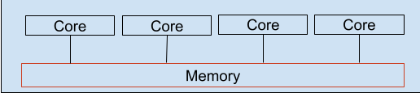
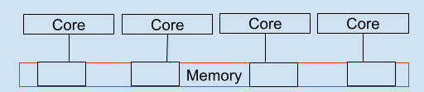
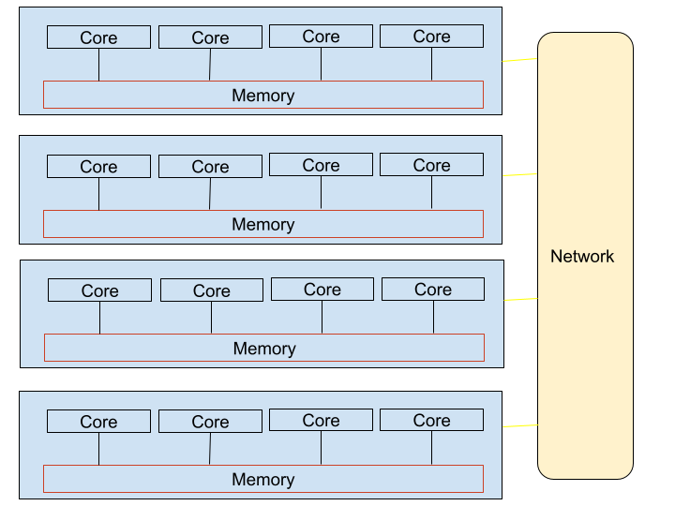
Processing Unit Computation: Threads vs. Processes
Threads
Share 1 Memory Space
Processes have
Independent Memory spaces,
Must communicate to share data
Single machine
Or
Cluster of machines
Single shared memory, multicore machine
Or GPU card with thousands of cores
Everything is multicore!
Computing using any combination of these together is referred to as PDC

Slide 7

Parallel Hardware Systems
Parallel Systems
Plus Software
Plus processing units
Shared
Memory
Distributed
Memory,
Networked
multicore
computer clusters
Heterogeneous
Clusters
mscs server
mscs server
Multicore
CPU,
Main memory
Multicore CPU
+ “manycore”
Accelerator
Card
with memory
Newer
Clusters
Modern
Super
Computers
Raspberry Pi
Clusters
OpenMP
threads
OpenACC
MPI, Message passing interface
threads
GPUs
processes
MPI
CUDA, OpenACC
processes
threads

Slide 8
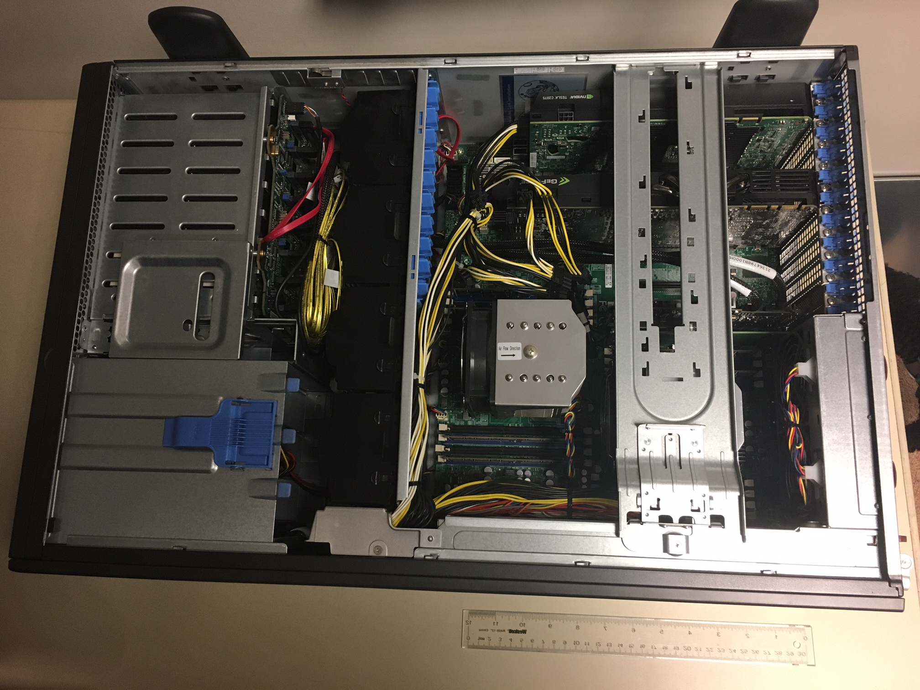

A ‘heterogeneous’ system
Many-core GPU
cards
Multicore CPUs
(underneath heat sinks)

Slide 9


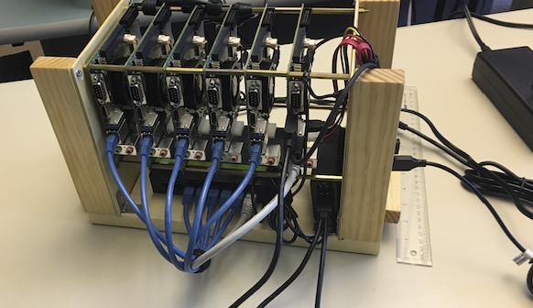
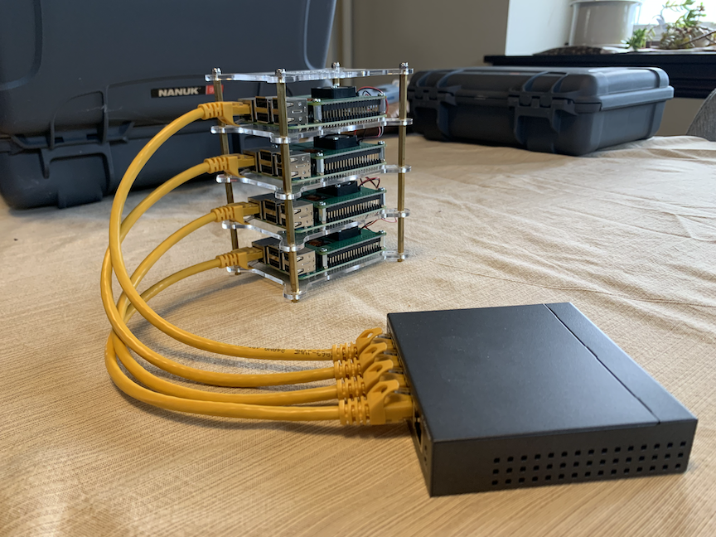
Clusters
supercomputers
Beowulf clusters using “COTS”:
Commodity off-the-shelf systems
By OLCF at ORNL - https://www.flickr.com/photos/olcf/52117623843/, CC BY 2.0, https://commons.wikimedia.org/w/index.php?curid=119231238

Slide 10
Course outline
Learn by doing
Start with some code, not from scratch
Practice Activities, hw0 are low stakes
Learn and practice as prep for homework
Suggested reading before class on the schedule
Homework assignments with suggested deadlines (flexible)
Coding and a report
Course project
Coding, report, presentation

Slide 11
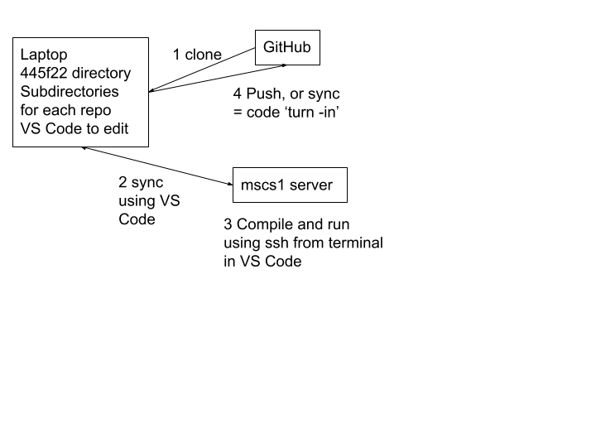
Method of work on code for course
445f24
mscs
Reports for homework should be placed on Google Drive provided by instructor

