Slide 1
Patterns found in a code example
trap_omp.c

Slide 2
double start = omp_get_wtime();
#pragma omp parallel for \
default(none) \
private(i) \
shared(n, a, h) \
reduction(+:integral)
for(i = 1; i < n; i++) {
integral += f(a+i*h);
}
integral = integral * h;
// Measuring the elapsed time
double end = omp_get_wtime();
// Time calculation (in seconds)
double elapsed_time = end - start;
printf("%lf\t",elapsed_time);
trap-omp example:
What patterns are used?

Slide 3
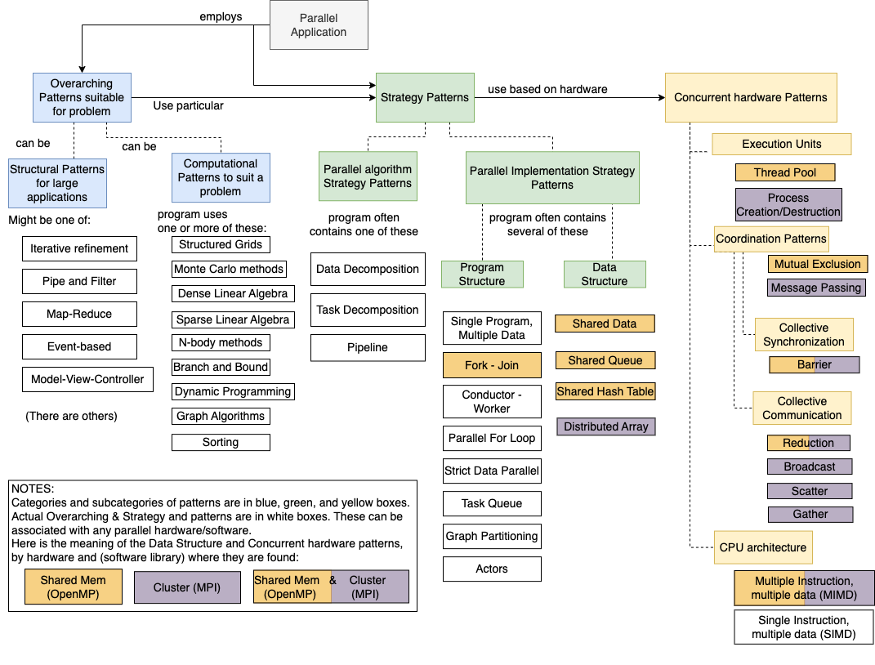
The patterns framework

Slide 4

… //setup
#pragma omp parallel for \
default(none) \
private(i) \
shared(n, a, h) \
reduction(+:integral)
for(i = 1; i < n; i++) {
integral += f(a+i*h);
}
integral = integral * h;
… // finish
OpenMP is based on systems where instructions run independently with no guarantee of order, each acting on its own shared or private data

Slide 5
… //setup
#pragma omp parallel for \
default(none) \
private(i) \
shared(n, a, h) \
reduction(+:integral)
for(i = 1; i < n; i++) {
integral += f(a+i*h);
}
integral = integral * h;
… // finish
OpenMP is implemented so that a group of threads is created as a ‘pool’ and used as needed

Slide 6
… //setup
#pragma omp parallel for \
default(none) \
private(i) \
shared(n, a, h) \
reduction(+:integral)
for(i = 1; i < n; i++) {
integral += f(a+i*h);
}
integral = integral * h;
… // finish
OpenMP is implemented so that only one program is written

Slide 7
… //setup
#pragma omp parallel for \
default(none) \
private(i) \
shared(n, a, h) \
reduction(+:integral)
for(i = 1; i < n; i++) {
integral += f(a+i*h);
}
integral = integral * h;
… // finish
OpenMP parallel keyword automatically forks threads and joins them when completed.

Slide 8
… //setup
#pragma omp parallel for \
default(none) \
private(i) \
shared(n, a, h) \
reduction(+:integral)
for(i = 1; i < n; i++) {
integral += f(a+i*h);
}
integral = integral * h;
… // finish
OpenMP for keyword implies geometric decomposition of data among threads, using the parallel for loop.

Slide 9
… //setup
#pragma omp parallel for \
default(none) \
private(i) \
shared(n, a, h) \
reduction(+:integral)
for(i = 1; i < n; i++) {
integral += f(a+i*h);
}
integral = integral * h;
… // finish
Almost all OpenMP threaded programs use shared data

Slide 10
… //setup
#pragma omp parallel for \
default(none) \
private(i) \
shared(n, a, h) \
reduction(+:integral)
for(i = 1; i < n; i++) {
integral += f(a+i*h);
}
integral = integral * h;
… // finish
Reduction is a common OpenMP pattern that is used to ensure threaded programs avoid using mutual exclusion to ‘lock’ a shared variable that each thread needs to update. Each thread keeps a private copy instead.

Slide 11
… //setup
#pragma omp parallel for \
default(none) \
private(i) \
shared(n, a, h) \
reduction(+:integral)
for(i = 1; i < n; i++) {
integral += f(a+i*h);
}
integral = integral * h;
… // finish
At the end of every parallel for data decomposition, there is an implied ‘barrier’ used to ensure that all threads complete before the main thread continues.

Slide 12
… //setup
#pragma omp parallel for \
default(none) \
private(i) \
shared(n, a, h) \
reduction(+:integral)
for(i = 1; i < n; i++) {
integral += f(a+i*h);
}
integral = integral * h;
… // finish
trap-omp
example
Patterns found
Built into
OpenMP

Slide 13
trng random
demo
example
Patterns found
Some Built into
OpenMP

