Slide 1
Patterns in Parallel Programming
COMP 445
Relevant reading and reference:
Chapter 1 of Intermediate PDC

Slide 2
Parallel Patterns in Programs
… are industry-standard techniques and best-practices that have proven useful in many different parallel contexts.
… are built into popular platforms like MPI and OpenMP.
… are likely to be useful for the long-term, regardless of future PDC developments.
… provide a way to organize PDC concepts.

Slide 3
Patterns: tried and true methods in our code
Let’s consider how to organize the types of software patterns that enable us to achieve parallelism

Slide 4
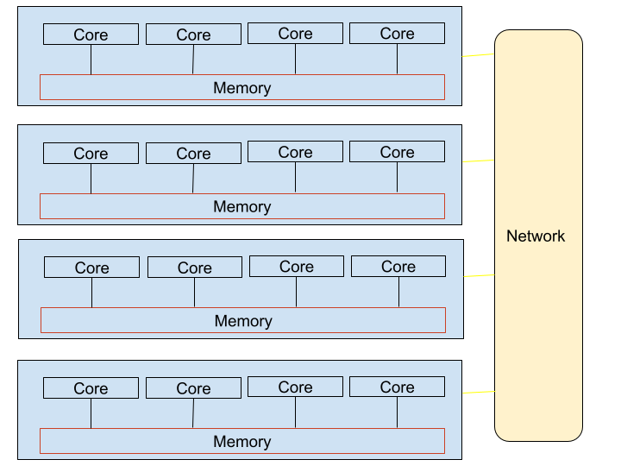
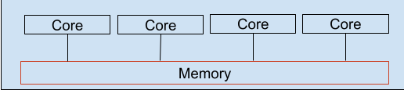
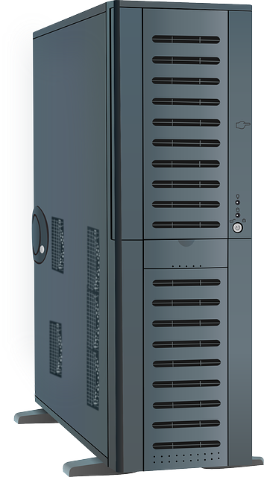
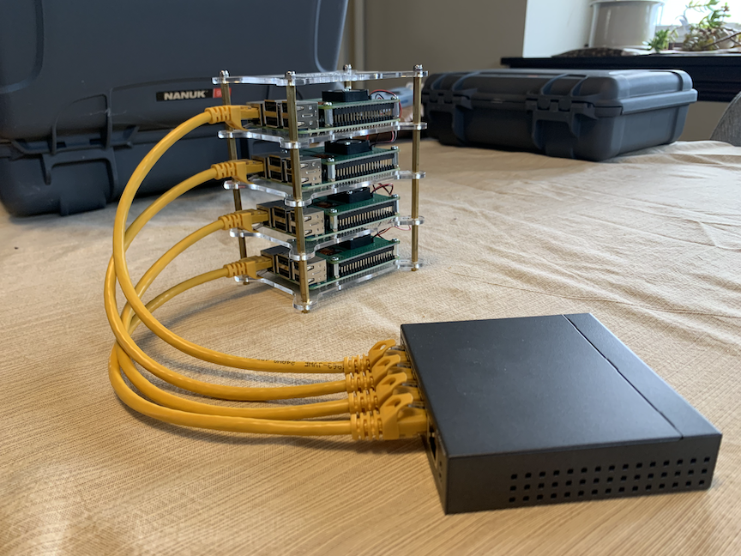
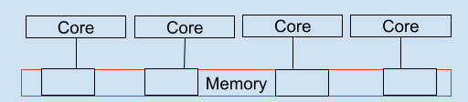
Parallel Hardware Systems
Parallel Systems
Plus Software
Plus processing units
Shared
Memory
Distributed
Memory,
Networked
multicore
computer clusters
Heterogeneous
Clusters
mscs server
mscs server
Multicore
CPU,
Main memory
Multicore CPU
+ “manycore”
Accelerator
Card
with memory
Newer
Clusters
Modern
Super
Computers
Raspberry Pi
Clusters
OpenMP
threads
OpenACC
MPI, Message passing interface
threads
GPUs
processes
MPI
CUDA, OpenACC
processes
threads

Slide 5
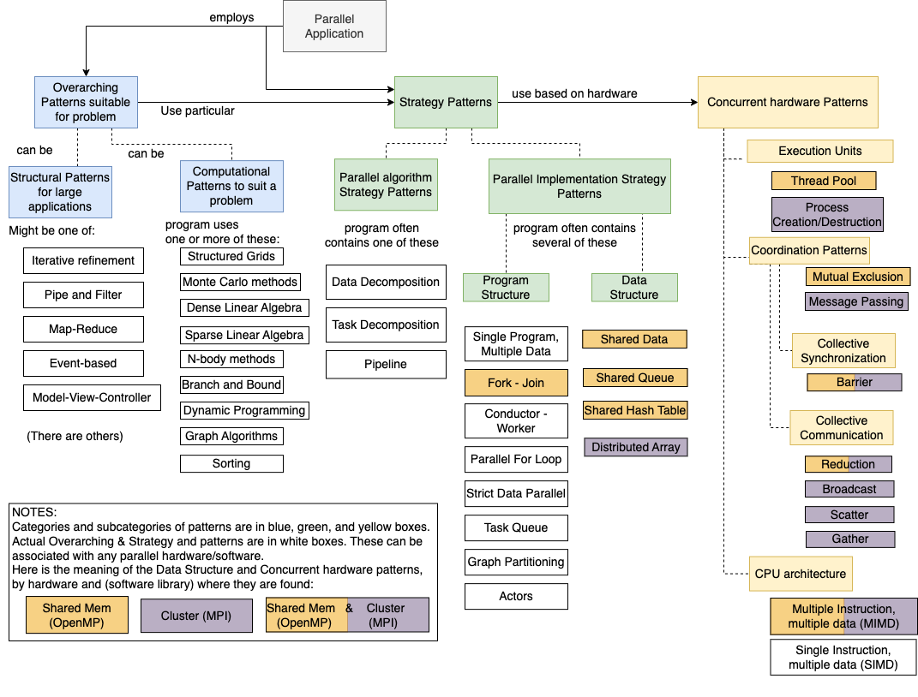
On a google doc in moodle

Slide 6
Parallel Pattern Categories
These patterns can be categorized:
Computational Patterns:
overall approach to a problem (originally sequential).
Algorithmic Strategies:
general approaches to devising parallel algorithms of a computational pattern.
Implementation Strategies:
patterns used to implement a given algorithmic strategy.
Concurrent Hardware (Communication & Synchronization):
patterns for synchronizing/communicating between the tasks in a given strategy.
--> These are usually found inside of the libraries we use to build our code.

Slide 7
Parallel Algorithm Strategies
Let’s start with this one
Most parallel programs use one of just three parallel algorithm strategy patterns:
Data decomposition: divide up the data and process it in parallel.
Task decomposition: divide the algorithm into functional tasks that are performed in parallel (to the extent possible).
Pipeline: divide the algorithm into linear stages, through which we “pump” the data.
This approach is usually
more scalable than the others
Also called
“functional decomposition”

Slide 8
Data Decomposition Algorithm Strategy
on shared memory machines with threads
Yet applies generally to other systems

Slide 9

Data Decomposition: 1 Thread
Thread 0

Slide 10
Data Decomposition: 2 Threads
Thread 0
Thread 1

Slide 11
Data Decomposition: 4 Threads
Thread 0
Thread 1
Thread 2
Thread 3
In OpenMP, this is accomplished by using “parallel for” in the pragma.
In this example, ‘chunks’ of the original data are worked on by each thread

Slide 12

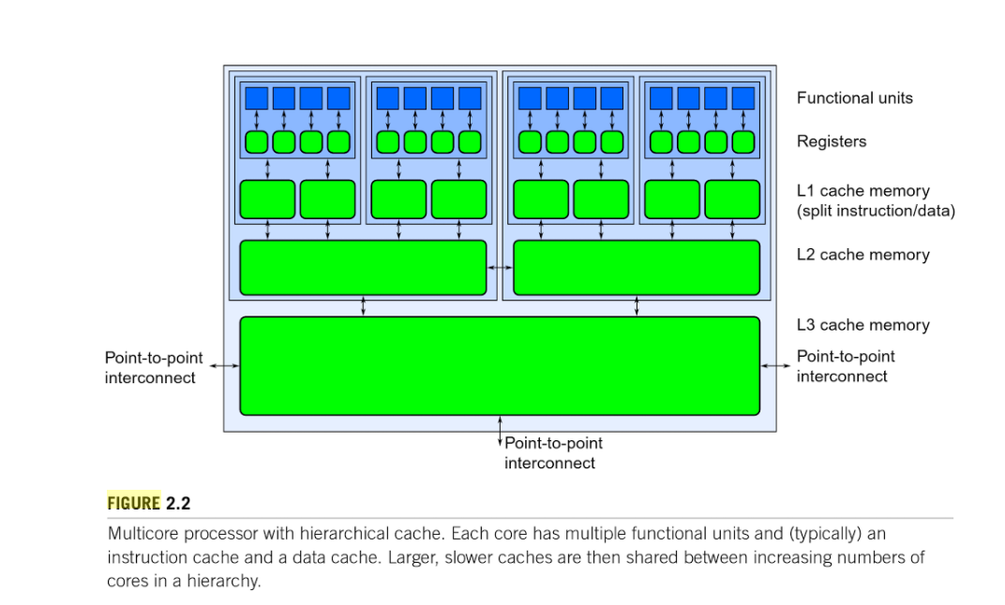
Shared Memory Machines
Thread 0
False sharing is an issue!
Thread 0 could load part of thread 1
data into thread 0’s cache

Slide 13
Task Decomposition Algorithm Strategy
on shared memory machines with threads
Yet applies generally to other systems

Slide 14
Algorithmic Strategy: Task Decomposition
Also called “functional decomposition”
The independent functions in a sequential computation can be “parallelized”:
int main() {
x = f();
y = g();
z = h();
w = x + y + z;
}
Thread 0
main()
f()
g()
h()
Thread 1
Thread 2
Thread 3
In OpenMP, this is accomplished by using ‘sections’.
See the 16.sections patternlet

Slide 15
Pipeline Algorithm Strategy
on shared memory machines with threads
Yet applies generally to other systems

Slide 16
Algorithmic Strategy: Pipeline
- When functions are not independent:
fin is a stream of elements
Time Step:
0
1
2
3
4
5
6
int main() {
...
while (fin) {
fin >> a;
b = f(a);
c = g(b);
d = h(c);
fout << d;
}
...
}
Thread 0
main()
a₀
a₁
a₂
a₃
a₄
a₅
a₆
Thread 1
f(a)
b₀
b₁
b₂
b₃
b₄
b₅
Thread 2
g(b)
c₀
c₁
c₂
c₃
c₄
Thread 3
h(c)
d₀
d₁
d₂
d₃
they can still be pipelined…

Slide 17
Implementation Strategies

Slide 18
How do we implement Data Decomposition?
Thread 0
Thread 1
Thread 2
Thread 3

Slide 20
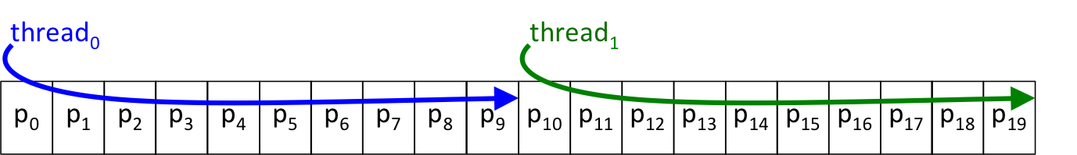
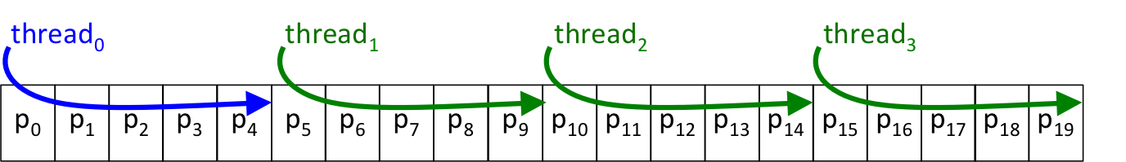
Implementation Strategy: Parallel Loop
One Thread:
Two Threads:
Four Threads:

Slide 21
Implementation Strategy: Parallel Loop
One Thread:
Suppose the task was to add all the numbers in this array:
Reduce to a single sum
We will use another pattern for that!
Two Threads:
Four Threads:

Slide 23
Communication Pattern: Reduction
Parallel programs often need to combine the local results of N parallel tasks.
The reduction pattern typically does it in O(log(N)) time
0
1
2
3
4
5
6
7
1 | 2 | 0 | 3
2 | 2 | 2 | 2
1 | 2 | 0 | 2
1 | 0 | 1 | 1
2 | 2 | 1 | 0
3 | 2 | 2 | 2
0 | 0 | 1 | 1
0 | 2 | 2 | 0
0
1
2
3
4
5
6
7
Sum from thread:
6
8
5
3
5
9
2
4
Time 1
14
8
14
6
Time 2
22
20
Time 3
42

Slide 24
Concurrent Hardware Patterns
Communication and synchronization of tasks
These are usually found inside of the libraries we use to build our code.

Slide 25
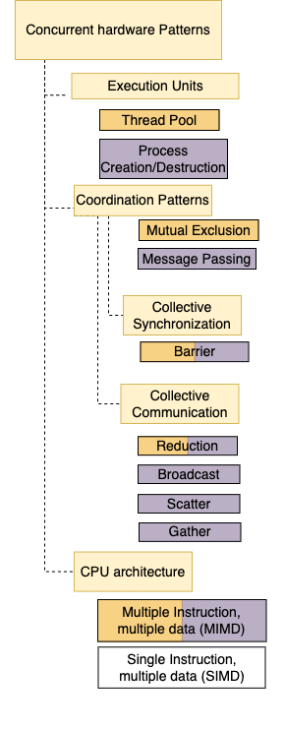
Shared Memory OpenMP & MPI pattern
MIMD:
Multiple Instruction, Multiple Data
A consequence of shared memory CPU architecture:
simultaneous instructions accessing shared data
Threads, OpenMP
Processes, MPI

Slide 26
Shared Memory OpenMP patterns
Thread Pool:
Before parallel execution, threads are set up in a ‘pool’:
a group of available threads
Threads, OpenMP
In computer science, a pool is a collection of resources that are kept ready to use, rather than acquired on use and released afterwards. In this context, resources can refer to system resources …
https://en.wikipedia.org/wiki/Pool_(computer_science)

Slide 27
Shared Memory OpenMP & MPI pattern
Barrier:
Place in code where all threads or processes must finish before continuing
Code examples in book, activities
There are implicit barriers also: end of parallel loop, e.g.
Threads, OpenMP
Processes, MPI

Slide 28
Shared Memory OpenMP pattern
Mutual Exclusion:
Provides a place in code where only one thread can execute at a time
(critical section)
Specific to shared-memory systems where race conditions can occur
Patternlets show two possibilities for this in OpenMP
atomic
critical
Threads, OpenMP

Slide 29
Parallel Patterns in Programs
… are industry-standard techniques and best-practices that have proven useful in many different parallel contexts.
… are built into popular platforms like MPI and OpenMP.
… are likely to be useful for the long-term, regardless of future PDC developments.
… provide a way to organize PDC concepts.

Slide 30
Conclusions
There are many possible starting points in PDC
There are many hardware and software options
Getting started is more important than where
Choose a software platform(s) that we can start with:
In first part of course:
C/C++ and shared memory: OpenMP, OpenACC
C and “distributed” systems: MPI
Patterns offer a much-needed source of stability
You will find them in different types of software on various hardware

Slide 31
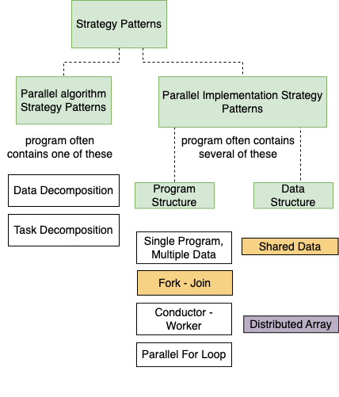
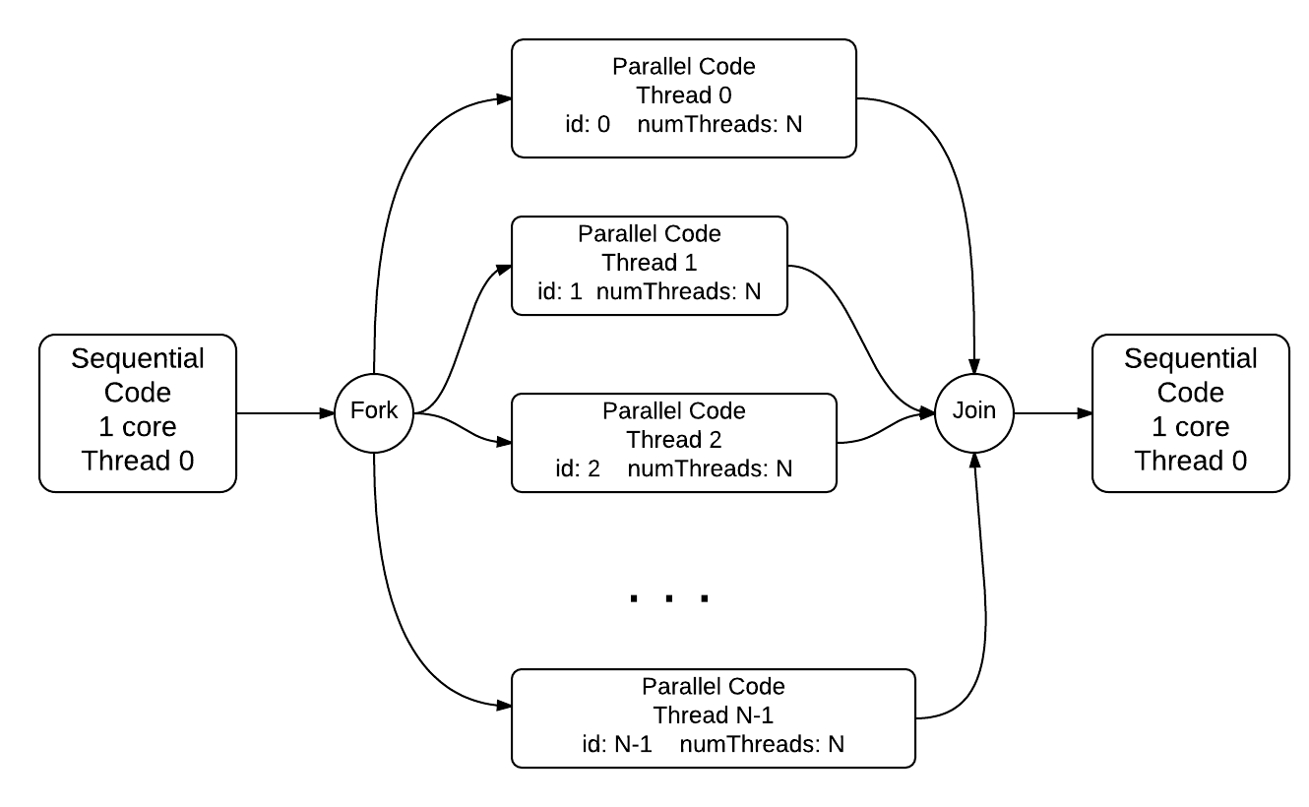
Hw 0:
Shared Memory with OpenMP
#pragma omp parallel

