Slide 1
Shared Queues and Message Passing in OpenMP
Slides originally by Peter Pacheco
Edited substantially by Libby Shoop
for COMP 445, Macalester College

Slide 2
Queues
dequeue
Can be viewed as an abstraction of a line of customers waiting to pay for their groceries in a supermarket.
A natural data structure to use in many multithreaded applications.
For example, suppose we have several “producer” threads and several “consumer” threads.
Producer threads might “produce” requests for data.
Consumer threads might “consume” the request by finding or generating the requested data.
enqueue
enqueue
dequeue

Slide 3
Message Passing
Messages are a general term for data objects of some type that one thread would like another thread to work on.
Passing is the act of ‘sending’ that data object
implementation of this can have many forms
we’ll examine in parallel shared memory with OpenMP
The pattern of message passing can be used as a way to implement various applications
including producer-consumer
or the pipeline strategy as a special case of that

Slide 4
Algorithmic Strategy: Pipeline
fin is a stream of elements
Time Step:
0
1
2
3
4
5
6
int main() {
...
while (fin) {
fin >> a;
b = f(a);
c = g(b);
d = h(c);
fout << d;
}
...
}
Thread 0
main()
a₀
a₁
a₂
a₃
a₄
a₅
a₆
Thread 1
f(a)
b₀
b₁
b₂
b₃
b₄
b₅
Thread 2
g(b)
c₀
c₁
c₂
c₃
c₄
Thread 3
h(c)
d₀
d₁
d₂
d₃

Slide 5
Generic Producer-Consumer
any thread produces for any other thread
The code example will have the following patterns

Slide 6
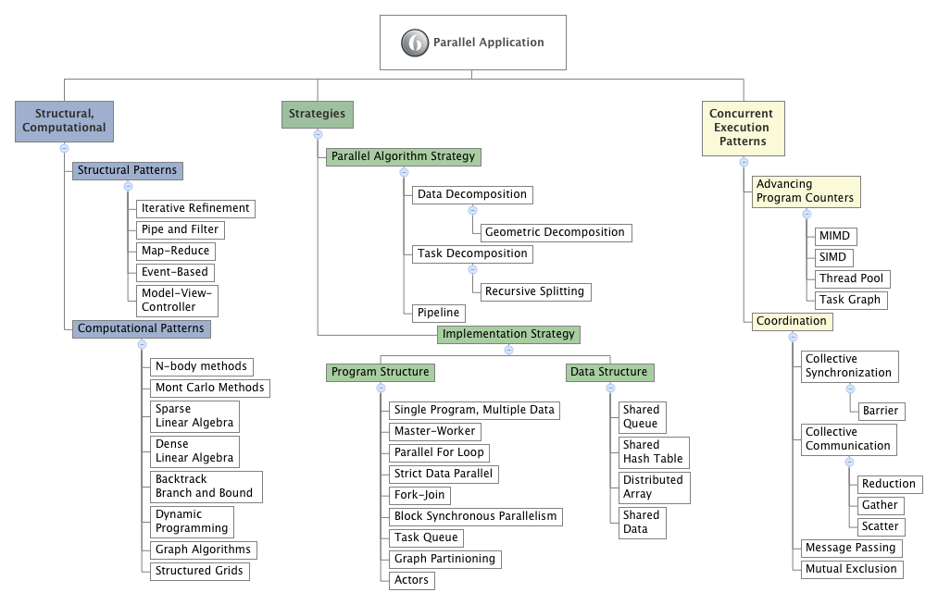
part of OpenMP
different than
other examples

Slide 7
Message-Passing
Each thread could have a shared message “queue” (set of queues)
when one thread wants to “send a message” to another thread, it could enqueue the message in the destination thread’s queue.
A thread could receive a message by dequeuing the message at the head of its message queue.
shared array of pointers to queues
one queue per each thread’s messages

Slide 8
Message-Passing
Shared Queue
Data Structure
Pattern
Each thread could have a shared message “queue” (set of queues)
any thread can be ‘sending’ a message to any other thread at any time
any thread can be ‘receiving’ a message at any time
we need to worry about race conditions on the queues
will have to ‘lock’ a queue when enqueue and dequeue a message
provide mutual exclusion (lower level coordination pattern)
shared array of pointers to queues
one queue per thread

Slide 9
Message-Passing
shared array of pointers to queues
one queue per thread

Slide 10
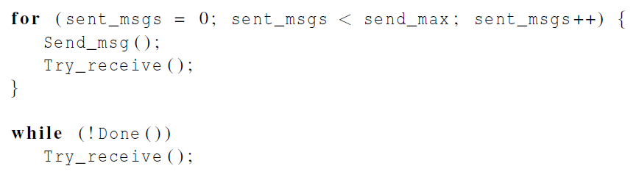
Message-Passing “test” pseudocode
Each thread is executing this code (SPMD pattern)
each thread is producing and consuming an equal number of messages
This is in main() of omp_msgps.c, omp_msglk.c
omp_msglk.c : uses one form of mutual exclusion on the queues: locks
omp_msgps.c: uses another form of mutual exclusion on the queues : critical sections

Slide 11
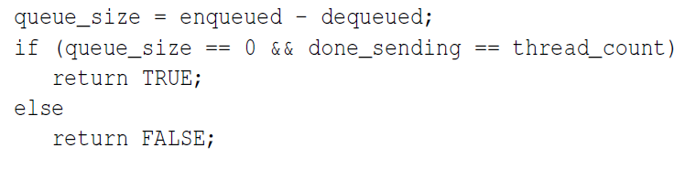
Termination Detection [ Done() ]
each thread increments this after completing its for loop

Slide 12
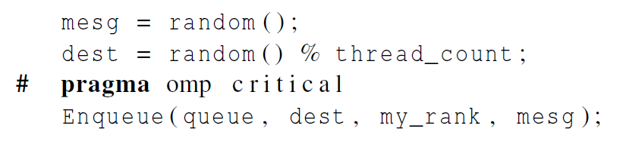
Sending Messages
omp_msgps.c

Slide 13
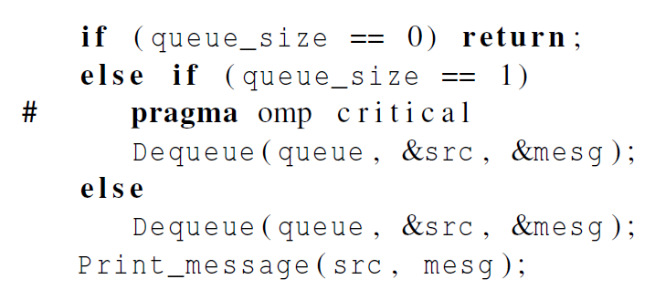
Receiving Messages
omp_msgps.c

Slide 14
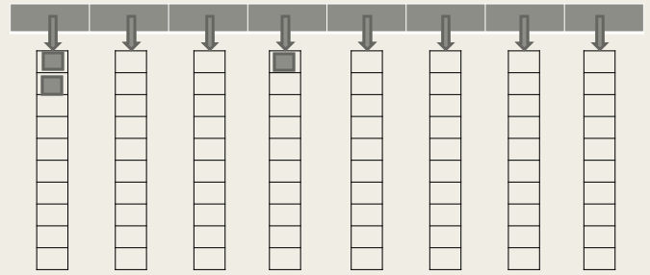
Compare these operations
enqueue, or add
dequeue, or remove
front
rear
Only one thread ever dequeues a message from its designated queue
As long as there are more than 2 messages on the queue, a call to Dequeue won’t conflict with a call to Enqueue

Slide 15
Startup (1)
When the program begins execution, a single thread, the master thread, will:
get command line arguments and
allocate an array of pointers to message queues: one for each thread.
This array needs to be shared among the threads, since any thread can send to any other thread, and hence any thread can enqueue a message in any of the queues.
Shared Queue
Data Structure
Pattern

Slide 16

Startup (2): each thread creates its queue in parallel
One or more threads may finish allocating their queues before some other threads.
We need an explicit barrier so that when a thread encounters the barrier, it blocks until all the threads in the team have reached the barrier.
After all the threads have reached the barrier all the threads in the team can proceed.
Barrier Coordination
Pattern

Slide 17
Example ‘test’ program: all threads sending messages concurrently
for (msg_number = 0; msg_number < send_max; msg_number++) {
Send_msg(msg_queues, my_rank, thread_count, msg_number);
Try_receive(msg_queues[my_rank], my_rank);
}
# pragma omp atomic
done_sending++;
# ifdef DEBUG
printf("Thread %d > done sending\n", my_rank);
# endif
while (!Done(msg_queues[my_rank], done_sending, thread_count))
Try_receive(msg_queues[my_rank], my_rank);
Mutual Exclusion
Pattern
omp_msglk.c : uses one form of mutual exclusion on the queues: locks
omp_msgps.c: uses another form of mutual exclusion on the queues : critical sections

Slide 18

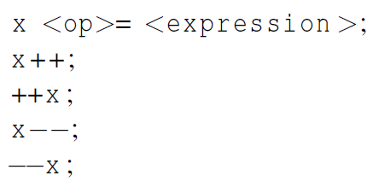
The Atomic Directive (1)
Unlike the critical directive, it can only protect critical sections that consist of a single C assignment statement.
Further, the statement must have one of the following forms:

Slide 19
The Atomic Directive (2)
Here <op> can be one of the binary operators
Many processors provide a special load-modify-store instruction.
A critical section that only does a load-modify-store can be protected much more efficiently by using this special instruction rather than the constructs that are used to protect more general critical sections.

Slide 20
Example ‘test’ program: all threads sending messages concurrently
for (msg_number = 0; msg_number < send_max; msg_number++) {
Send_msg(msg_queues, my_rank, thread_count, msg_number);
Try_receive(msg_queues[my_rank], my_rank);
}
# pragma omp atomic
done_sending++;
# ifdef DEBUG
printf("Thread %d > done sending\n", my_rank);
# endif
while (!Done(msg_queues[my_rank], done_sending, thread_count))
Try_receive(msg_queues[my_rank], my_rank);

Slide 21
sending messages using critical
void Send_msg(struct queue_s* msg_queues[], int my_rank,
int thread_count, int msg_number) {
// int mesg = random() % MAX_MSG;
int mesg = -msg_number;
int dest = random() % thread_count;
# pragma omp critical
Enqueue(msg_queues[dest], my_rank, mesg);
# ifdef DEBUG
printf("Thread %d > sent %d to %d\n", my_rank, mesg, dest);
# endif
} /* Send_msg */

Slide 22

Critical Sections
OpenMP provides the option of adding a name to a critical directive:
When we do this, two blocks protected with critical directives with different names can be executed simultaneously.
However, the names are set during compilation, and we want a different critical section for each thread’s queue.

Slide 23

Locks
A lock consists of a data structure and functions that allow the programmer to explicitly enforce mutual exclusion in a critical section.
OpenMP provides a functional mechanism for this as an alternative to the pragma construct

Slide 24
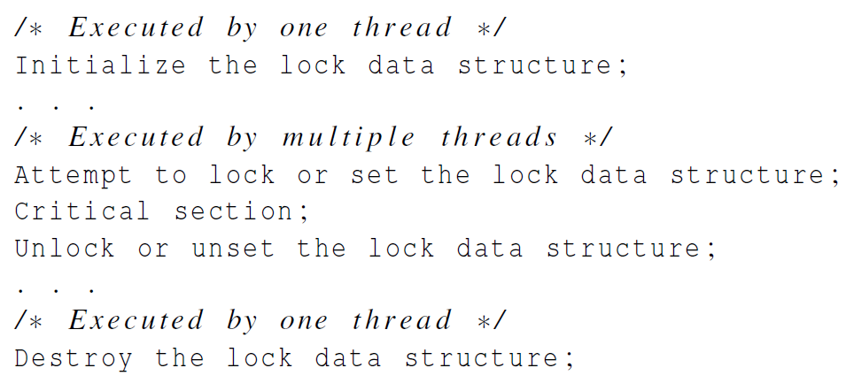
Locks

Slide 25
Simple example
#include <omp.h>
lock_t myLock;
int main(….) {
(void) omp_init_lock(&myLock);
#pragma omp parallel
{
(void) TheCookieJar();
} // End of parallel region
(void) omp_destroy_lock(&myLock); }
void TheCookieJar() {
(void) omp_set_lock(&myLock); // acquire lock
(void) grabMyFavouriteCookie(); // get cookie
(void) omp_unset_lock(&myLock); // release lock
}

Slide 26
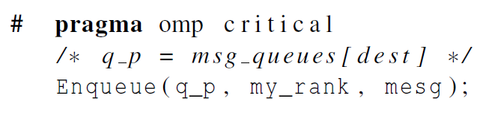
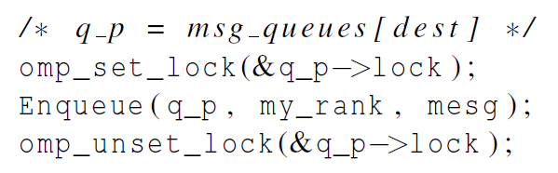
Using Locks in the Message-Passing Program

Slide 27
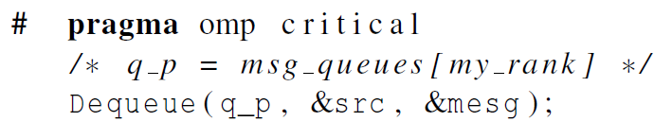
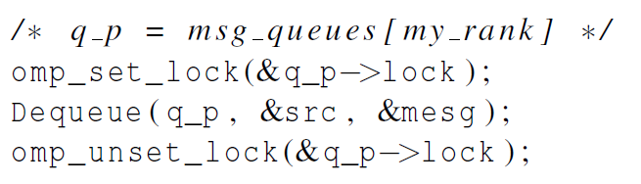
Using Locks in the Message-Passing Program

Slide 28
Some Caveats
You shouldn’t mix the different types of mutual exclusion for a single critical section.
There is no guarantee of fairness in mutual exclusion constructs.
It can be dangerous to “nest” mutual exclusion constructs.

Slide 29
Locks vs. critical
critical focuses on the code section
locks are about the data
A real implementation would place the locking inside the Dequeue function:
has potential of being more fine-grained (smaller amount of code is locked

Slide 30
Locks are subject to more errors
forgetting to initialize lock variable
deadlock
unsetting a lock from another thread

Slide 31
You try the code
Work with a neighbor
shared/activities/omp_msg
original code: examples/Pacheco-ipp-source/ch5/omp_msg
Note the two different implementations, which have different queue code files:
queue.c and queue.h
queue_lk.c and queue_lk.h

Slide 32
Example ‘test’ using critical & atomic
uses queue.c/h
/* File: omp_msgps.c
*
* Purpose: Simulate message-passing using OpenMP. Uses critical and
* atomic directives to protect critical sections.
*
* Compile: gcc -g -Wall -fopenmp
* -o omp_msgps omp_msgps.c queue.c
* needs queue.h
* Usage: ./omp_msgps <number of threads> <number of messages each thread sends>
*
* Input: None
* Output: Source, destination and contents of each message received.
*
* Notes:
* 1. DEBUG flag for more verbose output
*/

Slide 33
Example ‘test’ using OpenMP locks & atomic
/* File: omp_msglk.c
*
* Purpose: Simulate message-passing using OpenMP. This version uses
* an atomic directive and OpenMP locks to protect critical
* sections.
*
* Compile: gcc -g -Wall -fopenmp -o omp_msglk omp_msglk.c queue_lk.c
* needs queue_lk.h
* Usage: ./omp_msglk <number of threads> <number of messages each thread sends>
*
* Input: None
* Output: Source, destination and contents of each message received.
*
*
* Notes:
* 1. DEBUG flag for more verbose output
* 2. This version uses locks to control access to the message queues.
*/
uses queue_lk.c/h

Slide 34

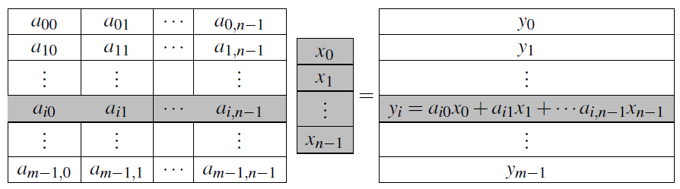
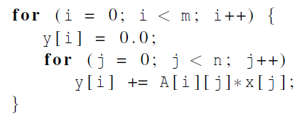
Matrix-vector multiplication
Notes:
Please refer to the detailed slides on cache coherence and thread-safety in Chapter 4.

Slide 35
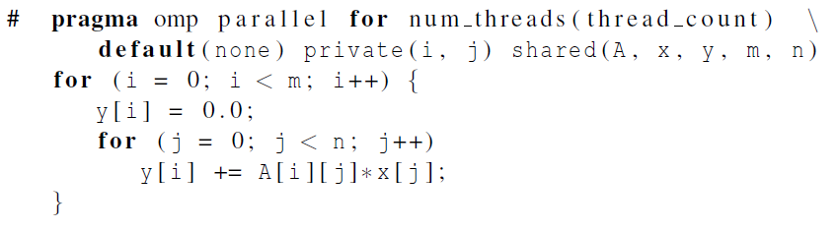
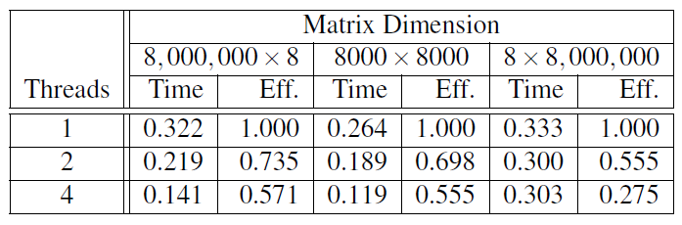
Matrix-vector multiplication
Run-times and efficiencies of matrix-vector multiplication (times are in seconds)
Notes:
Please refer to the detailed slides on cache coherence and thread-safety in Chapter 4.

Slide 36
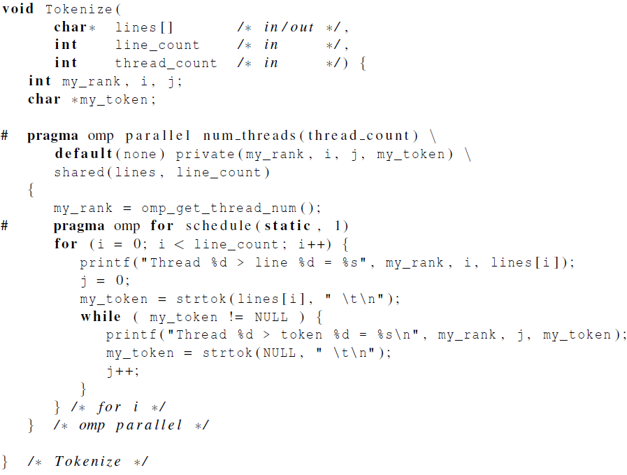
Thread-Safety
Notes:
Please refer to the detailed slides on cache coherence and thread-safety in Chapter 4.

Slide 37
Concluding Remarks (1)
OpenMP is a standard for programming shared-memory systems.
OpenMP uses both special functions and preprocessor directives called pragmas.
OpenMP programs start multiple threads rather than multiple processes.
Many OpenMP directives can be modified by clauses.

Slide 38
Concluding Remarks (2)
A major problem in the development of shared memory programs is the possibility of race conditions.
OpenMP provides several mechanisms for insuring mutual exclusion in critical sections.
Critical directives
Named critical directives
Atomic directives
Simple locks

Slide 39
Concluding Remarks (3)
By default most systems use a block-partitioning of the iterations in a parallelized for loop.
OpenMP offers a variety of scheduling options.
In OpenMP the scope of a variable is the collection of threads to which the variable is accessible.

Slide 40
Concluding Remarks (4)
A reduction is a computation that repeatedly applies the same reduction operator to a sequence of operands in order to get a single result.

