Slide 1
Measuring Effectiveness
Important to answer this:
How Scalable is a Parallel Program?

Slide 2
Speedup and Efficiency
See section 0.3 in PDC For Beginners
Speedup:
S_{p} = T_{s} / T_{p}
T_{s} = time for sequential program
Time of sequential version gives us true speedup
We could use time of parallel version running on one core
Gives us relative speedup
T_{p} = time for parallel program

Slide 3
Code for parallel loop, reduction patterns
not parallel
#define SIZE 67000000
int main(int argc, char** argv) {
int array[SIZE];
if (argc > 1) {
omp_set_num_threads( atoi(argv[1]) );
}
double start = omp_get_wtime(); // wall clock time
initialize(array, SIZE);
double total = parallelSumSqrt(array, SIZE);
// Measuring the elapsed time
double end = omp_get_wtime();
// Time calculation (in seconds)
double elapsed_time = end - start;
printf("Parallel time: %lf seconds\n",elapsed_time);
return 0;
}
/* fill array with random values */
void initialize(double* a, int n) {
int i;
for (i = 0; i < n; i++) {
a[i] = (double) (rand() % 100000);
}
}
/* sum the array using multiple threads */
double parallelSumSqrt(double* a, int n) {
double sum = 0.0;
int i;
#pragma omp parallel for reduction(+:sum)
for (i = 0; i < n; i++) {
sum += sqrt(a[i]);
}
return sum;
}
parallel
Suppose executing this program with one thread takes 2 seconds.
T_{s} sequential time
Using 2 threads should take about 1 seconds (ideally)
T_{p} parallel time, where p = 2
Using 4 threads should take about 0.5 seconds (ideally)
T_{p} parallel time, where p = 4
and so on- doubling the threads each time should cut the time in half

Slide 4

Speedup for multicore with OpenMP
Number of cores = p
Serial run-time = T_{serial} = T_{s}
Parallel run-time = T_{parallel} = T_{p}
linear speedup
T_{parallel} = T_{serial} / p

Slide 5
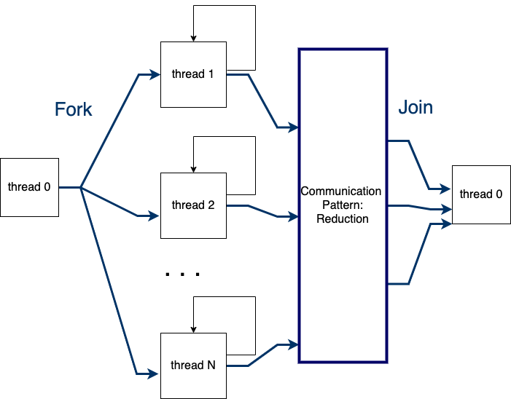
However, there is overhead in parallel programs
#pragma omp parallel for reduction(+:sum)
for (i = 0; i < n; i++) {
sum += sqrt(a[i]);
}
Fork, reduction, and Join take time.
If there is enough work going on in the loops on each thread, this time will be dwarfed by that work.
If not, we will be far from ideal speedup.

Slide 6
Speedup and Efficiency
Speedup, S_{p} = T_{s} / T_{p}
Efficiency helps us measure the overhead
E_{p} = S_{p} / p = T_{s} / (p * T_{p})
Efficiency near 1, or 100% is ideal; usually above 75% is fairly good
p is number of threads used in a parallel OpenMP program
You can also think of the p subscript as saying Efficiency of the parallel program
S₂ = 2 / 1 in the ideal ‘linear’ situation from previous code
E₂ = S₂ / 2 = 1, or 100% in the ideal situation from previous code

Slide 7
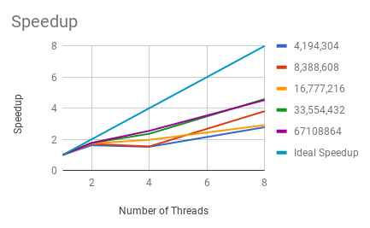
How we experiment and report speedup
 | Array size
Time for threads | 4,194,304 | 8,388,608 | 16,777,216 | 33,554,432 | 67108864
1 | 0.140389 | 0.278735 | 0.554305 | 1.10265 | 2.190898
2 | 0.086532 | 0.162967 | 0.318345 | 0.623389 | 1.233185
4 | 0.092176 | 0.180323 | 0.281316 | 0.467516 | 0.859808
8 | 0.050442 | 0.073141 | 0.190127 | 0.240296 | 0.484111
Speedup S_{p} = T_{s} / T_{p}
For threads | 4,194,304 | 8,388,608 | 16,777,216 | 33,554,432 | 67108864 | Ideal Speedup
1 | 1 | 1 | 1 | 1 | 1 | 1
2 | 1.622 | 1.710 | 1.741 | 1.769 | 1.777 | 2
4 | 1.523 | 1.546 | 1.970 | 2.359 | 2.548 | 4
8 | 2.783 | 3.811 | 2.915 | 4.589 | 4.526 | 8

Slide 8
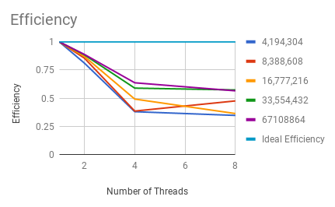
How we experiment and report speedup
Speedup S_{p} = T_{s} / T_{p}
For threads | 4,194,304 | 8,388,608 | 16,777,216 | 33,554,432 | 67108864 | Ideal Speedup
1 | 1 | 1 | 1 | 1 | 1 | 1
2 | 1.622 | 1.710 | 1.741 | 1.769 | 1.777 | 2
4 | 1.523 | 1.546 | 1.970 | 2.359 | 2.548 | 4
8 | 2.783 | 3.811 | 2.915 | 4.589 | 4.526 | 8
Efficiency = S_{p} / p
 | 4,194,304 | 8,388,608 | 16,777,216 | 33,554,432 | 67108864 | Ideal Efficiency
1 | 1 | 1 | 1 | 1 | 1 | 1
2 | 0.811 | 0.855 | 0.871 | 0.884 | 0.888 | 1
4 | 0.381 | 0.386 | 0.493 | 0.590 | 0.637 | 1
8 | 0.348 | 0.476 | 0.364 | 0.574 | 0.566 | 1

Slide 9
Scalability
Speedup near ideal, or efficiency above 75%, for a particular problems size and number of threads, demonstrates strong scalability
Another form of scalability that is poorly named is weak scalability
if we increase the size of a problem by some factor
and we increase the number of threads by that factor
if the time remains the same or close to it, we have weak scalability
This kind of scalability can be very useful:
we can solve a larger problem by using a larger machine
with more cores

Slide 10
Scalability
In general, a problem is scalable if it can handle ever increasing problem sizes.
If we increase the number of processes/threads and keep the efficiency roughly fixed without increasing problem size, the problem is strongly scalable.
If we can keep the efficiency roughly fixed by increasing the problem size at the same rate as we increase the number of processes/threads, the problem is weakly scalable.
I emphasize the words roughly in the two definitions above, because ideal speedup is rarely possible

Slide 11
This example?
Strongly scalable?
Is speedup near ideal?
When is efficiency above 75%?
Would not characterize as strongly scalable at these problem sizes.

Slide 12
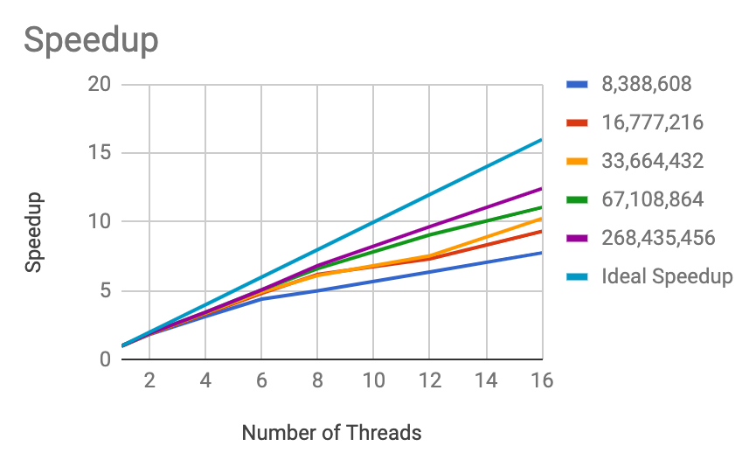
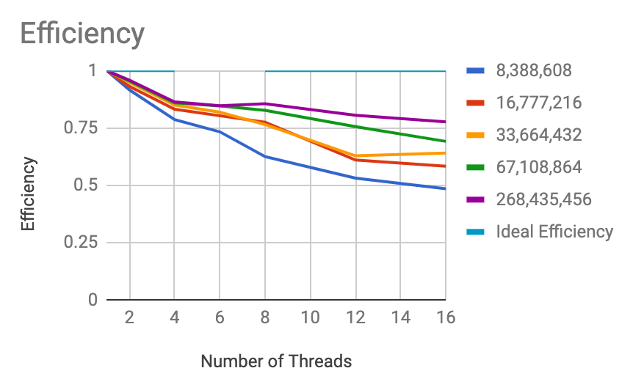
How about this in terms of strong scalability?
Is speedup near ideal?
When is efficiency above 75%?

Slide 13
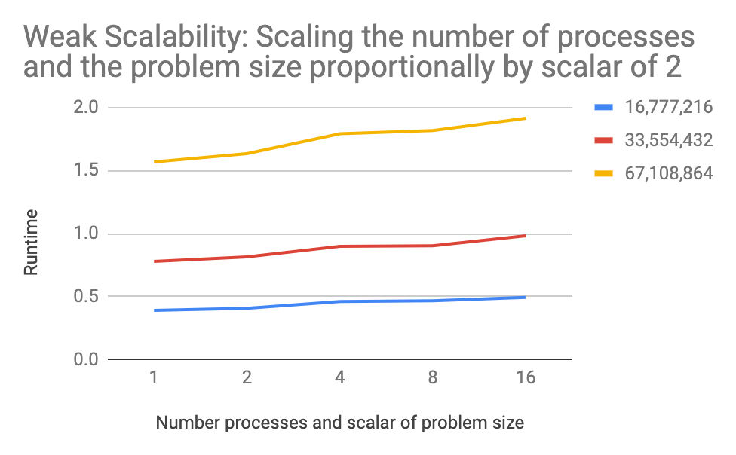
Is this weak scalability?
If we can keep the efficiency roughly fixed (i.e. has same time) by increasing the problem size at the same rate as we increase the number of processes/threads, the problem is weakly scalable.

Slide 14
Experimental process for this course
Use ‘shell scripts’ to execute code several times
duplicate experiments
run several different conditions
Transfer data to spreadsheet
analyze using different measurements
speedup and efficiency
for strong scalability
run times as problem size and number of threads are increased proportionally
for weak scalability

Slide 15
Sequential timing
Parallel timing
#include <omp.h>
. . .
double start = omp_get_wtime();
// compute each rectangle, adding area to the accumulator
for(i = 1; i < n; i++) {
integral += f(a+i*h);
}
integral = integral * h;
// Measuring the elapsed time
double end = omp_get_wtime();
. . .
#include <omp.h>
. . .
// for timimg
double start = omp_get_wtime();
// compute each rectangle, adding area to the accumulator
#pragma omp parallel for default(none) \
private(i) shared(n, a, h) reduction(+:integral)
for(i = 1; i < n; i++) {
integral += f(a+i*h);
}
integral = integral * h;
// Measuring the elapsed time
double end = omp_get_wtime();
. . .
We use this for sequential timing too:
Easy to use,
Can compare times properly

Slide 16
Sequential timing
Parallel timing
You could use this for sequential timing too
#include "seq_time.h"
. . .
double start = c_get_wtime();
// compute each rectangle, adding area to the accumulator
for(i = 1; i < n; i++) {
integral += f(a+i*h);
}
integral = integral * h;
// Measuring the elapsed time
// double end = omp_get_wtime();
double end = c_get_wtime();
. . .
#include <omp.h>
. . .
// for timimg
double start = omp_get_wtime();
// compute each rectangle, adding area to the accumulator
#pragma omp parallel for default(none) \
private(i) shared(n, a, h) reduction(+:integral)
for(i = 1; i < n; i++) {
integral += f(a+i*h);
}
integral = integral * h;
// Measuring the elapsed time
double end = omp_get_wtime();
. . .

