Slide 1
Pseudo Random Number Generators or PRNGs
COMP 445

Slide 2
Motivation
“The Monte Carlo method is a major industry and random numbers are its key resource”
Stephan Mertens
Lecture given at the International Summer School Modern Computational Science (August 16-28, 2009, Oldenburg, Germany)
Some examples are traffic simulations, economics, game simulations, physics simulations
From shorter paper provided for the trng library:
Random Number Generators: A Survival Guide for Large Scale Simulations
Stephan Mertens

Slide 3
References
Some material here is copied from these sources:
Tutorial: Random Number Generation
By John Lau Henry Yu
June 2018
http://koclab.cs.ucsb.edu/teaching/cren/project/2018/Lau+Yu.pdf
Random Number Generators: A Survival Guide for Large Scale Simulations
Stephan Mertens
Found as ‘shorter paper’ on our moodle site (References and OpenMP section)

Slide 4
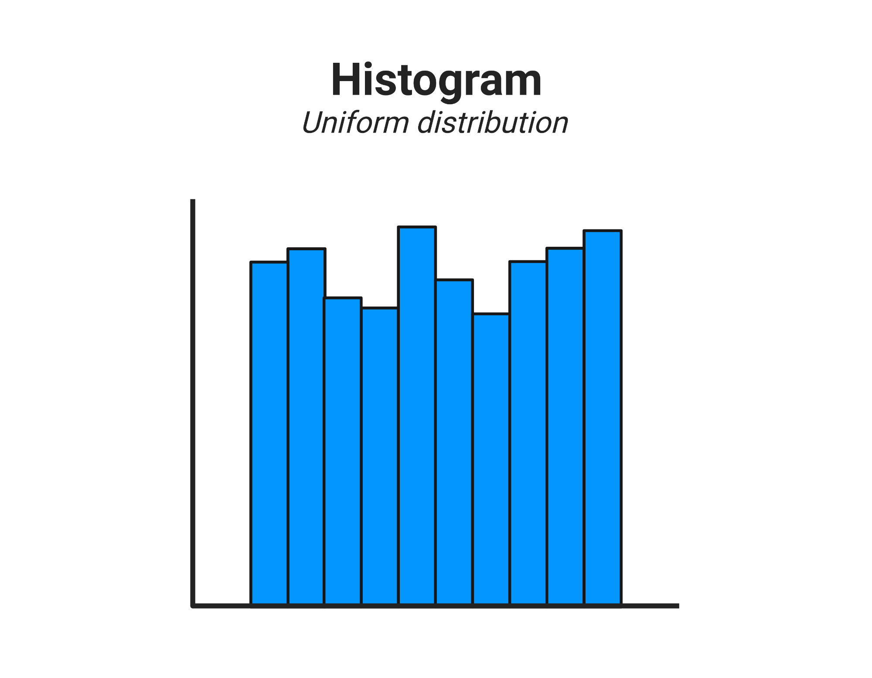
Computer generated random number statistical properties
A sequence of random numbers R1, ... Ri must fulfill two statistical properties:
1. Uniformity – If the interval [0,1] is divided into n classes, or sub intervals of equal length, the expected number of observations in each interval is N/n, where N is the total number of observations
100
Generally computer RNGs are not perfect, but very close
If N = 1000 and n = 10
1000/10 = 100
0
0 0.1 0.2 0.3 0.4 0.5 0.6 0.7 0.8 0.9 1.0

Slide 5
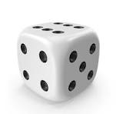
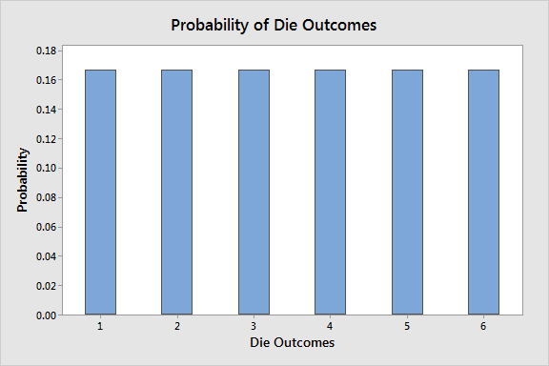
Computer generated random number statistical properties
A sequence of random numbers R1, ... Ri must fulfill two statistical properties:
1. Uniformity – Consequence of this property: If the interval [0,1] is divided into n classes, or sub intervals of equal length, the expected number of observations in each interval is N/n, where N is the total number of observations
Perfect case shown left:
Rolling dice has six outcomes that are uniformly distributed.
Therefore, each one has a likelihood of 1/6 = 0.167. The bar chart below displays the rectangular-shaped distribution.
If we randomly generate numbers between 1 and 6, the number of times each occurs should be uniformly distributed
https://statisticsbyjim.com/probability/uniform-distribution/

Slide 6
Computer generated random number properties
A sequence of random numbers R1, ... Ri must fulfill two statistical properties:
2. Independence – Consequence of this property: The probability of observing a value in a particular interval is independent of the previous value drawn
Rolling a 1 is independent of rolling a 5 on the previous roll.
So too for generating numbers between 1 and 6

Slide 7
Other properties that random number generators should have:
• Efficiency – The generator should be fast and efficient.
• Reproducibility – The generator should be able to generate the same stream of random numbers repeatedly. This is mainly for testing and debugging purposes.
• Long Cycle Length – The generator should take a very long time before numbers start to repeat.

Slide 8
Popular method: Linear Congruential Method, LCM
To produce a sequence of integers, X1, X2, . . . between 0 and m-1 by following a recursive relationship
X_{i+1} = (aX_{i} + c) mod m
i = 0, 1, 2, …
X₀ = is a ‘seed’ value, typically a large integer
The selection of the values for a, c, m, and X₀ drastically affects the statistical properties and the cycle length.
Important concept:
Different seeds produce different streams of random values

Slide 9
An Issue with LCM
X_{i+1} = (aX_{i} + c) mod m
The numbers generated fall into planes.
If k random numbers at a time are used to plot points in k-dimensional space, then the points lie on k-1 dimensional planes rather than filling up all k-space.
There are at most m/k planes, or fewer (which is even worse) if a, c, or m are not well chosen
But modern versions have overcome this and they are quite fast, uniform, and independent

Slide 10
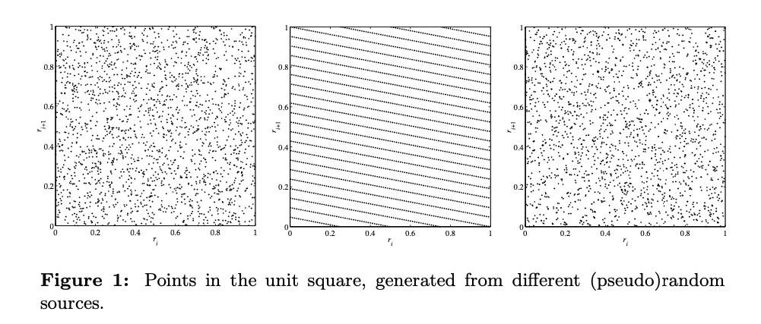
An Issue with LCM
X_{i+1} = (aX_{i} + c) mod m
The numbers generated fall into planes.
If k random numbers at a time are used to plot points in k-dimensional space, then the points lie on k-1 dimensional planes rather than filling up all k-space.
There are at most m1/k planes, or fewer (which is even worse) if a, c, or M are not well chosen
From shorter paper provided for the trng library:
Random Number Generators: A Survival Guide for Large Scale Simulations
Stephan Mertens

Slide 11
A variation
linear feedback shift register sequences, or LFSR
To generate pseudo random integers between 0 and some prime number p is the linear recurrence
r_{i} = a₁r_{i−1} + a₂r_{i−2} + ... + a_{n}r_{i−n} mod p

Slide 12
Non-linear generators
To alleviate problems with linear methods,
Many non-linear generators have been tried, for example:
“Mersenne Twister”
Yet another random number generator (YARN)
feed a stream of numbers from a PRNG to the Berlekamp-Massey algorithm
“Measured in terms of linear complexity, YARN generators are as random and nonlinear as it can get.”

Slide 13
How is this done in parallel?
We need to split the ‘stream’ of random values across the threads/processes

Slide 14
PRNG in parallel
In parallel applications we need to generate streams
r_{j,i} of random numbers
where j = 0,1,...,p − 1 represents streams for each of the p threads/processes.
We require statistical independency of the r_{j,i} within each stream and between the streams.

Slide 15
Efficient generation of numbers is important
You will see with examples:
random numbers are very often needed in the innermost loop of a simulation that has nested loops
Thus, efficiency of a PRNG is very important.
We require that a PRNG can be parallelized without loosing its efficiency.

Slide 16
Still must be reproducible
Stephan Mertens called this ‘play fair’:
“Fair play implies the use of the same pseudo random numbers in the same context, independently of the number of parallel processes.”

Slide 17
What parallel methods have been tried?
Random Seeding
All processes use the same PRNG but a different “random” seed. The hope is that they will generate non-overlapping and uncorrelated subsequences of the original PRNG.
You may have done this before (or will see code that does it)
It’s easy to code using existing random libraries in a language
But it turns out to be a poor way to provide one of the guarantees we want:
A simulation does not play fair because its results will be different depending on the number of threads/processes used
The set of numbers generated together by all threads does not match a sequential version with one seed

Slide 18
How is this done in parallel?
X_{i+1} = (aX_{i} + c) mod m
2. Parameterization
Use different parameters in the same type of generator, for example:
linear congruential generators with additive constant bj for the jth stream created on each thread or process
rj,i = a · rj,i−1 + bj mod m
where the b_{j} are different prime numbers just below m/2.
Like random seeding, parameterization prevents fair play

Slide 19
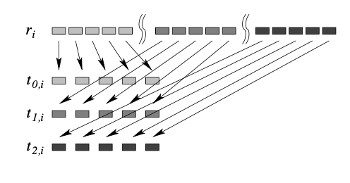
How is this done in parallel?
Block Splitting
break up a single stream of random numbers into non-overlapping, consecutive blocks of numbers and assign each block to one of the threads/processes.
Do this by:
Let M be the maximum number of calls to a PRNG by each thread/process, and let p be the number of threads/processes. Then we can split the sequence (r) of a sequential PRNG into consecutive blocks of length M
Issues:
This method works only if we know M in advance or can at least safely estimate an upper bound for M
For an efficient block splitting, it is necessary to jump from the ith random number to the (i + M )th number without calculating the numbers in between.
Total Numbers needed should be divisible by p
M random numbers
This will be fair and reproducible

Slide 20
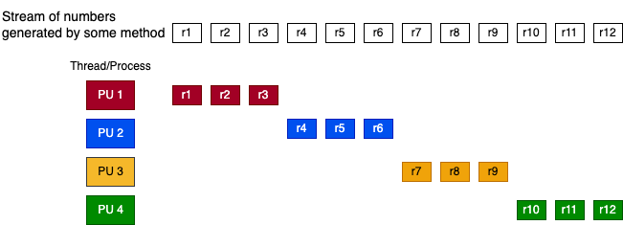
How is this done in parallel?
Block Splitting
break up a single stream of random numbers into non-overlapping, consecutive blocks of numbers and assign each block to one of the threads/processes.
Do this by:
Let M be the maximum number of calls to a PRNG by each thread/process, and
let p be the number of threads/processes.
Then we can split the sequence (r) of a sequential PRNG into consecutive blocks of length M
Issues:
This method works only if we know M in advance or can at least safely estimate an upper bound for M
For an efficient block splitting, it is necessary to jump from the ith random number to the (i + p )th number without calculating the numbers in between.
Total Numbers needed should be divisible by p
M=12/4 random numbers
This will be fair and reproducible

Slide 21
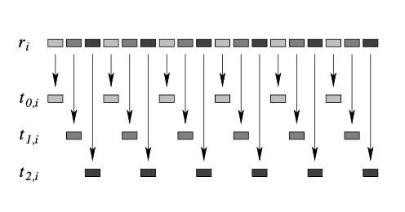
How is this done in parallel?
4. Leap Frogging
The leapfrog method distributes a sequence (r) of random numbers over d processes (shown right)
It does not require an a priori estimate of how many random numbers will be consumed by each processor.
Can in general be implemented to ensure fair play. And it reproduces the same values regardless of numbers of threads.

Slide 22
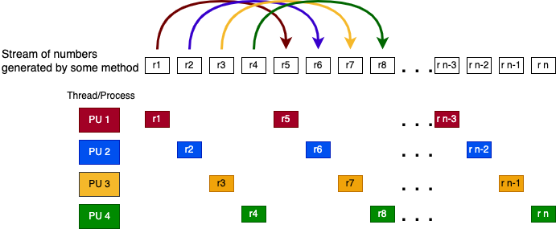
How is this done in parallel?
4. Leap Frogging
The leapfrog method distributes a sequence (r) of random numbers over d processes (shown right)
It does not require an a priori estimate of how many random numbers will be consumed by each processor.
Can in general be implemented to ensure fair play. And it reproduces the same overall set of values regardless of numbers of threads.

Slide 23
How is this done in parallel?
To do the last 2 efficiently in each thread/process will:
Modify a PRNG to generate directly only every dth element of the original sequence (for leapfrogging)
or
Directly advance the PRNG stream by M steps (for block splitting)
Techniques for doing this have been developed, including for LSFR and YARN algorithms for generating the numbers

Slide 24
How is this done in parallel?
To do the last 2 efficiently, each thread/process will:
Directly advance the PRNG stream by M steps, then generate each number in order
for block splitting
or
Modify a PRNG to generate directly only every
r_{pid} , r_{pid+p} , r_{pid+2p} , etc
element of the original sequence
for leapfrogging
Techniques for doing this have been developed, including for LSFR and YARN algorithms for generating the numbers

Slide 25
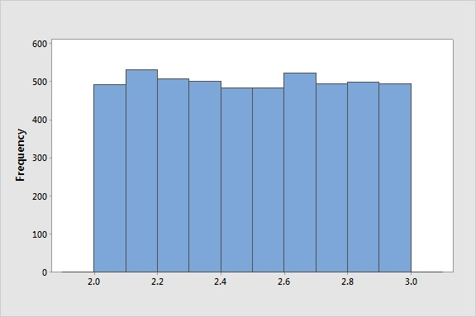
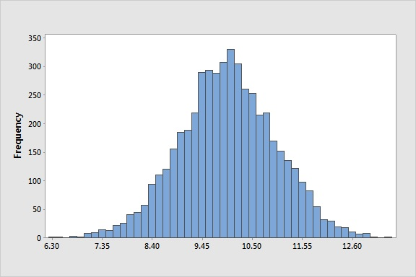
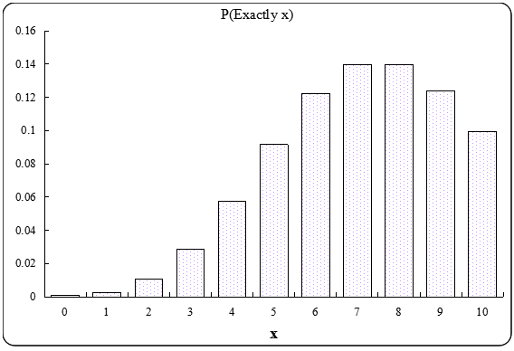
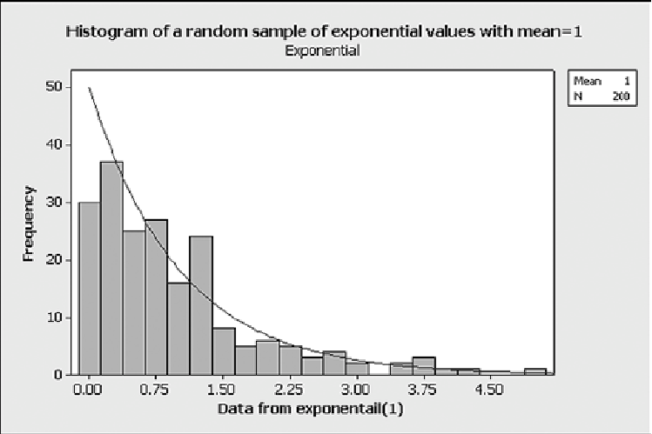
A library we will use: TRNG
TRNG (Tina’s random number generator library)
https://www.numbercrunch.de/trng/
Has several different ways of generating numbers, including LCM, LFSR and YARN
Using either leap-frogging or block splitting
C++
Has many different distributions of the numbers, e.g.
‘bins’ :
Shows how many values generated in that range of numbers
uniform
normal
poisson
exponential

Slide 26
Activity: practice random
Note sequential versions that use this same trng library
Note the code is C++
study makefiles
study code looking for C++ features

