Slide 1
GPU Computing with CUDA
COMP 445

Slide 2
GPU: Massive fine-grain data parallelism
CPU
GP-GPU
A relatively small amount of very fast, complex cores
Individual and shared cache and large main memory
Programming model is to split out many data elements per core
Thousands of simpler cores
Different memory layout
Different architecture
Programming model is one thread in one core works on one data element

Slide 3


Slide 4
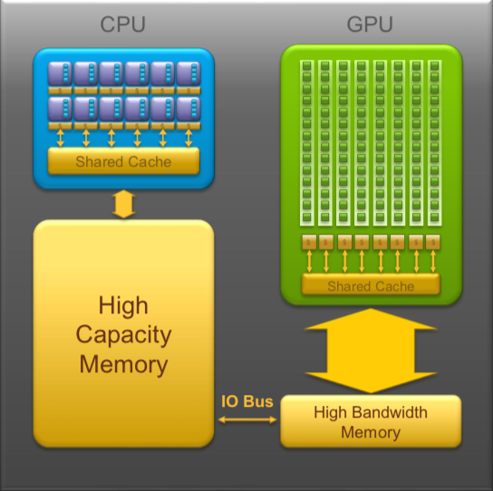
CPU memory is larger, GPU memory has more bandwidth
CPU and GPU memory are separate, connected by an I/O bus (traditionally PCI-e)
Any data transferred between the CPU and GPU will be handled by the I/O Bus
The I/O Bus is relatively slow compared to memory bandwidth
The GPU cannot perform computation until the data is within its memory
Host
Device
Data must be transferred to/from the host memory
Kernel function runs on the device after data transfer

Slide 5
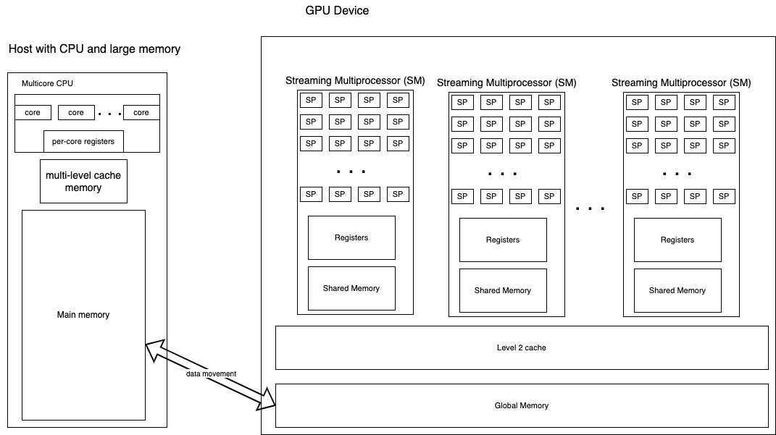
Different Architectures & Nomenclature
Streaming processor, or core

Slide 6
Different Architectures & Nomenclature
32 cores/SPs per SM
Each core running code gets registers
Some cores/SPs are for special calculations
SIMD (single instruction, multiple data):
When running instructions of a program, each SP in one SM is executing the same instruction
Warp scheduler: runs the code on an SM

Slide 7
CUDA Programmming
Normally we will have large arrays of data
They can be managed in two ways:
Programmer manages (not used any more on newer cards):
allocate memory on host and device,
copy data to device,
Compute on device,
copy data back to host
Programmer specifies “unified memory”
Allocate once as memory that will reside on device and host
Compute on device

Slide 8
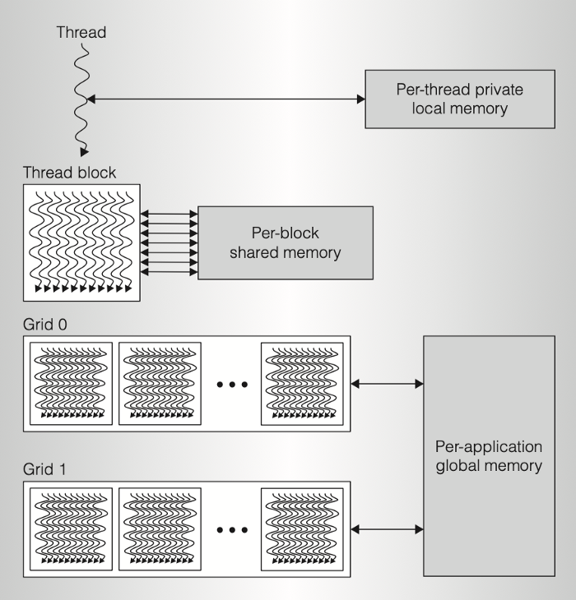
Programming Model
NVIDIA compiler:
CUDA
CUDA:
Programmer defines sizes:
Blocks per grid
Threads per block
Dimensions
Simplest version:
1D blocks of threads
inside
1D grid of blocks
2D and 3D are possible
Taken from this blog post

Slide 9
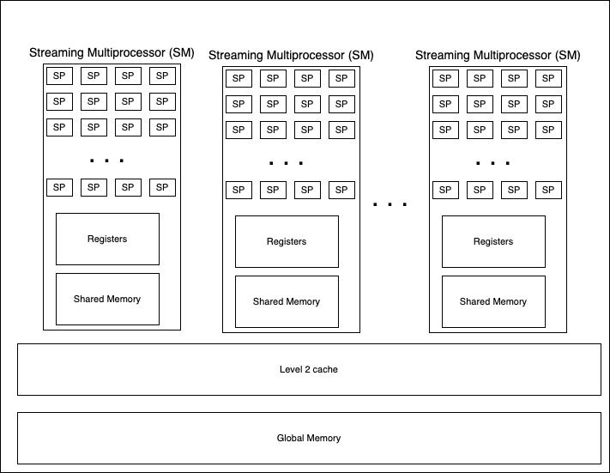
NVIDIA Architecture
Programming model of threads is somewhat related to this

Slide 10
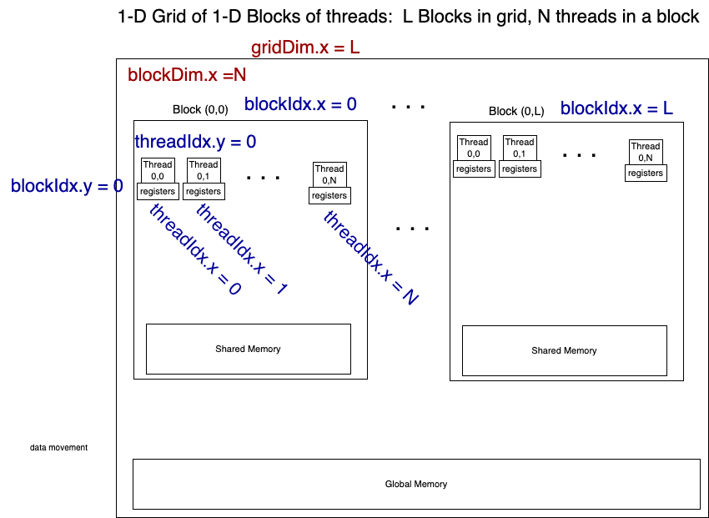
CUDA Programming Model
z
x
y
Programmer accessible per-thread values:
Overall dimensions:
gridDim.x (y, z)
blockDin.x (y, z)
Indexes of the block a thread is in:
blockIdx.x. (y,z)
Indexes of the position of the thread in a block:
threadIdx.x (y, z)
From these, a unique overall thread id can be calculated

Slide 11
CUDA Programming Model
z
x
y
Programmer accessible per-thread values:
Overall dimensions:
gridDim.x (y, z)
blockDin.x (y, z)
Blocks per grid
Threads per block
Indexes of the block a thread is in:
blockIdx.x. (y,z)
Indexes of the position of the thread in a block:
threadIdx.x (y, z)
Programmer determines unique thread id from 0 to (N x L)-1 like this: ((my block index in the x direction) * (number of threads in a block)) + my thread index in the block I'm in threadNumber = (blockIdx.x * blockDim.x) + threadIdx.x

Slide 12
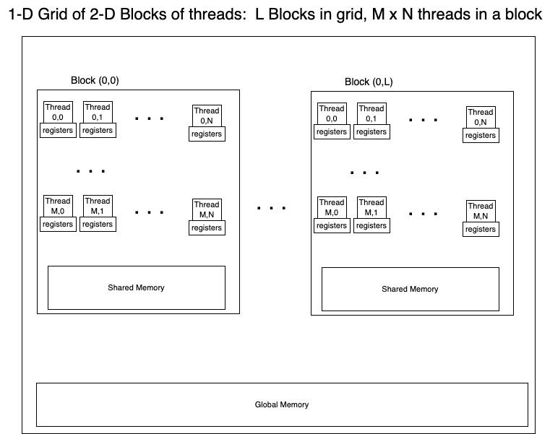
z
x
y

Slide 13
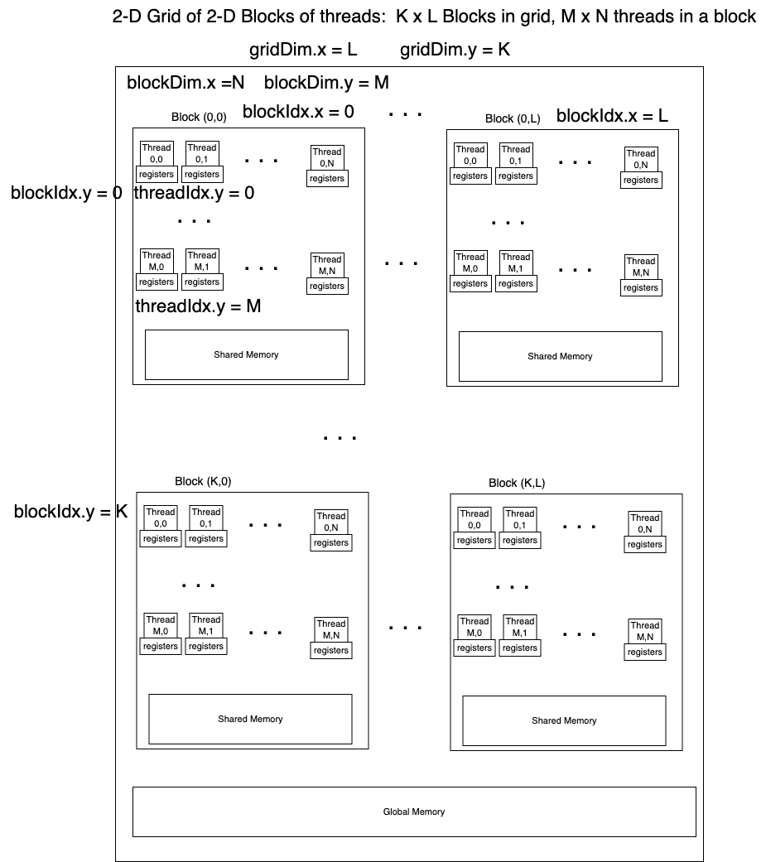
z
x
y

Slide 14
NVIDIA Architecture
This hasn’t changed:
32 SPs/cores per SM
Programming model of threads is somewhat related to this:
It’s best to have block sizes that are a multiple of 32
Each block specified maps to an SM

Slide 15
CUDA Programming
Define a kernel function that will run on the device
__global__ void test1DGridKernel(int val) {
…
}
Call it by specifying how many blocks and how many threads per block (simplest case 1D grid of 1D blocks)
// 1 block of 32 threads goes to 1 SM
test1DGridKernel<<<1, 32>>>(10);

Slide 16
CUDA Programmming
Normally we will have large arrays of data
They must be managed in two ways:
Programmer manages:
allocate memory on host and device,
copy data to device,
Compute on device,
copy data back to host
Programmer specifies “unified memory”
Allocate once as memory that will reside on device and host
Compute on device

