Slide 1
A brief Introduction to multicore and GPU computing
By way of demonstration

Slide 2
Matrix Multiply Example
Basic Linear Algebra technique
Applications such as image processing, genetic analysis, and many others:
multiply matrices in order to solve systems of linear equations
It is also an important computation for deep learning using convolutional neural networks

Slide 3
Dot Product of 2 vectors
A
0 | 1 | 2 | 3
* | * | * | *
B
2 | 2 | 2 | 2
0 + | 2 + | 4 + | 6 +
= 12
tmp = 0;
for (int k = 0; k < cols; ++k) {
tmp += A[k] * B[k];
}

Slide 4
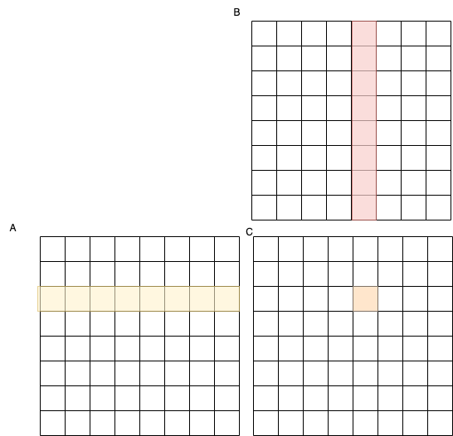
Matrix Multiply Example
2 square matrices
For A x B = C
One cell in new matrix C is dot product of row in A and column in B

Slide 5
Matrix Multiply Example
j
// function to multiply two matrices
void multiplyMatrices(float A[][],
float B[][],
float C[][],
int rows, int cols) {
// Multiplying first and second matrices and
// storing it in result C
for (int i = 0; i < rows; ++i) {
for (int j = 0; j < cols; ++j) {
for (int k = 0; k < cols; ++k) {
C[i][j] += A[i][k] * B[k][j];
}
}
}
}
i
i = 2
j = 4
When rows = cols = N, what is big-Oh of this algorithm?
O(N³)

Slide 6
Matrix Multiply Example
j
// function to multiply two matrices
void multiplyMatrices(float A[][],
float B[][],
float C[][],
int rows, int cols) {
// Multiplying first and second matrices and
// storing it in result C
for (int i = 0; i < rows; ++i) {
for (int j = 0; j < cols; ++j) {
for (int k = 0; k < cols; ++k) {
C[i][j] += A[i][k] * B[k][j];
}
}
}
}
i
i = 2
j = 4
Note when rows is doubled, run time increases by 8 (2³).
Suppose when rows = cols = 64, run time is 1 second.
What should run time be if rows = cols = 128?
O(N³)

Slide 7
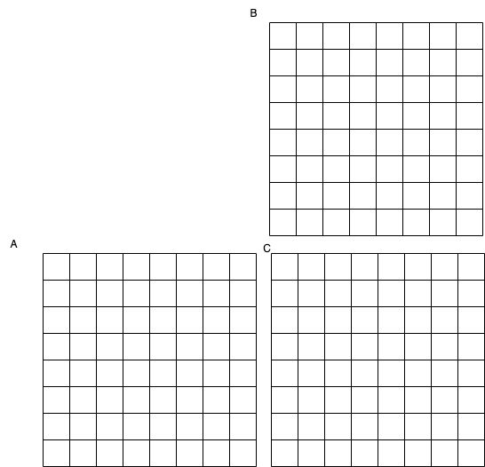
Multicore Parallelism with OpenMP
Thread
0
Thread
1
Suppose when rows = cols = 64, run time is 1 second with one thread. T_{serial}
What might the run time be if we use 2 threads? T_{p} where number of threads = 2
0.5 seconds

Slide 8
Multicore Parallelism with OpenMP
Thread
0
Thread
1

Slide 9
Multicore Parallelism with OpenMP
Thread
0
Thread
1

Slide 10
Multicore Parallelism with OpenMP
Thread
0
Thread
1

Slide 11
Sequential Matrix Multiply
Thread
0

Slide 12
Speedup
Suppose when rows = cols = 64, run time is 1 second with one thread. T_{serial}
What might the run time be if we use 2 threads? T_{p} where number of threads = 2
0.5 seconds
What might the run time be if we use 4 threads? T_{p} where number of threads = 4
0.25 seconds
Number of threads = p
Time on one thread = Serial run-time = T_{serial} = T_{s}
Parallel run-time = T_{parallel} = T_{p}
T_{parallel} = T_{serial} / p
linear speedup
Ideally, as we double the number of threads for a given rows, cols,
the time should be cut in half

Slide 13
However, there is overhead in parallel programs
Fork and Join take time. Longer when we use more threads.
If there is enough work going on in the loops on each thread, this time will be dwarfed by that work. The problem size, or number of cells in matrix in this case, must be large.
If not, we might be far from ideal speedup.
Also with more threads, there is more contention, which increases run time

Slide 14
Speedup Calculation
Speedup, S_{p} = T_{s} / T_{p}
p is number of threads used in a parallel OpenMP program
You can also think of the p subscript as saying Speedup of the parallel program
S₂ = 1 / 0.5 = 2
in the ideal ‘linear’ situation from previous code

Slide 15
Speedup and Efficiency
Speedup, S_{p} = T_{s} / T_{p}
Efficiency helps us measure the overhead
E_{p} = S_{p} / p = T_{s} / (p * T_{p})
Efficiency near 1, or 100% is ideal; usually above 75% is fairly good
p is number of threads used in a parallel OpenMP program
You can also think of the p subscript as saying Efficiency of the parallel program
S₂ = 2 / 1 in the ideal ‘linear’ situation from previous code
E₂ = S₂ / 2 = 1, or 100% in the ideal situation from previous code

Slide 16
Shared Memory Parallel Programming
Let’s observe these ideas about parallel programming by demonstrating the code:
We can get a sense of Big-Oh
Try small cases with 1 core, multiple cores to make sure no errors
Determine how scalable your code is
different problem sizes and different numbers of cores
T_{parallel} = T_{serial} / p
Ideally, as we double the number of threads, the time should be cut in half

Slide 17
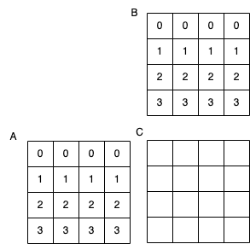
Small example that’s easy to test for accuracy
0
0
0
0
6
6
6
6
12
12
12
12
18
18
18
18

Slide 18
Small example that’s easy to test for accuracy
0
0
0
0
6
6
6
6
12
12
12
12
18
18
18
18

Slide 19
Demo

Slide 20
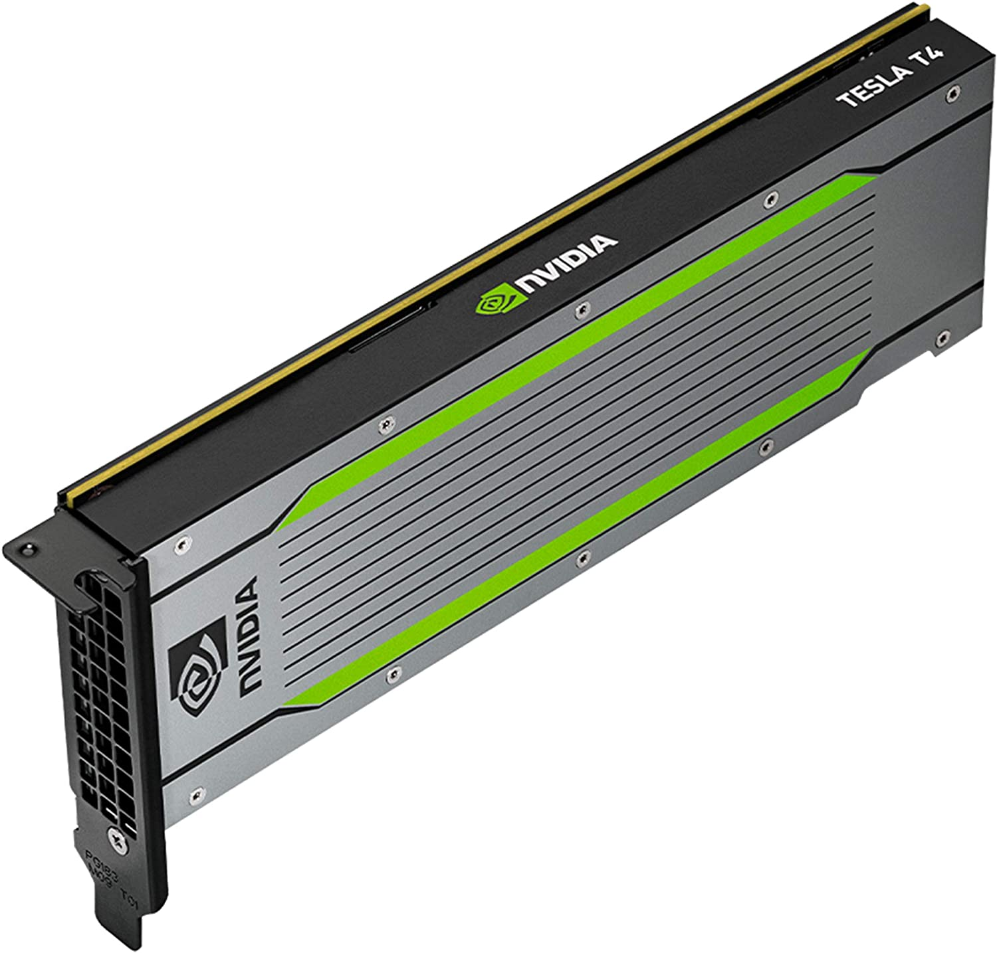
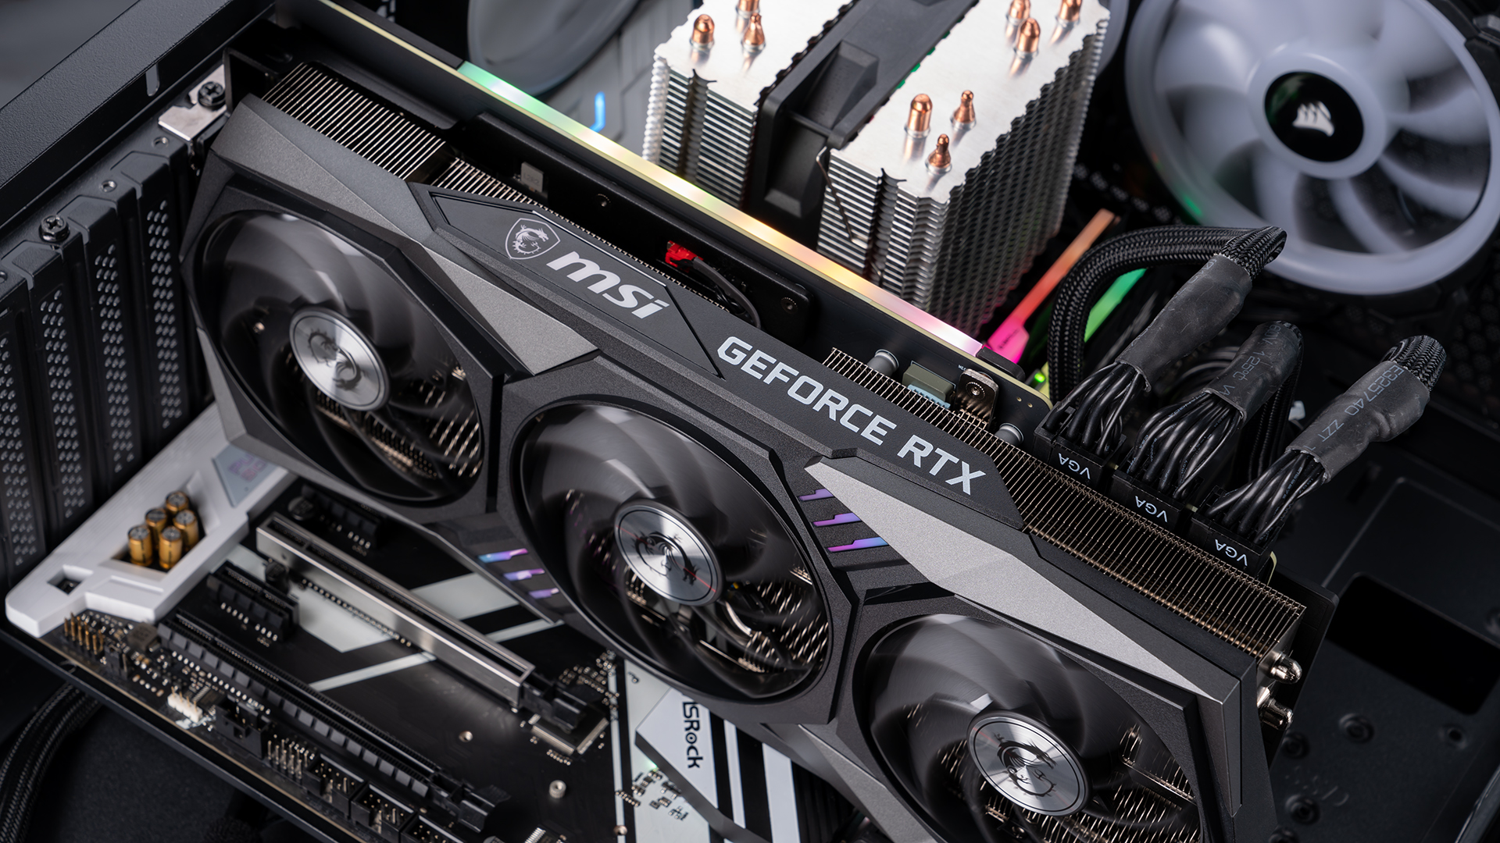
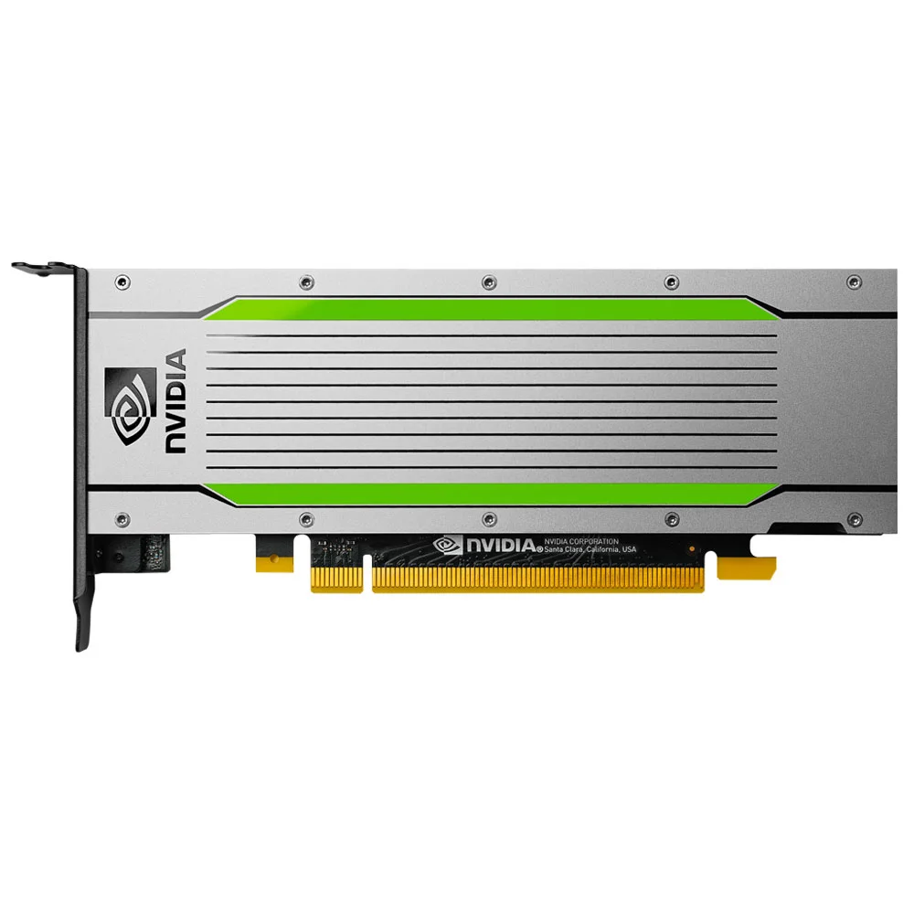
GPU Computing

Slide 21
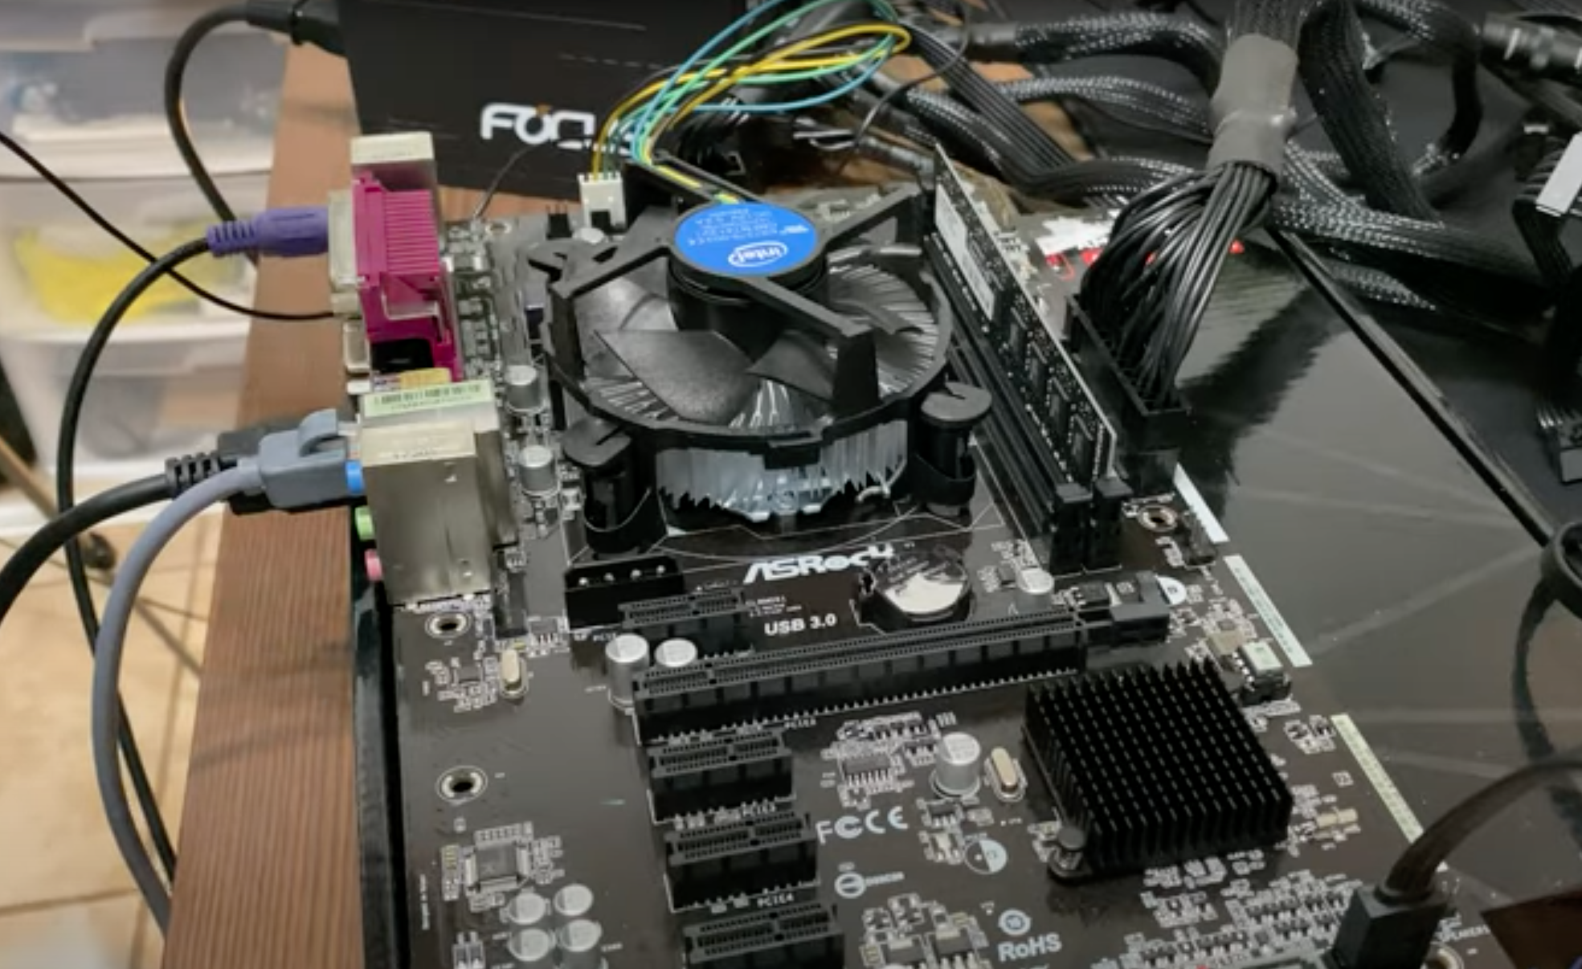
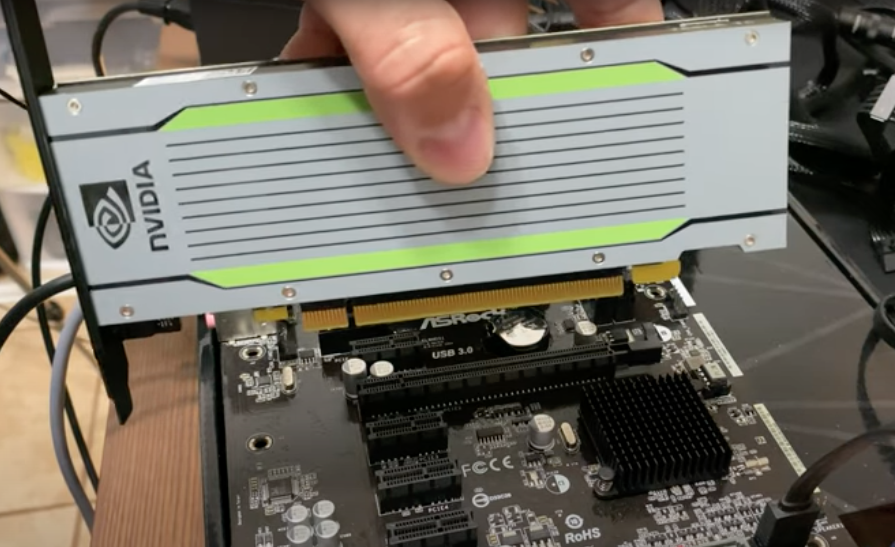
Tesla T4

Slide 22
GPU: Massive fine-grain data parallelism
CPU
GP-GPU
A relatively small amount of very fast, complex cores
Individual and shared cache and large main memory
Programming model is to split out many data elements per core
Thousands of simpler cores (slower)
Different memory layout
Different architecture
Programming model is one thread in one core works on one data element

Slide 23


Slide 24
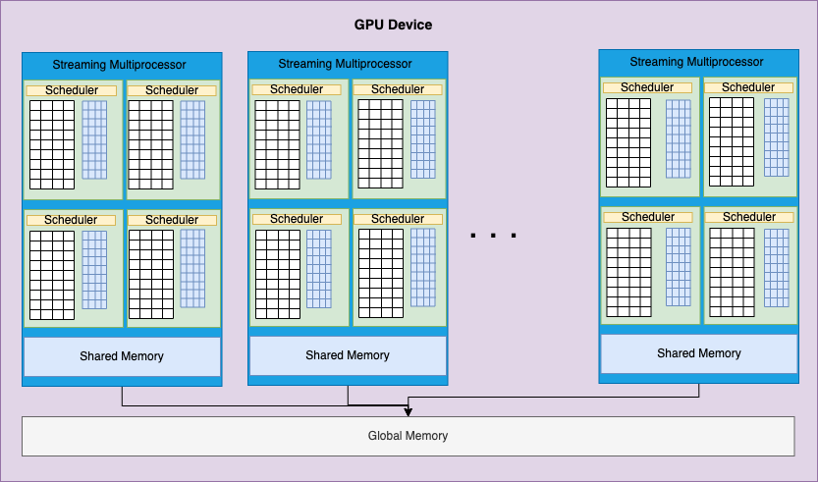
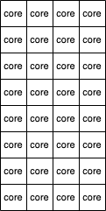
GPU Architecture, abstractly
1 SM on latest architecture has 128 cores (64 on mscs1).
Number of SMs per card can vary a lot: 16 to 128
Typically anywhere from 2048 – 16,384 cores per GPU

Slide 25
mscs1 GPU Architecture, concretely
Our mscs1 has a Tesla T4 card with:
40 Streaming multiprocessors (SM)
Cores per SM
2560 cores per GPU

Slide 26
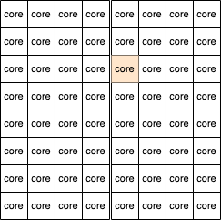
Matrix Multiply Example
// function to multiply two matrices
void multiplyMatrices(float A[][],
float B[][],
float C[][],
int rows, int cols) {
// Multiplying first and second matrices
// and storing it in result C
for (int i = 0; i < rows; ++i) {
for (int j = 0; j < cols; ++j) {
for (int k = 0; k < cols; ++k) {
C[i][j] += A[i][k] * B[k][j];
}
}
}
}
The GPU programming model is:
Every core computes one element in a thread
Scheduler assigns (hidden from programmer)

Slide 27
GPU Execution
CPU
(under heat sink)
I/O bus
(PCI-e)

Slide 28
Tesla T4 GPU
Main memory
CPU
(under fan, heat sink)
I/O bus
(PCI-e)

Slide 29
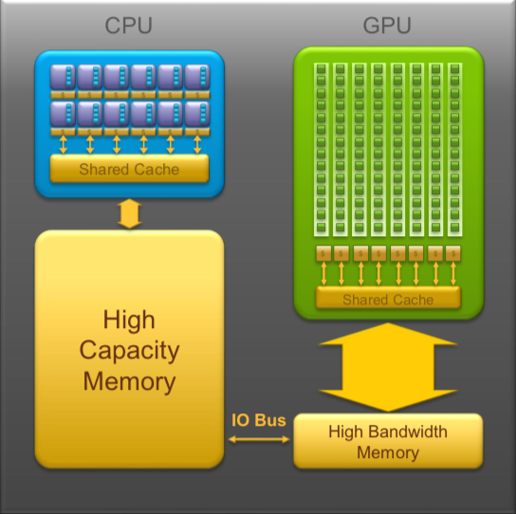
CPU memory is larger, GPU memory has more bandwidth
CPU and GPU memory are separate, connected by an I/O bus (traditionally PCI-e)
Any data transferred between the CPU and GPU will be handled by the I/O Bus
The I/O Bus is relatively slow compared to memory bandwidth
The GPU cannot perform computation until the data is within its memory
Host
Device
Data must be transferred to/from the host memory
Kernel function runs on the device after data transfer

Slide 30
// function to multiply two matrices
void multiplyMatrices(float A[][],
float B[][],
float C[][],
int rows, int cols) {
// Multiplying first and second matrices
// and storing it in result C
for (int i = 0; i < rows; ++i) {
for (int j = 0; j < cols; ++j) {
for (int k = 0; k < cols; ++k) {
C[i][j] += A[i][k] * B[k][j];
}
}
}
}
Message:
Only worth doing if matrices are large
Host
Device
A, B Data must be transferred to the device memory
Kernel function runs on the device after data transfer
C Data must be transferred back to the host memory

Slide 31
Demonstration
How big and how fast can we go?

Slide 32
The End

Slide 33
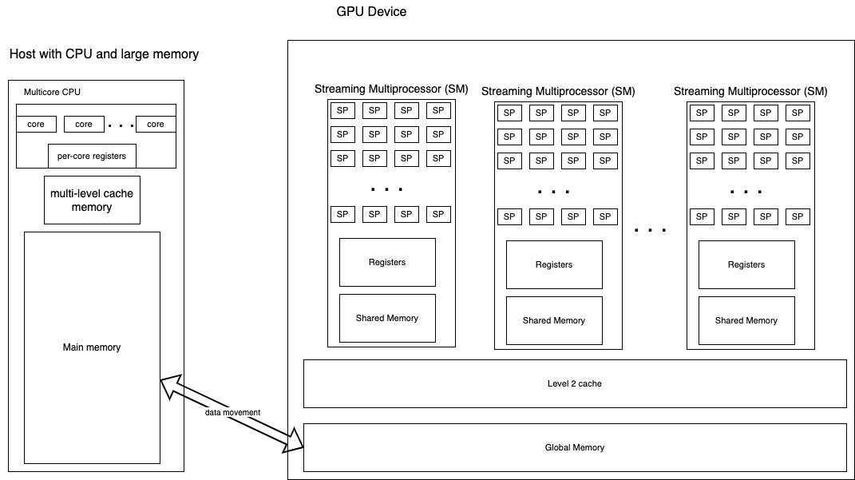
Different Architectures & Nomenclature
Streaming processor, or core

Slide 34
Different Architectures & Nomenclature
32 cores/SPs per SM
Each core running code gets registers
Some cores/SPs are for special calculations
SIMD (single instruction, multiple data):
When running instructions of a program, each SP in one SM is executing the same instruction
Warp scheduler: runs the code on an SM

Slide 35
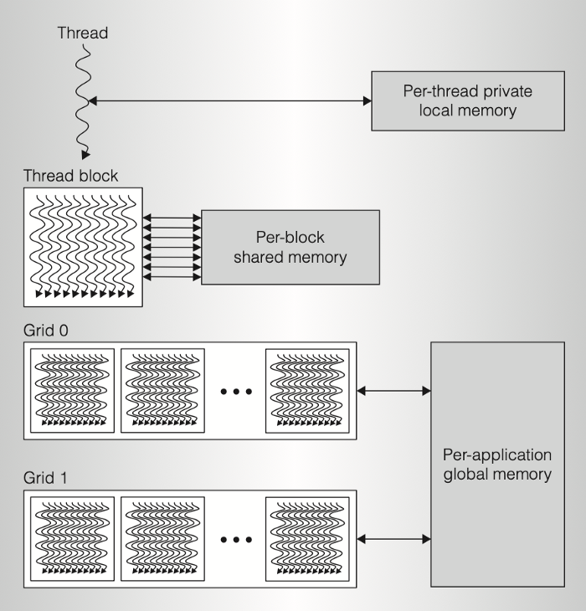
Programming Model
NVIDIA compiler:
CUDA
CUDA:
Programmer defines sizes:
Blocks per grid
Threads per block
Dimensions
Simplest version:
1D blocks of threads
inside
1D grid of blocks
2D and 3D are possible
Taken from this blog post

Slide 36
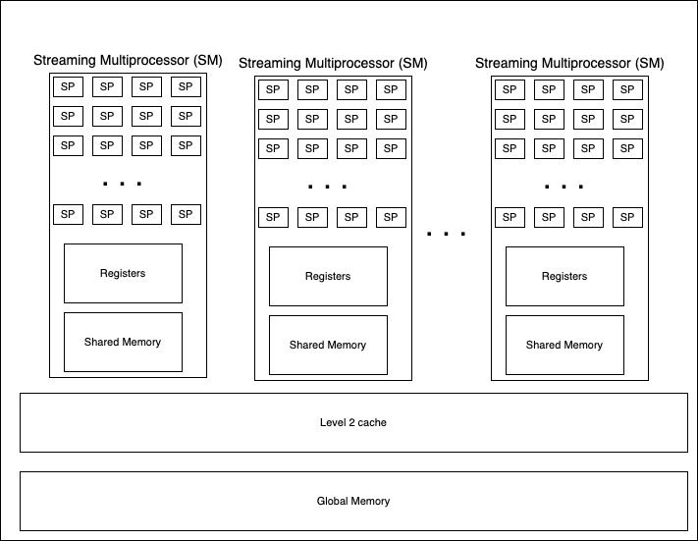
NVIDIA Architecture
Programming model of threads is somewhat related to this

Slide 37
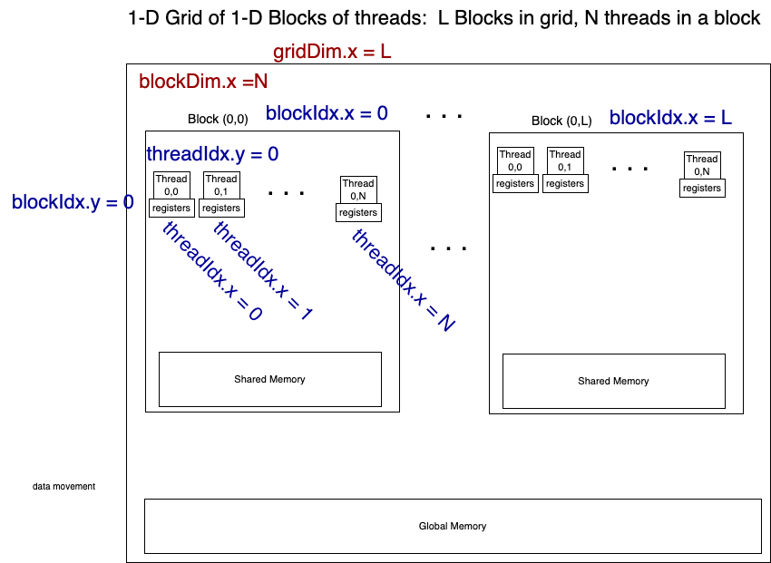
CUDA Programming Model
z
x
y
Programmer accessible per-thread values:
Overall dimensions:
gridDim.x (y, z)
blockDin.x (y, z)
Indexes of the block a thread is in:
blockIdx.x. (y,z)
Indexes of the position of the thread in a block:
threadIdx.x (y, z)
From these, a unique overall thread id can be calculated

Slide 38
CUDA Programming Model
z
x
y
Programmer accessible per-thread values:
Overall dimensions:
gridDim.x (y, z)
blockDin.x (y, z)
Blocks per grid
Threads per block
Indexes of the block a thread is in:
blockIdx.x. (y,z)
Indexes of the position of the thread in a block:
threadIdx.x (y, z)
Programmer determines unique thread id from 0 to (N x L)-1 like this: ((my block index in the x direction) * (number of threads in a block)) + my thread index in the block I'm in threadNumber = (blockIdx.x * blockDim.x) + threadIdx.x

Slide 39
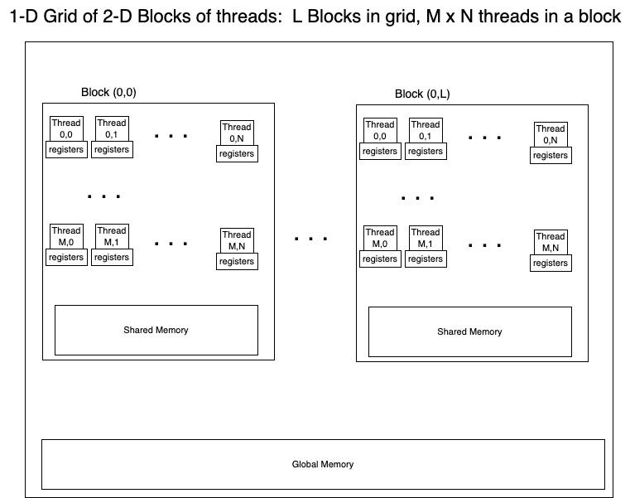
z
x
y

Slide 40
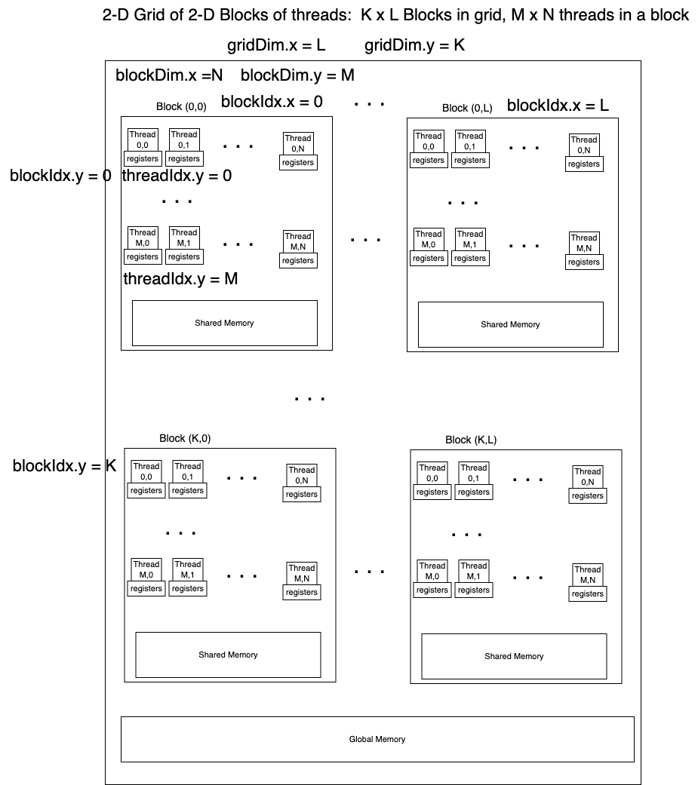
z
x
y

Slide 41
NVIDIA Architecture
This hasn’t changed:
32 SPs/cores per SM
Programming model of threads is somewhat related to this:
It’s best to have block sizes that are a multiple of 32
Each block specified maps to an SM

Slide 42
CUDA Programming
Define a kernel function that will run on the device
__global__ void test1DGridKernel(int val) {
…
}
Call it by specifying how many blocks and how many threads per block (simplest case 1D grid of 1D blocks)
// 1 block of 32 threads goes to 1 SM
test1DGridKernel<<<1, 32>>>(10);

Slide 43
CUDA Programmming
Normally we will have large arrays of data
They must be managed in two ways:
Programmer manages:
allocate memory on host and device,
copy data to device,
Compute on device,
copy data back to host
Programmer specifies “unified memory”
Allocate once as memory that will reside on device and host
Compute on device

