Slide 1
Programming with OpenACC
Using the accelerator

Slide 2
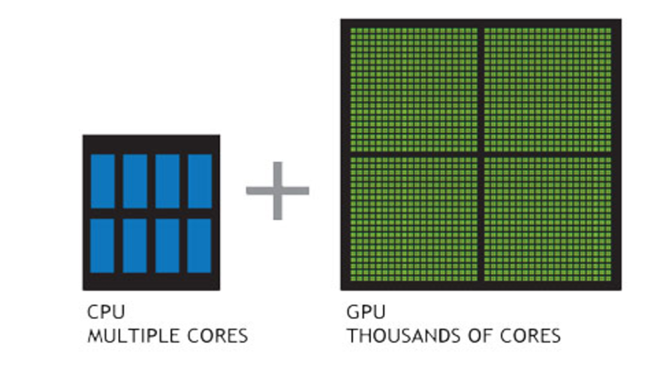
Host plus device
“host”
“device”

Slide 3
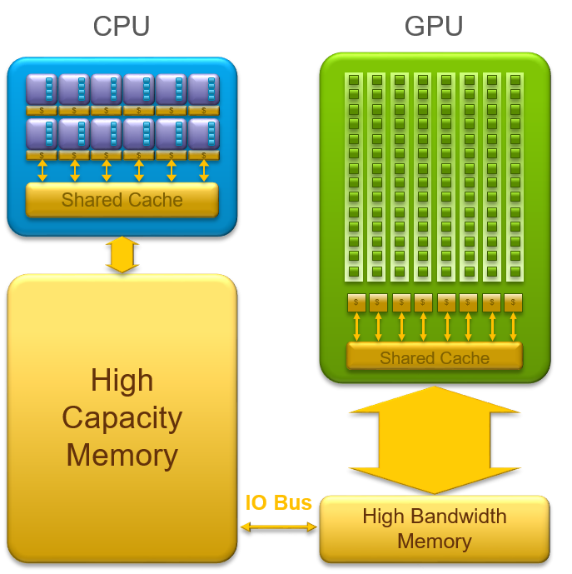
architecture schematic

Slide 4
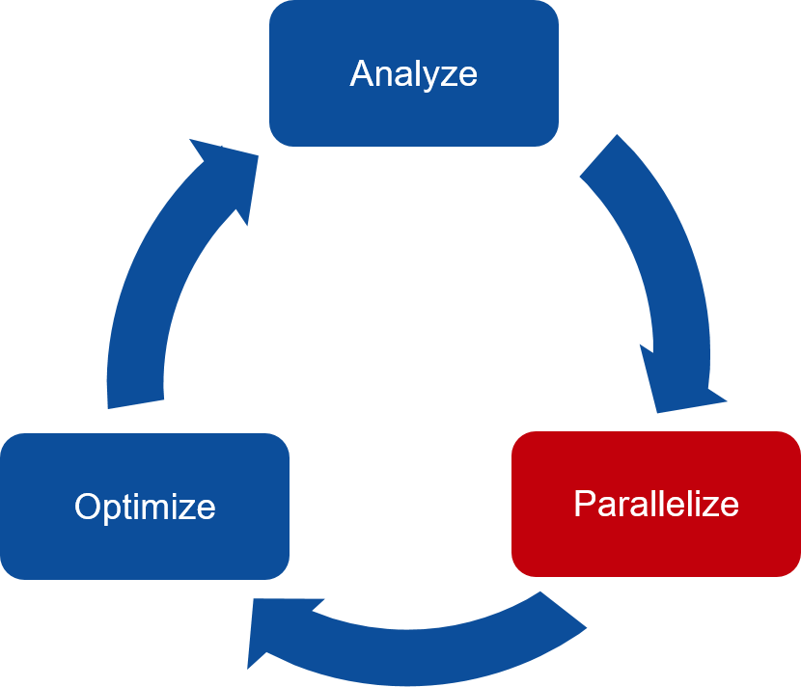
After Profiling, focus on parallelizing

Slide 5
pragmas in OpenACC: generic syntax
#pragma acc directive [clause [[,] clause]...] new-line
{
… code block
}
Some directives are also called constructs in the OpenACC reference card

Slide 6
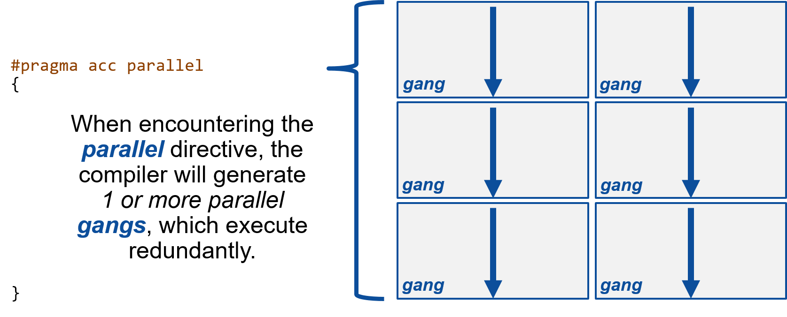
Parallel Directive

Slide 7
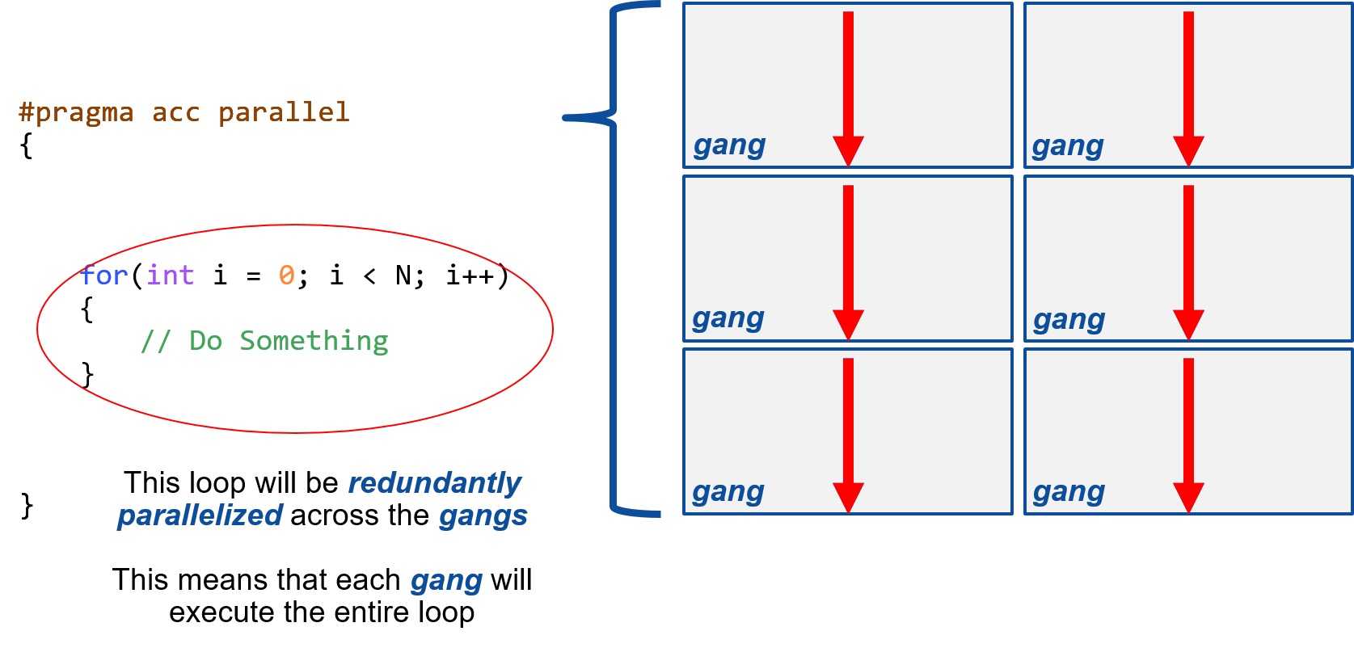
Parallel Directive

Slide 8
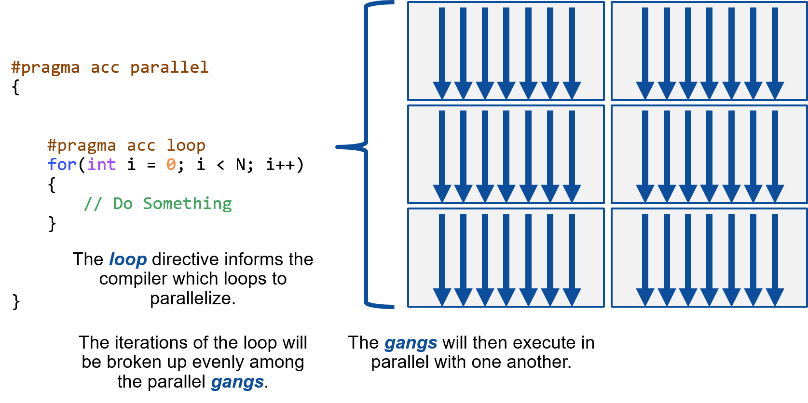
Parallel Directive

Slide 9
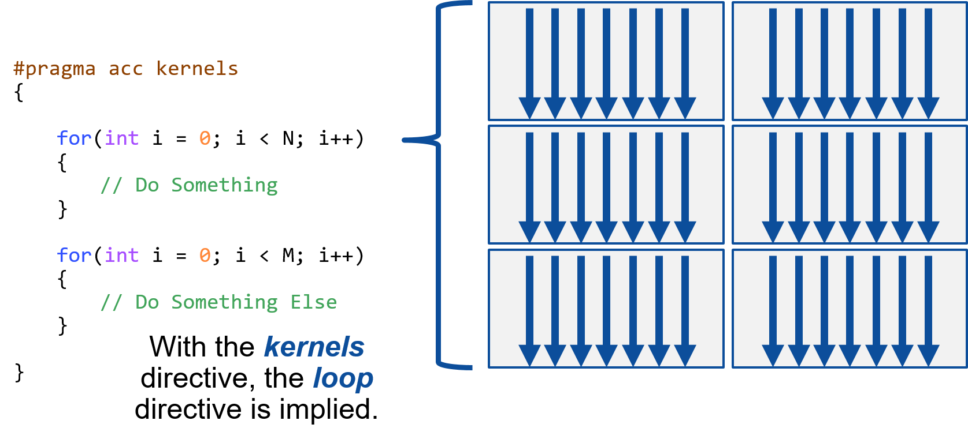
kernels directive/CONSTRUCT

Slide 10
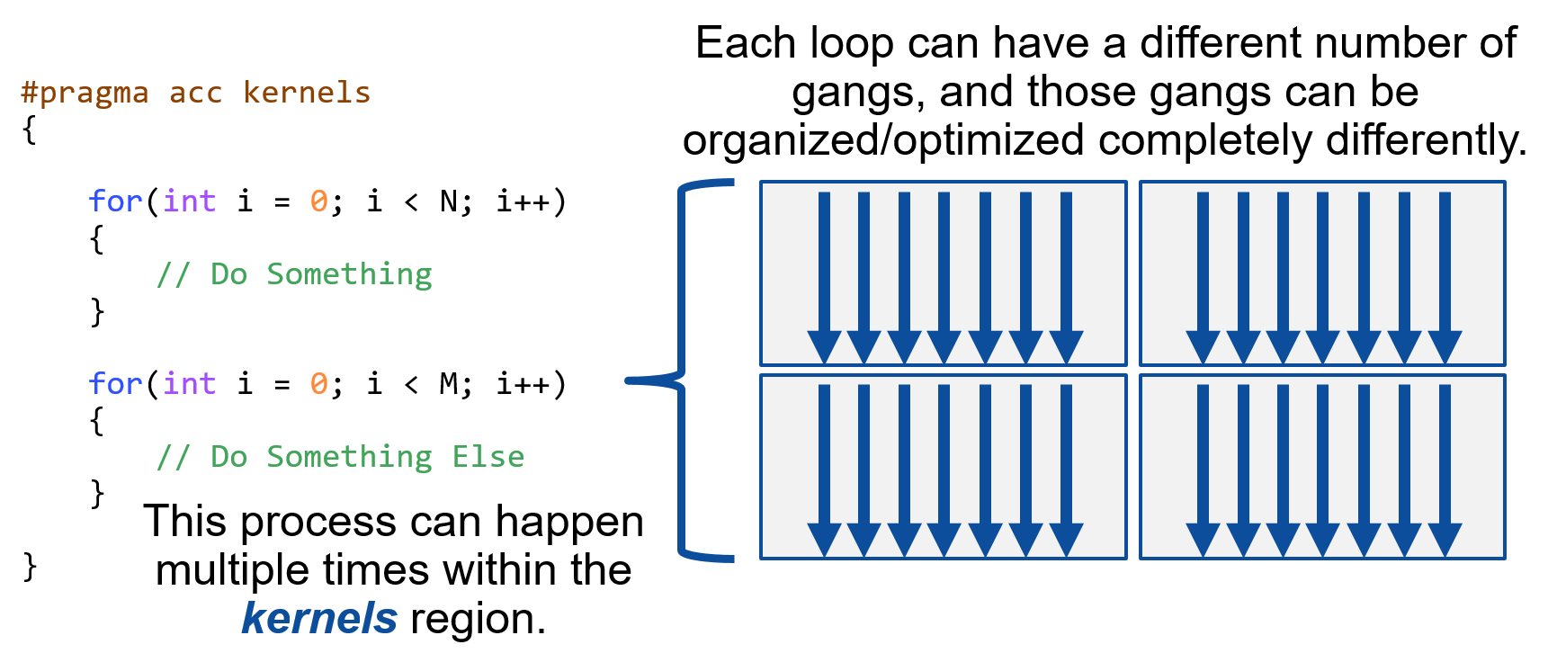
kernels directive

Slide 11
Managing Data Movement

Slide 12
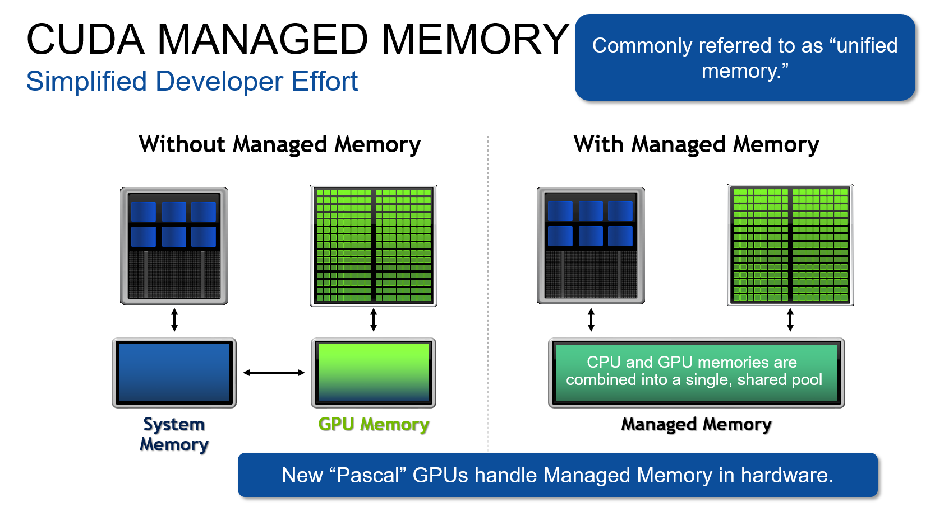
Managing memory
Our card on mscs1 has this capability

Slide 13
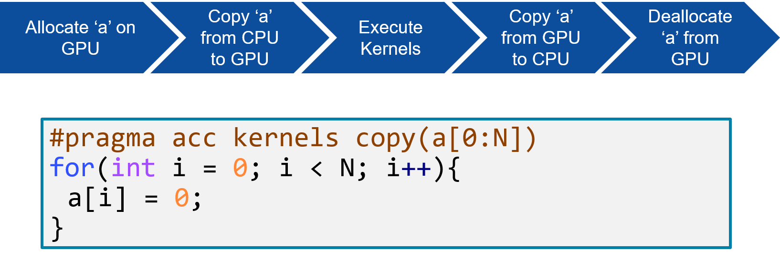
data copying

Slide 14
