Slide 1
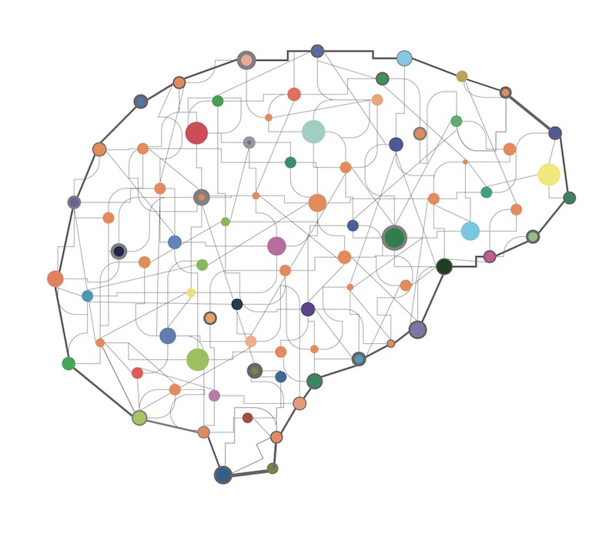
Uncovering brain connections underlying autism via graphical models
Chandan Singh

Slide 2
Connectomics: mapping the brain
Introduction
Background
Problem
Solution
Results
Conclusions
Brain’s connectivity is largely unknown
Memory, intelligence are distributed
Can study neurological disorders
Used for understanding / diagnosis
Requires big data analysis
Other connectivity problems
Gene networks

Slide 3
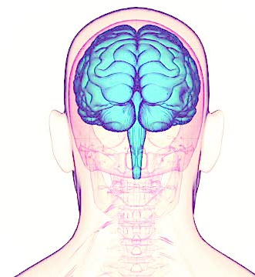
Background: data to connectome
Introduction
Background
Problem
Solution
Results
Conclusions
Inverse covariance matrix
1 | 0.25 | 0.117 | 0.34 | 0.436
0.3 | 1 | 0.89 | 0.36 | 0.46
0.6 | 0.25 | 1 | .78 | 0.2
0.37 | 0.74 | 0.02 | 1 | 0.37
0.74 | 0.85 | 0.26 | 0.64 | 1
Our Focus
Many human brains are scanned with fMRI
Resulting signals of activity
Correlations between signals
Connectome

Slide 4

The problem with correlations
Introduction
Background
Problem
Solution
Results
Conclusions
Correlations don’t find actual connections
B
A
C
Must consider all configurations
6 regions: 2⁶ = 64 possible connectomes
160 regions: 2¹⁶⁰ ≈ 10⁷⁸ possibilities
Need to impose some constraints

Slide 5
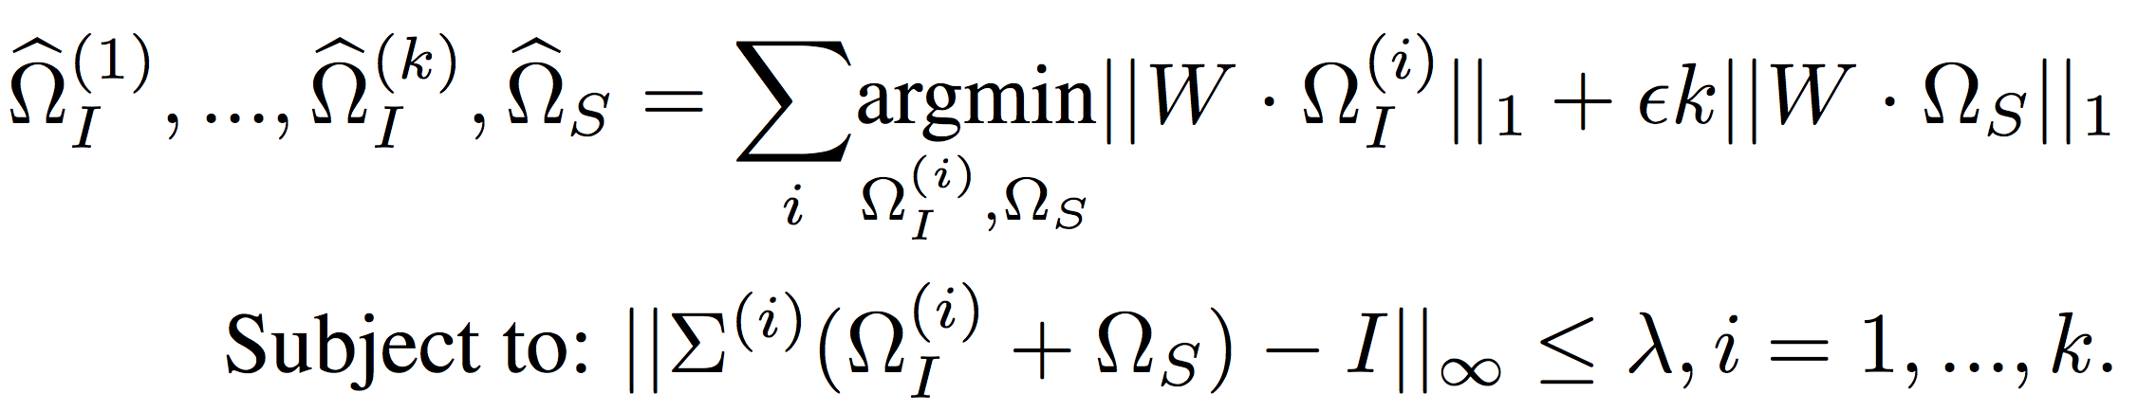
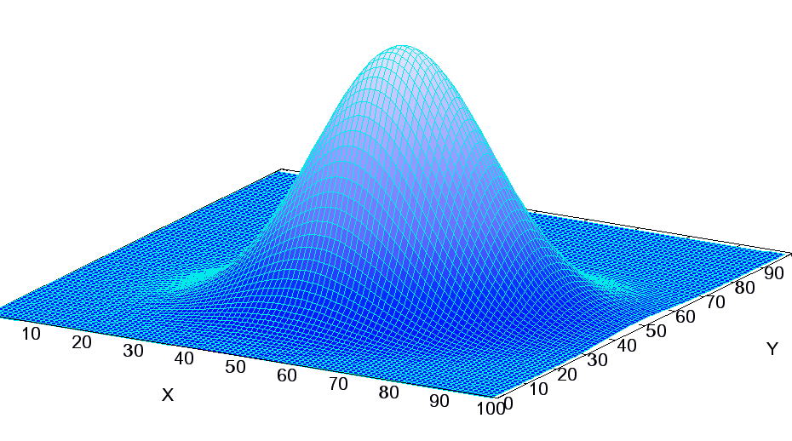
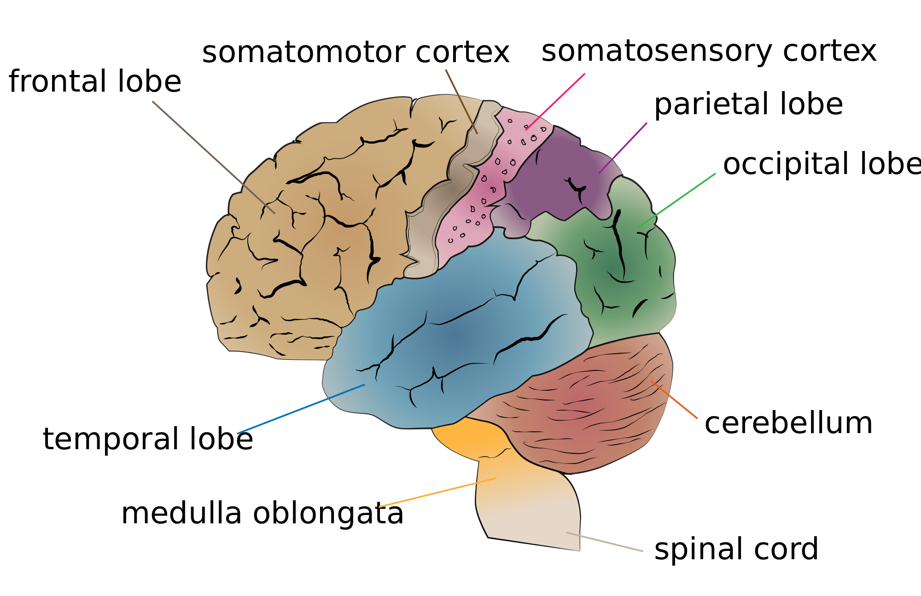
The Solution: WELM
Introduction
Background
Problem
Solution
Results
Conclusions
Nonparanormal assumption
Sparse
Imposes prior
Multi-task learning
Parallelizable
Autism
Control
Autism-specific
Potential Connectome
Shared
Control-specific

Slide 6
Results: validation
Introduction
Background
Problem
Solution
Results
Conclusions
Connection lengths decrease
Fits data we have seen
Finds differences between groups
Total Graph Sparsity (%)
Differential Graph Sparsity (%)

Slide 7
Conclusions
Introduction
Background
Problem
Solution
Results
Conclusions
Autism
Control
1. Areas differing in autism
Medial frontal cortex
Post cingulate
Post occipital
Occipital lobe
Precuneus
Difference
2. Autism group is under-connected

Slide 8
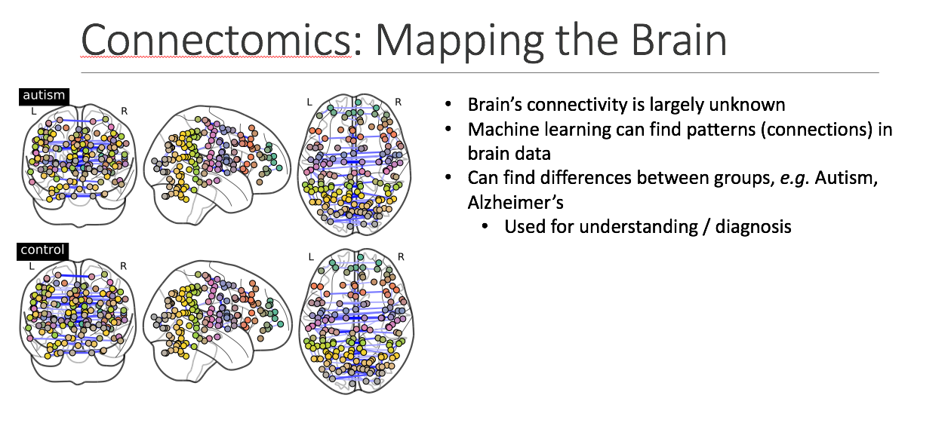
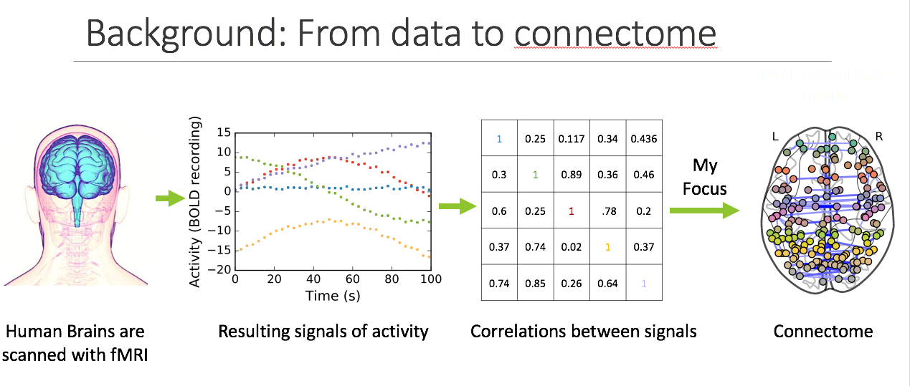
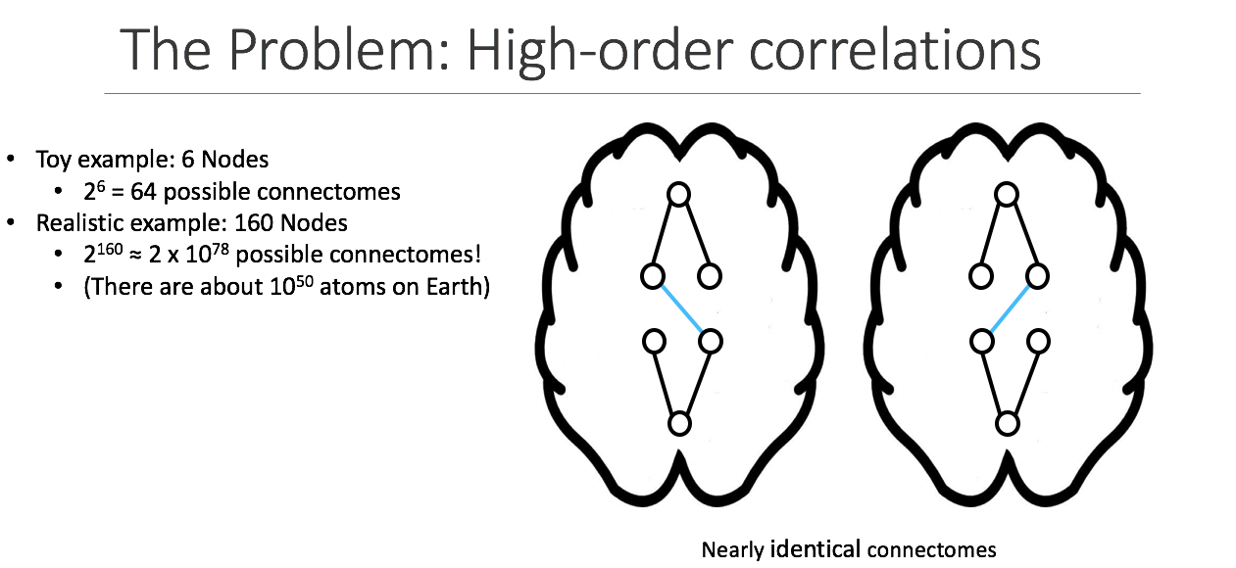
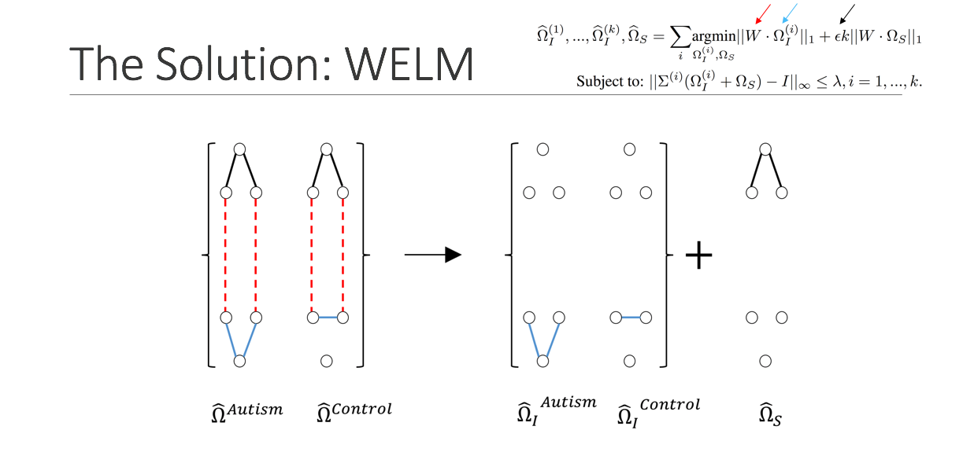
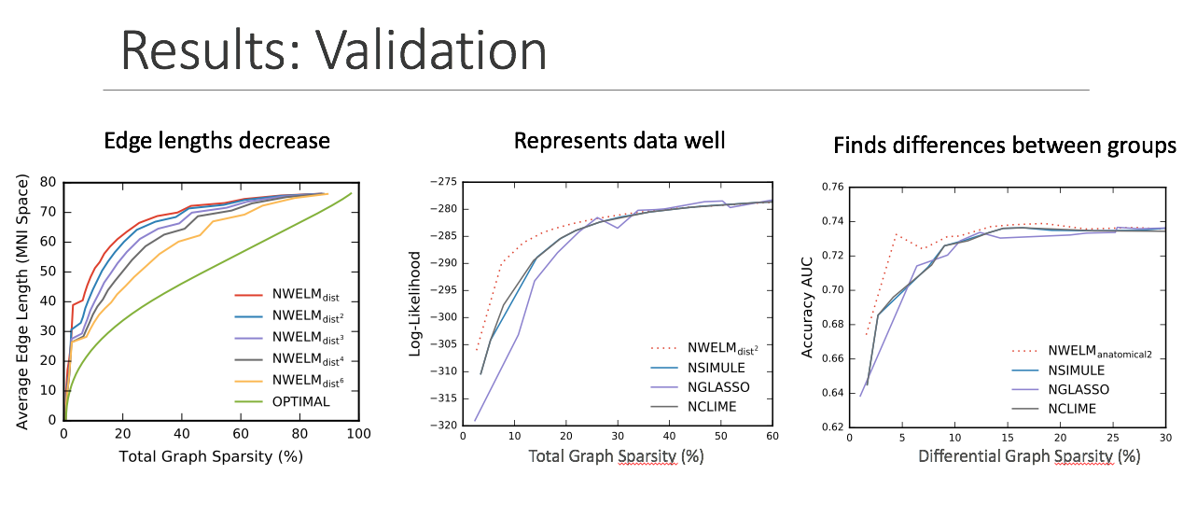
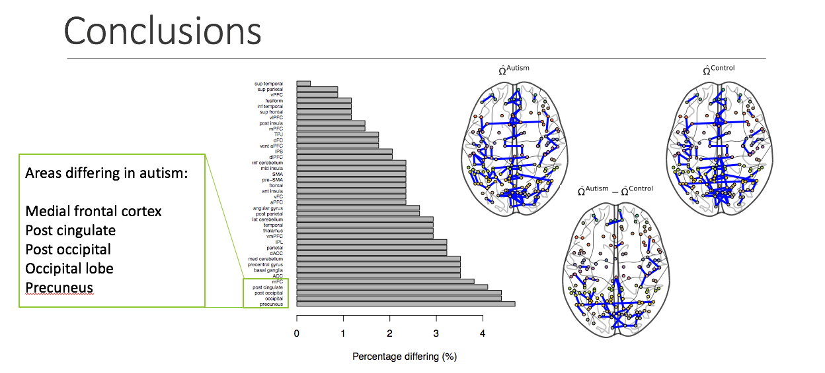
Appendix
Introduction
Background
Problem
Solution
Results
Conclusions

