Slide 1
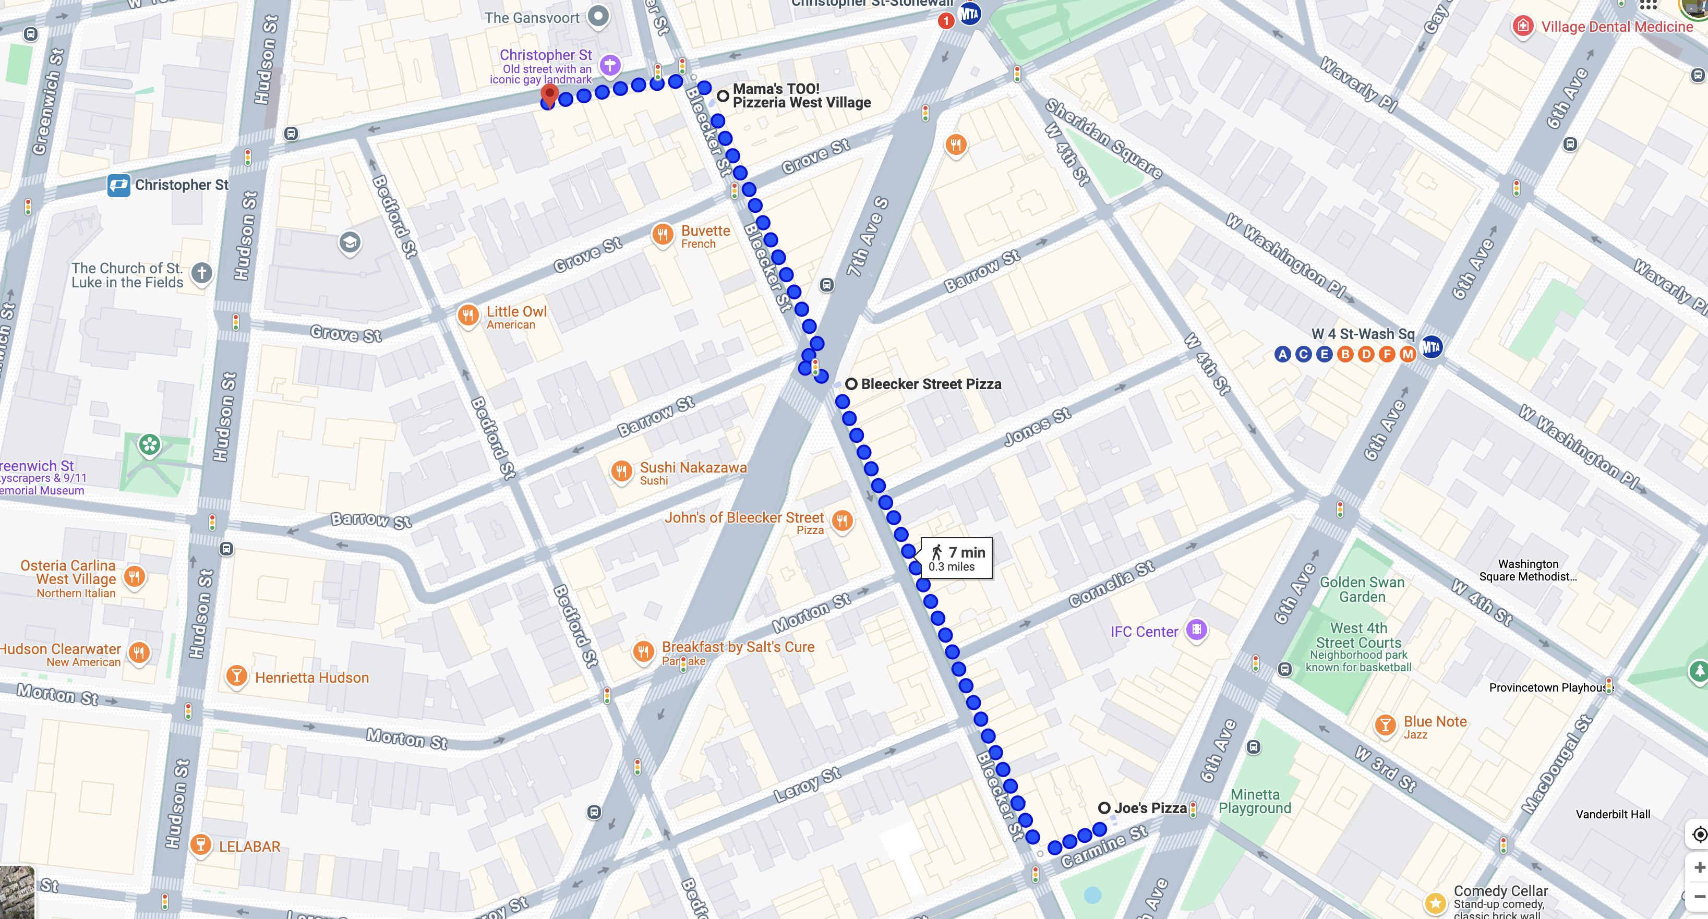
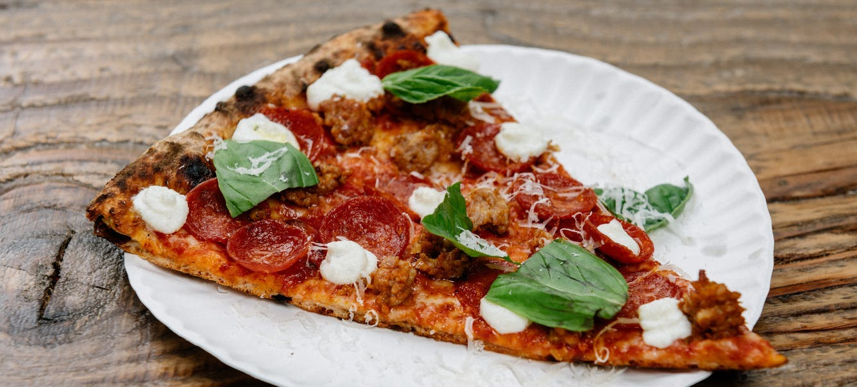
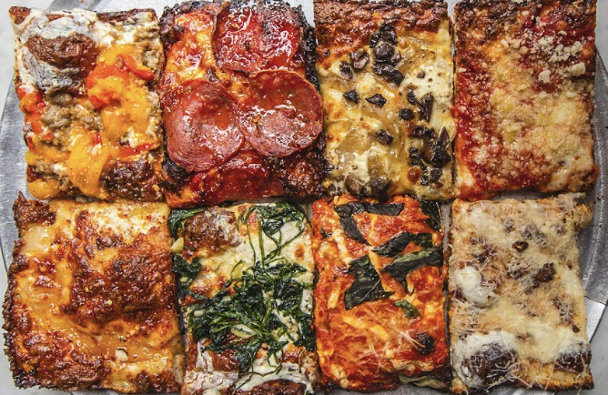
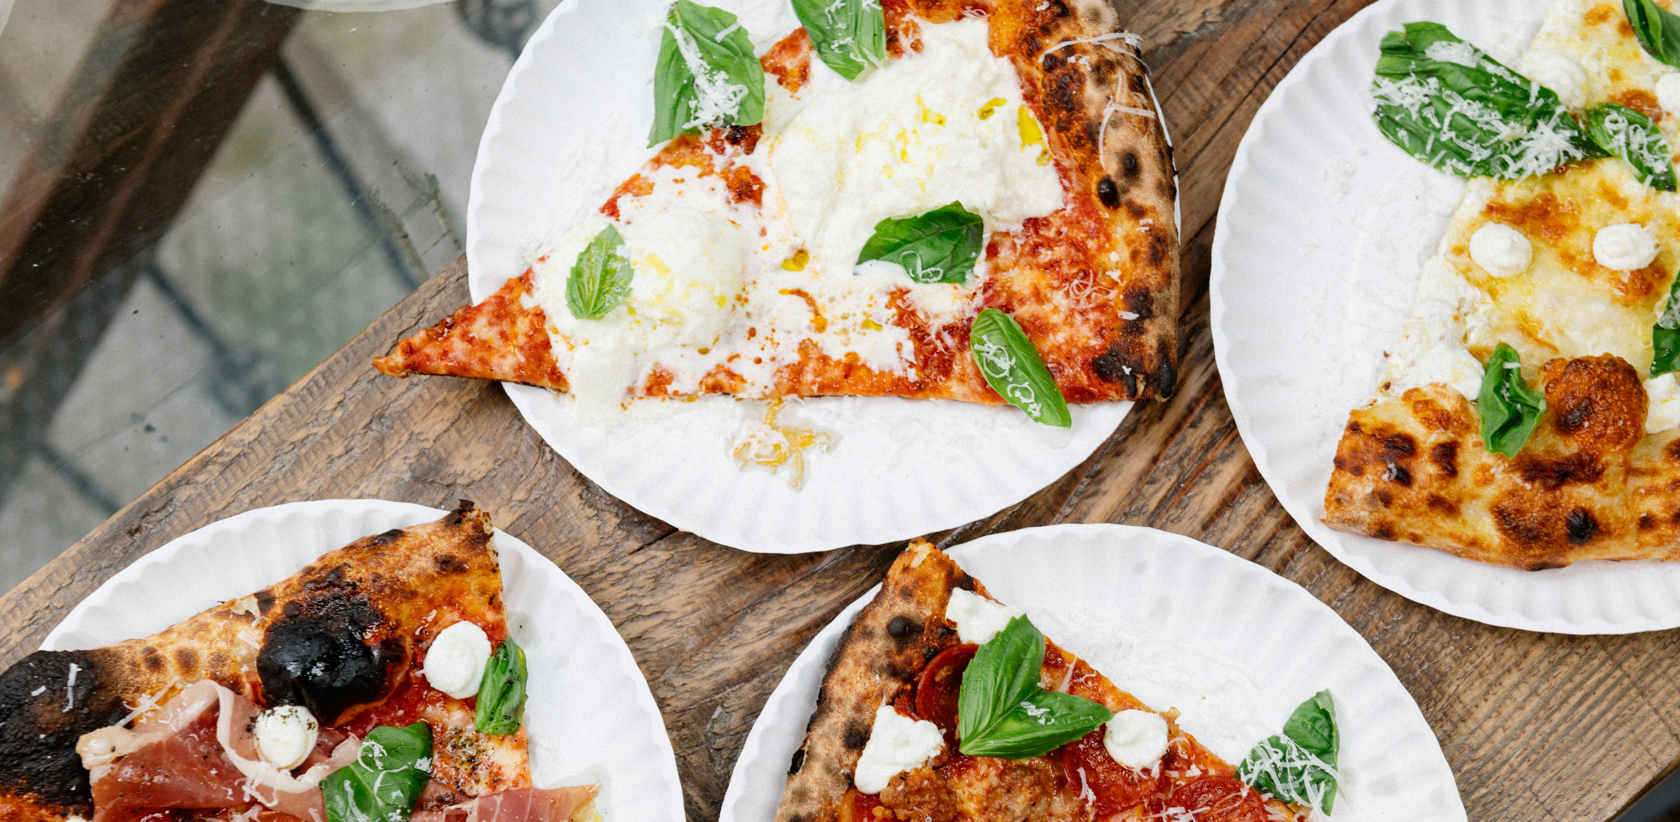
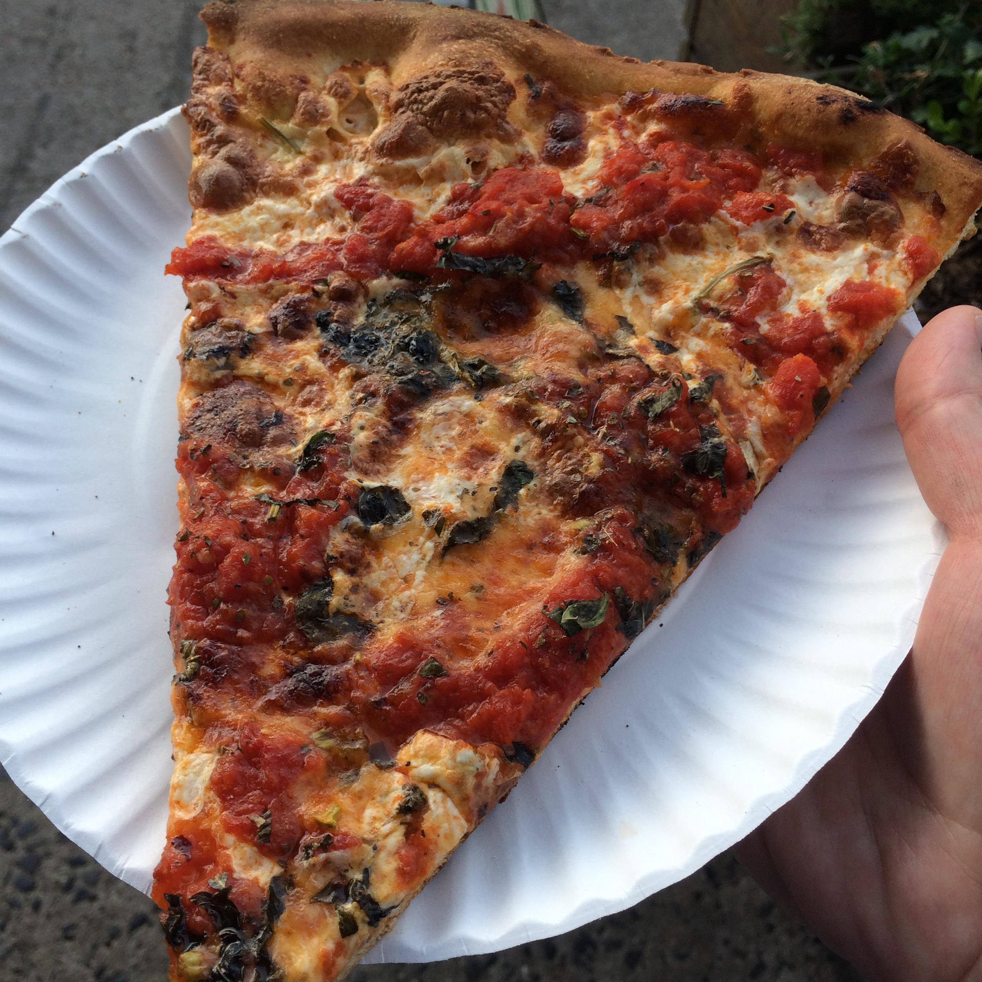
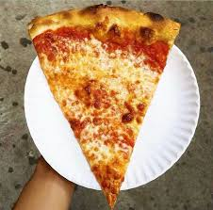
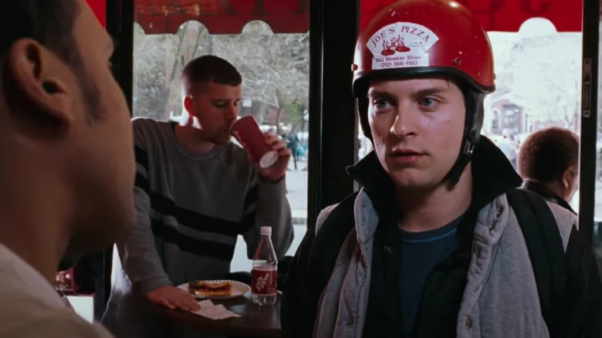
3 Mama’s too
4 L’Industrie
Very good square, dense slices with some creative toppings. Newish, 2nd location after original opened in UWS in 2017 (evolved from original Mama’s in UWS).
Excellent, very thin crust pizza. Newish, 2nd location after original opened in Williamsburg in 2017.
1 Bleecker st pizza
Classic west village slices (est 1915), Nonna Maria slice is good, nice place to hang
Bonus: Taylor’s house
She will not be here bc she claims she’ll never walk Cornelia St. again
2 Joe’s pizza [Skippable!]
Thin crisp crust, minimalist toppings for slices, cash-only. Recently popularized in movies and by “influencers” (est 1975).

