Slide 1
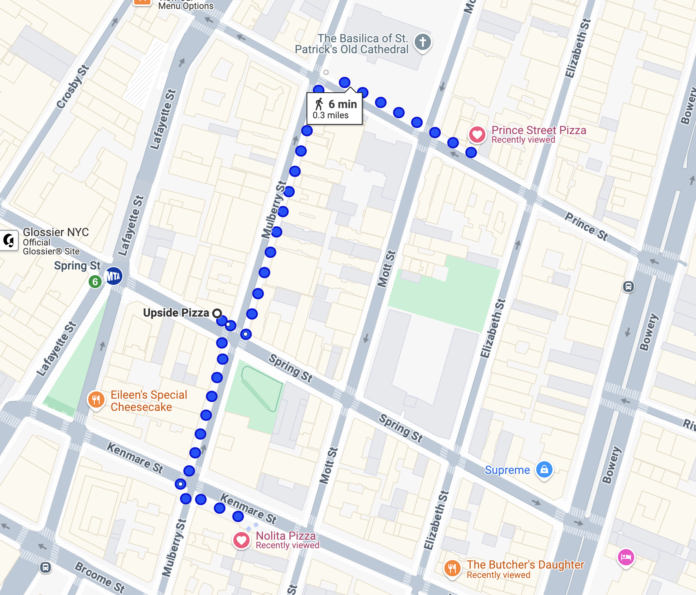
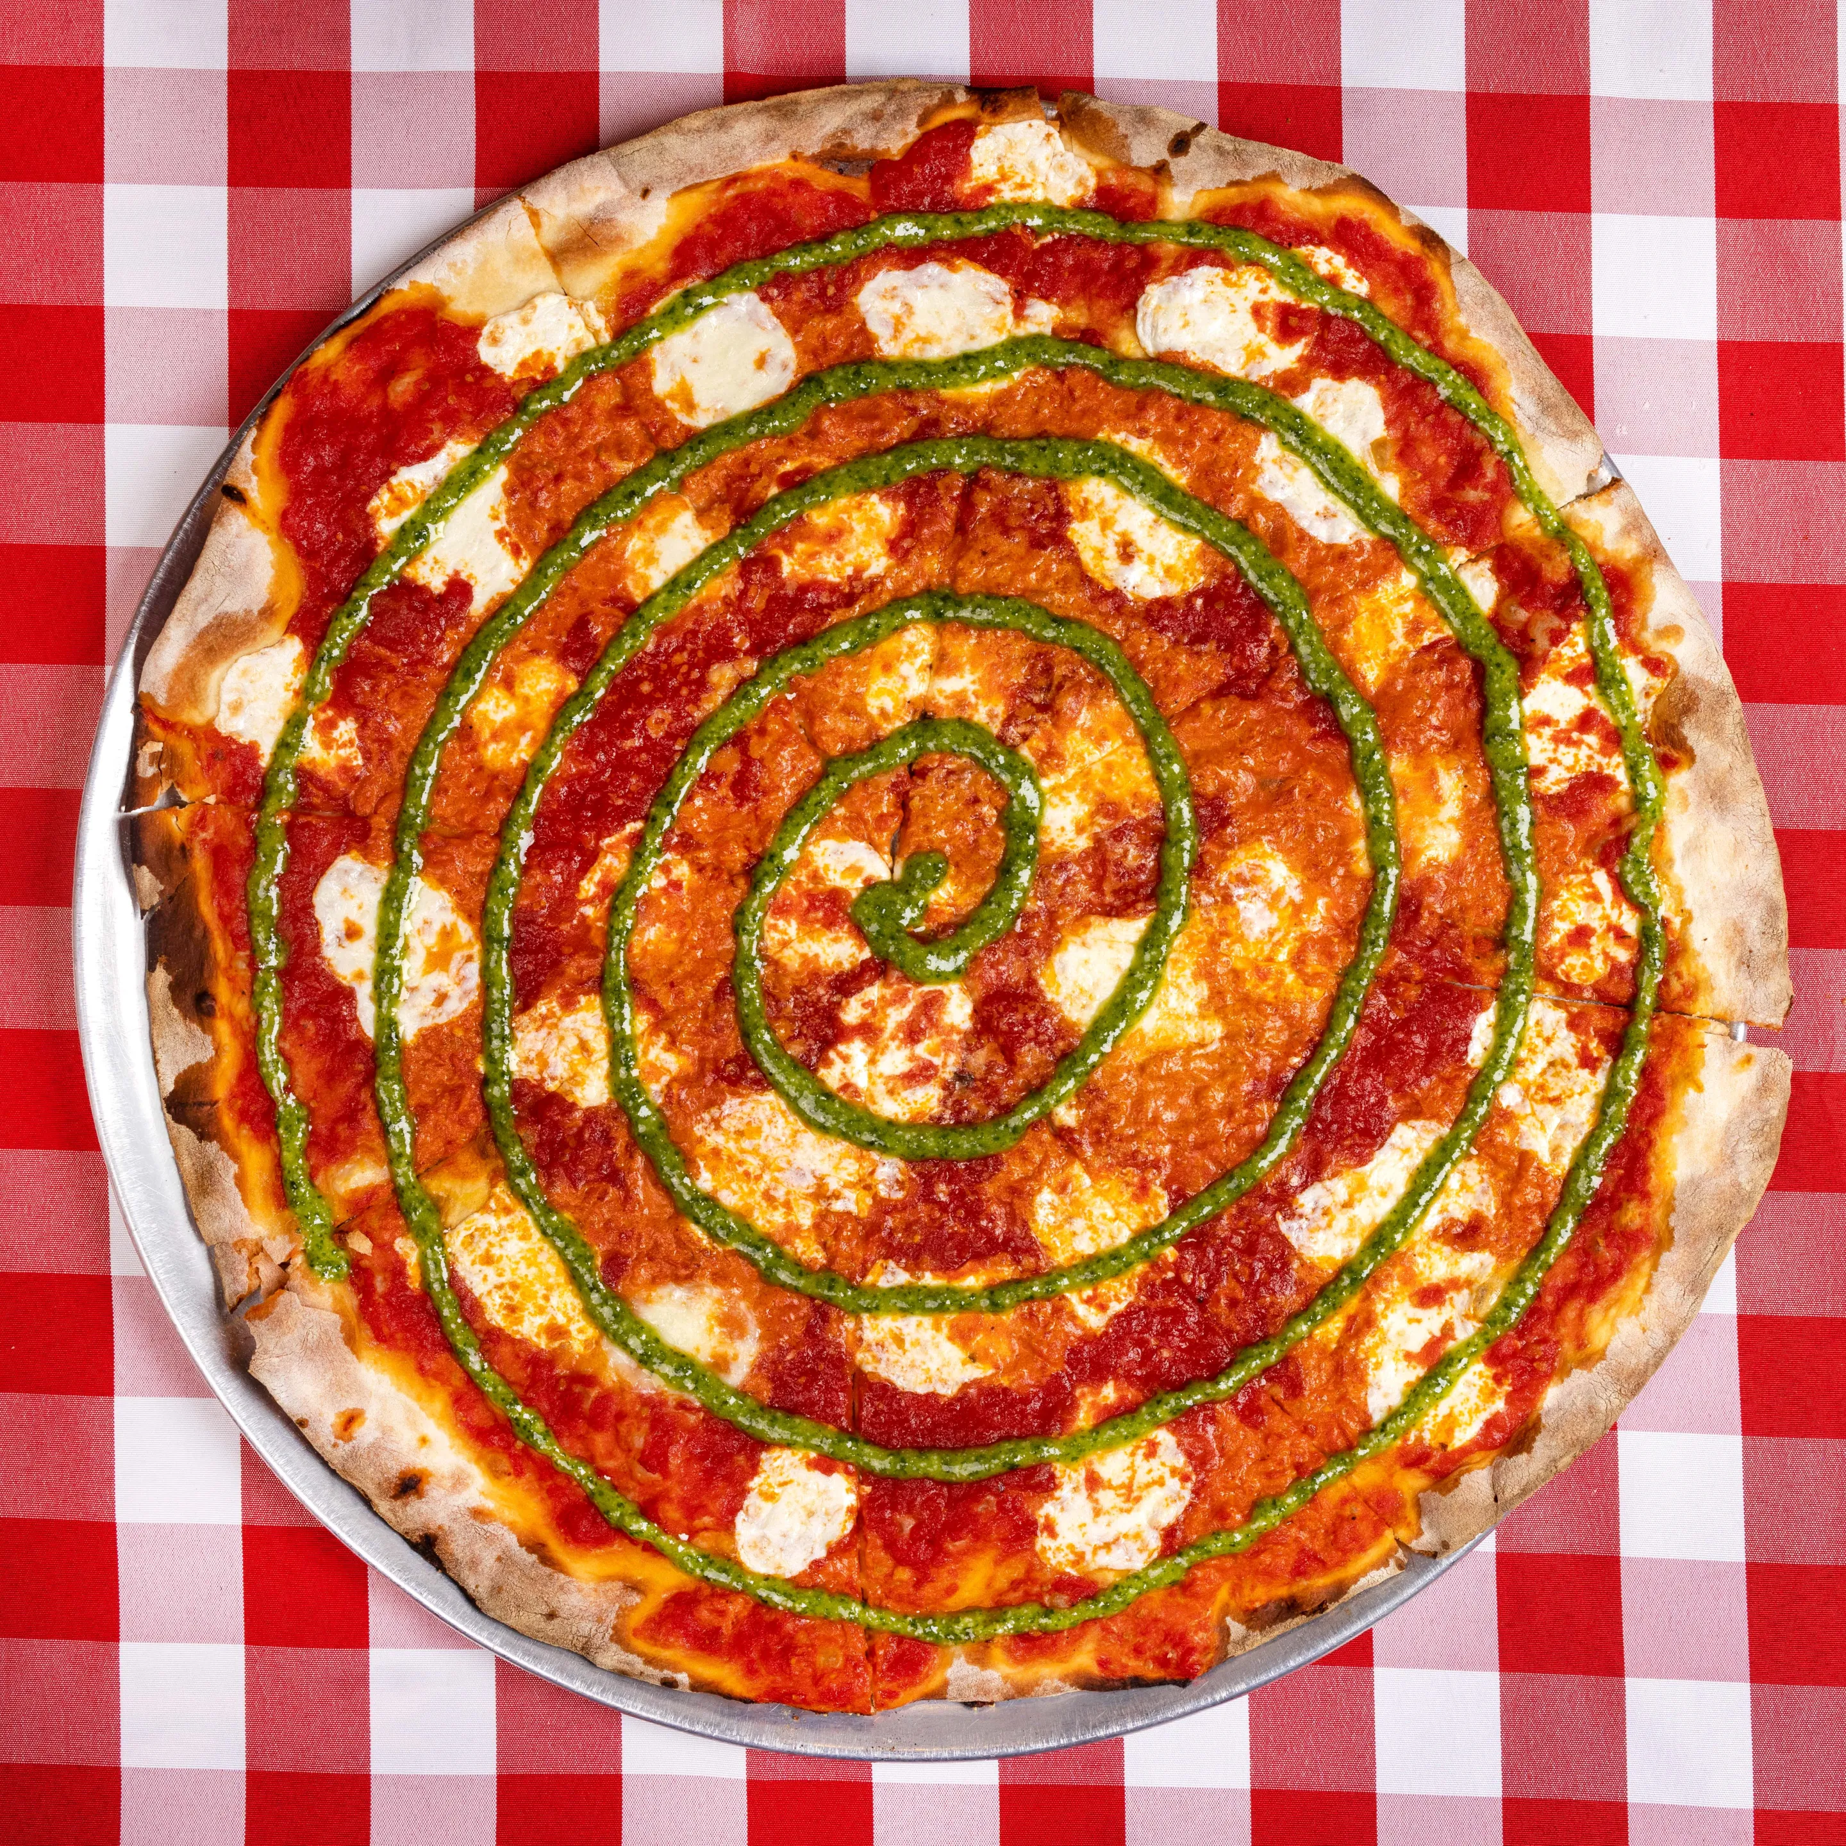

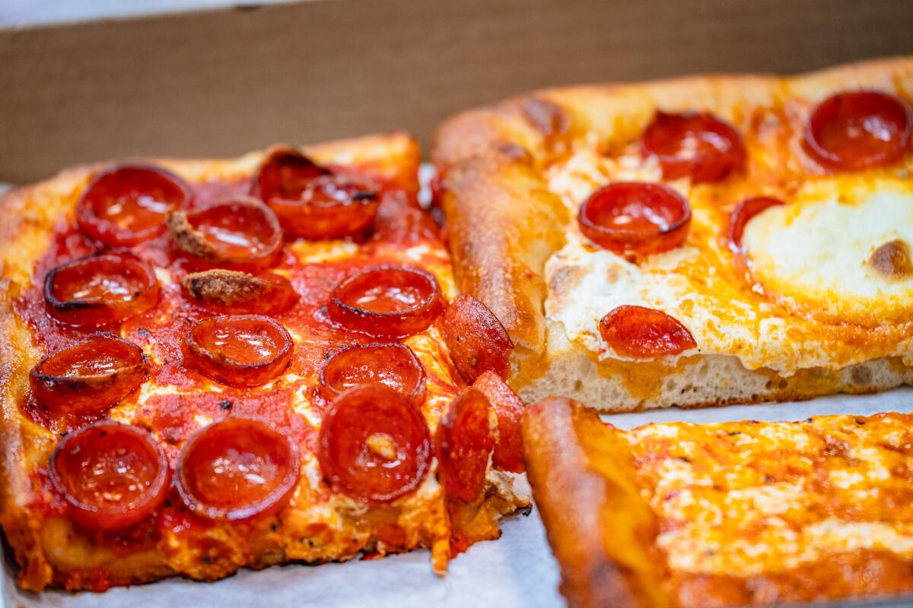
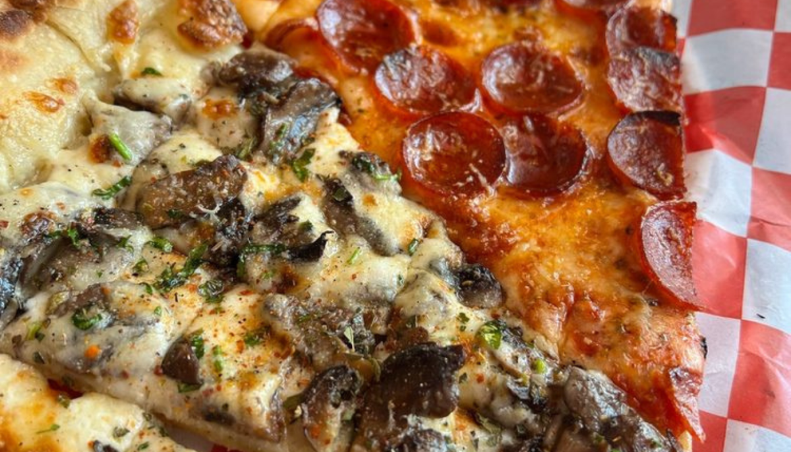
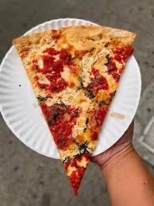
SOHO pizza crawl
rao incorporated spring 2026
*Rubirosa
3 Prince st pizza
Great pizza but no slices
Iconic 2012 slice shop
2 Upside Pizza
Sourdough crust, v good NYC pizza chain
*Scarr’s pizza [optional]
15 mins away
1 Nolita pizza
NY-style version of classic Italian style pizza

